Slide 1

Search Algorithm
Given:
  locations i=1..N,
  utility u(x)
  time cost C(t)‏
  beliefs p(x_{i})=N(_{i},_{i})‏
  observations j=1..M: □_{ij}
  dependencies x=Ax+
Find:
  argmax_{i} u(x_{i})‏
Compute expected utilities
Repeatedly
  Choose observation with highest value of information:
    VOI= benefit – time cost
  Stop and return location with highest expected utility
  Perform the observation
  Update beliefs
  Recompute expected utilities

Slide 2
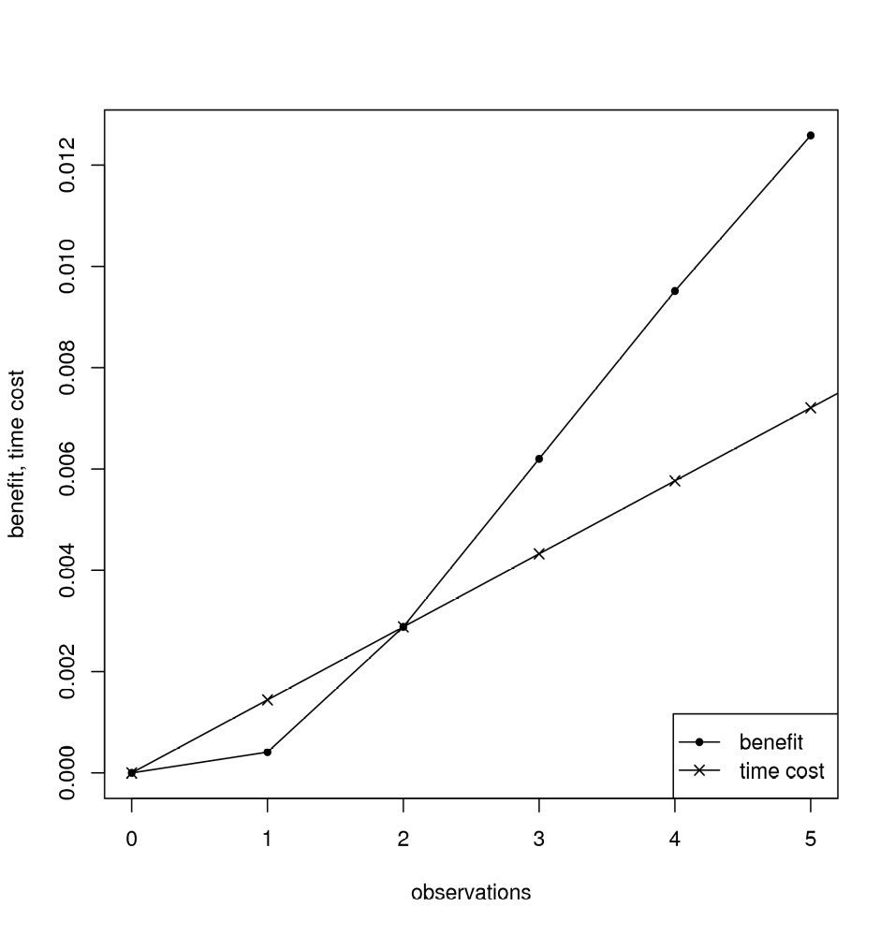
Hard Case Example
2 locations:
  one exact x=0.5
  the other estimated p(x)=N(,)‏
Utility u(x)=
  x<1→0
  x=1→0.5
  x>1→1
Time cost = benefit for two observations

