Slide 1
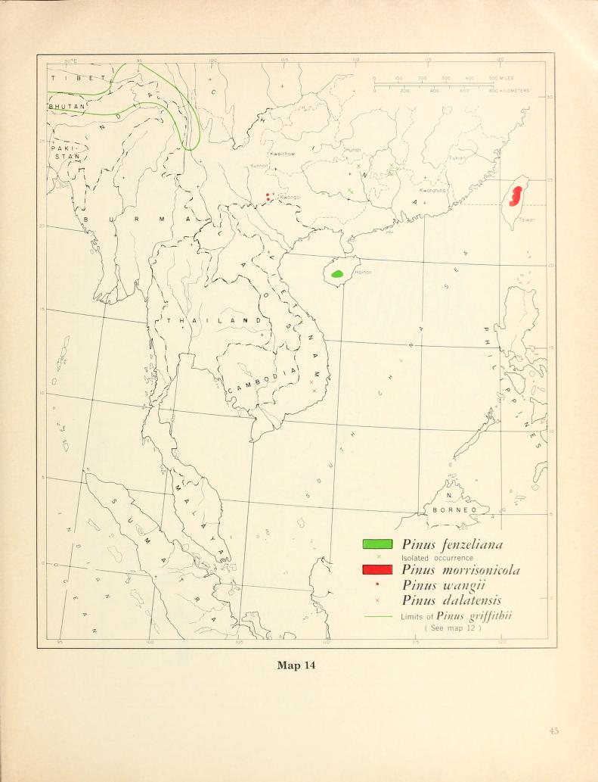
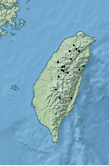
P. morrisonicola
Notes:
plot(crop(raster("/Volumes/GoogleDrive/My Drive/science/phd/dispersal_heterogeneity/datos/DATOS/MAPS/p_morrisonicola_01.img"), c(100,150,10,50)))

Slide 2
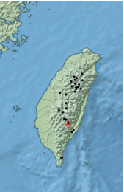
P. taiwanensis
P. fragilisima (red triangle in Farjon map)
Notes:
plot(crop(raster("/Volumes/GoogleDrive/My Drive/science/phd/dispersal_heterogeneity/datos/DATOS/MAPS/p_taiwanensis_01.img"), c(100,150,10,50)))
plot(crop(raster("/Volumes/GoogleDrive/My Drive/science/phd/dispersal_heterogeneity/datos/DATOS/MAPS/p_fragilissima_01.img"), c(100,150,10,50)))

Slide 3
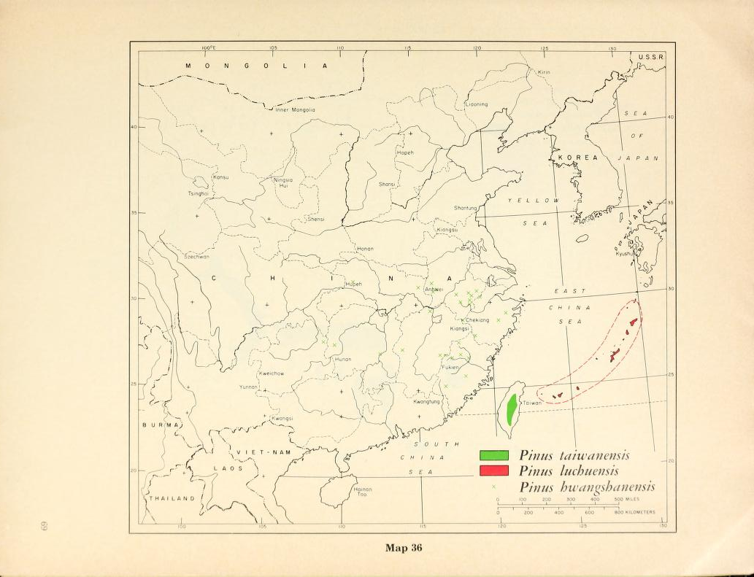
P. taiwanensis

