Slide 1
Movie Analysis Trends & Insights
Dan McCahon

Slide 2
Dataset Overview
Source: OMDb API
Size: 15 movies via csv files
Featured: Movie Title, Runtime, Genre, Award Wins, Award Nominations, Box Office, Director, Language, Plot
Libraries, Requests, CSV, Pandas, Matplotlib, Regex

Slide 3
Key Insights
Positive linear correlation of 0.60 between runtime and award wins. This moderate positive correlation suggests that as a movie’s runtime increases, it tends to win more awards.
Weak positive correlation of 0.19 between the amount of box office earnings a movie had and the number of nominations it received.

Slide 4
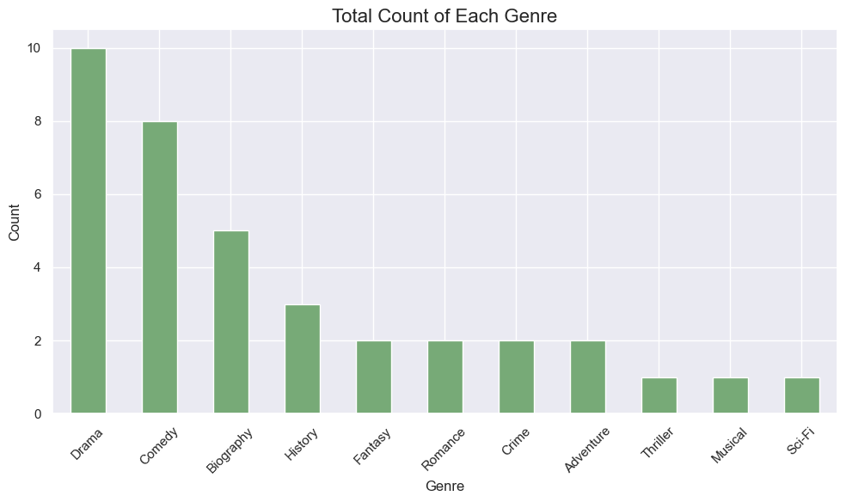
Key Insights
The genres in the data sorted by volume of content.
Drama and Comedy are the leaders.

Slide 5
Conclusion
The longer a film is the more likely it is to win awards.
Box office success does not guarantee a higher number of nominations.
Nearly two thirds of content is Drama, Comedy and Biographies.

