Slide 1
Movie Analysis

Slide 2
Data Used
Ten selected movies were provided in a CSV file.
The selected movies data was retrieved from OMBd’s API
The Data Included:
Movie Title
Runtime
Genre
Award Wins
Award Nominations
Box Office

Slide 3
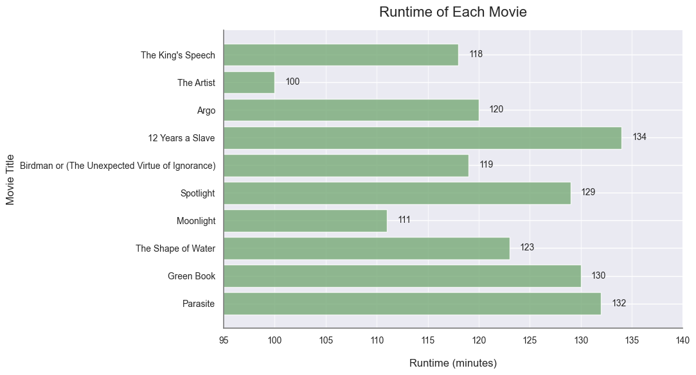
Analysis 1: Runtimes
The movie with the longest runtime is 12 Years a Slave, with a runtime of 134 minutes.

Slide 4
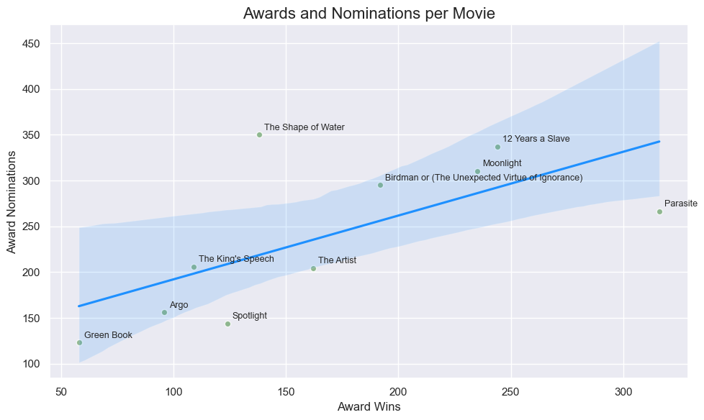
Analysis 2: Nominations vs Wins
0.66 correlation, a moderately strong positive relationship.
Movies with more wins tend to have more nominations.
Could be other factors at play as well.

Slide 5
Conclusion
All movies have a runtime over 100mins and under 134mins.
The more a movie is nominated is the more likely it is to win.

