Slide 1
Movie Analysis

Slide 2
Data Information

Slide 3
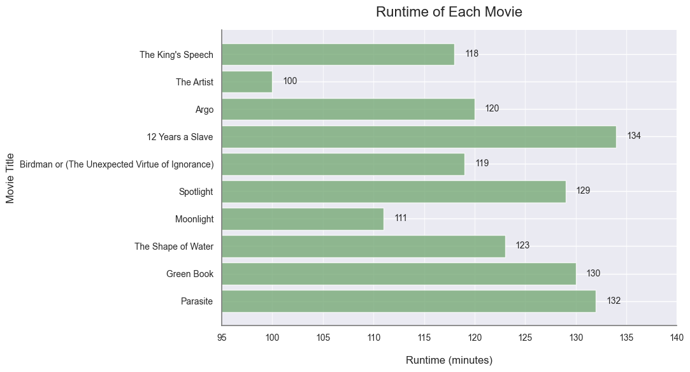
Analysis 1

Slide 4
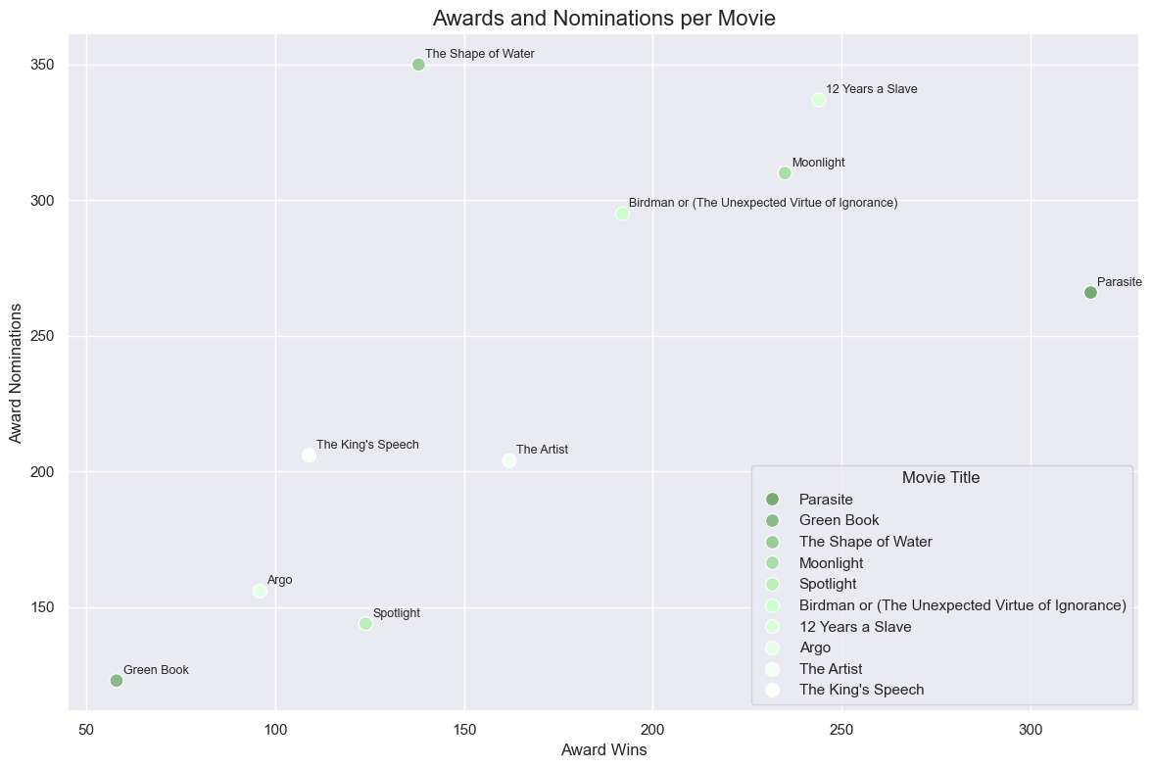
Analysis 2

Slide 5
Conclusion

