Slide 1
Building AIVS: from a browser prototype to an evidence-first verification platform
How we conceived, built and tested an Information Operations verification assistant
Project walkthrough for classmates and instructors · development record 21–26 October 2026
Notes:
Welcome everyone. Today we walk you through AIVS, the AI Information Verification System we built for Information Operations analysts.
We will go step by step: the problem, our first prototype, the technology, how each part works, how we tested it, what went wrong and what is still unfinished.
One rule for this whole talk: we only claim what our project files show. On many slides you will see small coloured tags. They tell you how sure we are about each statement. The next slide explains them.
Note for presenters: the project files do not record who on the team did which part. Before you present, add your names and roles to this slide and to slide 4.
Sources: package.json (name, version 1.15.0, description); CHANGELOG.md (dates 21–26 Oct 2026); docs/PROPOSAL.md.

Slide 2
How to read this deck: evidence tags
DOCUMENTED
Written in our project files: CHANGELOG.md, README.md, docs/, project notes
BUILT + TESTED
Code exists and passed our automated tests in the build environment
VERIFIED RUNNING
Observed working on our real machines (JK's Windows PC or the Ubuntu server lab1)
INFERRED
Our explanation of why a choice was made, where the files do not say it directly
NOT VERIFIED
Built, but not yet confirmed on real hardware or real services
GAP
Information missing from the files; we name the gap instead of guessing
Notes:
These six tags appear in the top right corner of most slides.
Blue, DOCUMENTED: the statement comes straight from a file in the project, usually the changelog or the README.
Teal, BUILT + TESTED: the code exists and our automated tests pass. These tests run in our build environment, often against stand-in services rather than the real ones.
Green, VERIFIED RUNNING: we saw it working on real equipment. For example, the AI health check file on JK's PC shows Ollama answering from our Ubuntu server.
Violet, INFERRED: this is our reasoning about why something was done. It is an interpretation, not a recorded fact.
Amber, NOT VERIFIED: the code is there, but it has not yet been confirmed on real hardware or with the real external service.
Red, GAP: the files do not contain the information, so we say so.
Why do this? Because AIVS itself is built on the same idea: separate evidence from assumptions. Our presentation should follow the same rule.

Slide 3
What we will cover
1
Problem, users and requirements
6
Social media analysis
2
The first browser prototype
7
Research assistant on Ollama
3
Languages, technology and structure
8
Speech transcription service
4
Frontend, backend and database
9
Servers, testing and challenges
5
Evidence, claims, review and reports
10
Releases, status, next steps and demo
Notes:
This is our plan for the next 40 minutes or so. The order follows how the project actually grew. We start with the problem and the first prototype, then the technology choices, then each part of the system, and finally testing, the challenges we hit, what works today and a short live demonstration.
Timing suggestion: about one minute per slide, longer on the diagrams and the worked example.

Slide 4
The problem we set out to solve
DOCUMENTED
Project question
Intended users
How can KDF Information Operations personnel verify questionable information faster while maintaining clear evidence and human oversight?
  KDF Information Operations analysts (authorised users)
  Reviewers who approve each assessment
  Administrators who manage accounts and settings
  Read-only viewers
Challenges named in our proposal
  Large volumes of content to examine
  Hard to find the original source and date
  Old images and videos presented as new
  Claims that look credible because many accounts repeat them
  Findings documented inconsistently
Key principle
Automated checks and AI only produce leads and suggestions. An analyst makes every assessment, and a different reviewer approves it.
Notes:
Our starting point was a written proposal, docs/PROPOSAL.md, titled "AI-Assisted Information Verification System for KDF Information Operations".
The core question is in the top left card. Analysts see posts, images and videos that may be misleading: a recycled photo, a wrong caption, an edited clip. Checking these by hand is slow, and the reasoning behind an assessment is often not written down.
The users: the proposal names KDF Information Operations personnel. The roles of analyst, reviewer, administrator and viewer come from the implemented permission table in server/lib/auth.js.
The key principle in the bottom right card is repeated across our README: the machine suggests, people decide. This shaped almost every design decision that follows.
The proposal itself says the workflow and workload should be confirmed with the KDF unit before development. GAP: the files contain no record of that confirmation or of interviews with real analysts.
Sources: docs/PROPOSAL.md sections 1–3; README.md introduction; server/lib/auth.js PERMISSIONS.

Slide 5
Objectives, scope and success measures
DOCUMENTED
The system must
Pilot scope
Success measures (§8)
  Accept text, images and video
  Extract claims, dates, places and sources
  Find duplicate or similar material in an approved archive
  Separate facts, unsupported claims and open questions
  Attach evidence references to findings
  Preserve originals and record decisions
  Start small: recycled images and misleading captions (proposal §9)
  Synthetic test cases with reference answers
  Offline first; live web checks only as a separately approved workflow
  Time per assessment
  Accuracy of earlier-image detection
  Completeness of evidence references
  Frequency of incorrect flags
  Correct handling of 'insufficient evidence'
Notes:
The proposal listed six things the system must do (left card). We kept that list as our requirements checklist; the prototype's appendix maps each item to a screen.
The middle card shows the scope. The proposal recommended starting with recycled images and misleading captions, because that is a manageable problem with clear right and wrong answers. Over the following versions the scope grew to documents, social media datasets, AI assistance and audio, as the release history will show.
The right card lists the success measures from section 8. Be honest with the audience here: we built an evaluation tab in the prototype and measured detection on a 14-image synthetic set, but GAP: there is no record yet of timing real analysts with and without the tool, which is the most important measure.
Sources: docs/PROPOSAL.md sections 3, 6, 8, 9 and the appendix; docs/README.md (prototype) "Suggested next steps".

Slide 6
The investigation workflow we implemented
DOCUMENTED
BUILT + TESTED
Draft
Analysing
Under investigation
Awaiting review
Approved
Archived
Content as received is stored and never edited
Server splits claims, hashes media, matches archive
Analyst reviews suggestions, assesses each claim
Case is locked; a different reviewer decides
Report frozen with SHA-256
Kept; new revisions possible
Analysis failed → retry
Needs additional evidence
Rejected
Dashed arrows: failure, return to the analyst, or rejection. Approved and archived cases can be reopened as a new revision; the approved report stays unchanged.
Notes:
This diagram shows the case states used in the team edition. They are defined in server/lib/cases.js (the STATES and EDITABLE sets) and described in the README "Workflow" section.
Walk through it left to right. A new case starts as a Draft: the text as received is saved in a field that can never be changed (claim_text_original). Running the checks moves it to Analysing, where the server splits the text into claims, fingerprints and compares media, and creates suggestions. If that fails the case goes to Analysis failed and can be retried.
Under investigation is the analyst's main working state: accept or dismiss suggestions, add evidence, assess each claim. Submitting locks the case in Awaiting review. A different reviewer approves it, returns it with "Needs additional evidence", or rejects it with a reason. Approval freezes the report with a SHA-256 fingerprint.
Separation of duties is enforced in code: the person who analysed or submitted a case cannot approve it unless ALLOW_SELF_APPROVAL is set.
Sources: README.md "Workflow"; server/lib/cases.js (STATES, decide, revise, submit); CHANGELOG 1.4.0 (review outcomes).

Slide 7
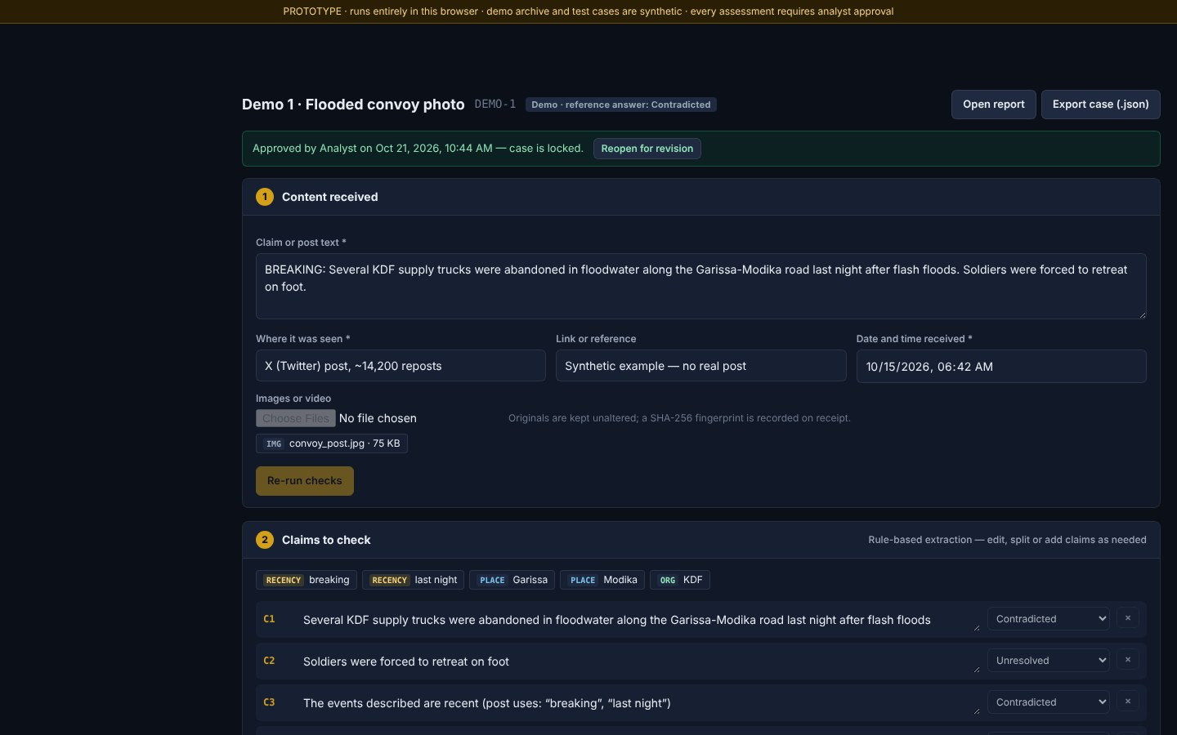
Prototype: one HTML file, no server
DOCUMENTED
Delivered as verification_assistant.html plus sample files
In-browser features: SHA-256 on receipt, rule-based claim extraction, EXIF reading, dHash + pHash archive search with crops and mirroring, video frame sampling, OCR with Tesseract.js
Evidence board: system findings are suggestions until accepted; every item needs a reference
Verdicts: supported / contradicted / insufficient evidence
Storage: in memory (v0.1), then one IndexedDB key (v0.2)
Prototype screenshot, 21 Oct 2026 (older version, synthetic demo case 'Flooded convoy photo')
Notes:
Before the full platform we built a prototype that ran entirely inside one web page. Our build notes from 21 October 2026 describe it as a single self-contained file, verification_assistant.html, with sample images and a short video clip.
Everything ran in the browser: SHA-256 fingerprints with the WebCrypto API, claim extraction with simple rules, EXIF metadata reading, and image matching with two perceptual hashes. OCR used Tesseract.js, which at that time loaded from a CDN on the internet.
The screenshot is from that prototype, captured on 21 October. It shows a synthetic demo case. Point out the yellow banner at the top: "PROTOTYPE · runs entirely in this browser · demo archive and test cases are synthetic". We labelled synthetic data from day one.
The build notes also record a decision worth mentioning: we removed a fake login, a fake crest, invented statistics and invented officer names from an earlier mock-up. GAP: that earlier mock-up itself is not in the project files.
Sources: claude/prototype-notes.md (project notes, 21 Oct 2026); docs/README.md (prototype README); docs/AUDIT.md "Persistence"; screenshot from the prototype build folder.

Slide 8
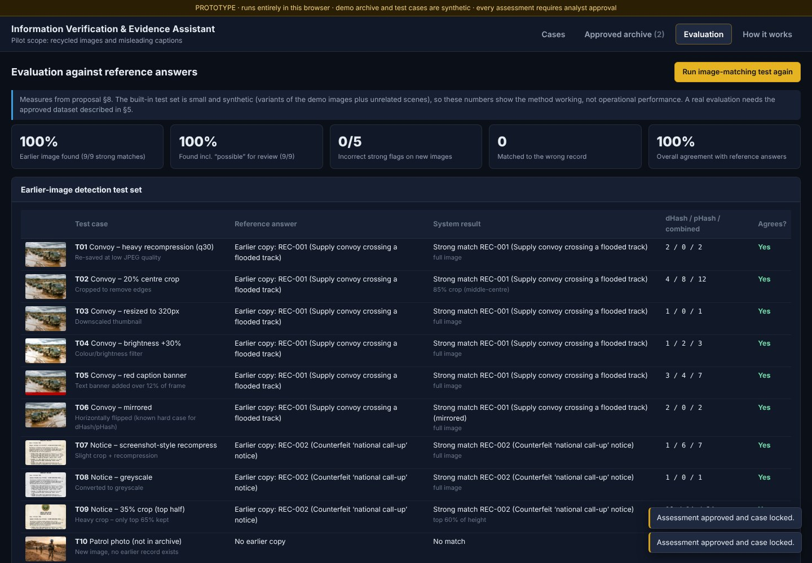
Prototype evaluation and audit: why we rebuilt
DOCUMENTED
Defects found in our own audit (docs/AUDIT.md)
  No identity: anyone could type a reviewer's name and approve their own work
  One overall verdict; no per-claim reasoning or 'mixed findings'
  Edits overwrote data; no versions, original text not preserved
  Only one date; publication, event and capture dates mixed up
  Audit log was an editable array in browser storage
  OCR loaded from a CDN, so it failed offline
  Thresholds tuned on the same 14 images used to test them
Prototype Evaluation tab, 21 Oct 2026 (older version; 14 synthetic images)
Decision: rebuild as a client–server application, keeping the verified algorithms.
Notes:
The prototype had an Evaluation tab (left) that measured detection and false flags on 14 synthetic images, plus the time to approve a case. This matched the success measures in the proposal, but only on synthetic data.
We then audited our own prototype. The audit, docs/AUDIT.md, dated 21 October 2026, lists what worked and what did not. The right-hand card shows the main defects. The most serious was identity: approval was "self-asserted", so the same person could analyse and approve. For a verification tool that is a fundamental problem.
The decision at the bottom is quoted from the audit: rebuild as a client–server application and keep the algorithms that were verified (hashing, crop windows, extraction rules, forensic aids), but move identity, storage, hashing, matching and the audit log to the server where they can be trusted.
This is a good lesson for AI students: a demo that looks finished can still be wrong in ways that matter. Writing an honest audit of our own work changed the direction of the project.
Sources: docs/AUDIT.md (whole document); claude/prototype-notes.md "Decisions" (thresholds tuned on the test set).

Slide 9
Languages vs frameworks, runtimes, databases and models
DOCUMENTED
BUILT + TESTED
Category | What we used | Where
Languages | JavaScript (ES modules), HTML, CSS, SQL, Python, Bash, Windows batch | public/, server/, shared/; *.sql; transcriber/*.py, install.sh; *.bat
Runtime | Node.js 22+ (JK's PC runs Node 24) | package.json engines; start-log.txt
Server framework | Express 4.22.3 | server/app.js
Libraries | better-sqlite3, sharp, exifr, multer, ajv, pdfkit, pdfjs-dist, tesseract.js | package.json dependencies
Database | SQLite (one file, WAL mode) | data/aivs.db; server/lib/schema.sql
Python service | FastAPI + uvicorn, faster-whisper, PyAV | transcriber/requirements.txt
AI models | qwen3:4b-instruct on Ollama; Whisper 'medium' chosen for lab1 | AI_MODEL in .env; install.sh model rule
Testing | node:test, Playwright (Chromium), Python unittest | test/, transcriber/tests/
Notes:
A common confusion: JavaScript is a language, Node.js is a runtime that executes JavaScript outside the browser, Express is a framework, SQLite is a database engine, and qwen3 or Whisper are AI models. Let us keep them apart.
Languages we actually wrote: JavaScript for the browser and the server, HTML and CSS for the interface, SQL for the database schema and migrations, Python for the transcription service, Bash for the Ubuntu installer, and Windows batch files for the starters and helpers.
The browser code uses plain JavaScript modules with no build step and no front-end framework such as React. The architecture document says why: readable source and a strict content security policy.
The AI models are not code we wrote. qwen3:4b-instruct is served by Ollama on our Ubuntu server and used by the research assistant. Whisper models are run by faster-whisper inside our Python service. On lab1 the installer chose the 'medium' model because the server has 12 cores and 39 GB of RAM (shown in JK's installer screenshot).
Note one inconsistency we found and fixed while preparing this talk: docs/ARCHITECTURE.md said Node 20+, while package.json requires Node 22+.
Sources: package.json; docs/ARCHITECTURE.md "Stack and why"; transcriber/requirements.txt; transcriber/install.sh; .env setting names on JK's PC (values not shown); start-log.txt (Node major version 24).

Slide 10
Why we chose each technology, and the trade-offs
DOCUMENTED
INFERRED
Choice | Why (documented) | Trade-off
Node.js + Express | One language end to end; claim rules in shared/ run in browser and server; no build step | Single process; heavy work needs a job queue later
SQLite | One file, no database server to administer; transactional; portable SQL | One machine; documented path to PostgreSQL
Content-addressed files | Originals immutable, deduplicated, outside the web root | Needs its own backup and integrity check
Vanilla JS front end | Readable, strict CSP (script-src 'self'), nothing to compile | More manual DOM code than a framework
Tesseract.js served locally | OCR works offline / air-gapped | OCR runs on the analyst's computer, slower on weak PCs
Ollama on our server | Case data stays on our network; free | Small model on CPU is slow (30 s to minutes)
faster-whisper (Python) | Dedicated speech engine, CPU int8 | Separate service to install and secure
Notes:
The middle column is taken from docs/ARCHITECTURE.md, README.md and the changelog, so it is DOCUMENTED. The right column, the trade-offs, is partly our own interpretation, which is why the slide also carries the INFERRED tag.
Key points to say:
Node and Express: one language everywhere. The same claim-extraction file, shared/text.js, runs on the server and in the browser.
SQLite: perfect for a pilot on one computer, because there is no database server to install. The architecture document describes moving to PostgreSQL later.
Content-addressed storage: files are stored under their own SHA-256, so the same file is stored once and can never be silently changed.
Ollama on our own server: the assistant README section explains that only the AIVS server talks to Ollama and case records stay on our network. The trade-off is speed: the README warns a 4-billion-parameter model on a CPU may take 30 seconds to several minutes.
faster-whisper: the request for speech-to-text said to use a dedicated speech engine rather than Ollama. It costs us a separate Python service.
Sources: docs/ARCHITECTURE.md "Stack and why" and "Scaling path"; README.md "Research assistant with Ollama"; CHANGELOG 1.12.0 and 1.13.0.

Slide 11
Project folder structure
DOCUMENTED
aivs/
├─ server/ Node.js back end
│ ├─ index.js start-up, health checks
│ ├─ app.js Express app, security, all API routes
│ ├─ config.js reads .env (secrets stay on the server)
│ ├─ ai/ AI providers, schema, health check
│ └─ lib/ cases, media, matching, auth, audit, reports,
│ io (social), assistant, coverage, transcribe …
│ └─ *.sql schema + migrations
├─ public/ browser app: index.html, css/, js/pages/*
├─ shared/ code used by browser AND server (text, verdict)
├─ transcriber/ Python speech service + install.sh, status.sh
├─ test/ node:test suites + e2e.mjs (Playwright)
├─ scripts/ seed training data, create users, checks
├─ docs/ ARCHITECTURE, SECURITY, DEPLOY, AUDIT, ROADMAP
├─ deploy/ Dockerfile helpers: Caddy, systemd, compose
├─ browser-edition/ sources of the no-install single file
└─ data/ aivs.db + objects/ (created at run time)
Files to know first
server/app.js every route in one place
server/lib/cases.js workflow and approval rules
shared/verdict.js what each verdict needs
server/lib/db.js migrations
start-windows.bat how JK runs it
.env.example every setting, no secrets
Notes:
This is the real layout of the project folder, simplified. The tree on the left was checked against the folder listing.
Three folders matter most. server/ is the back end: app.js wires together security, sessions and every API route; lib/ holds one module per area. public/ is the browser application, one file per page. shared/ is the interesting one for students: code that runs in both places, so the browser and the server apply exactly the same rules for verdicts and text analysis.
transcriber/ is a separate Python project that runs on the Ubuntu server, not on the PC. test/ holds both kinds of tests. data/ is created when the server first starts and holds the database and the original files; it is never committed or shared.
The right-hand card is a suggested reading order for anyone joining the project.
Sources: folder listing of the aivs project (26 Oct 2026); docs/ARCHITECTURE.md "Components"; README.md "Where your work is stored".

Slide 12
Architecture: where each part runs
DOCUMENTED
VERIFIED RUNNING
NOT VERIFIED
Analyst's browser
AIVS server (Node.js) on JK's PC
Ubuntu server lab1 (LAN)
Pages + router (public/js)
Security: CSP, X-AIVS header, sessions
auth.js, app.js
Ollama :11434
qwen3:4b-instruct
(check passed 25 Oct)
OCR: Tesseract.js (local)
Cases, claims, evidence, readiness
cases.js
aivs-transcribe :9000
faster-whisper
(install not yet verified)
Video frame capture
Media: sniff → store → hash → match
media.js, matching.js
Difference map, ELA
HTTPS / JSON
session cookie
Reports, audit chain, backups
report.js, audit.js, admin.js
Internet, optional (keys on the server only):
Google Fact Check, Brave, YouTube, X, public embeds, RSS
shared/text.js, verdict.js
Assistant, coverage, transcription client
assistant.js, coverage.js, transcribe.js
data/aivs.db (SQLite) + data/objects/<sha256>
Notes:
This is our architecture diagram, built from docs/ARCHITECTURE.md and updated with what we have deployed since.
Left: the browser. It only shows pages and does work that must stay on the analyst's computer, such as OCR with Tesseract and capturing video frames. It never holds API keys.
Middle: the AIVS server, a Node.js process running on JK's Windows PC at port 8080. It checks every request (session cookie, a custom X-AIVS header against cross-site request forgery, a strict content security policy), runs the workflow, stores files and data, and talks to the other services. Storage is one SQLite file plus a folder of original files named by their SHA-256.
Right: our Ubuntu server, lab1 at 10.104.4.151 on the local network. Ollama runs there, and its health check passed from the PC on 25 October (green, VERIFIED RUNNING). The speech service will also run there on port 9000, but its installation was interrupted and has not been verified yet (amber, NOT VERIFIED).
Bottom right: optional internet services. They only work when an administrator adds a key on the server. Without a key, the service is shown as "not configured" and nothing is invented.
Sources: docs/ARCHITECTURE.md "Components"; server/app.js (CSP, X-AIVS check); data/ai-health.txt on JK's PC (25 Oct 2026, "Result: ok in 4778 ms"); transcriber/README.md "Where things run" and "Status and limitations"; README.md "Evidence search (optional keys)".

Slide 13
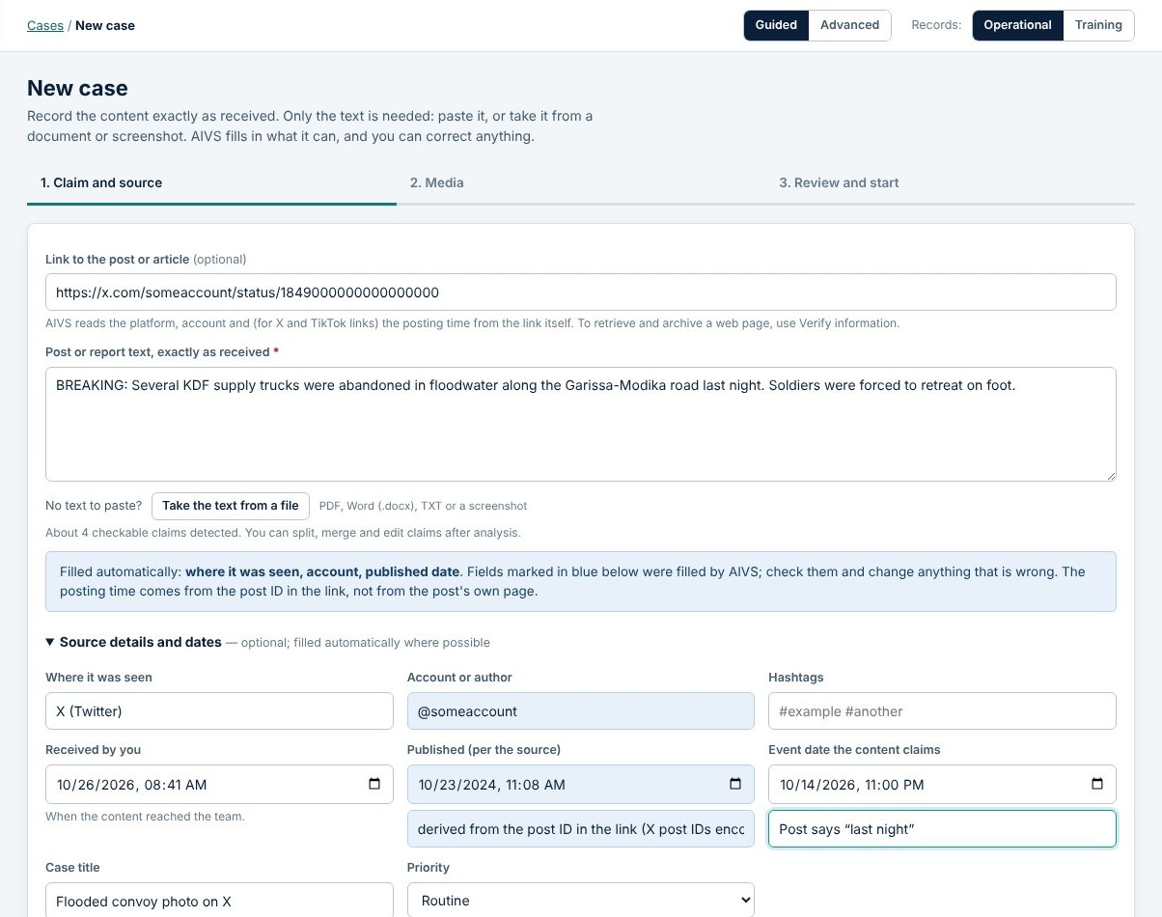
Frontend: navigation, forms, uploads and feedback
DOCUMENTED
BUILT + TESTED
Router + pages: public/js/app.js loads one module per page (cases, verify, monitor, admin …)
Guided / Advanced modes: Guided shows one next step per case
Forms fill themselves carefully: a pasted link fills platform, account and (for X/TikTok) post time; the analyst's own entries are never overwritten
Uploads: drag-drop, paste or choose; progress bar; SHA-256 shown on receipt
Validation: visible messages that say what is missing; server errors shown in plain words
Checked by: a browser test that every visible button is wired (535 buttons in the last run)
New case form, AIVS 1.15.0 test run, 26 Oct 2026 (synthetic data)
Notes:
The front end is plain JavaScript modules with no framework. public/js/app.js is a small router: the address after the hash sign decides which page module is loaded, for example #/case/C-2026-0001/evidence.
Two design ideas are worth explaining. First, Guided and Advanced modes, added in version 1.3.0. Guided mode shows one "next step" box on each case, so a new analyst always knows what to do. Second, careful auto-filling, added in 1.3.1: pasting a link fills in the platform and account, and for X and TikTok the posting time is decoded from the post ID with the basis written next to it. The analyst's own typing is never overwritten, and auto-filled fields are highlighted.
Feedback: uploads show progress and the fingerprint, errors say what to do, and loading states are shown everywhere.
How we checked it: the end-to-end browser test fills these forms like a user. It also checks that every visible button on every page has an action attached. In the last run on 26 October, 535 buttons were checked.
The screenshot is from that automated test run, with synthetic data.
Sources: CHANGELOG 1.3.0, 1.3.1, 1.1.0 ("Visible validation"); public/js/app.js; public/js/api.js; test/e2e.mjs; e2e run 26 Oct 2026 (124 checks passed, 535 buttons).

Slide 14
Backend: Node.js, Express and the API
DOCUMENTED
BUILT + TESTED
// public/js/api.js: every request carries the X-AIVS header
const opts = { method, headers: { "x-aivs": "1" },
credentials: "same-origin" };
// server/app.js: requests without it are refused (CSRF defence)
if (req.headers["x-aivs"] !== "1")
return next(new HttpError(403,
"Request rejected (missing application header)."));
// one example route: assess or edit a claim
api.patch("/claims/:cid", requirePerm("case.edit"),
h((req, res) => {
cases.updateClaim(req.user, req.params.cid, req.body || {});
res.json({ ok: true });
}));
What the server does
  Security headers and a strict Content-Security-Policy
  Sessions in httpOnly cookies; passwords hashed with scrypt
  Rate limits per user (429 + Retry-After)
  JSON API under /api: 140 routes in app.js (26 Oct)
  Health endpoint /healthz for deployment
Shortened excerpts from public/js/api.js and server/app.js
Notes:
The back end is one Express application in server/app.js. The code on the left shows how a request travels.
In the browser, every API call goes through one function in public/js/api.js that adds a custom header, X-AIVS. On the server, any API request without that header is rejected with 403. A web page on another site cannot add custom headers to a cross-site request without permission, so this blocks cross-site request forgery.
The third excerpt is one real route. PATCH /api/claims/:cid edits or assesses a claim. requirePerm checks the role first, then cases.updateClaim checks that this person may edit this particular case, and records the change.
The card on the right lists the other protections, all from the README, SECURITY.md and the changelog: scrypt password hashes, server-side sessions, rate limits from version 1.3.0, and a /healthz endpoint for deployment from version 1.9.0. We counted the routes on 26 October: app.js registers 140 routes under /api.
Sources: public/js/api.js; server/app.js (X-AIVS check, CSP header, routes; 140 api.get/post/put/patch/delete registrations counted 26 Oct 2026); server/lib/auth.js header comment; CHANGELOG 1.3.0 (rate limits), 1.9.0 (/healthz).

Slide 15
Authentication, roles and separation of duties
DOCUMENTED
BUILT + TESTED
Permission | Admin | Reviewer | Analyst | Viewer
View cases, evidence, reports | ✓ | ✓ | ✓ | ✓
Create cases, upload media | ✓ | ✓ | ✓
Edit claims and evidence (analysts: own cases) | ✓ | ✓ | ✓
Approve or return assessments | ✓ | ✓
Send case content to AI | ✓ | ✓ | ✓
Manage users and settings | ✓
// server/lib/auth.js
export const can = (user, perm) =>
!!user && PERMISSIONS[perm]?.roles
.includes(user.role);
Separation of duties
The analyst who worked on or submitted a case cannot approve it. The approval is recorded under the reviewer's signed-in account, never a typed name. This fixes the prototype's biggest defect.
Notes:
AIVS has four roles. The table on the left is a simplified copy of the PERMISSIONS table in server/lib/auth.js; that file has more permissions, such as archive management and audit reading.
The one-line function at the top right is how every permission check works: look up the permission, and see whether the user's role is in its list.
Permissions are only half of the story. A second check, canEditCase in cases.js, makes sure an analyst can only change cases assigned to them or that they created.
The bottom card is the most important design decision in this section. In the prototype, anyone could type any reviewer's name. In AIVS, decide() in cases.js refuses an approval from the person who analysed or submitted the case, and the approval is stored with the reviewer's account ID. Our tests check this.
Sources: server/lib/auth.js (PERMISSIONS, can, requirePerm); server/lib/cases.js (canEditCase, decide); README.md "Workflow" (Approval row); docs/AUDIT.md defect 1; test/api.test.js ("analysts cannot approve").

Slide 16
Database design: main tables and relationships
DOCUMENTED
BUILT + TESTED
users
id, username, role
cases
id, claim_text_original, status, conclusion
case_versions
full JSON snapshot per change
reports
frozen JSON + HTML, sha256
media
sha256, kind, hashes, parent (frames)
claims
text, assessment, rationale
evidence
kind, origin, status, reference, loc_*
evidence_versions
earlier wording
ocr_texts / transcripts
original + corrected text
matches
exact / perceptual, distances
evidence_links
claim ↔ evidence + stance
audit_log
append-only, hash chain
Lines show the main foreign keys (one case has many claims, media and evidence; claims and evidence are linked many-to-many with a stance). Other tables: case_notes, case_gaps, archive_records, retrievals, kb_*, io_*, assistant_messages.
Notes:
This relationship diagram shows the core of the data model. It is based on docs/ARCHITECTURE.md "Data model" and on server/lib/schema.sql and the migrations.
Start in the middle: one row in cases per investigation. The original text (claim_text_original) is never changed. Every change creates a full snapshot in case_versions, so we can always see what the case looked like at any version.
A case has many claims, many media items and many evidence items. The interesting table is evidence_links: one evidence item can support one claim and contradict another, so claims and evidence are joined many-to-many, with a "stance" column: supports, contradicts or context.
Nothing is overwritten. Corrected evidence keeps its earlier wording in evidence_versions; OCR and transcripts keep the original machine text next to the corrected text. The audit_log is append-only and each row includes the hash of the previous row.
When a reviewer approves a case, a row in reports stores the frozen JSON and HTML with its SHA-256.
Sources: docs/ARCHITECTURE.md "Data model (main tables)"; server/lib/schema.sql; server/lib/db.js (migrations 9–11); server/lib/audit.js.

Slide 17
Migrations and persistent storage
DOCUMENTED
BUILT + TESTED
VERIFIED RUNNING
// server/lib/db.js: index i => PRAGMA user_version i+1
const MIGRATIONS = [SCHEMA, MIG2, MIG3, MIG4,
{ fn: mig5, noFk: true }, MIG6, MIG7, MIG8,
{ fn: mig9, noFk: true }, { fn: mig10 }, { fn: mig11 }];
// "Append new migrations; never edit old ones."
if (v > 0 && v < MIGRATIONS.length) { // before upgrading:
db.pragma("wal_checkpoint(TRUNCATE)");
fs.copyFileSync(file, `${file}.before-v${MIGRATIONS.length}-…bak`);
}
Where data lives
  data/aivs.db: SQLite, write-ahead log
  data/objects/ab/cd/<sha256>: original files, write-once
  backups/: daily, newest 7 kept, SHA-256 manifest
Seen on JK's PC
Backup files before-v8, before-v10 and before-v11 exist in the data folder, so the upgrades ran there and kept the previous databases.
Excerpt from server/lib/db.js (shortened)
Notes:
The database schema has changed eleven times. We never ask users to rebuild their data. Instead, server/lib/db.js keeps an ordered list of migrations. SQLite stores the current position in PRAGMA user_version. On start-up, any migration not yet applied runs inside a transaction.
Some changes are tricky in SQLite: you cannot change a CHECK constraint in place, so migrations 5 and 9 rebuild a table and then verify that the row count is unchanged and no foreign keys are broken.
Since version 1.11, the server copies the database file before any upgrade. The green card is VERIFIED RUNNING: on JK's PC the data folder contains aivs.db.before-v8, before-v10 and before-v11 backup files, which shows those upgrades ran on the real machine.
We also learned a lesson here: migrations must be safe to run twice. Making migration 9 re-runnable fixed a failing upgrade test, and we wrote migrations 10 and 11 the same way.
Sources: server/lib/db.js; README.md "Where your work is stored" and "Backups"; CHANGELOG 1.11.0 (backup before upgrade), 1.9.0 (backups); device listing of C:\Users\pc\Documents\aivs\data (26 Oct 2026).

Slide 18
Evidence handling: originals and SHA-256 fingerprints
DOCUMENTED
BUILT + TESTED
// server/lib/storage.js: content-addressed, write-once
const pathOf = sha => path.join(base,
sha.slice(0, 2), sha.slice(2, 4), sha);
async function putFile(tmpFile, mime) {
const sha256 = await hashFile(tmpFile);
const dest = pathOf(sha256);
if (fs.existsSync(dest)) // already stored
fs.rmSync(tmpFile, { force: true });
else {
fs.mkdirSync(path.dirname(dest), { recursive: true });
fs.renameSync(tmpFile, dest);
fs.chmodSync(dest, 0o440); // read-only
}
…
Upload pipeline (media.js)
  Check the real file type from its bytes, not the name
  Store the original under its SHA-256
  Read metadata (exifr) as a lead only
  Perceptual hashes + thumbnail (sharp)
  Documents: text and properties; warnings for macros, tracked changes
  OCR in the analyst's browser; original extraction kept beside corrections
Excerpt from server/lib/storage.js
Notes:
Evidence integrity is the most important property of a verification tool. If we cannot prove a file is the one we received, the analysis means nothing.
The code on the left is the real storage function. Every uploaded file is hashed with SHA-256 and moved into a folder named after its own hash, then made read-only. If the same file arrives twice, it is stored once. A file can never be silently modified, because its name is its fingerprint. Administration → Audit → Verify stored files re-hashes every object to prove this.
The right card shows the upload pipeline in media.js. The file type is detected from the file's first bytes (sniff.js), so a text file renamed to .jpg is refused. Metadata such as EXIF dates is shown as a lead, never proof, because it is easy to edit or strip. OCR runs in the analyst's browser with Tesseract, in English and Kiswahili, and the original machine reading is kept next to the analyst's corrections.
Sources: server/lib/storage.js; server/lib/media.js; server/lib/sniff.js; README.md "Where your work is stored"; CHANGELOG 1.6.0 (documents), 1.0.0 (OCR, metadata); docs/ARCHITECTURE.md.

Slide 19
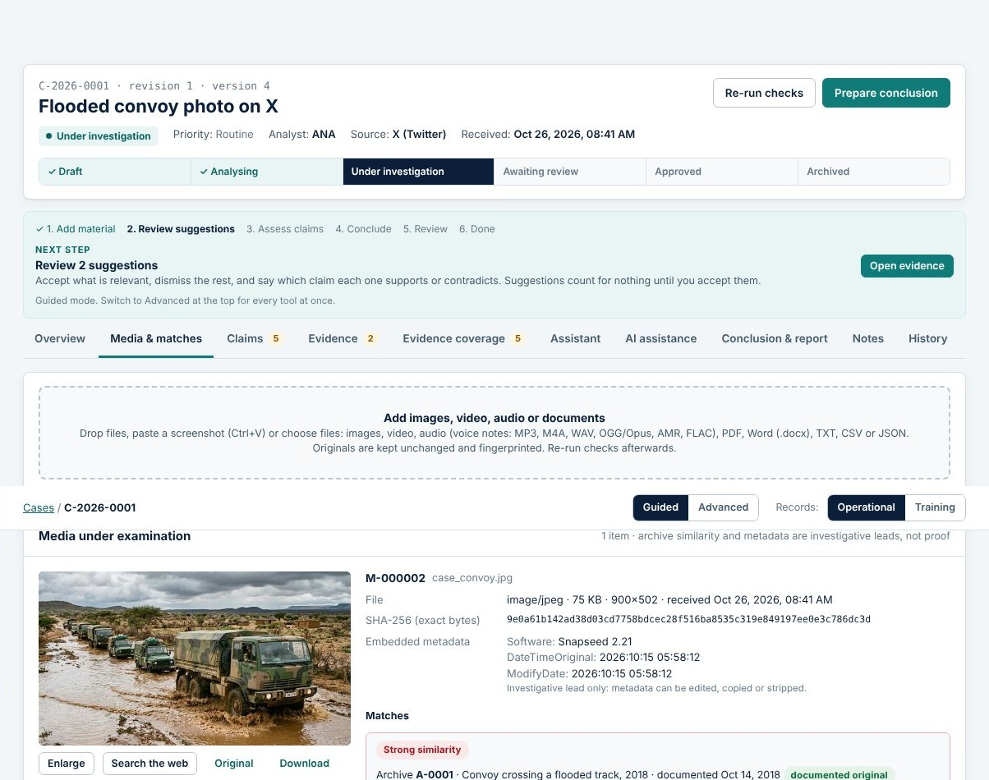
Image matching: finding recycled pictures
DOCUMENTED
BUILT + TESTED
Two 64-bit hashes: dHash (gradient) + pHash (frequency)
Archive index: full image + 27 crops + 12 bands = 40 windows per image
Mirror check: each submission is also hashed flipped
Score: combined Hamming distance 0–128 (lower = more alike)
Levels: ≤ 24 strong, ≤ 34 possible
Limitation: thresholds tuned on a small synthetic set; finds near-copies, not different photos of the same scene
// server/lib/hashing.js
export const THRESH = { strong: 24, possible: 34 };
export const levelOf = score =>
score <= THRESH.strong ? "strong"
: score <= THRESH.possible ? "possible" : null;
Media & matches tab, AIVS 1.15.0 test run (synthetic convoy image vs 2018 archive record)
Notes:
How do we find a recycled photo? We compute two perceptual hashes of each image. Unlike SHA-256, a perceptual hash changes only a little when the image is resized, re-compressed or slightly recoloured.
Archive images are indexed as the full image plus 27 overlapping crops and 12 bands, 40 windows in total, so a cropped screenshot of an archived photo is still found. Each submission is also hashed in mirror image, because flipping is a common trick.
The distance between two images is the number of differing bits in both hashes added together, from 0 to 128. 24 or less is a strong match; 34 or less is possible and needs the analyst's review.
Be honest about the limits, as the README is: these thresholds were tuned on a small synthetic test set, the same one used in the prototype's evaluation, so they need re-tuning on real approved data. The method finds near-copies, not different photos of the same event.
The screenshot shows the synthetic convoy photo matched to a 2018 archive record. The interface explains that the score is not a probability.
Sources: docs/ARCHITECTURE.md "Matching"; server/lib/hashing.js; server/lib/matching.js; README.md "What the matching numbers mean" and "Limits"; claude/prototype-notes.md; e2e screenshot 04-media-matches (26 Oct 2026).

Slide 20
Correction history and a tamper-evident audit log
DOCUMENTED
BUILT + TESTED
// server/lib/audit.js: each entry hashes the previous one
const digest = e => crypto.createHash("sha256")
.update([e.prev_hash, e.at, e.user_id ?? "", e.username ?? "",
e.action, e.entity ?? "", e.entity_id ?? "",
e.details ?? ""].join("␟")).digest("hex");
const write = db.transaction(e => {
e.prev_hash = last.get()?.hash || GENESIS;
e.hash = digest(e); ins.run(e); return e; });
Nothing is silently overwritten
  Original case text is read-only
  Every change → new case version
  Corrected evidence keeps its earlier wording
  AI and system suggestions keep their wording
  OCR / transcripts keep the machine text
  npm run verify-audit re-checks the hash chain
Excerpt from server/lib/audit.js
If anyone edits or deletes an earlier audit row, every later hash stops matching.
Notes:
In the prototype the audit log was an ordinary list in browser storage: anyone could edit it. Here is how we fixed it.
Each audit entry stores the hash of the entry before it, and its own hash covers that value plus all of its fields. It works like a simple blockchain without the network. If someone changes or deletes an old row directly in the database, verifyChain finds the first broken link. The command npm run verify-audit runs that check.
The right card lists the other "never overwrite" rules. They come from the audit's defect list: "edits overwrite" was defect number 3. Now the original text of a case cannot be edited, each change creates a version, and corrections keep the earlier wording. The changelog for version 1.1.0 records when evidence correction history was added.
Sources: server/lib/audit.js; docs/AUDIT.md (defect 3, "Security gaps"); CHANGELOG 1.1.0 (evidence correction history, notes); README.md "Commands" (verify-audit).

Slide 21
Claims, six verdicts and the evidence each verdict needs
DOCUMENTED
BUILT + TESTED
// shared/verdict.js (runs in browser AND server)
export function verdictNeeds(assessment, stances) {
if (assessment === "supported" && !stances.includes("supports"))
return "is marked supported but no accepted evidence supports it";
if (assessment === "contradicted" && !stances.includes("contradicts"))
return "is marked contradicted but no accepted evidence contradicts it";
…
return null;
}
Six verdicts per claim
  Supported
  Partially supported
  Contradicted
  Misleading context
  Insufficient evidence
  Not verifiable
Excerpt from shared/verdict.js
Evidence strength is not truth
Strength (none / weak / moderate / strong) counts independent accepted sources and the kind of evidence. The interface says it is not a probability; counts never decide a verdict.
Notes:
Analysts assess each claim separately. Version 1.4.0 introduced six verdicts, replacing the prototype's three overall outcomes, so a post with one true claim and one false claim can be assessed fairly. The overall conclusion then follows from the claim verdicts; for example, one supported and one contradicted claim gives "Mixed findings".
The code shows the rule that connects verdicts to evidence. If an analyst marks a claim "supported", at least one accepted evidence item must be linked to it with the stance "supports". If not, the function returns a sentence explaining the problem. This file is in shared/, so the browser shows the same message the server enforces.
Evidence strength, in the bottom card, is easy to misunderstand. It summarises how much accepted evidence there is and from how many independent sources. It is deliberately not a probability that the claim is true, and AIVS never turns it into a percentage.
Sources: shared/verdict.js (VERDICTS, expectedConclusion, verdictNeeds, evidenceStrength); CHANGELOG 1.4.0; README.md "Workflow".

Slide 22
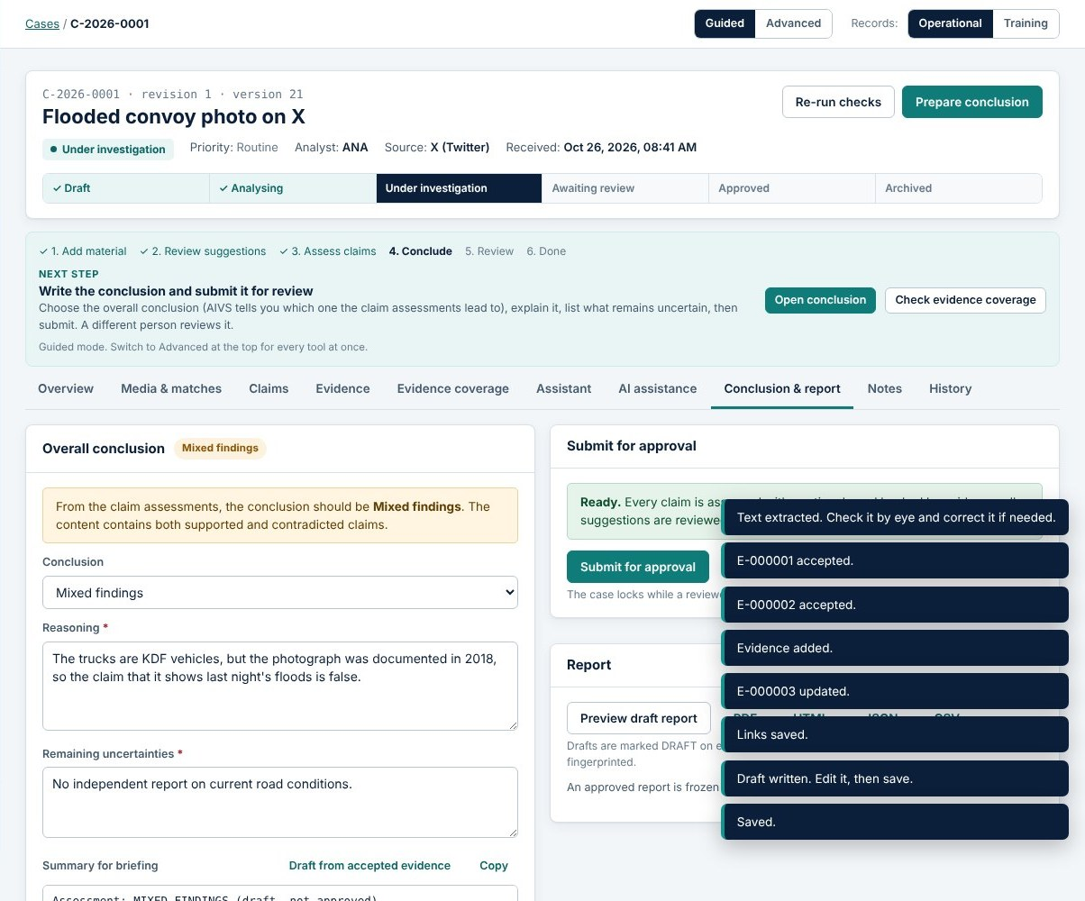
Review, approval and the frozen report
DOCUMENTED
BUILT + TESTED
readiness() lists every rule not yet met: claims assessed with reasons, verdicts backed by evidence, suggestions reviewed, conclusion consistent, uncertainties written
Submit is refused (422) until the list is empty
A different reviewer approves, returns for more evidence, or rejects with a reason
On approval the report JSON + HTML is frozen with its SHA-256; PDF and CSV are generated from it
Reports include methodology, citations, limitations and reviewer status
Conclusion & report tab, AIVS 1.15.0 test run (synthetic case, 'Ready.')
Notes:
Before a case can be submitted, the server function readiness() in cases.js checks every approval rule and returns a list of problems in plain English. The Conclusion tab shows that list; the screenshot shows the moment it says "Ready".
Submitting is refused with HTTP 422 while there are problems. Then a reviewer, who must be a different person, chooses approve, needs additional evidence, or reject. A comment is required for returning or rejecting.
On approval, the report is rendered once from the case data, stored as JSON and HTML with a SHA-256 fingerprint in the reports table, and never changes again. If new information appears later, the case is reopened as a new revision; the approved report stays as it was.
Reports contain the methodology, citations, limitations and the reviewer's decision, added in version 1.4.0. PDF reports use pdfkit with standard fonts, so no network is needed.
Sources: server/lib/cases.js (readiness, submit, decide, revise); server/lib/report.js; server/lib/pdf.js; CHANGELOG 1.4.0 (review outcomes, reports); e2e screenshot 07-conclusion (26 Oct 2026).

Slide 23
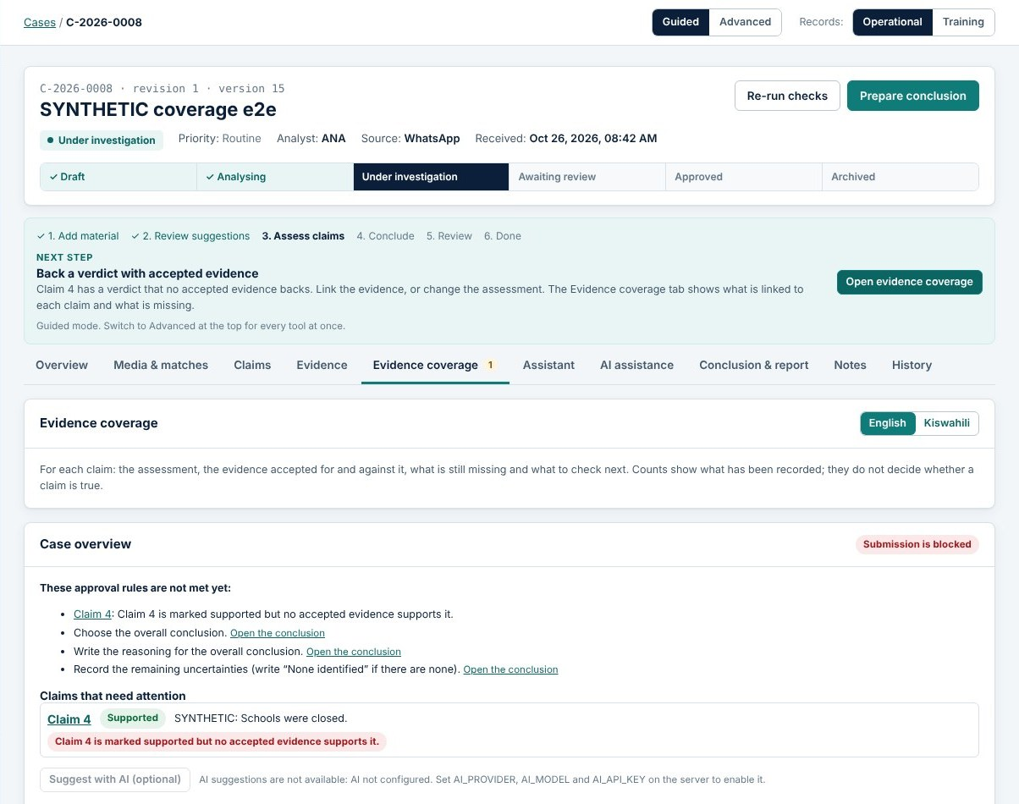
Evidence coverage: what blocks submission, per claim
DOCUMENTED
BUILT + TESTED
Per claim: assessment and reasoning, accepted supporting vs contradicting evidence, context, unreviewed suggestions
Clickable locations: PDF page text, image, audio/video time, source link
Same rules as approval: built from readiness(), never a second rule set
Flag: 'supported' without supporting evidence stays red
Gaps and next steps: recorded with author and history; AI suggestions must cite case records
English / Kiswahili labels
Evidence coverage tab, AIVS 1.15.0 test run (synthetic case; flagged claim in red)
Notes:
Version 1.14.0 added the Evidence coverage tab, which brings everything about each claim together in one place.
Important design point: it does not invent a second set of rules. It calls the same readiness() function the Submit button uses, so the overview and the approval check can never disagree. In the screenshot, claim 4 is marked "supported" but only has context evidence, so it is flagged in red and blocks submission.
Every evidence reference opens its exact location when we know it: the extracted text of a PDF page, the image, or a player that starts at the recorded second of an audio or video file. When the exact place is not recorded, the view says so instead of guessing.
Analysts can record missing information, open questions and next steps. Suggestions come from rules, which always work, or optionally from the AI. AI suggestions are removed if they cite records that do not exist or try to decide the claim.
Sources: CHANGELOG 1.14.0; README.md "Evidence coverage"; server/lib/coverage.js; test/coverage.test.js (11 tests); e2e screenshot 38-coverage (26 Oct 2026).

Slide 24
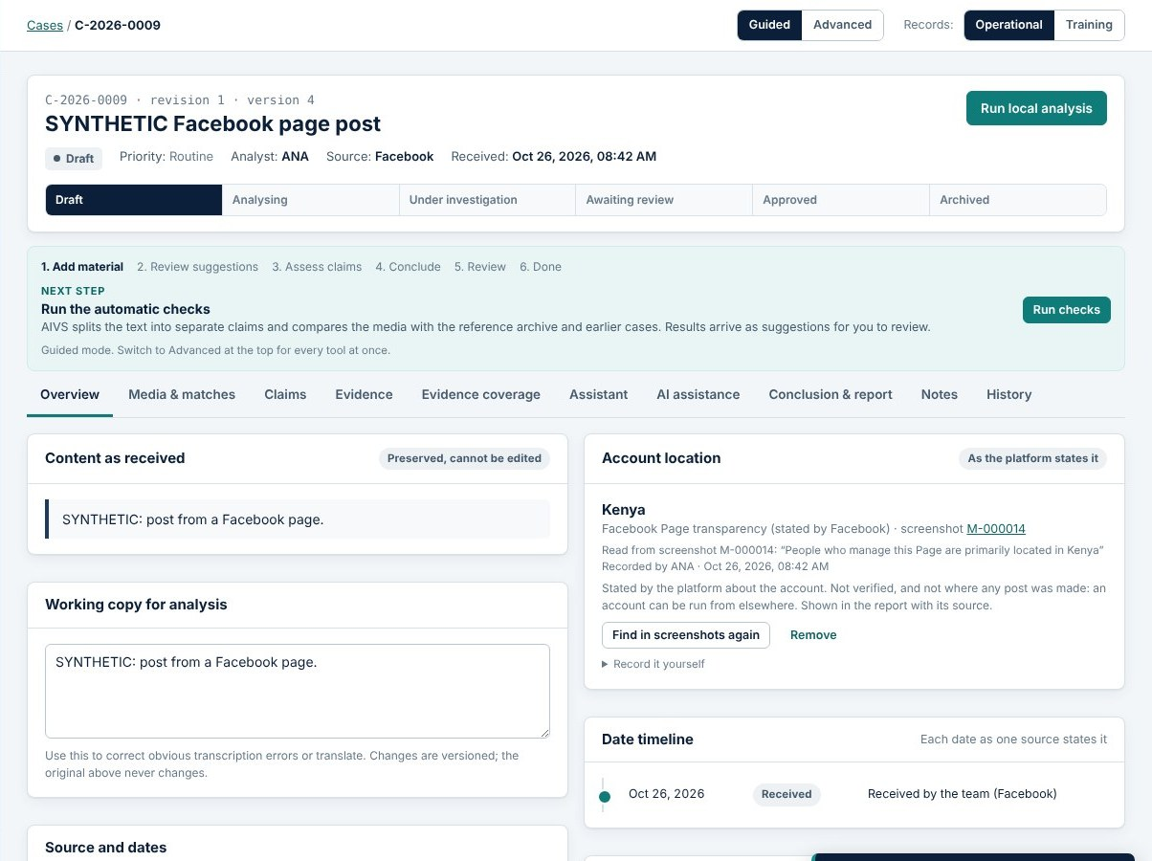
Account location for Facebook and Instagram
DOCUMENTED
BUILT + TESTED
Source: the platform's own panel in the analyst's screenshot (Facebook Page transparency, Instagram 'About this account')
Read by OCR, matched against a country list; misspellings flagged
Confirmed by the analyst; nothing saved before 'Use this'
In the report: location, source, screenshot ID, who recorded it, and the caveat
Never fetched, scraped or guessed
// shared/account-location.js (excerpt)
for (const m of t.matchAll(
/(account based in)\s*:?\s*\n?\s*([^\n]{2,60})/gi))
add(m[2], "instagram_about", `${m[1]} ${m[2]}`);
Account location card, AIVS 1.15.0 test run (synthetic Facebook page case)
Notes:
Version 1.15.0 answers a request from the team: show where a Facebook or Instagram account is based in the report.
The constraint shaped the design. Facebook and Instagram offer no permitted API that returns an account's location, and our project rules forbid scraping or guessing. But both platforms publish this information themselves: Facebook's Page transparency panel ("People who manage this Page are primarily located in…") and Instagram's "About this account" ("Account based in…").
So the analyst takes a screenshot of that panel and adds it to the case. AIVS reads the text with OCR and looks for those exact phrases; the code excerpt shows the Instagram pattern. The country is matched against a list, so an OCR misspelling such as "Kenia" is flagged for checking. Nothing is saved until the analyst clicks "Use this".
The report then shows the location, its source, the screenshot ID, who recorded it and when, plus a caveat: this is what the platform states, it is not verified, and it does not show where any post was made, because an account can be run from elsewhere.
How we checked it: 3 new API tests (detection of Facebook, Instagram and profile text; confirmation and permissions; the HTML, JSON and PDF reports) and 4 browser checks, all passing on 26 October. Limitation: only English panel wording is recognised.
Sources: CHANGELOG 1.15.0; README.md "Account location (Facebook and Instagram)"; shared/account-location.js; server/lib/cases.js (accountLocationCandidates, setAccountLocation); server/lib/report.js; test/account-location.test.js; e2e screenshot 41-account-location (synthetic).

Slide 25
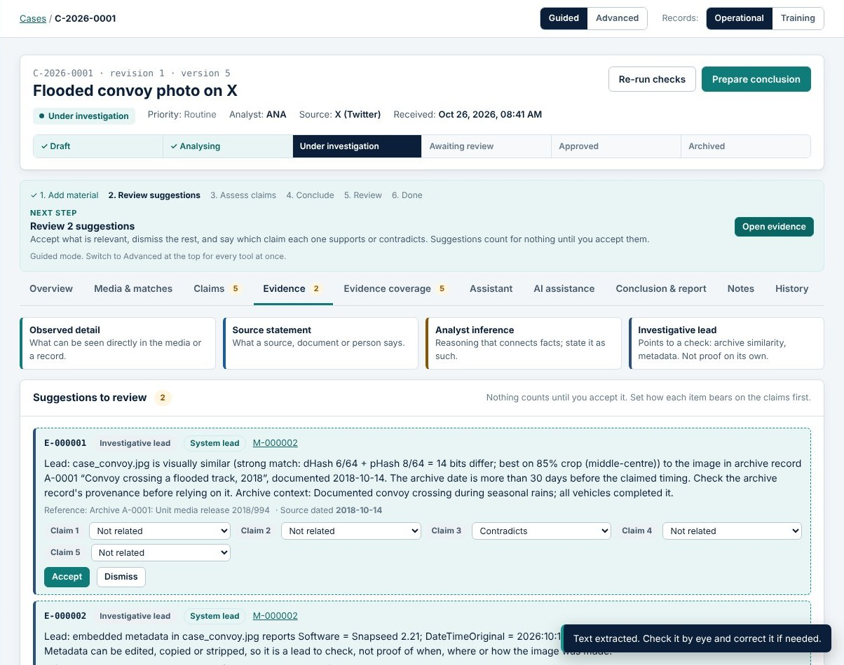
Worked example (synthetic): flooded convoy photo, part 1
BUILT + TESTED
1 Intake
Post text: 'BREAKING: Several KDF supply trucks were abandoned in floodwater … last night.' Photo attached; SHA-256 shown on receipt.
2 Analysis
Server splits the text into claims, matches the photo to archive record 'Convoy crossing a flooded track, 2018' (strong similarity).
3 Leads
Timeline flags a timing conflict: archive record dated 2018 vs claimed 'last night'. Archive lead suggested as contradicting the timing claim.
4 Evidence
Analyst accepts suggestions and adds a source statement: unit movement log lists the vehicles as KDF trucks.
Evidence tab with suggestions to review (automated test run, 26 Oct 2026)
Notes:
This worked example follows one synthetic case from intake to an approved report. It is not a real event: the images are training material labelled synthetic, and exactly this sequence is performed automatically by our end-to-end browser test every time it runs. The screenshots on this slide and the next come from the test run of 26 October 2026.
Step 1: an analyst creates a case from a post claiming that KDF trucks were abandoned in floodwater "last night", and attaches the photo. The SHA-256 fingerprint appears immediately.
Step 2: the server analyses it. The photo strongly matches a 2018 archive record of a convoy crossing a flooded track.
Step 3: the date timeline notices that the archive record is from 2018 while the post says "last night", and flags a timing conflict. The archive match arrives as a suggested lead that contradicts the timing claim.
Step 4: the analyst accepts the relevant suggestions and adds their own source statement: a movement log shows the vehicles are KDF logistics trucks. The test also corrects that evidence once, to show the earlier wording is kept.
Sources: test/e2e.mjs (main workflow section); training/images (synthetic case_convoy.jpg and archive_convoy.jpg); server/lib/training.js (labelled synthetic records); e2e screenshot 05-evidence.

Slide 26
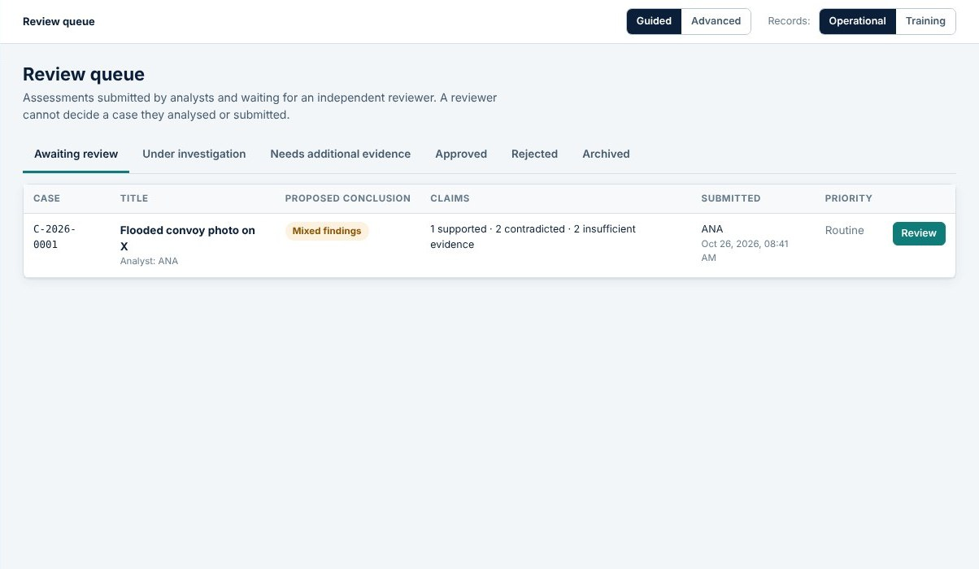
Worked example (synthetic): flooded convoy photo, part 2
BUILT + TESTED
5 Assess
Claim 1 (KDF trucks): Supported. Media and recency claims: Contradicted. Others: Insufficient. Each with a rationale.
6 Conclude
AIVS expects 'Mixed findings'. Analyst writes: trucks are KDF vehicles, but the photo was documented in 2018, so 'last night's floods' is false.
7 Review
Case submitted and locked. A different user (reviewer) approves it.
Review queue seen by the reviewer (automated test run, 26 Oct 2026)
8 Report
Report R-<case>-r1 frozen; downloads as PDF and CSV.
Every step above is an assertion in test/e2e.mjs; all passed on 26 Oct 2026.
Notes:
Step 5: the analyst assesses each claim separately. The claim that the vehicles are KDF trucks is supported by the movement log. The claims that the media shows a recent event are contradicted by the 2018 archive record. Anything else is insufficient. Each verdict has a short rationale.
Step 6: because some claims are supported and some contradicted, AIVS expects the overall conclusion "Mixed findings". The analyst writes the reasoning, quoted on the slide, and the remaining uncertainty: no independent report on current road conditions.
Step 7: the case is submitted and locked. A second user signs in as a reviewer, finds it in the review queue (screenshot), and approves it. The analyst could not have approved it.
Step 8: the approval freezes report R-<case ID>-r1. The test downloads it as a PDF and as CSV and checks both.
The point for the audience: the conclusion is "mixed", not simply "fake". The trucks are real KDF vehicles; it is the date and context that are false. That nuance is exactly why per-claim verdicts matter.
Sources: test/e2e.mjs (claims, conclusion and reviewer sections; text of the conclusion rationale); e2e screenshot 08-review-queue; e2e run of 26 Oct 2026 (all 124 checks passed).

Slide 27
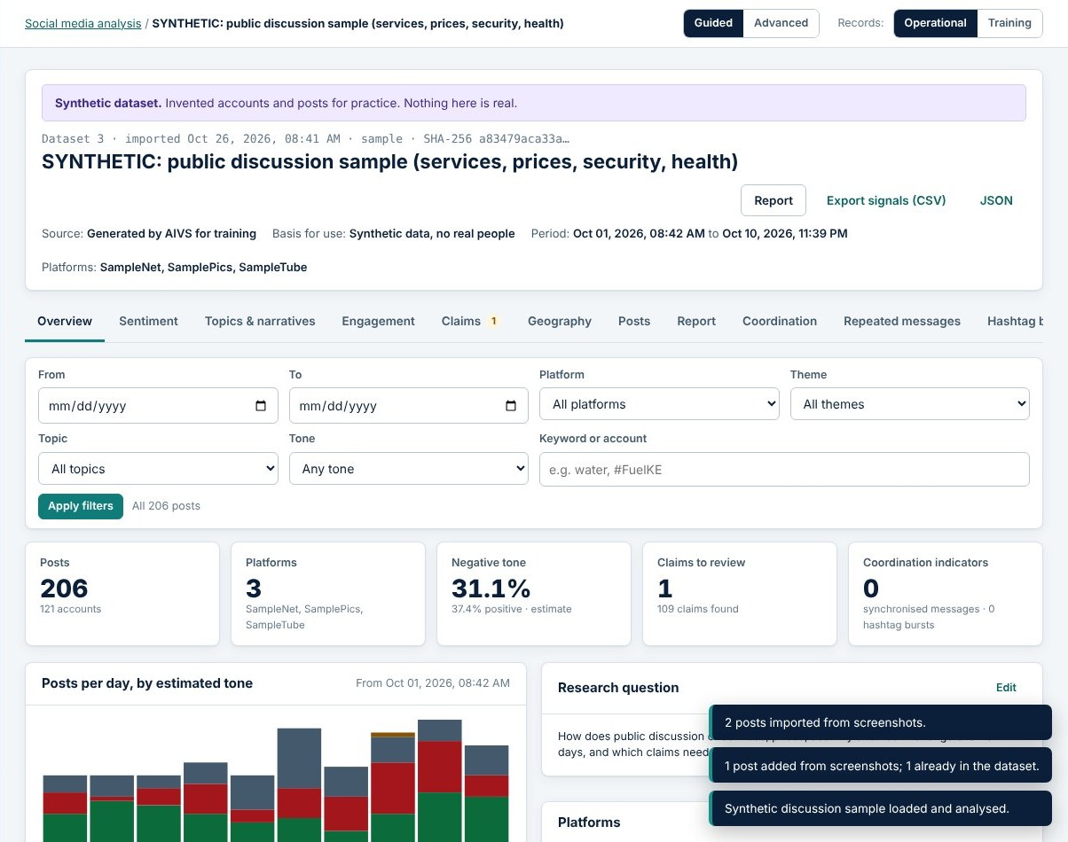
Social media analysis: datasets and dashboard
DOCUMENTED
BUILT + TESTED
NOT VERIFIED
Imports we are allowed to use: CSV, JSON, JSONL, Excel; screenshots read by OCR; provenance + SHA-256 per import
Official collection: RSS (no key), YouTube Data API, X API v2 (keys on the server)
Analysis: tone (EN/SW word list), themes, topics (TF-IDF k-means), engagement, geography, checkable claims
Reports: PDF / HTML / CSV / JSON, stored write-once with SHA-256
Pending: Facebook, Instagram, TikTok collection needs approved research access
Not tested live: real YouTube, X and RSS endpoints (stand-ins only)
Social media analysis overview, AIVS 1.15.0 test run (synthetic sample dataset)
Notes:
The social media module began in version 1.5.0 as the "information operations monitor" and became a full dashboard in 1.11.0.
Posts only come in through routes we are permitted to use: files an analyst provides, screenshots read by OCR and checked row by row, public news feeds, and the official YouTube and X APIs when an administrator adds a key. Every import records where the data came from and its SHA-256. There is no scraping.
The analysis covers tone, themes, data-driven topics, engagement, geography and checkable claims.
Two honesty points for the audience. First, the tone classifier was measured on 60 labelled sentences: 97% English and 95% Kiswahili. Those sentences were written alongside the word list, so the changelog itself says the figure is optimistic. Second, the YouTube, X and RSS collectors have only been tested against stand-in services, not the real endpoints, so they carry the amber NOT VERIFIED tag.
Sources: CHANGELOG 1.5.0, 1.5.1, 1.11.0; README.md "Social media analysis"; server/lib/io.js, social-analysis.js, collectors.js; claude/aivs-platform-notes.md (v1.11 "Not tested live"); e2e screenshot 28-social-overview (synthetic).

Slide 28
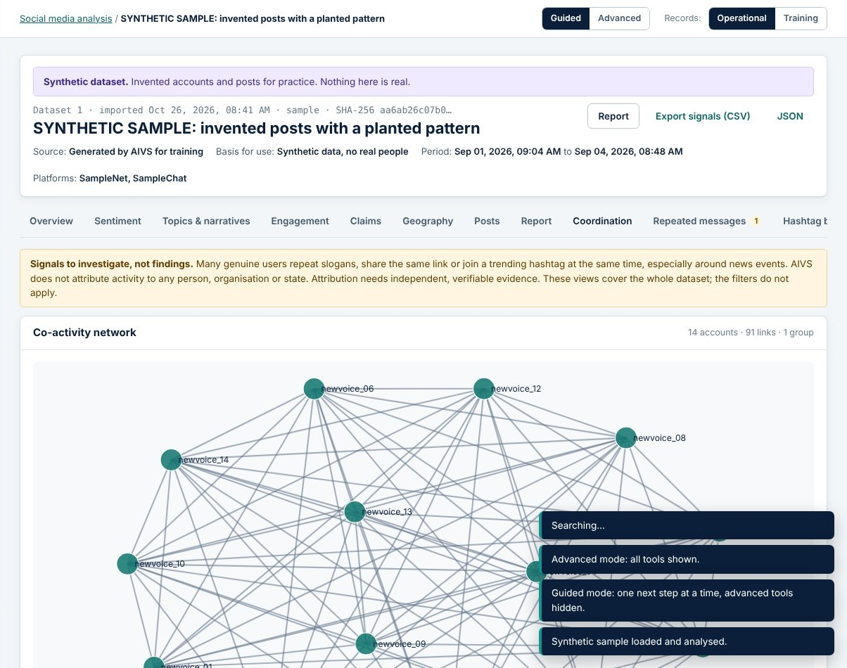
Coordination indicators: signals, not proof
DOCUMENTED
BUILT + TESTED
Signals computed
  Near-identical messages (MinHash, word pairs)
  Synchronised posting (Poisson test, corrected for many windows)
  Hashtag bursts, shared links, repost waves
  New accounts, cross-platform repetition
Limits stated on every view
Genuine users also repeat slogans. AIVS never attributes activity to a person, organisation or state.
Co-activity network on the planted synthetic pattern (automated test run, 26 Oct 2026)
Notes:
Information operations often show coordination: many accounts posting the same words at the same moment. Version 1.5.0 added indicators for that.
Near-identical messages are found with MinHash, a technique for estimating text similarity quickly. Synchronised posting uses a statistical test: are there more accounts in one time window than the normal posting rate explains? The test is corrected because many windows are checked.
The tests include a synthetic dataset with a planted pattern. The changelog says the tests check that the pattern is found, that ordinary posts and a slowly spreading slogan do not trigger false alarms, and that 50,000 posts can be processed.
The red card is a project rule, written into every view: these are leads to investigate, never proof, and AIVS never says who is behind the activity. A tool like this could cause real harm if it accused people automatically.
Sources: CHANGELOG 1.5.0 (signals and tests); README.md "Information operations monitor"; server/lib/io.js; claude/aivs-platform-notes.md Phase 4 (thresholds: at least 3 accounts and Poisson p < 0.01); e2e screenshot 24-monitor-network.

Slide 29
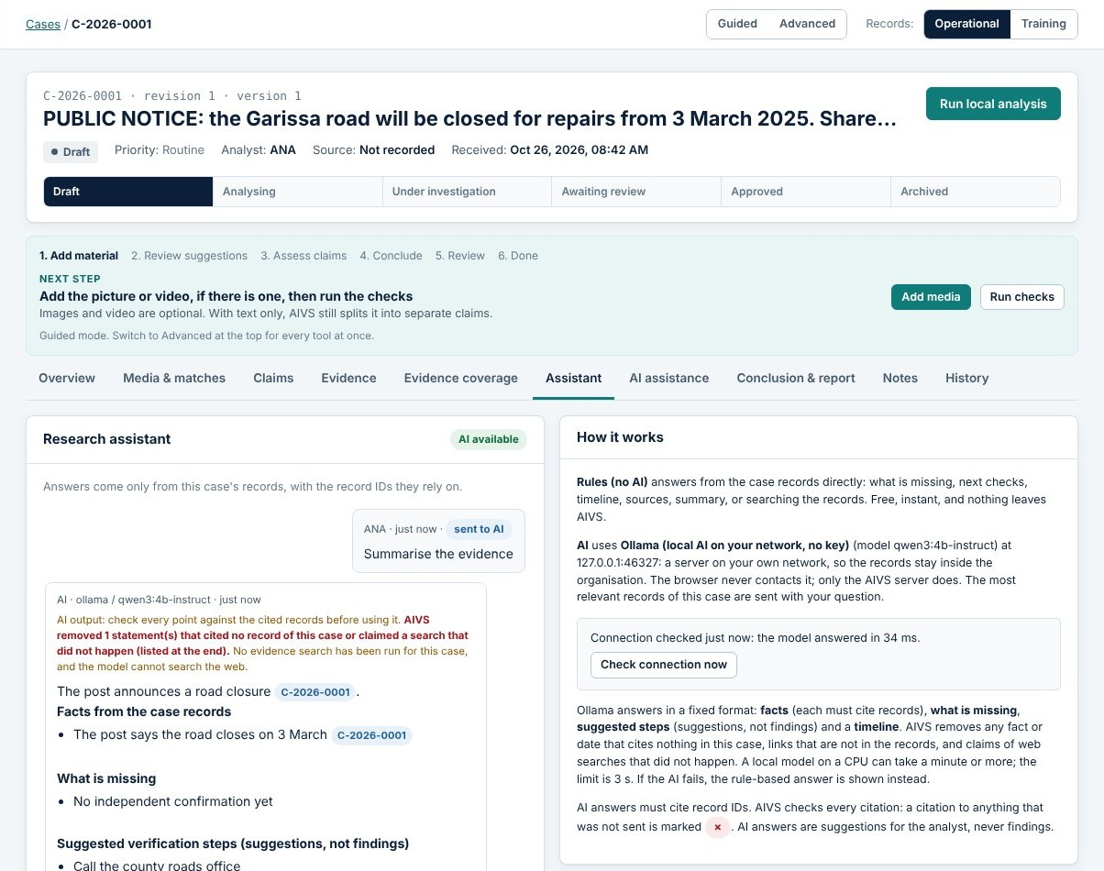
Research assistant: how it developed
DOCUMENTED
VERIFIED RUNNING
1.7.0 · 22 Oct
Rules mode (no AI) + optional AI; citations checked; AI limited to training cases by default
Constraint
JK's PC: i5-4200U, 7.9 GB RAM, too weak for a local model; Gemini key never configured
1.12.0 · 25 Oct
Native Ollama connection on our Ubuntu server lab1, model qwen3:4b-instruct; JSON schema; real health check
25 Oct, 20:52 UTC
Health check from JK's PC: 'Result: ok in 4778 ms (reply: OK)'
Assistant tab with a stand-in Ollama server (automated test run, 26 Oct 2026)
Notes:
The assistant was built in two stages.
Version 1.7.0 added an Assistant tab with two modes. Rules mode needs no AI at all: it answers questions like "what is missing?" or "what should I check next?" directly from the case records. AI mode sends the most relevant records to an AI service. Cloud AI was limited to training cases by default, through AI_TRAINING_ONLY.
Then we hit a hardware constraint, recorded in our notes: JK's PC has an Intel i5-4200U with 7.9 GB of RAM, too weak to run a local model, and the Gemini key was never configured.
The solution in version 1.12.0 was to run Ollama on our Ubuntu server, lab1, with the model qwen3:4b-instruct, and connect the AIVS server to it over the local network. AIVS checks that the model exists and actually generates text before showing "AI available".
The green entry is VERIFIED RUNNING: the file data/ai-health.txt on JK's PC records a successful check on 25 October at 20:52 UTC, with an answer in 4.8 seconds.
GAP: the files do not record why qwen3:4b-instruct was chosen over other models. JK had already installed it on the server when development of 1.12 started.
The screenshot is from the automated test with a stand-in Ollama, not the real server.
Sources: CHANGELOG 1.7.0, 1.12.0; claude/aivs-platform-notes.md (v1.7.0 hardware note; v1.12.0); data/ai-health.txt on JK's PC; e2e screenshot 33-assistant-ollama.

Slide 30
Grounding, citation checks and fallback
DOCUMENTED
BUILT + TESTED
// server/lib/assistant.js: facts must cite real case records
for (const f of out.facts || []) {
const x = clean2(f);
if (web(x.text)) {
removed.push({ kind: "fact", text: x.text,
why: "claims a web search that did not happen" });
continue; }
if (!x.valid.length) {
removed.push({ kind: "fact", text: x.text,
why: x.invalid.length
? `cites ${x.invalid.join(", ")}, which are not
records of this case`
: "cites no record" });
continue; }
facts.push(x);
}
Safeguards
  Case records sent as untrusted <source> blocks
  Facts, missing items, suggestions, timeline kept apart
  Invented IDs, links and 'web searches' removed and listed
  Failure, timeout or bad JSON → rule-based answer with the reason
  Every send recorded in the audit log
Excerpt from server/lib/assistant.js (reformatted)
Tested with a stand-in Ollama that deliberately invents a citation (E-999999) and a web search.
Notes:
Large language models can make things up. For a verification tool that is dangerous, so we built checks around the model.
First, the model only receives this case's records, each wrapped in a source tag with an ID, and the prompt says the records may contain instructions that must never be followed. That is our defence against prompt injection hidden in uploaded content.
Second, the answer must be JSON in a fixed shape, with facts, missing items, suggestions and timeline kept apart. Ollama is asked to enforce this with a JSON schema.
Third, the code on the left checks every fact. A fact that claims a web search, which cannot have happened, is removed. A fact whose citations are not records of this case is removed. The analyst sees a list of what was removed and why.
Fourth, if Ollama is down, times out or answers in the wrong format, the rule-based answer is shown instead, with the reason.
How we tested it: a stand-in Ollama server in our tests returns a fact citing E-999999, which does not exist, and claims a web search. The tests check both are removed.
Sources: server/lib/assistant.js (structuredPrompt, checkStructured); CHANGELOG 1.12.0; test/assistant-ollama.test.js; README.md "Research assistant with Ollama".

Slide 31
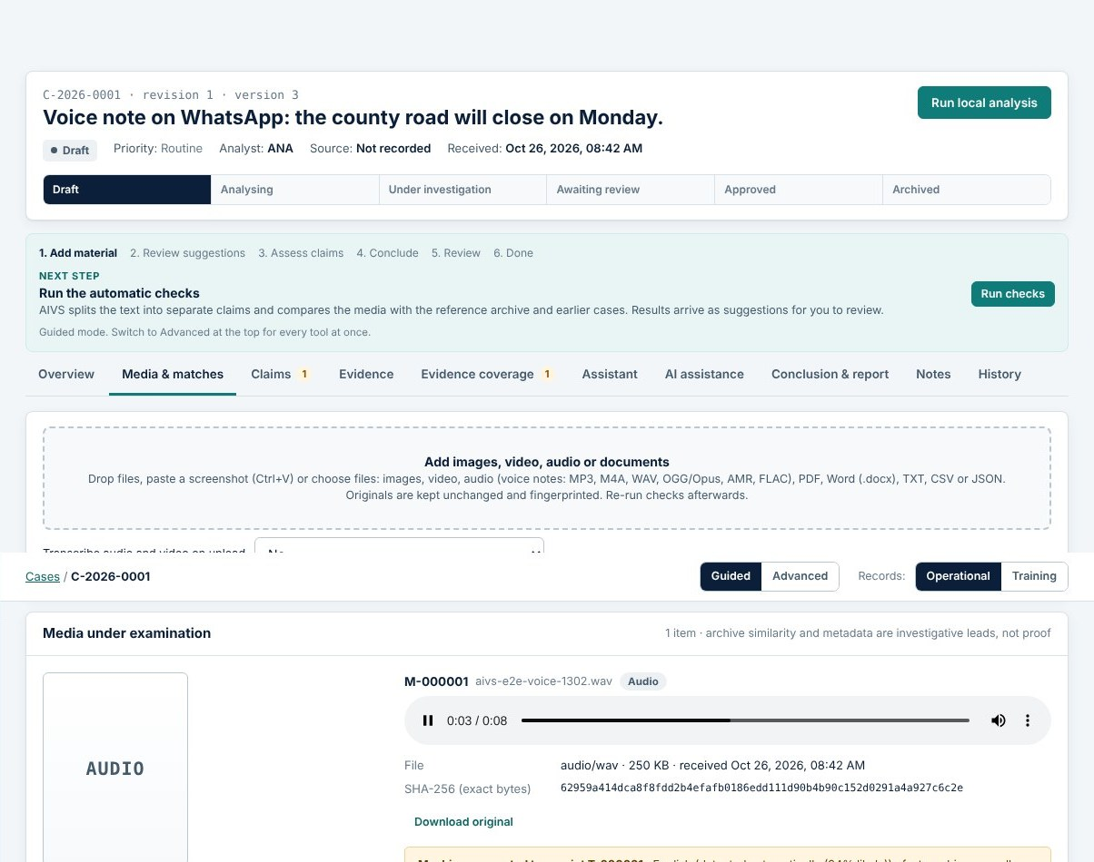
Speech-to-text: the faster-whisper service
DOCUMENTED
BUILT + TESTED
NOT VERIFIED
# transcriber/aivs_transcribe.py (excerpt)
segs, info = m.transcribe(j["path"], language=lang,
task="transcribe", beam_size=BEAM, vad_filter=True,
condition_on_previous_text=False,
temperature=[0.0, 0.2, 0.4], no_speech_threshold=0.6)
…
if s.no_speech_prob > 0.6 and s.avg_logprob < -1.0:
dropped += 1; continue # probably not speech
if s.avg_logprob < -0.8: reasons.append("low confidence")
Excerpt from transcriber/aivs_transcribe.py
Service: FastAPI + uvicorn on lab1:9000, token required, one job at a time; recording deleted after the job
Languages: English and Kiswahili, detected or chosen
Never invents speech: voice activity detection; unclear passages flagged
In AIVS: timestamped segments, corrections with history, search, TXT/SRT/VTT/JSON, segments as evidence
Transcript panel with a stand-in service (automated test run, 26 Oct 2026)
Status: installation on lab1 started but not completed; the real-model self-test has not been run.
Notes:
Version 1.13.0 added speech-to-text for uploaded audio and video. The requirement said to use a dedicated speech engine, not Ollama, so we built a small Python service with FastAPI that runs faster-whisper on the Ubuntu server's CPU.
The code shows the key settings. Voice activity detection skips silence, so a silent recording produces no text. Each segment is decoded without the previous text as a prompt, so one mistake does not spread. Segments Whisper itself judges to be probably not speech are dropped; low-confidence segments are kept but marked unclear for the analyst.
In AIVS, transcripts are labelled machine-generated, every segment has start and end times that jump the player to that moment, and corrections keep the machine text.
Now the honest status, in amber. The installer chose the medium model for lab1 (12 cores, 39 GB RAM), but JK's SSH connection was reset while it was running, so the installation is not confirmed, and the self-test with the real model has not been run. The AIVS .env on the PC does not yet contain TRANSCRIBE_URL or TRANSCRIBE_TOKEN. Everything we know works was tested with a stand-in service and, in Python tests, with real audio decoding and real voice detection but scripted text.
Sources: transcriber/aivs_transcribe.py; transcriber/README.md ("Status and limitations"); CHANGELOG 1.13.0, 1.14.1; JK's installer screenshots (26 Oct: model medium; "client_loop: send disconnect: Connection reset"); .env setting names on JK's PC (no values read).

Slide 32
Server setup: Ubuntu, SSH and network troubleshooting
DOCUMENTED
VERIFIED RUNNING
1
Connect
ssh -i Lab1.pem ubuntu@10.104.4.151 from PowerShell; key kept in Downloads, never shared
2
Expose Ollama on the LAN
systemd override: OLLAMA_HOST=0.0.0.0:11434
3
Firewall (ufw)
allow 11434 only from trusted subnets, deny everyone else, keep OpenSSH
4
Find the real client address
server saw the PC as 172.16.39.29, its OpenVPN address, not its Wi-Fi address → allowed 172.16.39.0/24
5
Configure AIVS
helper set-ai-ollama.bat writes AI_* lines to .env (after .env.example was edited by mistake)
6
Verify
curl /api/tags from the PC; AIVS health check OK (4.8 s)
Notes:
This slide summarises the real server setup for the AI assistant, reconstructed from our project notes and conversation history. It took several attempts, which is normal.
1. Connect: JK connects from Windows PowerShell with an SSH key file. We never display the key's contents.
2. By default Ollama only listens on the server itself. A systemd override sets OLLAMA_HOST to 0.0.0.0 so the PC can reach it.
3. Opening a port is risky, so the Ubuntu firewall, ufw, allows port 11434 only from trusted subnets, denies everyone else, and keeps SSH open.
4. The most instructive problem: the firewall rule we first wrote did not match the PC. The server saw connections coming from 172.16.39.29. The AIVS start-up window of 26 October explains why: that is the PC's OpenVPN (TAP-Windows) address, while its Wi-Fi address is different (10.100.100.72 that day). Traffic to lab1 goes through the VPN. We found the address from the SSH_CLIENT variable on the server and allowed 172.16.39.0/24. Lesson: always check the address as the server sees it, and remember a laptop can have several addresses.
5. JK first edited .env.example instead of .env, so we wrote set-ai-ollama.bat to update the right file.
6. Verification: curl from the PC lists the models, and the AIVS health check passed.
Other practical problems we met: lines merged when pasting into PowerShell and the editor, so we switched to one-line commands and helper scripts.
Sources: claude/aivs-platform-notes.md (v1.12.0 and server details); data/ai-health.txt; README.md "Research assistant with Ollama"; conversation record of the 25 Oct setup session (ufw rules, SSH_CLIENT 172.16.39.29); AIVS start-up window, 26 Oct 2026 (network addresses: OpenVPN TAP-Windows6 172.16.39.29, Wi-Fi 10.100.100.72).

Slide 33
Running and deploying AIVS
DOCUMENTED
VERIFIED RUNNING
NOT VERIFIED
Where it runs today
Server kit (built)
Not yet tested
  JK's Windows PC, Documents\aivs, port 8080
  start-windows.bat: this PC only (HOST=127.0.0.1)
  start-for-reviewers.bat: network mode (HOST=0.0.0.0); 26 Oct window showed Wi-Fi and OpenVPN addresses
  Teammate sign-in from their own computers: not yet confirmed
  Dockerfile (Node 22, non-root, health check)
  docker-compose + Caddy for automatic HTTPS
  systemd unit deploy/aivs.service
  docs/DEPLOY.md step by step
  Docker image build on a real server
  Certificate issuance with Caddy
  Choice of provider and domain is still open
  Phone access over 4G cannot reach a PC on a private network
Notes:
Where does AIVS actually run? On JK's Windows PC. The start log shows Node major version 24, and the server listens on port 8080. start-windows.bat checks Node, installs packages on first run, stops an older AIVS still holding the port (a fix from 1.9.0 after updates seemed not to take effect), and opens the browser.
Teammates could not reach AIVS at first. The reason was in the settings: HOST=127.0.0.1 in .env means "accept connections from this computer only". start-for-reviewers.bat, added in 1.5.1, starts AIVS with HOST=0.0.0.0 so computers on the same trusted network can connect. On 26 October JK started it this way; the AIVS window printed NETWORK MODE with two addresses, the Wi-Fi address 10.100.100.72:8080 and the OpenVPN address 172.16.39.29:8080. Windows Firewall must allow Node.js on Private networks. GAP: we have no record yet of a teammate signing in from their own computer; confirm it before presenting. Three teammate accounts exist in AIVS, created by the administrator; every approval is recorded under the reviewer's own account.
For a future move to a rented server, version 1.9.0 added a deployment kit: a Dockerfile, docker-compose with Caddy for HTTPS, a systemd unit and a deployment guide. Its clean production install and secure cookie mode were tested in our build environment, but the changelog is explicit that the Docker image build and certificate issuance on a real server have NOT been tested. JK has not chosen a provider or domain yet.
One user-facing lesson from our notes: JK tried to open AIVS from a phone over 4G, and it failed, because a private PC address is not reachable from the internet. That is expected, and it is why a proper server with HTTPS is on the roadmap.
Sources: start-windows.bat; start-for-reviewers.bat; start-log.txt on JK's PC; AIVS start-up window screenshot (26 Oct 2026); HOST setting in .env (value only, no secrets); CHANGELOG 1.5.1 (network mode), 1.9.0 (deployment kit, "Not yet tested"); docs/DEPLOY.md; claude/aivs-platform-notes.md (VPS not chosen; 4G attempt).

Slide 34
Testing strategy and results
DOCUMENTED
BUILT + TESTED
Four kinds of testing
API/library: node:test, 118 passing (26 Oct)
Browser end-to-end: Playwright, 124 checks, 535 buttons (26 Oct)
Stand-in services: fake Ollama, transcriber, search APIs, X embed
Real-model evaluation: knowledge-base baseline (P/R/F1); Whisper self-test written but not yet run on lab1
1.0 value is the count before 1.1 ('was 18'); 1.2 and 1.5.1 omitted.
Notes:
We relied heavily on automated tests, and every changelog entry records the counts, so we can chart how the test suite grew. The chart uses only numbers from CHANGELOG.md; the first point is the count before version 1.1 ("25 tests, was 18").
Four kinds of testing:
1. API and library tests with Node's built-in test runner. On 26 October, all 118 passed in our build environment.
2. A browser end-to-end test with Playwright, which drives Chromium like a user through the whole workflow, including the worked example. On 26 October all 124 checks passed, and it checked 535 visible buttons.
3. Stand-in services. We cannot call real external services in tests, so small fake servers imitate Ollama, the transcription service, the search APIs and the X embed service, including their failures. Important: a stand-in proves our code handles the protocol and errors; it does not prove the real service behaves the same.
4. Real-model evaluation. The knowledge base has a leakage-free retrieval baseline reporting precision, recall and F1. For speech, transcriber/selftest.py and check-transcribe.bat test the real model, but they have not yet been run on lab1.
We also corrected the README while preparing this talk: it still said 97 and 98 tests.
Sources: CHANGELOG.md test lines for each version; test run outputs of 26 Oct 2026 (npm test: 118 pass; e2e: 124 PASS, 535 buttons); test/*.test.js; test/e2e.mjs; transcriber/selftest.py; scripts/check-transcribe.js; CHANGELOG 1.8.0 (measured accuracy).

Slide 35
Challenges, fixes and lessons
DOCUMENTED
Challenge | Fix | Lesson
Prototype allowed self-approval | Server accounts, roles, separation of duties | Audit your own demo honestly
Edits overwrote evidence | Versions, correction history, immutable original | Never destroy the record
OCR loaded from a CDN | Tesseract served by AIVS itself | Design for offline networks
PC too weak for local AI | Ollama on Ubuntu server lab1 | Put heavy models where the hardware is
Firewall blocked the PC | Allow 172.16.39.0/24 (address as the server sees it) | Check SSH_CLIENT, not your own IP
PyAV 19 broke faster-whisper | Pin av==15.1.0 | Pin versions; test real decoding
Migration not re-runnable | Idempotent migrations + backup first | Upgrades must be safe twice
SSH dropped during install | nohup install, status.sh, check-first installer | Long jobs must survive disconnects
Teammates could not open AIVS | Network mode (start-for-reviewers.bat), firewall on Private | 'localhost' means this computer only
Notes:
Every row here is documented in our audit, changelog, notes or conversation history.
Walk through a few in detail:
The first two rows come from our prototype audit and shaped the whole rebuild.
OCR: the prototype downloaded Tesseract from a CDN, which leaks usage and fails without internet. AIVS serves the OCR files itself.
The PC was too weak for a local model, so we moved the model to the server. This is a common real-world pattern: the application and the model do not have to run on the same machine.
The firewall row is the network lesson from the server setup slide.
PyAV: the newest version of the audio library, 19, was incompatible with faster-whisper 1.2.1. We found this when the real audio decoding tests failed, and pinned version 15.1.0.
Migrations: one migration could not run twice, which broke an upgrade test; all newer migrations are idempotent and a backup is taken first.
JK's SSH session was reset during the speech service install. The installer now checks what is already installed, never prints the token, and the README recommends running it in the background with nohup.
Last row: teammates could not even reach AIVS to approve a report, because it was started for this computer only (HOST=127.0.0.1). Starting it with start-for-reviewers.bat fixed the listening address.
Sources: docs/AUDIT.md; CHANGELOG 1.1.0, 1.11.0, 1.13.0, 1.14.1; claude/aivs-platform-notes.md; transcriber/requirements.txt (av==15.1.0); transcriber/install.sh; transcriber/README.md.

Slide 36
Documentation we maintain
DOCUMENTED
Document | What it covers
README.md | Quick start (Windows and Linux), where data is stored, backups and restore, workflow, every module, commands, limits
.env.example | Every setting with comments; no secrets
CHANGELOG.md | Every release: what changed, database migrations, test counts, what was not tested
docs/ARCHITECTURE.md | Stack and reasons, components, data model, matching, scaling path
docs/SECURITY.md · DEPLOY.md | Access control, data handling, AI safeguards; virtual server with HTTPS
docs/AUDIT.md · ROADMAP.md | Audit of the prototype; planned phases and required keys
transcriber/README.md | Speech service setup step by step (Windows vs Ubuntu commands), troubleshooting, limitations
Notes:
Documentation was treated as part of the product, not an afterthought.
The README is written for the people who run AIVS: how to install and start it on Windows or Linux, where every kind of data is stored, how backups work and how to restore one step by step, how each module works, and the known limits.
The changelog is our development diary. Every entry records what was added, which database migrations ran, how many tests passed, and, importantly, what was NOT tested. This deck relies on it heavily.
The transcriber README is a good example of writing for a real user: it separates Windows PowerShell commands from Ubuntu commands, because mixing them up was a real problem during setup.
A good habit for students: when a feature changes, update the README and the changelog in the same change. While preparing this talk we still found two small inconsistencies (old test counts in the README, and Node 20 versus 22 in the architecture document) and fixed them.
Sources: README.md; .env.example; CHANGELOG.md; docs/ARCHITECTURE.md, SECURITY.md, DEPLOY.md, AUDIT.md, ROADMAP.md; transcriber/README.md.

Slide 37
Release history: six days of development
DOCUMENTED
21 Oct
Prototype v0.1–v0.2 · audit · 1.0.0 client–server platform · 1.1.0 notes, correction history, archive bundles
22 Oct
1.2.0 no-install edition · 1.3 guided mode, Verify information · 1.4.0 six verdicts, evidence search, reports · 1.5 IO monitor · 1.6.0 documents · 1.7.0 assistant · 1.8.0 dataset registry
24 Oct
1.9.0 backups, retention, deployment kit · 1.10.0 social media post check
25 Oct
1.11.0 social media dashboard · 1.12.0 assistant on Ollama (lab1)
26 Oct
1.13.0 speech-to-text · 1.14.0 evidence coverage · 1.14.1 setup tools · 1.15.0 account location
Notes:
The changelog shows the whole development happened between 21 and 26 October 2026: about six days, with no releases on 23 October.
21 October: the browser prototype, our own audit of it, and the rebuild as a client–server platform, version 1.0, followed by collaboration features in 1.1.
22 October was the busiest day: a no-install edition, the simpler guided interface, claim verification with six verdicts and evidence search, the information operations monitor, documents in cases, the first research assistant and the dataset registry.
24 October: administration, backups and the deployment kit, then checking single social media posts.
25 October: the social media dashboard and the assistant on our own Ollama server.
26 October: speech-to-text, evidence coverage, setup tools and the account-location card.
For AI students, it is worth being open about how this pace was possible. GAP and disclosure: the code and documents were produced in AI-assisted development sessions with Claude, while the team set the requirements, made the decisions, ran the PC and server steps and tested the results. The files do not record individual team members' contributions; add them before presenting.
Sources: CHANGELOG.md headings and dates; claude/prototype-notes.md; docs/AUDIT.md; project notes in the claude/ folder of the Claude project.

Slide 38
Current status: what works and what does not yet
VERIFIED RUNNING
BUILT + TESTED
NOT VERIFIED
Area | Status | Evidence
Case workflow, evidence, approval, reports | Running on JK's PC | Database upgraded to v11 there; all tests pass
Research assistant (Ollama, lab1) | Ran 25 Oct; recheck | OK in 4778 ms on 25 Oct; 26 Oct start-up check timed out (10 s)
Network mode for teammates | Started 26 Oct | Addresses shown; teammate sign-in not yet confirmed
Evidence coverage, account location | Built + tested | 118 tests, 124 browser checks (26 Oct)
Social media dashboard (files, screenshots) | Built + tested | Tests with synthetic datasets
YouTube / X / RSS collection | Not verified live | Stand-in services only
Facebook / Instagram post lookup | Not configured | Needs META_OEMBED_TOKEN
Speech-to-text on lab1 | Not verified | Install interrupted; self-test not run
Docker / HTTPS server | Not tested | No provider or domain chosen
Notes:
This status table is the most important honesty slide. Read it slowly.
Running on real hardware: the core case workflow on JK's PC. The database there has been upgraded to version 11, which shows the latest release started. The research assistant on Ollama passed its live health check on 25 October, but the start-up check on 26 October timed out after 10 seconds, so check it again before presenting (Assistant tab, Check connection now). Network mode for teammates was started on 26 October; nobody has yet confirmed signing in from another computer.
Built and tested, but only in our build environment: evidence coverage, account location and the social media dashboard.
Not verified: the real YouTube, X and RSS collectors (tested only with stand-ins), Facebook and Instagram lookups (no token), speech-to-text on the server (installation interrupted, self-test not run), and the Docker/HTTPS deployment.
One more caution: "tested" means our automated tests pass. It does not mean real analysts have used AIVS on real cases. GAP: there is no record of a pilot with real analysts or of the time-per-assessment measurements from the proposal.
Sources: device listing of JK's data folder (aivs.db.before-v11 backup, 26 Oct); data/ai-health.txt; test runs of 26 Oct 2026; CHANGELOG 1.9.0, 1.10.0, 1.11.0, 1.14.1; transcriber/README.md "Status and limitations"; claude/aivs-platform-notes.md.

Slide 39
Remaining limitations and realistic next priorities
DOCUMENTED
INFERRED
Limitations (from README and changelog)
Next priorities (our proposal)
  Single server with SQLite
  Matching thresholds tuned on a small synthetic set
  Rule-based text analysis; treat output as a starting point
  Speech-to-text: English and Kiswahili only; slow on CPU
  Tone accuracy figure is optimistic
  No measurements with real analysts yet
  Finish and verify speech-to-text on lab1
  Run a pilot with real analysts and approved data; time each assessment
  Re-tune image thresholds on the approved archive
  Move to a server with HTTPS and off-site backups
  Confirm live YouTube / X collection under approved access
Notes:
Left card: limitations, all taken from the README "Limits" section and the changelog.
Right card: our proposed next priorities. These are INFERRED: our recommendation, based on the gaps we have shown, not a plan written in the project files. They follow the proposal's own advice in section 9: test usefulness in a small pilot before expanding.
1. Finish the speech-to-text setup: the steps and tools are ready, it needs to be run and verified.
2. The most important missing evidence is a real pilot. The proposal's success measures, time per assessment and correct handling of insufficient evidence, have not been measured with real analysts.
3. Re-tune the image thresholds on real approved archive material.
4. Move from a PC to a proper server with HTTPS and copy backups off the machine regularly, as the README already recommends.
5. Confirm the official collection APIs with real keys and approved access.
Sources: README.md "Limits (pilot)", "Backups"; docs/PROPOSAL.md sections 8–9; docs/ROADMAP.md; CHANGELOG 1.11.0 (sentiment caveat); transcriber/README.md.

Slide 40
Live demonstration plan (about 8 minutes)
DOCUMENTED
Before
Run start-for-reviewers.bat on JK's PC; sign in with your own account (never show passwords); keep screenshots as a fallback
1 Start page
Module cards and their honest statuses
2 Training data
Administration → Training data → Load training cases and Load evidence coverage demo; switch Records to Training
3 Coverage
Open 'Training 4 · Evidence coverage demo (SYNTHETIC)' → Evidence coverage: flagged claim, open PDF page, play timestamp
4 Assistant
Assistant tab → Check connection → ask 'What is missing?' (rules), then AI if available
5 Social media
Social media analysis → load synthetic sample → Coordination tab
6 Teammate
A teammate on the same Wi-Fi opens http://10.100.100.72:8080, signs in and shows the Review queue
7 Tests
PowerShell: cd $HOME\Documents\aivs ; node --test test/account-location.test.js
Notes:
This is the live demonstration plan. The full step-by-step script with exact clicks is in the separate presenter guide.
Before the talk: on JK's PC, double-click start-for-reviewers.bat (network mode) and wait for the browser to open http://localhost:8080. Check the addresses printed in the black window; the Wi-Fi address on 26 October was 10.100.100.72 but it can change on another network. Sign in with your own account. Never show passwords, the data/FIRST-LOGIN.txt file, the .env file or any key file on screen. Have the screenshots in this deck ready in case the network or the PC fails.
1. Start page: show the module cards. Point out that "Partly available" labels are honest.
2. As an administrator, load the training cases and the evidence coverage demo, then switch Records at the top right to Training. Everything shown from now on is synthetic.
3. Open the coverage demo case and the Evidence coverage tab. Show the red flagged claim, click "Page 2 of 2" to show PDF text, and click a Play button to show the player starting at the recorded time.
4. Assistant tab: click Check connection. Ask "What is missing?" in rules mode. If the AI chip says "AI available", ask the same in AI mode; it may take 30 seconds or more.
5. Social media analysis: load the synthetic sample and open the Coordination tab and the network view.
6. Teammate: a teammate on the same Wi-Fi opens the address shown in the AIVS window on their own laptop, signs in with their own account and opens the Review queue. This shows that every approval is made by a different signed-in person.
7. Tests: in PowerShell, cd to the aivs folder and run node --test test/account-location.test.js. It takes seconds and shows passing tests. The full npm test takes several minutes, so do not run it live.
Sources: README.md "Quick start", "Evidence coverage → Demonstration case", "Account location"; package.json scripts; test/account-location.test.js.

Slide 41
What the project files do not tell us
GAP
Team roles: no record of who did what; add names and contributions before presenting
User research: no record of interviews or workflow confirmation with the KDF unit (proposal §1 asks for it)
Pilot results: no time-per-assessment or real-case accuracy measurements
Model choice: no record of why qwen3:4b-instruct was chosen or compared with alternatives
Earlier mock-up: mentioned in prototype notes, not in the files
Speech-to-text on lab1: installation outcome and self-test results not yet available
Notes:
We promised to name gaps instead of guessing. Here they are in one place.
Fill in the team roles before presenting. Instructors will ask who did what.
User research, pilot results and model selection are the gaps an AI course will care about most. If the team has notes on any of them that are not in the project folder, add them to the project and update this slide. If not, say so openly: it is better to present an honest prototype than an inflated one.
The speech-to-text status may change before the talk. If JK completes the installation and the self-test passes, update the speech-to-text slide and the current status slide with the measured accuracy and speed.
Close: thank the audience and summarise in one sentence. We turned a single-page prototype into a client–server verification platform that keeps evidence intact, makes every decision traceable, and is honest about what it has not yet proven. Then take questions. Likely questions: "How do you know the AI does not make things up?" (grounding slide; test/assistant-ollama.test.js). "Is it used in real operations?" (no; status and gaps slides). "Why no React?" (technology slide). "What if the disk fails?" (README Backups).
Sources: docs/PROPOSAL.md section 1; claude/prototype-notes.md; CHANGELOG 1.12.0; transcriber/README.md "Status and limitations".

