Slide 1

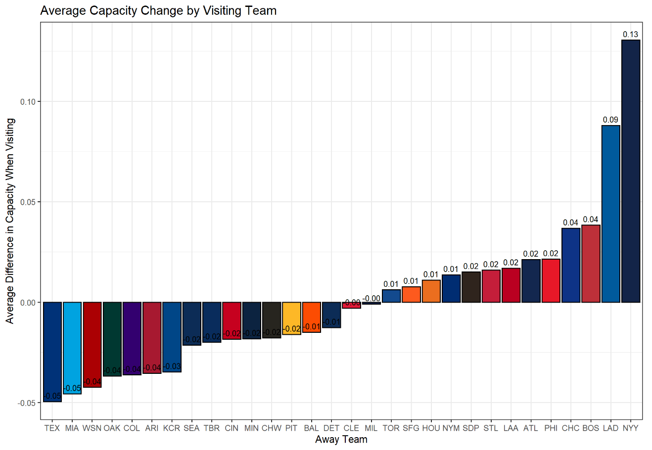
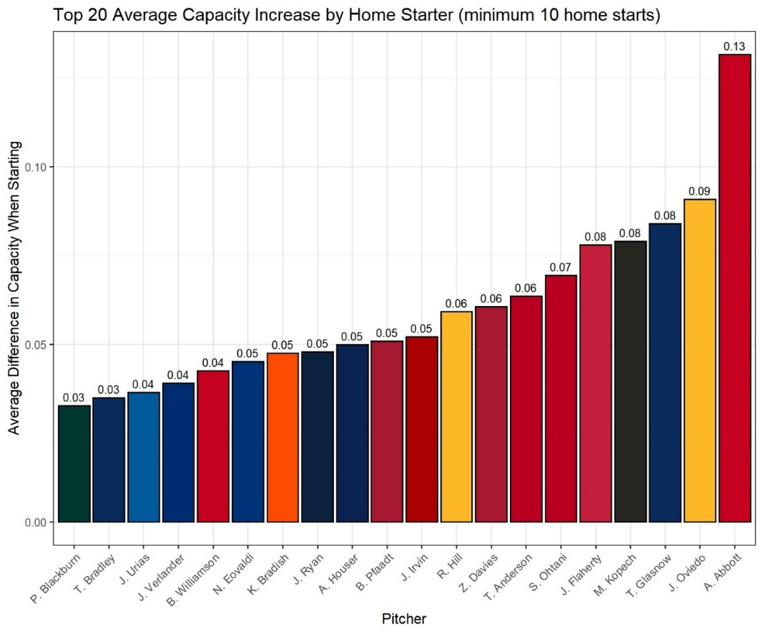
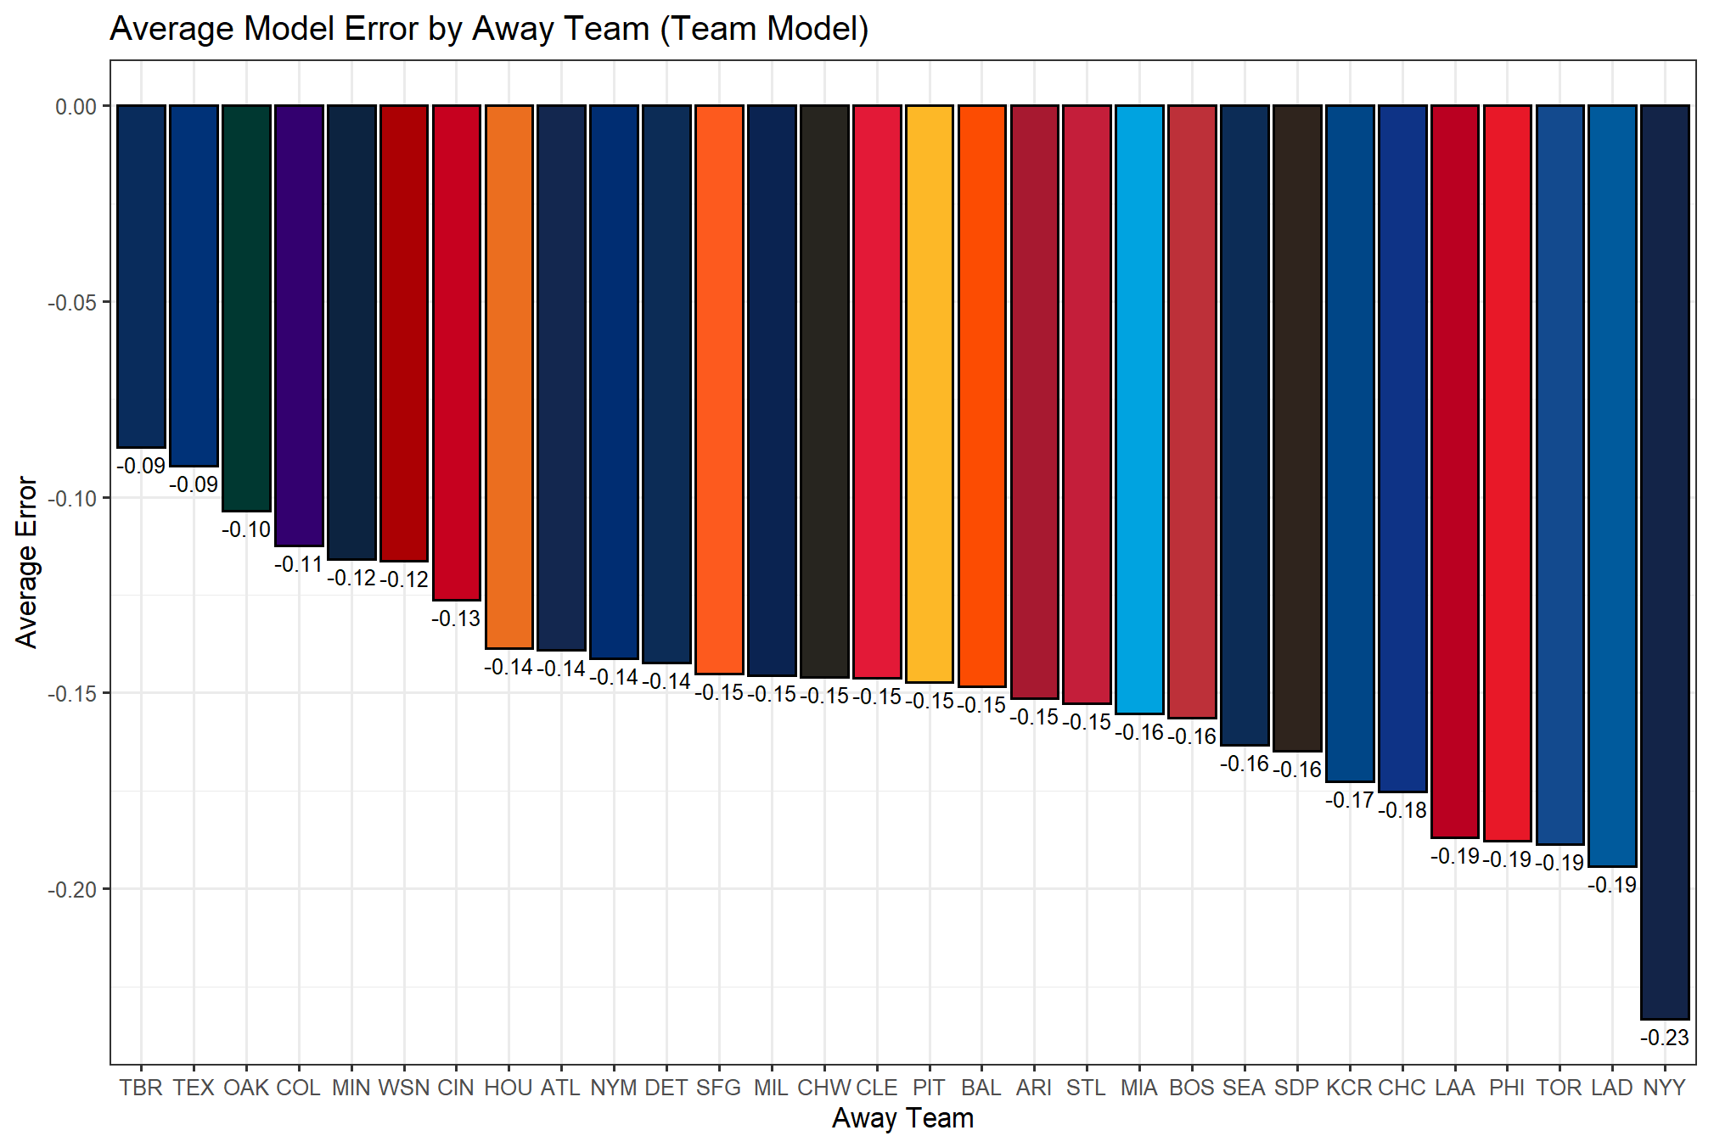
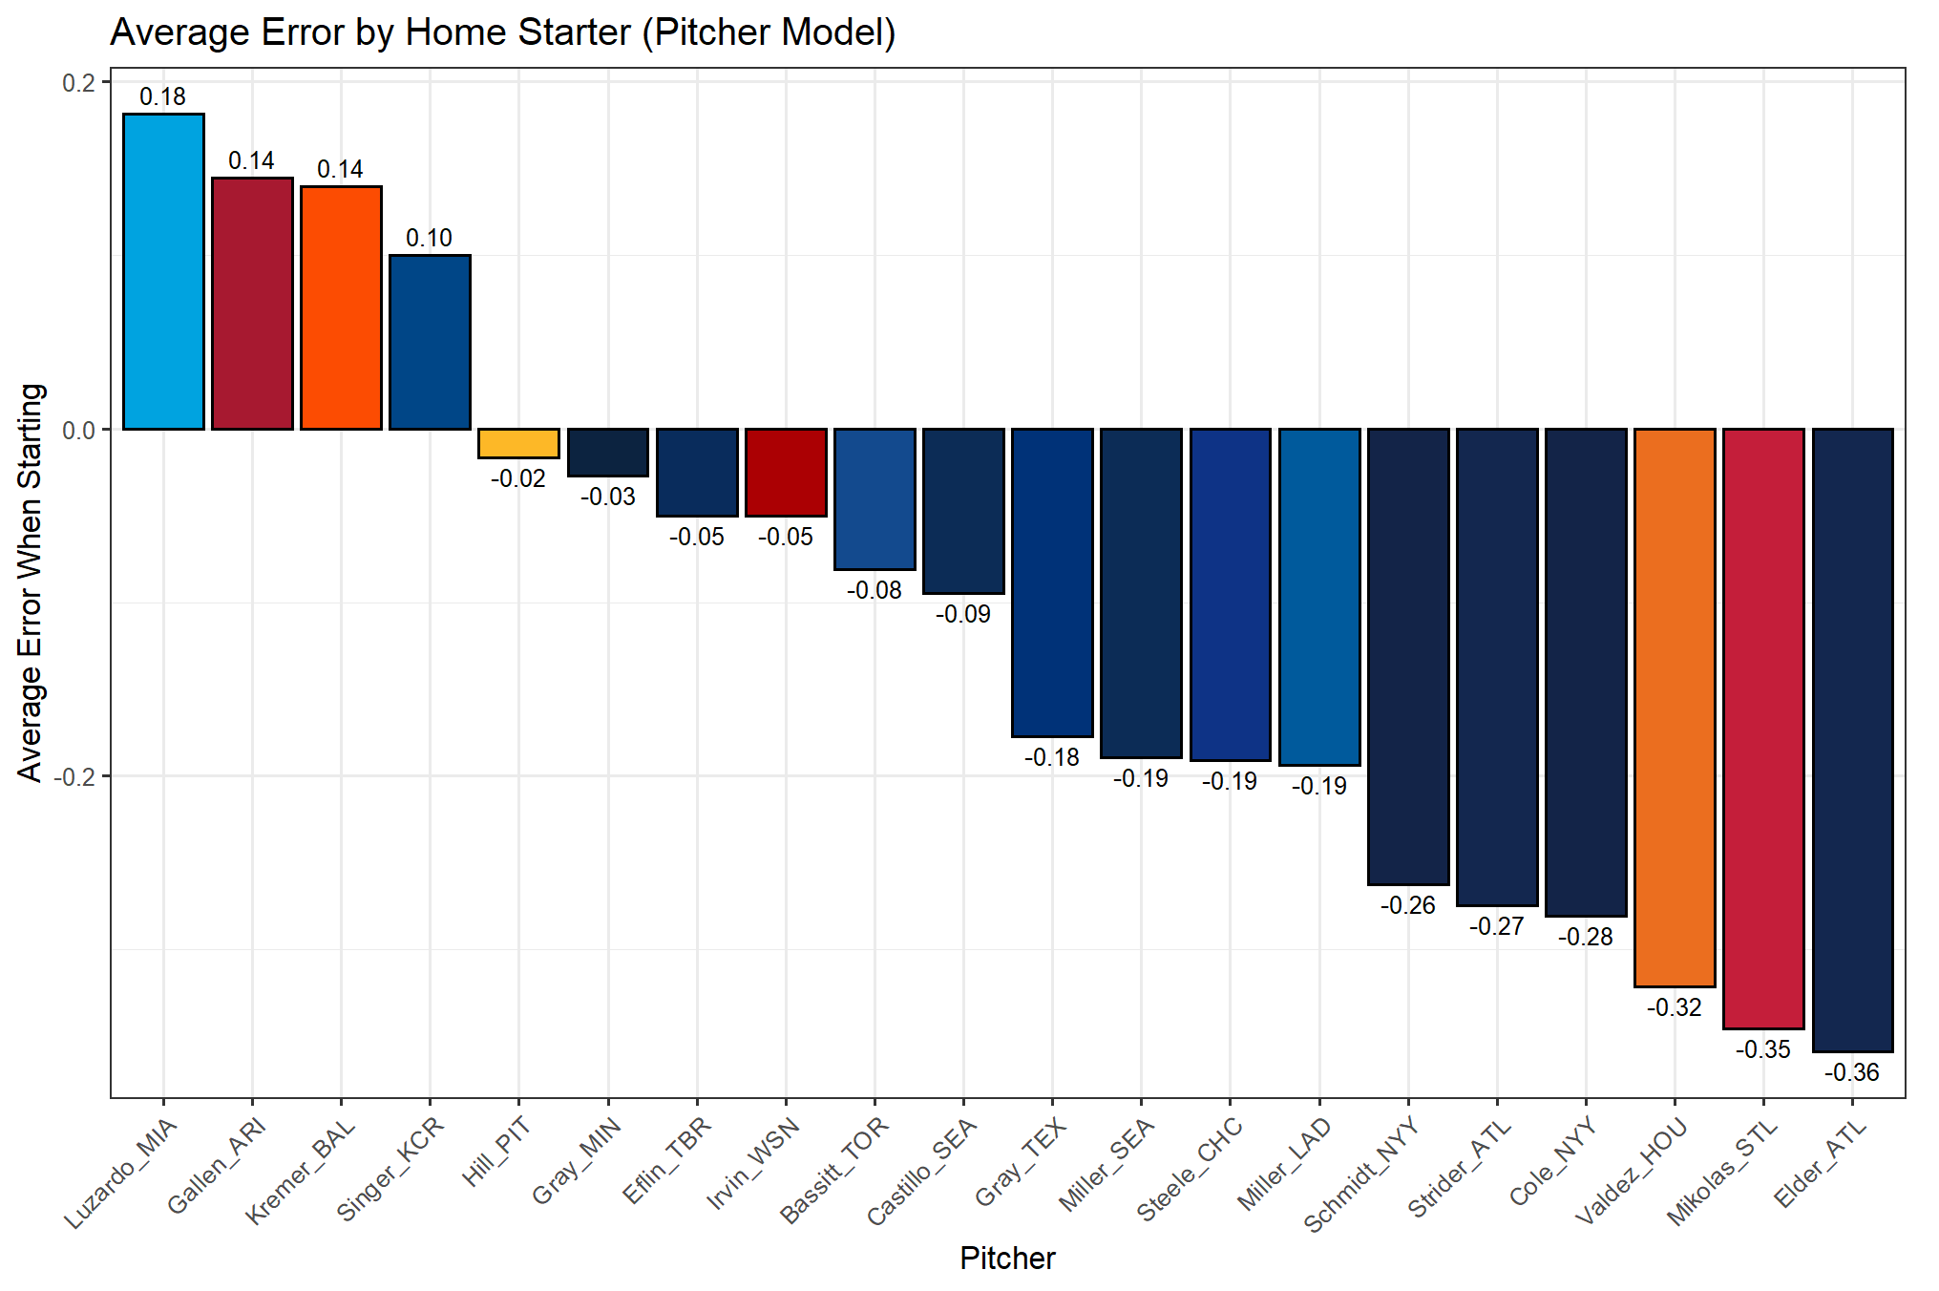
Star Power in Major League Baseball: The Attendance Effects of Starting Pitchers
Dylan Phillips Department of Sport Analytics, Falk College of Sport and Human Dynamics, Syracuse University
ABSTRACT
One of the major sources of income for organizations in the sports realm is through ticket sales. Maximizing this revenue by increasing attendance can lead to an advantage compared to other teams, both in the sport and as a business. This is no different in Major League Baseball. With a 162-game season and 81 home games, learning how to maximize attendance can lead to an unparalleled advantage over other teams. In general, the better a team plays, the more fans will come to the games. Success in baseball has many factors, but one of the most important is the quality of the starting pitcher. If a team is looking to increase attendance, will investing in big-name, successful pitchers in free agency and contract negotiations lead to an increase in attendance? Star power in the NBA has been well-researched, but how does this past research apply to MLB? Using attendance and pitching data from 2021-2023, three ranger random forest models were created, focusing on team aspects, pitcher aspects, and the two together. Variable importance measures found that the home team and the success of both teams playing had more of an effect on tree creation than pitcher success did. In the pitcher model, measures of overall pitching success, such as FIP, took precedence. Overall, the models tended to underpredict attendance, but there were still apparent patterns. On a team basis, the teams that had above-expected attendance were historically successful or were in large markets, like the New York Yankees and Los Angeles Dodgers. On a pitcher basis, attendance was above expected for All-Star level talent, such as Gerrit Cole and Bryce Elder. These models are versatile, as the results and methods applied to create them can be applied to other sports and other positions, and, once optimized, should be accurate predictors of star power.
METHOD
Before modeling, visualizations were created to see how the results of the models would compare to simple mathematical processes. The two main components of the models are team effects and pitcher effects. The following model is an estimate of the team effect. It displays the average change in attendance when a team is visiting versus the home team’s average.
As seen, the Yankees and Dodgers draw the largest crowds, even when they are visiting. Among those that draw bigger crowds, most are historically successful franchises. This shows there may be an attendance effect based on the visiting team. The next visualization shows average difference in attendance when compared to average by starting pitcher.
Interestingly, Andrew Abbott of the Cincinnati Reds had the highest average attendance difference after his surprising debut season in 2023. Going down the list, we see big-name pitchers, such as Tyler Glasnow, Jack Flaherty, Justin Verlander, and, of course, Shohei Ohtani. This shows that all-star-level talent drives more fans to the ballpark.
The goal of the model is to measure the externalities that starting pitchers bring and how these “superstars” affect attendance by following a similar approach to Humphreys and Johnson’s study of the increases in attendance in the NBA. For this model, top pitchers were determined by the number of starts that they had in the dataset. If they appeared in the top 50 on the list, they were deemed superstars.
Because of the number of categorical and differing behaviors of the data, a random forest model to predict attendance would be the best approach. The dataset was split into train and test datasets, with the 2021 and 2022 seasons being used to train the model. With the 2023 season as the test set, we can see which pitchers brought above-expected numbers during the season using fitted values.
The models were built using a ranger random forest model. The hyperparameters were tuned using a grid search approach to reduce the mean-square error. Variable importance was determined using permutation, and cross-validation was performed ten times for each model.
RESULTS
In total, three models were run. The first model used both the team-centric and player-centric variables found in the dataset. This model returned an MSE of 0.026 and an R-squared value of 0.592. In this model, the team factors seemed to take precedence over pitcher factors when the model was built, based on variable importance measures. Home performance and the team itself are important drivers in attendance. Surprisingly, the away team did not have a large effect in this model, even though we saw increased attendance when the Yankees and Dodgers visited before modeling. To get a better understanding of attendance effects, the model was split into two, one with team factors and one with pitcher factors.
The team model resulted in an RMSE of 0.015 and an R-squared of 0.76. The higher performance is likely due to the reduction in the number of variables, and, in turn, the minimal noise in the model. Like the broad model, home team success is the most important in building trees. Additionally, the home team is highly important, showing the importance of market size on attendance.
Finally, seeing the effects pitchers have on attendance, the player factors were isolated for a third model. This model returned an MSE of 0.035 and an R-squared of 0.46. The expectations were that the pitcher name variable, both home and away, would be highly important, however, the pitcher did not appear in the top ten in importance. Further analysis showed that the home pitcher had a slightly higher importance level than the away pitcher, but the low value is still concerning. This does not mean the pitcher does not have any effect on attendance. We can still use fitted values in the test set to see if there are any patterns in the data.
Once these models were created, fitted values and errors were calculated in the test set, which contained all the games in 2023. With these values, we could recreate the visualizations in the methods section.
The above visualization shows the average model error for the visiting team using the team-based model. Although there was a consistent underestimation, the patterns that we saw pre-modeling are present. The Yankees and Dodgers attendance while visiting was, on average, the most underestimated, with the more successful franchises following.
Here we have the average error by home starter using the pitcher-centric model. The most underestimated pitcher was Bryce Elder, who had a surprising 2023 season. Following him are other All-Star level pitchers, such as Cole and Strider. The pattern of talent leading to underestimation in the model is a good sign for its predictive abilities.
CONCLUSIONS
Using game-level data from the 2021-2023 MLB seasons, random forest modeling was conducted in an attempt to quantify the effects that starting pitchers have on attendance for a given day. Game information, such as the time of the first pitch, the date the game was played, and the two teams playing in the game, were used to build a team-based model, which had an R-squared value of 0.76. Pitchers were analyzed in a separate model, using season-level statistics, such as ERA, FIP, and number of starts, which resulted in an R-squared value of 0.46. A third model was run, using the two sets of variables to create an overarching predictive model, with an R-squared of 0.592.
After running the models, many of the results that were found were consistent with the prediction made using the pre-model visualizations. On a team level, recently successful teams drew larger crowds both at home and when they visited, with historically significant teams having a larger attendance change when visiting. In the pre-model visualizations, this was represented by a high average attendance, and a high level of change in attendance when visiting, and it is shown in the models by high levels of underestimation.
When focusing on the results of the pitcher models, we also see consistency in predictions that were made before running the models. For both the home and away starting pitchers, it seems that fans prefer to see talented pitchers, with a majority of the names in the visualizations being at or near an all-star level. One precaution we must take before estimating the true attendance effects of these pitchers is the variable importance discussed before modeling. In the full model, team-based variables seemed to take precedence in predictive power. This is why many of the pitchers whose attendance was often underestimated are also on more successful teams over the past three seasons. Focusing more on the results of the pitcher model provides much more information in finding which pitchers bring the largest superstar effects.
INTRODUCTION
As the modern world continues to become more fast-paced, sports fans are beginning to turn away from America’s Pastime in favor of more action-packed sports. The National Football League and the National Basketball Association have taken over the public’s eye in recent years, with increased attendance and viewership, while Major League Baseball has struggled. Its slow-paced play has failed to catch the eyes of young fans, and MLB organizations are trying to reverse the downward trend in attendance.
The sports world has changed dramatically in the last decade, as the marketability of players has become an increasingly important factor in viewership, attendance, and profits. The NBA’s small roster size and star-centered play have allowed it to blossom into an industry of its own. The NFL’s large fanbase and reach have steadied it at the top of North American sports. Although it is shrinking, MLB’s reach is as expansive as the NFL’s, with a steady hold in Latin America. With this reach, the factors necessary for the growth of MLB’s pull in the market are present, but it has fallen behind in the marketing of players.
One determinant in attendance is the players the fans came to see. In baseball, the only way to predict who they will see in a given game is the starting pitcher. Often, teams will follow a steady rotation for their starters, while batting lineups are often set the day of the game. Because of this, in theory, player effects on attendance will be encapsulated more in the starting pitchers than in any other player. There is no doubt that superstar pitchers help their teams succeed on the field, but how do they help the organization on a game-by-game basis?
REFERENCES
Hall, S., Szymanski, S., & Zimbalist, A. (2002). Testing causality between Team Performance and payroll the cases of ... ResearchGate. https://www.researchgate.net/publication/227351010_Testing_Causality_Between_Team_Performance_and_Payroll_The_Cases_of_Major_League_Baseball_and_English_Soccer
Hepper, T. (2017, June 1). Predicting MLB game attendance. Medium. https://towardsdatascience.com/predicting-mlb-game-attendance-c36cdc1b8de6
Humphreys, B., & Johnson, C. (2019). The effect of superstars on game attendance: Evidence from the NBA ... Sage Journals. https://journals.sagepub.com/doi/abs/10.1177/1527002519885441?journalCode=jsea
Langhorst, B. (2014, April 2). What Do Your Fans Want? Attendance Correlations with Performance, Ticket Prices, and Payroll Factors. Society for American Baseball Research. https://sabr.org/journal/article/what-do-your-fans-want-attendance-correlations-with-performance-ticket-prices-and-payroll-factors/
Näf, J. (2023, November 3). Variable importance in random forests. Medium. https://towardsdatascience.com/variable-importance-in-random-forests-20c6690e44e0
ACKNOWLEDGEMENTS
Special thanks to Dr. Rodney Paul for his unrelenting support and guidance during this process and to Francesco Riverso for endless work for the entire program.
Notes:
Template for a 48” x 36” poster

