Slide 1

Hands-On Session
Philipp Koehn
Hieu Hoang
1st September, 2013

Slide 2
SMT Pipeline
Preprocessing
- tokenizer
- tagging
- lemmatization
Alignment
Phrase extraction
Tuning
Decoding
Postprocessing
- recasing
- detokenizer
Scoring
- BLEU score
Notes:
MT pipeline
- each part is critical to producing good MT system
Can show you how to do each part
- take a week
Lose the will to live!
However, not necessary to know the mechanics of each & every part to start
Those that don’t need to know, or know but just want it to work consistently
- provide a system which wraps up the pipeline

Slide 3
Using the Experiment Management System (EMS)
In brief
from raw data to tuned MT system
Wrapper for everything needed to
Train
Tuning
Decode
Evaluate
Require
config file
Notes:
This system is called the EMS
- series of scripts
- included with the Moses toolkit but can work with most MT systems
More about it from philip laters
- in essense
- takes raw data
- turn into a phrase-based system, or hierarchical system
By running the entire pipeline.
All you need to do it give is a config file

Slide 4
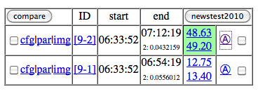
Using the EMS
ssh guest@thor.inf.ed.ac.uk
Password = mosessmt
cd workspace/experiment/fr-en/<river>/
nohup ./run.pb.recase.sh &
config file:
steps/1/config.1
Browse: http://amta.statmt.org/
- find your experiment
_
Click Here
Notes:
We’ve set up a small experiemtn for you
- so log onto the our server as guest
- password is ‘welcome’
And run this script
- it’s a standard phrase-based system. Training on just 1000 lines of data
- hopefully it’ll finish in 10-15 minutes.
- can look at this script, it’s 1 line which runs the EMS, telling it which config file to use, in this case it says the 1st config file.
So where’s the config file?
- it’s in the steps directory, under ‘1’
- look inside it
- doesn’t sayhow things are run, EMS already knows that
- instead, specify where the data and the executables are found
- <PAUSE> for questions
Now it’s running, can check on it progress online.
Go to this URL with firefox or whatever
- find your experiment. (Name of fruit)
- ‘cfg’ is the config file your supplied it with
- par is the parameters the EMS extracted from the config file
- click on the ‘image’ link
- shows you progress of your running experiment

Slide 5
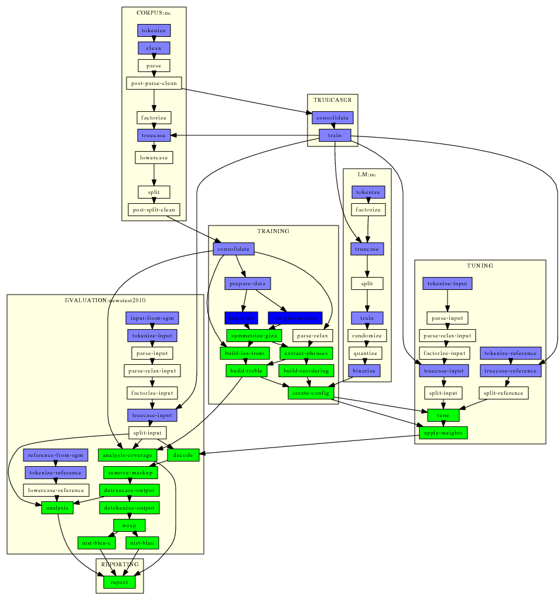
Using the EMS
Notes:
All the steps that you have to do to create MT systems
Refresh your browser to see updates
Wait for all boxes to turn light-blue. Everything has finished!
Green – still to do
Dark blue – Running jobs
- in this 1, GIZA and inverse giza is still running.
If you see RED
- that means that step broke. You have to fix it
R

Slide 6
Hierarchical/Syntax Models
Same pipeline
Different
Extraction
Decoding
Reuse common output
Data cleaning
Tokenization
Alignment
Notes:
For hierarchical and syntax models, only the extraction and decoding is different.
Many of the other steps are identical. The EMS understand that
- if a step has identical input and output, and the same arguments
- reuse

Slide 7
Hierarchical/Syntax Models
nohup ./run.hiero.recase.sh &
Browse: http://amta.statmt.org/
- find your experiment
Click Here
Notes:
So do the same thing for another experiement
This uses the same data
- but creates a hierarchical model instead of a phrase-based model
Find your experiment again

Slide 8
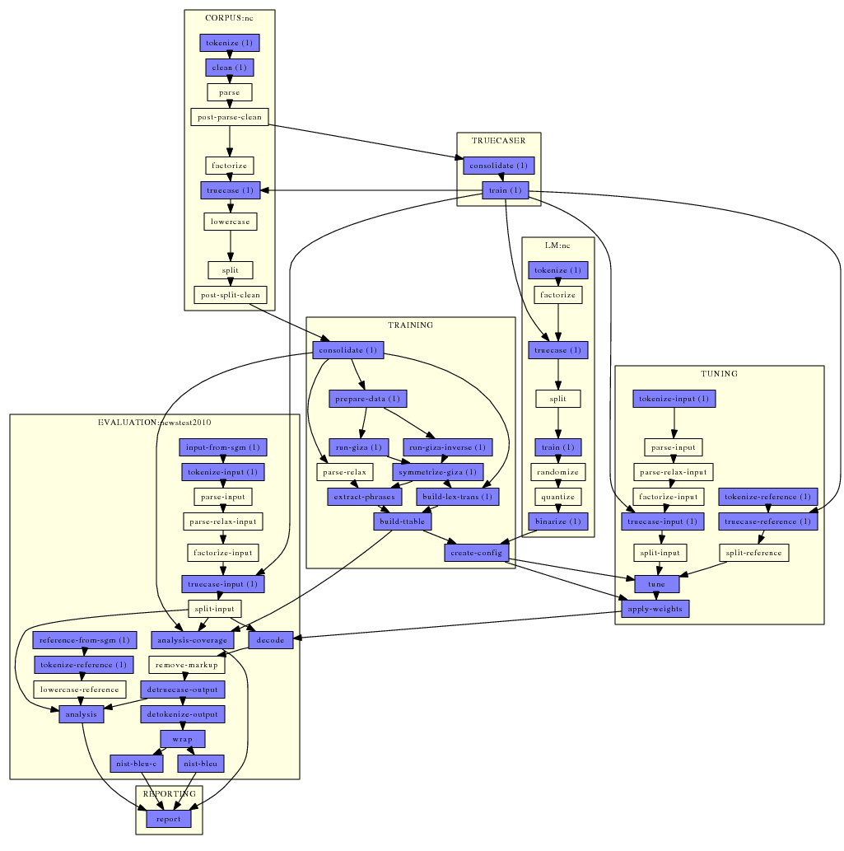
Using the EMS
Notes:
Looks exactly like the phrase-based
However, those parts that can be resused from the phrase-based
- aren’t green, or blue
- those steps are white
- meaning the EMS will reuse the output from the phrase-based experiment instead.
- steps like tokenization, cleaninng, alignment are all white

Slide 9

Using the EMS
Notes:
Looks exactly like the phrase-based
However, those parts that can be resused from the phrase-based
- aren’t green, or blue
- those steps are white
- meaning the EMS will reuse the output from the phrase-based experiment instead.
- steps like tokenization, cleaninng, alignment are all white

Slide 10
Using the EMS
Standardized directories
corpus
evaluation
lm
model
steps
training
truecaser
Tuning
Standardized file names for each experiments, eg.
nc.lm.1 - nc.lm.2
extract.1 - extract.1
moses.ini.1 - moses.ini.2
Notes:
Digging deeper into how the EMS works
Standardized directories
Standardized naming convention for files
- easy to see which exactly which files have been created by which experiment

Slide 11
Analysis
BLEU scores
Analysis
Look at 2 experiments created earlier
- ‘FULL NEWS COMM’
- with 90,000 lines of training corpora
Notes:
Has anyone experiement finished?
- if not, won’t have anything to analysies
- instead, look at an experiment I did earlier
- instead of running on only 1000 lines of tranining data, used whole news commentary
- also, tuned & tested on 2000 sentences, instead of 20
Once the experiments have finished running
Look on the web interface
- tell you when it finished
- its BLEU score
Can get detailed analysis by clicking on this links
- what addiotnal does this tell you?

Slide 12
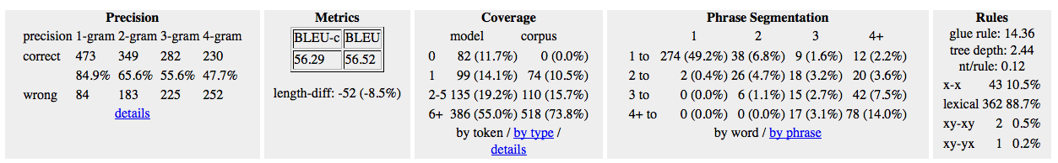
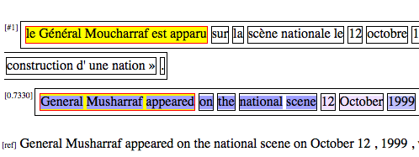
Analysis
Hierarchical / Syntax Models
High-Level Analysis
Sentence-by-Sentence
Notes:
High-level analysis
- what the bleu score was
- the calculation of that score
Coverage
- drill down to get more details.
- unknown words
Covered later on by philipp
Sentence-by-sentence analysis
- shows how each sentence in the test set was translated
- for hiero/syntax – boxes represent trees, (or derivation) the translation used.
- interactive – hover over each box to see how that boxes was translated.

Slide 13
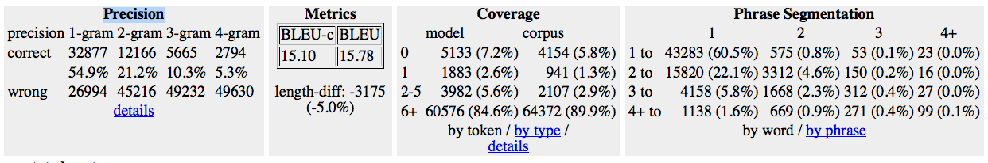
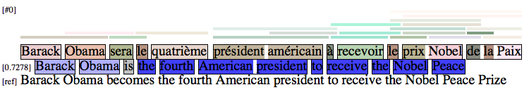
Analysis
Phrase-Based Model
High-Level Analysis
Sentence-by-Sentence

Slide 14
Debugging
Incorrect file paths
Data files
Executables
Bugs in scripts
Bugs in data

Slide 15
Debugging
steps /<num>/
Working directory of EMS
config.<num>
Parameters for experiment <num>
Scripts that run moses script
eg. TRAINING_run_giza.1
Errors produced by every script
eg. TRAINING_run_giza.1.STDERR

Slide 16
Summary of EMS
Create complete MT system from raw data
Consistent, reproduceable
Efficient
Re-use when it can
Analysis
Support parallelization
SGI
Multi-threading

