Slide 1


Refactored Moses
Hieu Hoang
MT Marathon
Prague
August 2013

Slide 2
What did you Refactor?
Decoder
Feature Function Framework
moses.ini format
Simplify class structure
Deleted functionality
NOT decoding algorithms
Tuning
NOT tuning algorithm
EMS (Experiment Management System)
Notes:
Just the facts. What have I changed?
Changed the way feature functions interact with the decoder
- API for feature functions
Changed the ini file format
Simplified class hierarchy
Deleted some functionality
Specifcally haven’t done
- touch any of the decoding algorithms
- spent years refining.
- if you have a model you’ve previously built
- get EXACTLY the same output
- same BLEU and model score
- if not, shout VERY LOUDLY at me
Changing the decoder
- especially the ini file
- change things which are dependent on it
- particularly
- tuning process
- however, again, have NOT touched tuning algorithm
- MERT, MIRA, PRO still EXACTLY the same
- just made sure that can deal with the new ini file format

Slide 3
Why did you Refactor?
Feature Function Framework
easier to implement new features
use sparse features
Simplify class structure
easier to develop with Moses
Delete functionality
easier to refactor code
very little deletion
Notes:
over the last few years
- gotten bored with existing features like language models and reordering models
the trend in MT
- create novel features which give a score to a translation
- like any feature, tries to give bigger scores to better models
New feature function framework
- designed to make it easy to add new features
Not totally new to Moses
- always had the ability have
- add new LM implementations
- add new phrase-table implementation
- now – generalize to mutiple implementations of arbitary features that gives a score to transation
Another trend
- FF shouldn’t just have a fixed, limited number of scores
- they can have unknown number of scores
- that can flicker on when a particularly good, or bad translation, is used
- this is usually called sparse features
Aim of feature function framework
- give them equal prominense to dense features
- rather than have them as abjuncts
- easy to forget
Simplify class structure
- to make it easier for us to develop with Moses
- Moses has been around for 8 years now
- everyone has the freedom to add what they want
- no-one is in overall control
- this way of organising an open-source project is great
- gotten lots of contribution, lots of features
- downside
- grown organically
- things are not as well structured as they can be
- now I have the time
- with the benefit of hindsight
- go back and put some structure to what we’ve done
Why did I delete things
- delete very little
- I’m not the gatekeeper of moses
- if a functionality was deleted, it’s not a comment on usefulness of it
- purely ‘cos it got in the way of the refactoring
Quickly go thru the last 2
- before telling you about feature functions

Slide 4
Why did you Refactor?
Feature Function Framework
easier to implement new features
use sparse features
Simplify class structure
easier to develop with Moses
Delete functionality
easier to refactor code
very little deletion
Notes:
Simplify class structure
- to make it easier for us to develop with Moses
- Moses has been around for 8 years now
- everyone has the freedom to add what they want
- no-one is in overall control
- this way of organising an open-source project is great
- gotten lots of contribution, lots of features
- downside
- grown organically
- things are not as well structured as they can be
- now I have the time
- with the benefit of hindsight
- go back and put some structure to what we’ve done
Why did I delete things
- delete very little
- I’m not the gatekeeper of moses
- if a functionality was deleted, it’s not a comment on usefulness of it
- purely ‘cos it got in the way of the refactoring
Quickly go thru the last 2
- before telling you about feature functions

Slide 5
Why did you Refactor?
Feature Function Framework
easier to implement new features
use sparse features
Simplify class structure
easier to develop with Moses
Delete functionality
easier to refactor code
very little deletion
Notes:
Why did I delete things
- delete very little
- I’m not the gatekeeper of moses, I don’t control it
- if a functionality was deleted, it’s not a comment on usefulness of it
- purely ‘cos it got in the way of the refactoring
Quickly go thru the last 2
- before telling you about feature functions

Slide 6
Language Model
IN THE BEGINNING
LanguageModel
LanguageModelSingleFactor
LanguageModelMultiFactor
SRI
IRST
KEN

Slide 7
Language Model
THEN….
LM
LMImplementation
LMRefCount
LMSingleFactor
LMMultiFactor
KEN
LMPointerState
SRI
IRST
Notes:
2 parallel class hierarchies
if someone with a great new language model
- wants to integrate it into moses
- what class should then extend?
designed for distributed language models
- never realised
- may oliver’s ORLM
- not really used

Slide 8
Language Model
NOW
LM
LMImplementation
KEN
LMSingleFactor
LMMultiFactor
SRI
IRST

Slide 9
Phrase Tables
IN THE BEGINNING
PhraseDictionary
Memory
TreeAdaptor
SCFG
OnDisk
Notes:
tree adaptor
- binary phrase table implementation

Slide 10
Phrase Tables
THEN….
PhraseDictionary
PDFeature
Memory
TreeAdaptor
RuleTableTrie
OnDisk
Compact
SCFG
RuleTableUTrie
Notes:
again there’s a parallel class structure
- again the reason is quite sound
- use thread phrase tables which aren’t thread safe
- Feature class CONTAINS multiple objects of phrase dictionaries
added RuleTableTrie class
- reason too complicated to explain
- I think mostly to hold data structures for active parsing
- phil might be able to enlighten us

Slide 11
Phrase Tables
NOW
PhraseDictionary
TreeAdaptor
RuleTableTrie
OnDisk
Compact
Memory
RuleTableUTrie
Notes:
deleted the parallel class hierachicy
- moved hacks to make non-threads classes, threadsafe. INTO each offending class
- merged the 2 memory phrase tables for phrase-based and scfg decoding into 1

Slide 12
Why did you Refactor?
Feature Function Framework
easier to implement new features
use sparse features
Simplify class structure
easier to develop with Moses
Delete functionality
easier to refactor code
very little deletion
Notes:
Why did I delete things
- delete very little
- I’m not the gatekeeper of moses, I don’t control it
- if a functionality was deleted, it’s not a comment on usefulness of it
- purely ‘cos it got in the way of the refactoring
Quickly go thru the last 2
- before telling you about feature functions

Slide 13
Deleted
Translation Systems
multiple engines in 1 decoding process
replaced with alternative weights function
Distributed Language Model
send LM queries to different machines
replace with multipass/asynchronous decoding?
Continue Partial Translation
start from non-empty hypothesis
Notes:
These are the only 3 functionality I deleted
- all potentially useful stuff
- but made refactoring harder for me
- so I deleted them
multiple translation systems
- useful feature
- especially for commercial users
- very quickly replaed by alternative weights
- has research angle to it

Slide 14
Why did you Refactor?
Feature Function Framework
easier to implement new features
use sparse features
Simplify class structure
easier to develop with Moses
Delete functionality
easier to refactor code
very little deletion
Notes:
Why did I delete things
- delete very little
- I’m not the gatekeeper of moses, I don’t control it
- if a functionality was deleted, it’s not a comment on usefulness of it
- purely ‘cos it got in the way of the refactoring
Quickly go thru the last 2
- before telling you about feature functions

Slide 15
Adding new Feature Function
THEN….
Add entry to
Parameter class
Read parameter in StaticData
add variable to hold new feature
load feature
Bespoke
ini file:
[new-feature-section]
0 0 1-1 file.name
[weight-new-feature]
Notes:
completely bestoked
- no framework to help you
- if you don’t do it right, wont’ work

Slide 16
Adding new Feature Function
Now….
StaticData
Simple framework to load feature
ini file:
[feature]
WordPenalty
Distortion
…
NEW-FEATURE file=path factor=0
[weight]
WordPenalty0= -0.27
Distortion0= 0.14
…
NEW-FEATURE0= 0.54
Notes:
now there’s a simple framework to add your new feature
no need to create a custom section in the ini file
- or create variable in staticdata

Slide 17
MERT
THEN….
Only know about certain feature functions
Hardcoded array
my @ABBR_FULL_MAP = qw(d=weight-d lm=weight-l tm=weight-t w=weight-w
g=weight-generation lex=weight-lex I=weight-i dlm=weight-dlm pp=weight-pp wt=weight-wt pb=weight-pb lex=weight-lex glm=weight-glm);
requires feature name and abbreviation
Notes:
even if you have the decoder sorted out
there’s a world of hurt in the mert script

Slide 18
MERT
THEN….
Only know about certain feature functions
Hardcoded array
my @ABBR_FULL_MAP = qw(d=weight-d lm=weight-l tm=weight-t w=weight-w
g=weight-generation lex=weight-lex I=weight-i dlm=weight-dlm pp=weight-pp wt=weight-wt pb=weight-pb lex=weight-lex glm=weight-glm);
requires feature name and abbreviation
Deleted array
Ask decoder for feature function
abbreviations deleted
Notes:
even if you have the decoder sorted out
there’s a world of hurt in the mert script

Slide 19

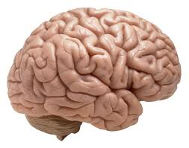


Timeline of a Translation Rule
File
Memory
Load
Apply to input
sentence
Translation Option
Hypothesis
Search
Notes:
What is the task of a feature function
- it’s task is to give a score to a translation rule
Translation rule has a lifespan
- starts off in a file on disk
- gets loaded into memory
- before a sentence is decoded
- translation rules are looked up
- fitted to a specific place in the source sentence
- name of translation rules
- changes to translation option
- all intents and purposes
- is a trans rule
When it’s being used in search
- it’s name changes to hypothesis
- again, wrapper around a translation rule
During each step in the lifespan of translation rule
- each feature function has the ability to change the score of the rule
Where should a feature function change the score?
why should it change it during search
instead of load?

Slide 20
Timeline of a Translation Rule
File
Memory
Load
Source phrase
Target phrase
Apply to input
sentence
Translation Option
Input sentence
Input path
Hypothesis
Search
Translation context
Segmentation
Notes:
at each step
- feature function has access to different kinds of side information
with which to score the rule
During loading
- only know what the rule is, without context
When it is being applied to a sentence
- it know the sentence
During search
- it know what other rules have been used
These are the information it can use to score the rule

Slide 21
Timeline of a Translation Rule
File
Memory
Load
Once
Apply to input
sentence
Translation Option
Per occurrence in sentence
Hypothesis
Search
Per hypothesis
Notes:
Point of showing you this timeline
sooner you caclulate it, the better
1. efficiency
- not repeated
2. more accurate
- each stage – subject to pruning
- some rules are thrown away
- if the feature function can give a good score
- the rule can say
‘hey I’ll be really useful to you, don’t throw me away!”

Slide 22
Feature Function API
Loading
File
X→ je suis X₁ ||| I am X₁
Source phrase:
je suis X₁
Access to:
Target phrase:
I am X₁
void Evaluate(source,
target,
scores,
estimated future scores)
Feature functions that use this:
Word Penalty
Phrase penalty
Language model (partial)
Memory
Notes:
During load
- this is the translation rule
-

Slide 23
Feature Function API
Apply to input sentence
Memory
Input:
je|PRO suis|VB 25|NUM ans|NNS .|.
Input subphrase:
je|PRO suis|VB 25|NUM
Access to:
Input scores:
0.3 0.2 0.1
void Evaluate(input,
input path,
scores)
Translation Option
Feature functions that uses this:
Input feature
Bag-of-word features….
Notes:
Have a sentence
- looking up rules that can be used in that sentence
- once you find a rule that can be applied
- to a specific substring in a specific sentence
- create translation option
At this point
- have another opportunity to evaluate the scores of the rules

Slide 24
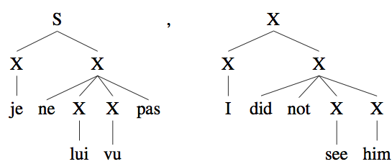
Feature Function API
Search
Translation Option
Hypothesis:
Access to:
Current hypothesis
Previous hypotheses
Segmentation
Stateless features:
void Evaluate(hypo, scores)
void EvaluateChart(hypo, scores)
Stateful features:
state Evaluate(hypo,
previous state,
scores)
state EvaluateChart(hypo
previous state,
scores)
Hypothesis
Notes:
search
when you have a translation rule
- you know exactly where it’s going to be applied to
- and you actually apply it
Only place where calculating the feature function is different for phrase-based or syntax models
- slightly different for stateless and stateful features
all the translation rules that were used,
the total output phrase
segmentation
- derivation tree if hiero/syntax model

Slide 25
Feature Function API
Decoding
Translation Option
Feature functions that uses this:
All stateful features
Language models
Distortion model
Lexicalized distortion
…
Some stateless features
Global lexicalized model
Word translation
Hypothesis
Notes:
all the translation rules that were used,
the total output phrase
segmentation
- derivation tree if hiero/syntax model

Slide 26
Feature Function
Loading:
void Evaluate(source,
target,
scores,
estimated future scores)
Apply to Input:
void Evaluate(input,
input path,
scores)
Search:
Stateless features:
void Evaluate(hypo, scores)
void EvaluateChart(hypo, scores)
Stateful features:
state Evaluate(hypo,
previous state,
scores)
state EvaluateChart(hypo
previous state,
scores)

Slide 27
Strange Features functions (1)
Language model
implement 2 Evaluate()
Loading
evaluate full n-grams
estimate future cost
partial n-grams
Decoding
evaluate overlapping n-grams
reprise de la session ||| resumption of the session
Notes:
For those who know Moses
- this is nothing new
- this is the way Moses has always computed language model scores
- the new feature function framework enable any other feature function to do this

Slide 28
Strange Feature Functions (2)
Phrase-tables
Unknown Word Penalty
Generation Model
integral part of decoding process
Uses no Evaluate()
scores assign by decoder

Slide 29
Register a Feature Function
Register
in moses/FF/Factory.cpp
add entry
MOSES_FNAME(ClassName);
Notes:
The parent constructor can be slightly diffierent
- have a look for yourself
- the constructor must call ReadParameters()

Slide 30
Language Model
Inherit from
LanguageModelSingleFactor
class LanguageModelSingleFactor : …
{
LMResult GetValue(
const std::vector<const Word*> &contextFactor, State* finalState = NULL) const = 0;
}
Notes:
LM are just like any other feature functions
- want to create your own LM
- can implement evaluate methods yourself
- u have to deal with
- beginning of sentence
- end-of sentence
However, used LM for a long time
- know how to do it efficiently
- provide a class which does the plumbing for you
if creating new LM
- rather than inherit from StatefulFeatureFunction
- instead inherit from LanguageModelSingleFactor

Slide 31
Phrase Table
Inherit from
PhraseDictionary
Legacy API:
class PhraseDictionary : . . .
{
public:
TargetPhraseCollection *GetTargetPhraseCollectionLEGACY(
Phrase &src) const;
protected:
const TargetPhraseCollection *GetTargetPhraseCollectionNonCacheLEGACY(Phrase &src);
}
Notes:
Phrase-table isn’t like any other feature function
- it contains scores
BUT
- also create the search space
A phrase table MUST inherit from class
- PhraseDictionary
For phrase-based
-

Slide 32
Phrase Table
New API:
InputPathList
class PhraseDictionary : . . .
{
public:
void GetTargetPhraseCollectionBatch(InputPathList &);
}
Input Sentence:
je suis 25 ans .
Input Path List:
je
je suis
je suis 25
…
suis
suis 25
…
Notes:
input path
- substring of the input sentence
the list is garanteed to be in topoligical order

Slide 33
Phrase-table
Optimization
Input Sentence:
je suis 25 ans .
Phrase-table trie
Input Path List:
je
je suis
je suis 25
…
suis
suis 25
…
0
je
suis
1
2
suis
25
3
4
25
5
Notes:
By topilocical order, I mean
- the prefix of every phrase
- comes before it.
- each input path
- given a pointer to it’s imeediate prefix
Optmized for trie-based phrase-tables
1st optiimizsation
- if you’re looking up a phrase
- ‘je suis’
- it’s immediate prefix wasn’t found
- don’t bother looking it up
2nd optimization
- if you’re looking up a phrase
- only need to extend it’s immediate prefix by 1 word

Slide 34
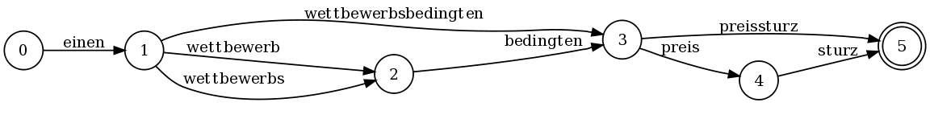
Phrase-table
Lattice Input
Input Path List:
einen
einen wettbewerb
einen wettbewerbs
einen wettbewerbsbedingten
einen wettbewerb bedingten
einen wettbewerbs bedingten
einen wettbewerb bedingten preissturz
einen wettbewerbs bedingten preis
einen wettbewerbsbedingten preissturz
einen wettbewerbsbedingten preis
….
Notes:
if your input is a lattice or confusion networks
- input path list is built in the same way
- topological order
If your phrase-table can just interact with this list
- it can be used to decode lattices and confusion networks

Slide 35
Phrase Table
Syntax Decoding
New API:
Active Parsing
CKY+
class PhraseDictionary : . . .
{
virtual ChartRuleLookupManager *CreateRuleLookupManager(
const ChartParser &,
const ChartCellCollectionBase &) = 0;
}
class ChartRuleLookupManager
{
void GetChartRuleCollection(
const WordsRange &range,
ChartParserCallback &outColl) = 0;
}
Notes:
for syntax decoding
- delegate looking up rules to another object
- Chart Rule Lookup Manager
Have to implement this object
- implement CKY+ parsing
- the details of this is tricky
- look at the code
- liable to change shortly when we add lattice decoding for syntax models

Slide 36
Results
Lattice decoding
use all phrase-table implementations
Syntax model (nearly…)
One in-memory phrase-table implementation
One on-disk phrase-table
Syntax models
AND phrase-based model
Zen’s binary implementation
phrase-based only
deprecated – to be removed

Slide 37
Results
Translation Quality
Pass regression tests
tests have also changed…
BLEU unchanged
subject to random variability
 | # | Description | v 1.0 | 29th July |  |  | # | Description | v 1.0 | 29th July
En-es | 1 | pb | 24.81 | 24.59 |  | De-en | 1 | pb | 15.75 | 15.81
 | 2 | hiero | 24.2 | 24.2 |  |  | 2 | hiero | 15.53 | 15.71
 | 3 | (1) + CreateOnDiskPt |  | 24.58 |  |  | 3 | (1) + POS de | 15.84 | 15.9
Es-en | 1 | pb | 23.01 | 23 |  |  | 4 | (3) + POS en | 15.93 | 15.78
 | 2 | hiero | 22.37 | 22.32 |  |  | 5 | (1) + CreateOnDiskPt |  | 15.91
 | 3 | (1) + CreateOnDiskPt |  | 23.03 |  |  | 6 | (3) + CreateOnDiskPt |  | 15.7
En-cs | 1 | pb | 11.04 | 11.05 |  |  | 7 | (4) + CreateOnDiskPt |  | 15.78
 | 2 | hiero | 10.93 | 10.9 |  | En-fr | 1 | pb truecase | 24.38 | 24.38
 | 3 | (1) + placeholders |  | 9.23 |  |  | 2 | pb recase | 22.94 | 22.81
 | 4 | (1) + CreateOnDiskPt |  | 11.19 |  |  | 3 | (2) + hiero | 22.28 | 22.36
 | 5 | (2) + Ken's incre algo |  | 10.84 |  |  | 4 | (2) + POS en | 23.05 | 23.07
Cs-en | 1 | pb | 15.72 | 15.8 |  |  | 5 | (2) + kbmira |  | 22.85
 | 2 | hiero | 15.68 | 15.66 |  |  | 6 | (2) + pro |  | 22.64
 | 3 | (1) + placeholders |  | 14.01 |  |  | 7 | (2) + CreateOnDiskPt |  | 22.65
 | 4 | (1) + CreateOnDiskPt |  | 15.66 |  | Fr-en | 1 | pb truecase | 24.06 | 23.97
 | 5 | (2) + Ken's incre algo |  | 15.44 |  |  | 2 | pb recased | 22.41 | 22.43
En-de | 1 | pb | 11.87 | 11.7 |  |  | 3 | (2) + hiero | 18.05 | 17.75
 | 2 | hiero | 11.62 | 11.58 |  |  | 4 | (2) + factors | 22.55 | 22.47
 | 3 | (1) + POS de | 11.67 | 11.65 |  |  | 5 | (2) + kbmira |  | 22.44
 | 4 | (3) + POS en | 11.75 | 11.65 |  |  | 6 | (2) + pro |  | 22.49
 | 5 | (1) + CreateOnDiskPt | 15.75 | 11.62 |  |  | 7 | (2) + CreateOnDiskPt |  | 22.46
Notes:
proof of the pudding is in the bleu score
for the past year
- moses releases has been accompanied by trained and tuned Europarl models
- small, vanilla moses
- with some factored models and hierarchical models too
rerun the refactored code
- no significant movement

Slide 38
Results
Speed
Phrase-based
 |  | speed (sec) | speed (sec)
1 | v 1.0 | 784 | 857.12
2 | master + caching | 1,154 | 1317.07 | -54%
With compact pt:
3 | v1 |  | 840.57 | 2%
4 | master (with caching) |  | 934.82 | -9%
Hierarchical
Pop Limit | 100 | 200 | 500 | 1000 | Loading
v 1.0 | 1,044 | 1,393 | 2,620 | 4,546 | 115
13th Aug | 670 | 1034 | 2064 | 3743 | 115
Reduction (excl load) | -65% | -26% | -21% | -18%

Slide 39
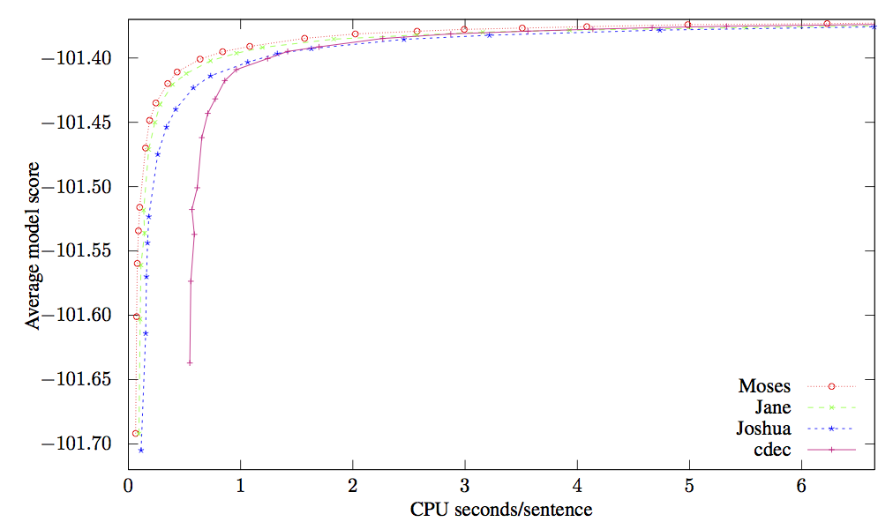
Comparison with the decoders
Ken’s thesis (2013)

