Slide 1
excellence
excellent
guilty
the
room
was
but
the
hallway
was
excel
filthy

Slide 2
Trửng
Quốc
Trựng
Qựoc
Trung
Qược
Trững
Quốc
Trưng

Slide 3
Trung Quốc cảnh báo Mỹ về luật tiền tệ
硬质合金号称”工业牙齿"
硬质 合 金 号称 " 工 业牙 齿 "
硬 质 合金 号称 " 工业 牙齿 "

Slide 4
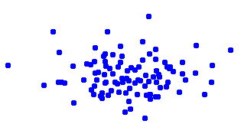
MBR best translation
x
MAP best translation

