Slide 1
Direct Workflow
Use Cases
Class Diagrams

Slide 2
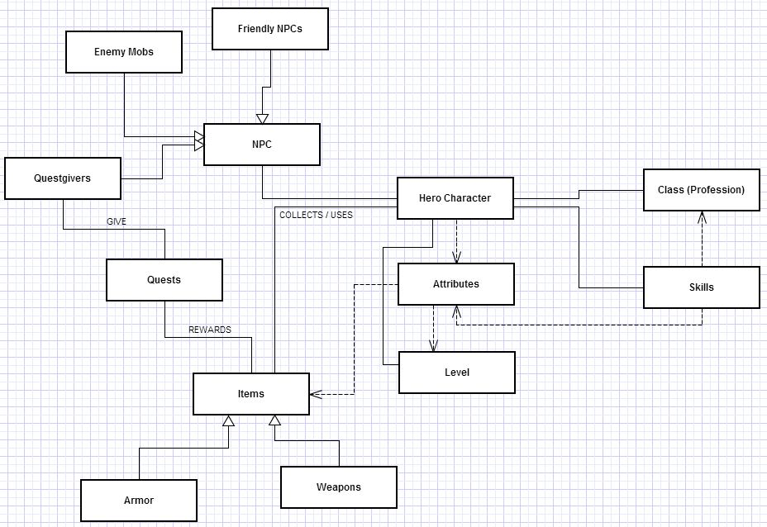
Class Diagram

Slide 3
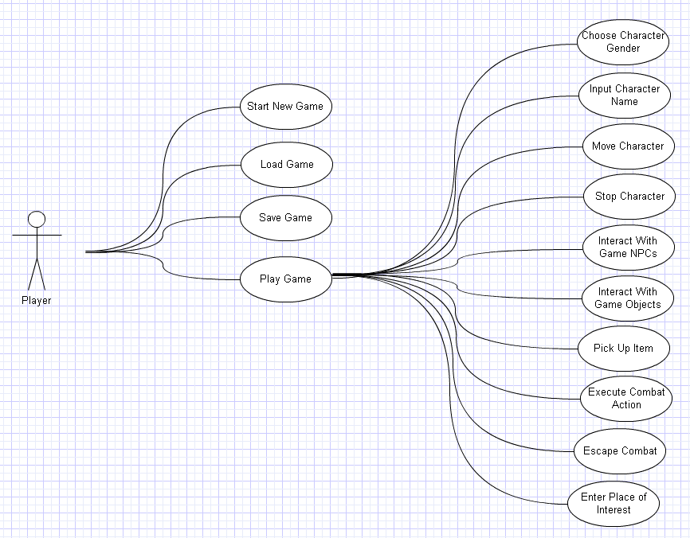
Use Case Diagram

Slide 4
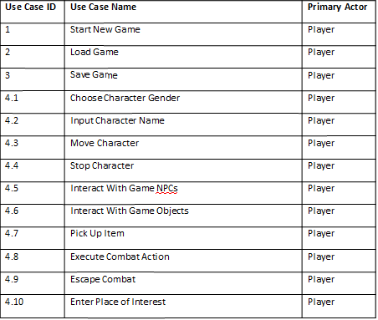
Use Case Index

Slide 5
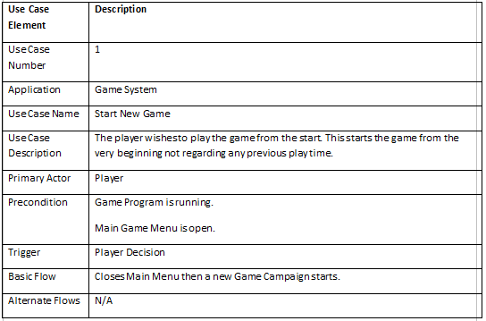
Detailed Use Cases – New Game

Slide 6
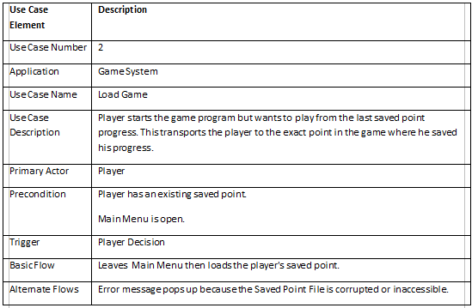
Detailed Use Cases – Load Game

Slide 7
The End
Questions?
Comments?

