Slide 1
Overview of Auran Jet
Presented by
  Damian Trebilco
  Andrew Cox

Slide 2
Auran Overview
Founded in 1995 in Brisbane
1997 released Dark Reign, a multiplayer real-time strategy game, which has sold 680,000 units worldwide
Auran developed a ‘Tactics Engine’ to power Dark Reign
Introduced many new revolutionary features to the RTS genre

Slide 3
Auran Overview (cont’d)
1997 Started development of the S.A.G.E. game authoring system
1999 granted a A$2.048 million grant from the Federal Government, S.A.G.E was renamed Auran Jet

Slide 4

Auran Jet
Described as a professional game development engine for the creation of interactive entertainment
Package includes a 3D game engine, fully integrated construction kit (JIVE), extensive documentation (coming soon currently beta 2)

Slide 5
Auran Jet (cont’d)
Goals:
Provide a generic and comprehensive solution to application authoring
Reduce the overall costs and time associated with producing multimedia applications
Maintain the leading edge of engine technology and scalable applications

Slide 6
Features
Platform Neutrality
Hardware Abstraction
System Services
Multi-Threaded
Plug-in Management System

Slide 7
Platform Neutrality
Write and maintain a single set of source code
Jet currently supports Windows 95/98/2000
Support planned for :
  Linux
  Microsoft’s Xbox
  Playstation 2

Slide 8
Hardware Abstraction
Jet provides an abstraction layer to the hardware and third party tools
Currently supports:
  OpenGL
  DirectX
  WinSock
  3D Studio Max R3

Slide 9
Industry Standard Formats
Jet supports industry standard data formats for it’s resources
e.g.
BMP, TGA, PCX, JPG, WAV, MP3, 3DS
However Jet also provides it’s own file formats to handle non-standard types of data. (ie Progressive Meshes)

Slide 10
System Services
Provides greater functionality than simple library functions
Services include:
  Memory management and some garbage collection
  Thread management

Slide 11
Multi-Threaded
Jet is multi-threaded e.g. different threads for networking, loading resources, rendering etc
Also allows Jet applications to create and run their own threads
Thread usage is hidden from a casual user by being encapsulated in base classes.
Most usage can be accomplished by adding tasks to threads.

Slide 12
Plug-In Management System
Allows programmers to extend or replace engine features and systems
Plug-in system supports:
  Factory based instance creation
  Run-time type information
  Automatic reference counting
  External plug-in registration and DLL support

Slide 13
Architecture
Jet is broken down into 29 DLL’s
Only explicitly accessed DLL’s are loaded when a Jet application is launched
DLL’s are separated by functionality e.g.
  AIFoundation
  Render3DCore
  InputSystem

Slide 14
Music and Sound
Supports Wav and MP3 files
Playback from memory or streaming from disk
Microphone, 2D and 3D sound support

Slide 15
Animation
Jet primarily focuses on skeletal based deformations for realtime rendered 3D objects
Support is included for 2D animations such as AVI files
Other types of animation may be included with further plug-ins

Slide 16
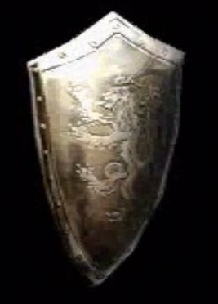
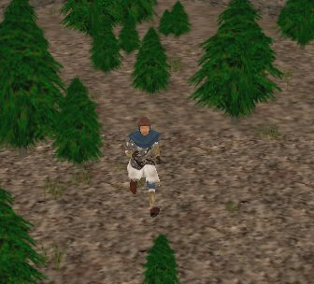
Animation Example
AVI and real time example

Slide 17
Movement
Specifies what animations to load at what time and what speeds they run at
Also supports the blending of one animation to another e.g. blending from a running character to a walking character
The movement interface supports the loading of movement scripts to allow the modification of the system after compile time

Slide 18
Movement Example
// Motion system configuration file
*TYPE_ID MotionConfig
*VERSION 1.0
// Motion table sets up motion types, modes and ranges for movement
*MOTION_TABLE {
// The following motion types exist
// Motion Type 0 - Terrestrial
// terrestrial motion type
*MOTION_TYPE {
*MOTION_TYPE_ID 0
// The following motion modes exist
// Motion Mode 0 - linear speed range
*MOTION_MODE {
*MOTION_MODE_ID 0
*MOTION_MODE_NAME "Default"
*MOTION_MODE_ANIMATION "idle_normal.kin"
*MOTION_RANGE {
*MOTION_RANGE_ID 1 // Nominal speed (m/s)
*RANGE 1.2 1.2
.......

Slide 19
Artificial Intelligence
Currently provides basic agent classes and filters that can be combined in finite state machines to aid in the building of the AI
AI support is primitive at the moment
Will be extended to include more extensive path-searching and order management

Slide 20
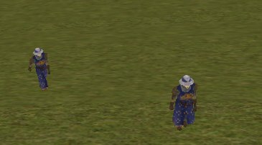
AI Example
Basic master/slave example

Slide 21
User Interface Components
Support for forms
Large number of supplied interface controls e.g. slider, push button etc
Support for user created controls
Bitmap and true-type font support
Drag’n’Drop support
Form creation tool included

Slide 22
Networking
MS DirectPlay and TCP/IP support
Provides an abstraction for these protocols

Slide 23
Development Timeline
Auran Jet beta 1 was released on 30 Sept 2000
Currently at Beta 2 released on 31 January 2001
Two release candidates are scheduled before the release of Auran Jet v1.0
No definite time for the 1.0 version release, expected around mid-late 2001

Slide 24
Potential Uses
Computer Games (obviously)
Multimedia applications
Virtual Environment simulations.
Anywhere a portable 2D/3D environment is needed

Slide 25
Licensing
• Still under development (like Jet itself) but the proposal is:
- Non Commercial Use: Free
- Educational Use: Free
- Commercial Use: $US 30,000 paid any time prior to shipment.
- A royalty based option is currently being considered.

Slide 26
JIVE
Jet Integrated Visual Environment
Allows the editing and creation of all Jet resource types
Also allows developers to easily develop plugins to modify resources that rely on the Jet architecture

Slide 27
Auran Jet Code
Framework
Written in C++
Overrides new and delete operations
Event/Listener interfaces for Input and actions.
Makes frequent use of multiple inheritance
Contains built-in error handler and log file reporting.

Slide 28
Main Task Functions
Init – Called once before the first update
Update – Called every cycle with the amount of time since the last cycle. Update fully completes before the next task update is executed.
Done – Called when the task manager (thread) is shutdown.

Slide 29
Example Application Code
OS windows(hInstance, lpCmdLine);
// Create the application object with a given name and operating system specific data
App theApp;
theApp.Init("ExStartup", &windows);
// Create an example task. The task is automatically added to the Jet task manager.
Task *exampleTask = NewMem(ExStartupTask);
// Run the main loop. This method will launch the Jet task manager and
// only return when the Jet engine has been shut down.
int result = theApp.Main();
// Release the example task
DeleteMemZ(exampleTask);

Slide 30
Example Application Running

Slide 31
What we’re using it for…
Aim is to provide an inference engine that can create virtual environments using a number of aesthetic descriptors
An aesthetic descriptor is simply a term that describes the way something looks

Slide 32
What we’re using it for…(cont’d)
Long term goal would be to specify the whole virtual world in a number of terms
E.g. Outdoor park at night with one big angry man and one small frightened man
Big task to create software to do this, and we’re only honours students so….

Slide 33
Our Project
Damian is concentrating on character generation and animation
Andrew is concentrating on lighting setup generation and dynamic lighting

