Slide 1
Final Honours Presentation
  Presenter:
  Damian Trebilco

Slide 2
Project Details
Bachelor of IT ( Honours )
Area Of Research : Computer Graphics Modeling
Project Title: “ Modeling Emotional Characters in Virtual Environments”
Principle Supervisor: Binh Pham
Secondary Supervisor: Ruth Christie

Slide 3

Introduction to Computer Graphics Modeling
Computer Graphics Modeling is the generation of the objects to be used in an scene/animation
ie. Buzz Lightyear from Toy Story

Slide 4
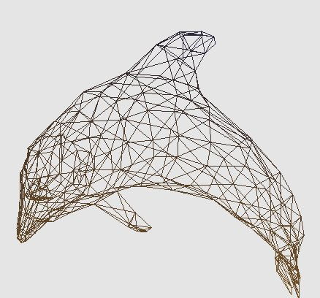
Introduction to Computer Graphics Modeling
This representation is usually done as a wireframe mesh, which is essentially a series of points connected by lines.
Modeling is not to be confused with computer rendering, which is the generation of the finished scene using these models.

Slide 5
Research Problem
In order to model objects successfully on a computer, an artist needs to understand technical computer concepts.
In fact, in order for the artist to produce realistic animations, the artist has to have an understanding of what computer techniques are available, how they work and how they interact! (a BIG task)

Slide 6
Research Aims and objectives
The aim of this research is to build a system to aid artists to model a scene.
This is a BIG area, so this project will focus on helping artists give their models “emotion”.
The objective is to build a system with an interface that accepts simple aesthetic/emotion descriptors which then alters the user’s models to match.

Slide 7
Research Aims and objectives
This system will be designed as a “virtual environment” where characters and objects move and interact.
Due to time restrictions on the project, only a few aesthetic/emotion keywords have been programmed.

Slide 8

So how could this research impact on you?
More realistic animations produced in movies and video.
Easier learning curve on animation packages.=> more animation diversity.
But.. Perhaps most importantly.. Games!
ie. Imagine Lara Croft expressing unique real-time emotions as she travels through different environments

Slide 9
Research Stages
This research was developed in three stages:
Emotion Model Deformation
Inference Engine
Virtual Environment

Slide 10
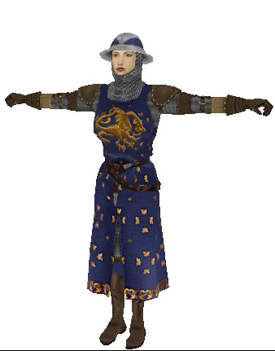
Emotion Model Deformation
This will involve the creation of a plugin into the game engine Auran Jet.
The research behind this development was done by personal experimentation and verified by evaluation.
Works by manipulating the underlying skeleton of a characters 3D mesh.

Slide 11
Inference Engine
The aim of the inference engine is to convert basic user input into data that can be passed to the emotion model.
This was developed by creating pre-defined data for certain emotions and interpolating to get the requested emotion at the requested influence.

Slide 12
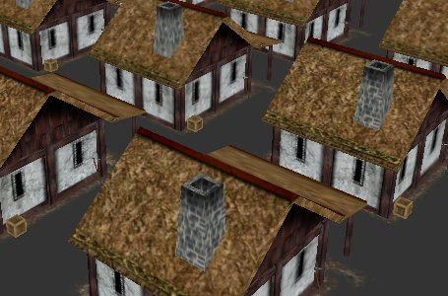
Virtual Environment
A Virtual Environment was created to demonstrate the previous steps in a working system.
This system randomly assigns objects, positions and emotions throughout the world.
User has the ability to change the global emotion and influence as well as individual emotions and influences.

Slide 13
Any Questions?
????

