Slide 1

Efficient Packet Sniffing With Wireshark
Devin Trejo
Devin.Trejo@temple.edu

Slide 2
Goals and Content
Goal:
Analyze NMAP scans network footprint in order to take steps to minimize possible detection when actively probing a network.
Content:
Wireshark Usage
Popular Filters
Coloring
Capture Summary
Wireshark Analysis of NMAP Scans
Discovery Scan
Popular Port Scan
Version Scan

Slide 3

Wireshark Usage
Popular Filters | Coloring | Capture Summary

Slide 4
Wireshark Popular Filters
ip.addr == 10.0.0.1 [Sets a filter for any packet with 10.0.0.1, as either the source or dest]
ip.src == 10.0.0.1 && ip.dest==10.0.0.2 [sets a conversation filter between the two defined IP addresses]
http or dns [sets a filter to display all http and dns]
tcp.port==4000 [sets a filter for any TCP packet with 4000 as a source or dest port]
tcp.flags.reset==1 [displays all TCP resets]
http.request [displays all HTTP GET requests]
tcp contains traffic [displays all TCP packets that contain the word ‘traffic’. Excellent when searching on a specific string or user ID]
!(arp or icmp or dns) [masks out arp, icmp, dns, or whatever other protocols may be background noise. Allowing you to focus on the traffic of interest]
udp contains 33:27:58 [sets a filter for the HEX values of 0x33 0x27 0x58 at any offset]
tcp.analysis.retransmission [displays all retransmissions in the trace. Helps when tracking down slow application performance and packet loss]

Slide 5
Wireshark Comparison Operators
English* | C-like* | Description and example
eg | == | Equal. ip.src==10.0.0.5
ne | != | Not equal. ip.src!=10.0.0.5
gt | > | Greater than. frame.len > 10
lt | < | Less than. frame.len < 128
ge | >= | Greater than or equal to. frame.len ge 0x100
le | <= | Less than or equal to. frame.len <= 0x20
*Note both English or C-Like definitions work within Wireshark.

Slide 6
Wireshark Logical Operators
English* | C-like* | Description and example
and | && | Logical AND. ip.src==10.0.0.5 and tcp.flags.fin
or | || | Logical OR. ip.scr==10.0.0.5 or ip.src==192.1.1.1
xor | ^^ | Logical XOR. tr.dst[0:3] == 0.6.29 xor tr.src[0:3] == 0.6.29
not | ! | Logical NOT. not llc
[…] | n/a | Substring Operator. After a label you can place a pair of brackets [] containing a comma separated list of range specifiers. Example: eth.src[0:3] == 00:00:83
*Note both English or C-Like definitions work within Wireshark.

Slide 7
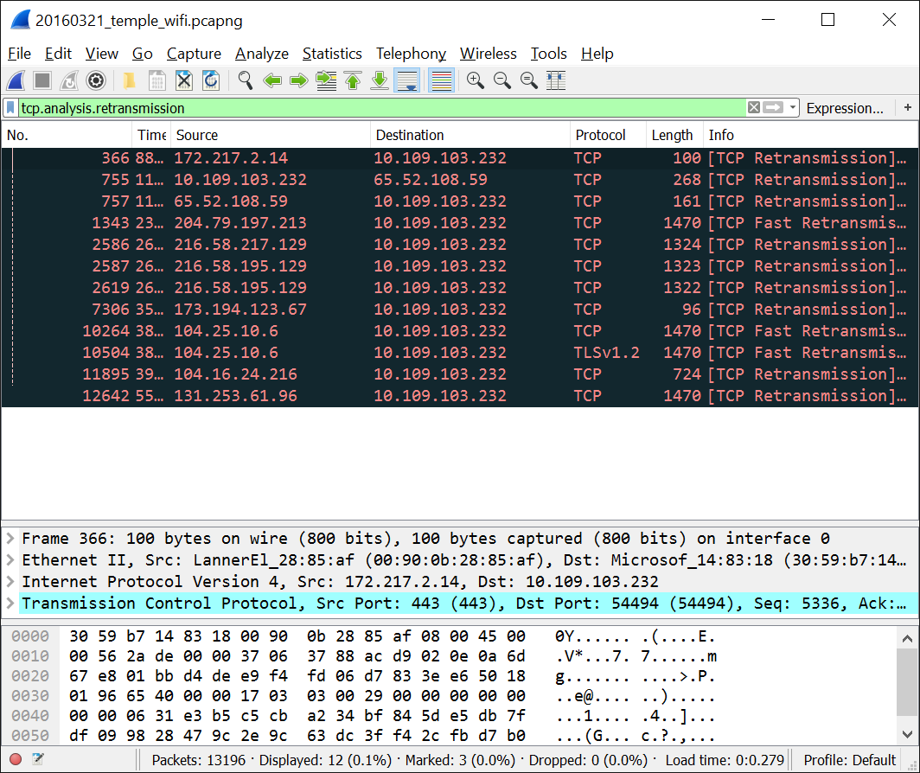
Wireshark Filters
Apply your filters using the Filter toolbar.
To the right:
Wireshark capture over a span of 10 mins on Temple’s tusecurewireless network.
Applying the retransmission filter we see only 12 TCP packets needed re-transmission during this time-frame.

Slide 8
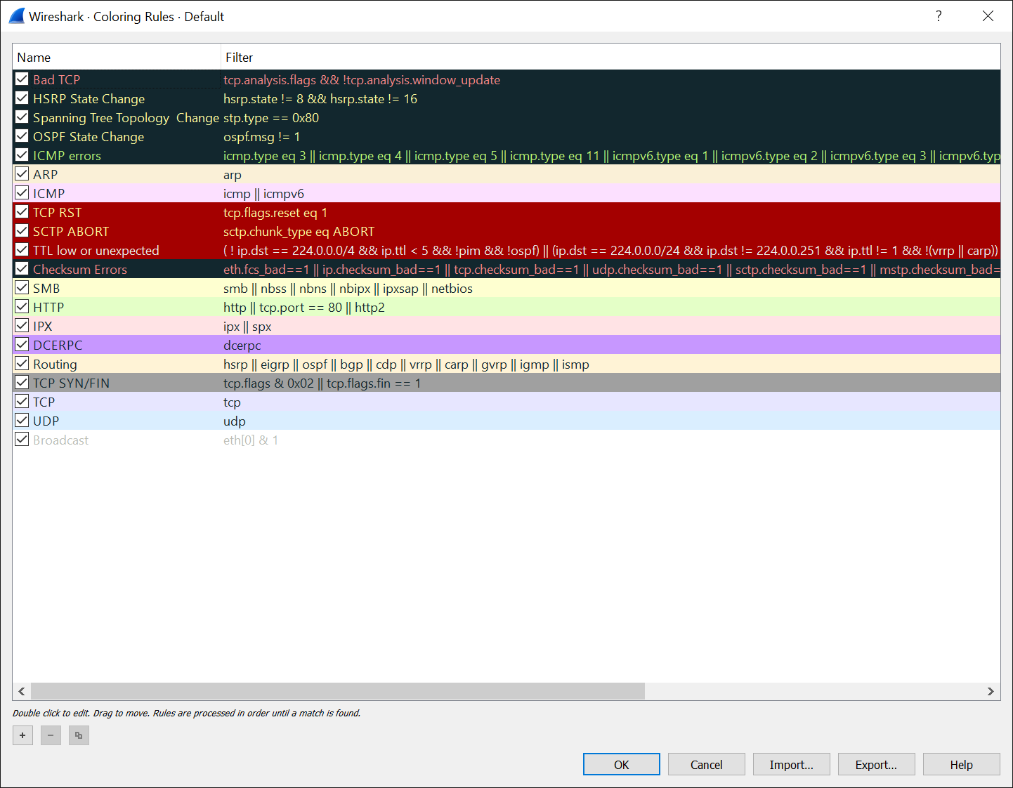
Wireshark Default Coloring
You can combine filters with Wireshark Coloring Rules to easily scan through Wireshark Dumps.
Wireshark uses a default color scheme shown to the right.
Coloring Rules:
[ToolBar] View -> Coloring Rules

Slide 9
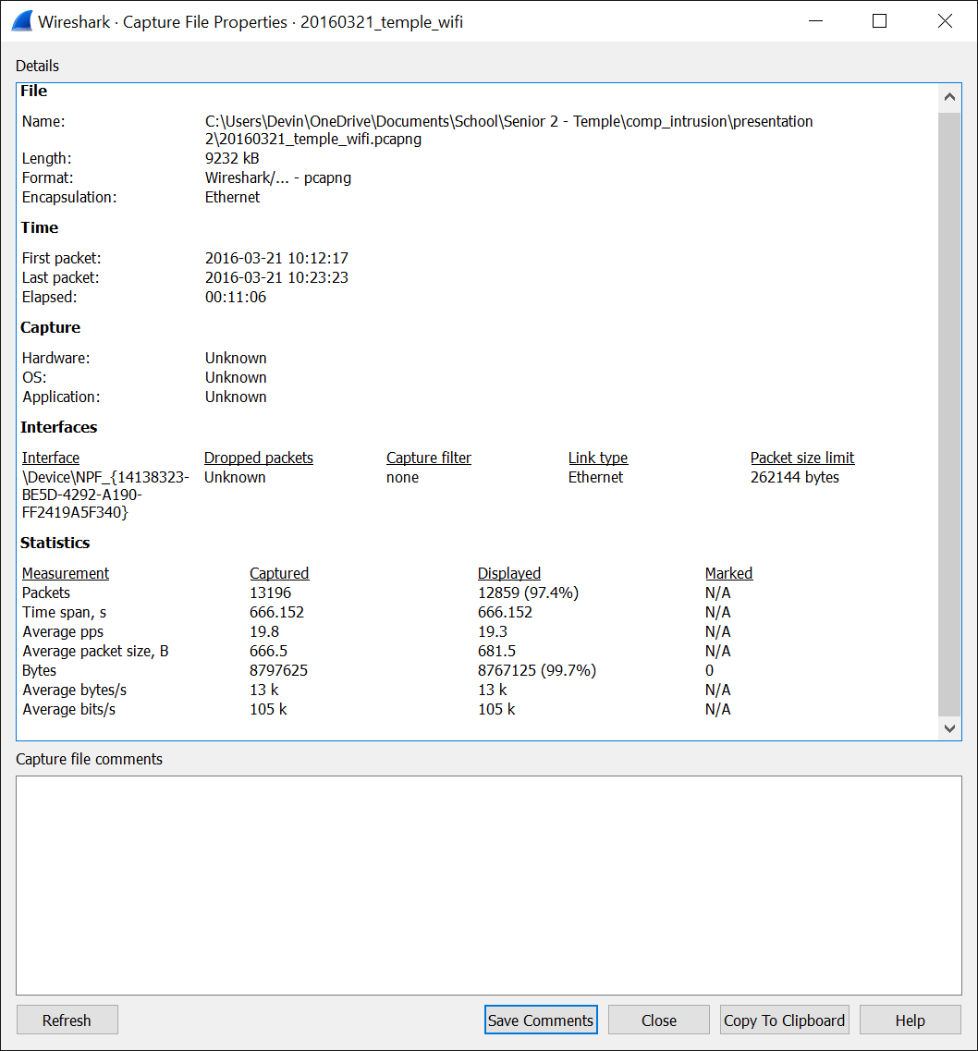
Wireshark Capture Summary
Capture summary shows important statistics like:
Packet Count
Time Span
Average packets per second (PPS)
Bytes Transferred
Average Bytes per second
Capture Summary:
[ToolBar] Statistics -> Capture File Properties

Slide 10
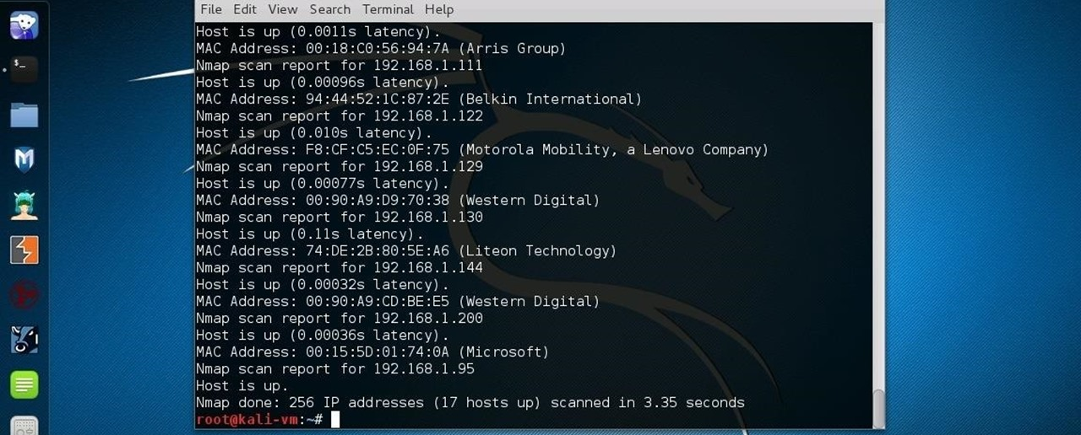
Wireshark Analysis of NMAP Scans

Slide 11
Virtual Network Environment
Client # | Hostname | Linux Kernel Version | NMAP Predicted Kernel | MAC Address | IPv4 Address
0 | Metasploitable0 | 2.6.24.16-server | Linux 2.6.X | 08:00:27:0a:c4:ee | 10.10.10.102
1 | Metasploitable1 | 2.6.24.16-server | Linux 2.6.X | 08:00:27:ea:5f:0d | 10.10.10.100
2 | Metasploitable2 | 2.6.24.16-server | Linux 2.6.X | 08:00:27:42:4b:fc | 10.10.10.104
3 | Ubuntu 14.04.4 LTS | 4.2.0-27-generic | Too Many Fingerprints | 08:00:27:be:90:e1 | 10.10.10.105
4 | Centos 7 | 3.10.0-327.el7.x86_64 | Linux 3.X|4.X | 08:00:27:32:6d:5b | 10.10.10.106
5 | Kali Linux | 4.3.0-kalil-686-pae | Too Many Fingerprints | 08:00:27:94:5b:ba | 10.10.10.103

Slide 12
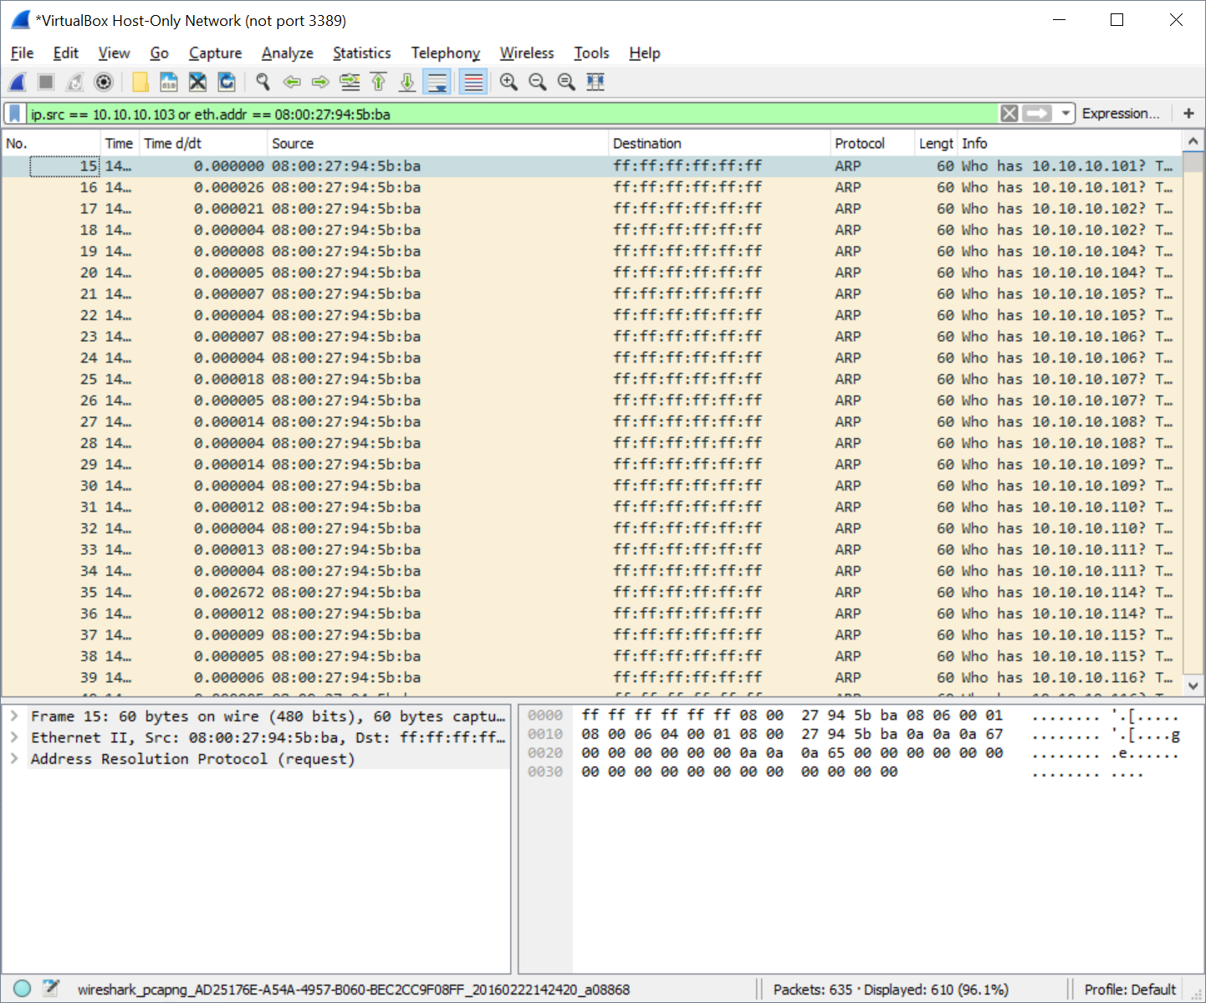
NMAP Discovery Scan
NMAP Discovery Scan Command:
$ nmap –sP 10.10.10.[100-255]
Uses ARP protocol (Brown) to broadcast a message to all clients with a “Who has 10.10.10.[100-255]”.
ARP Request Protocol occurs at the transport layer of the TCP/IP stack so there are no associated IPv4 address with ‘src/dest’ fields. We instead add a filter by MAC address.
Wireshark Filter:
“ip.src == 10.10.10.103 or eth.addr == 08:00:27:94:5b:ba”

Slide 13
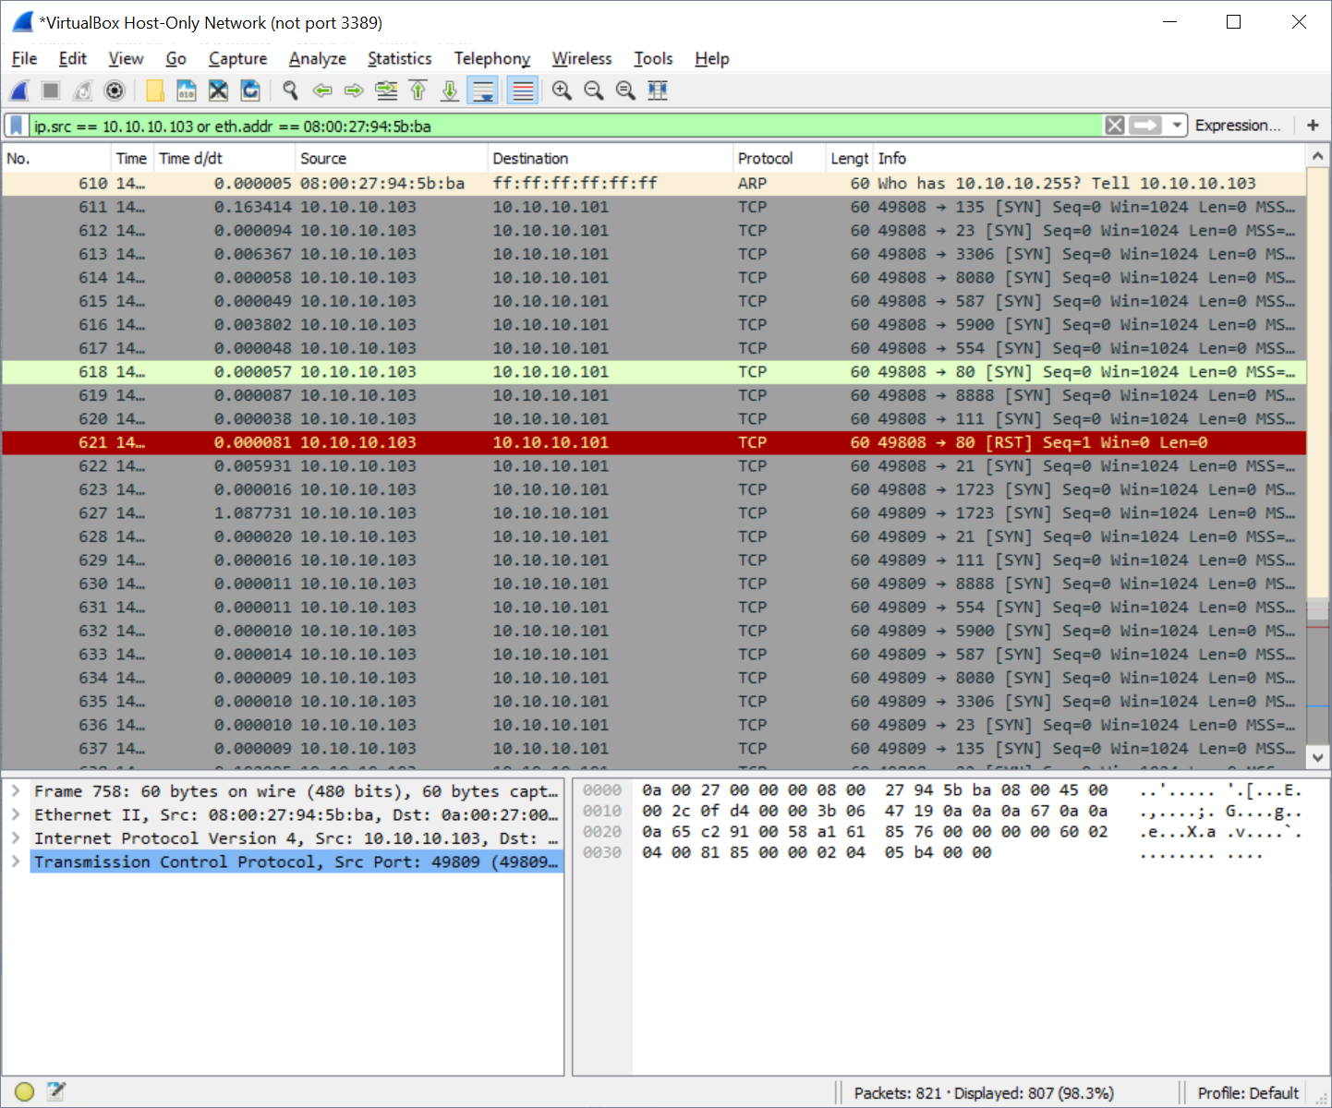
NMAP Popular Port Scan
NMAP Popular Port Scan Command:
$ nmap –nF 10.10.10.[100-255]
Packets 619 and 630 are both addressing port 8888 going to different hosts probing to see if that port is open.
Wireshark Filter:
“ip.src == 10.10.10.103 or eth.addr == 08:00:27:94:5b:ba”

Slide 14
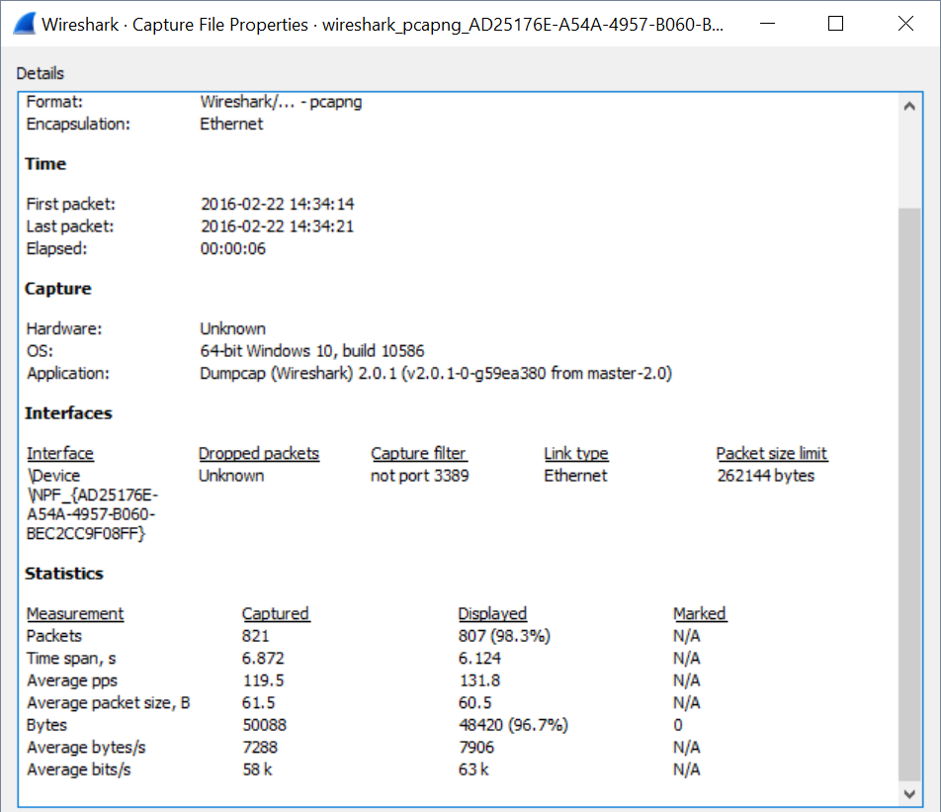
NMAP Popular Port Scan
NMAP Popular Port Scan Command:
$ nmap –nF 10.10.10.[100-255]
For each test run we can analyze the packet count, time span, and bytes sent.

Slide 15
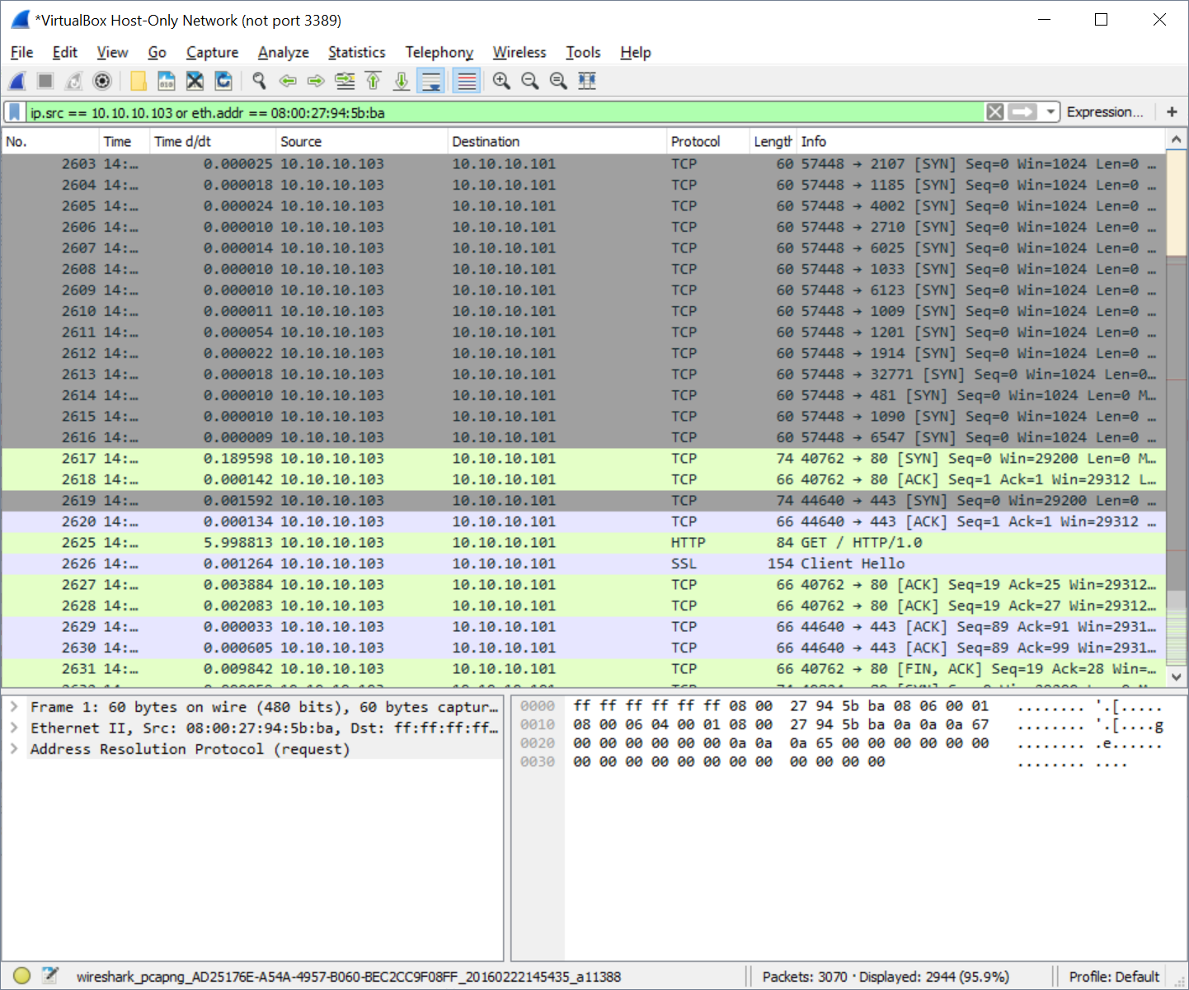
NMAP Version Check Scan
NMAP Version Check Scan Command:
$ nmap -nsV 10.10.10.[100-255]
Steps taken by Version Check Scan:
Runs Discovery Scan.
Runs Full Port scan.
Finally checks for versions for services running behind open ports.
Packet 2617 we see the stop of the port scan and the start of the version check scan.
Highly Parallel.
Includes TCP and UDP protocols
Capable of deciphering services behind encryption layer.

Slide 16

Wireshark NMAP Scans Summary
NMAP Scan Type | Packet Count | Run-Time (secs) | Bytes Transferred
Discovery Scan | 610 | 1.49 | 36.600 KB
Popular Port Scan | 807 | 3.58 | 48.420 KB
Version Check Scan | 2944 | 123.34 | 182.688 KB

Slide 17
References
[1] D. Trejo, "[ECE 5526] NMAP Network Footprint and A Recon on Metasploitable," 29 February 2016. [Online]. Available: http://www.tdevin.com/blog/2016/2/29/ece-5526-nmap-network-footprint-and-a-recon-on-metasploitable [Accessed 21 March 2016].
[2] C. Greer, "Top 10 Wireshark Filters," 3 April 2010. [Online]. Available: http://www.lovemytool.com/blog/2010/04/top-10-wireshark-filters-by-chris-greer.html. [Accessed 21 March 2016].
[3] Wireshark.org, "6.4. Building display filter expressions," [Online]. Available: https://www.wireshark.org/docs/wsug_html_chunked/ChWorkBuildDisplayFilterSection.html. [Accessed 1 March 2016].

