Slide 1



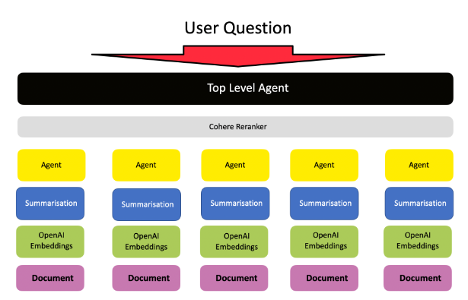
Chart of Account – gen Ai Crew
LATS or ReAct
UserProxyAgent
ChartBuilderAgent
AccountStoreAgent
Vector Store
Lower Level:
CoA Agent
Web Access
LATS or ReAct
ValidationAgent
Lower Level:
IFRS Knowledge
User
Planning
Group Chat Manager

Slide 2
Invoice Recorder– gen Ai Crew
LATS or ReAct
UserProxyAgent
ChartBuilderAgent
AccountStoreAgent
Vector Store
Lower Level:
Invoice Parser
Web Access
LATS or ReAct
ValidationAgent
Lower Level:
IFRS Knowledge
User
Planning
Group Chat Manager

