Slide 1
Predicting the cost for housing
David Trinidad, W207 Fall 2022

Slide 2
Outline
Problem Motivation
Dataset description
Solution/approach description
Experiments
Conclusions drawn as a result of the experiments/data analysis

Slide 3
Problem Motivation
General introduction to the competition
Why did I choose this?

Slide 4

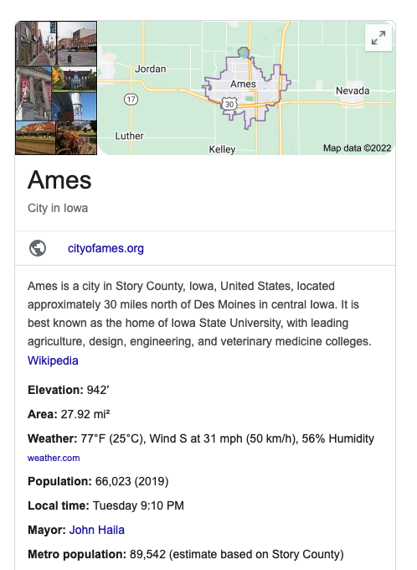
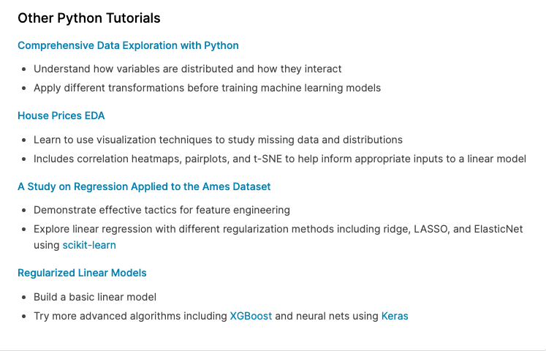
The Housing Prices Competition (link) is an ongoing competition that has over 4,391 competitors with over 22K entries.
It’s a regression problem that utilizes root mean squared error as a metric for predicting Sales Price.
I liked this project because it’s pretty straight forward being that we’re working on regression techniques, it’s pretty reflective of what the data sets i'm presented with in supply chain (S&OP)
There’s a lot of helpful tips, tutorials, and documentation on the kaggle page
Notes:
Why did I choose this data set?
-I chose this project merely because it was straight forward, and since I was to work on this solo, it would be something I could finish.

Slide 5
Data Description
Descriptions of the Data Features?
What I initially saw Issues with the data?
Baseline Submission Results:

Slide 6
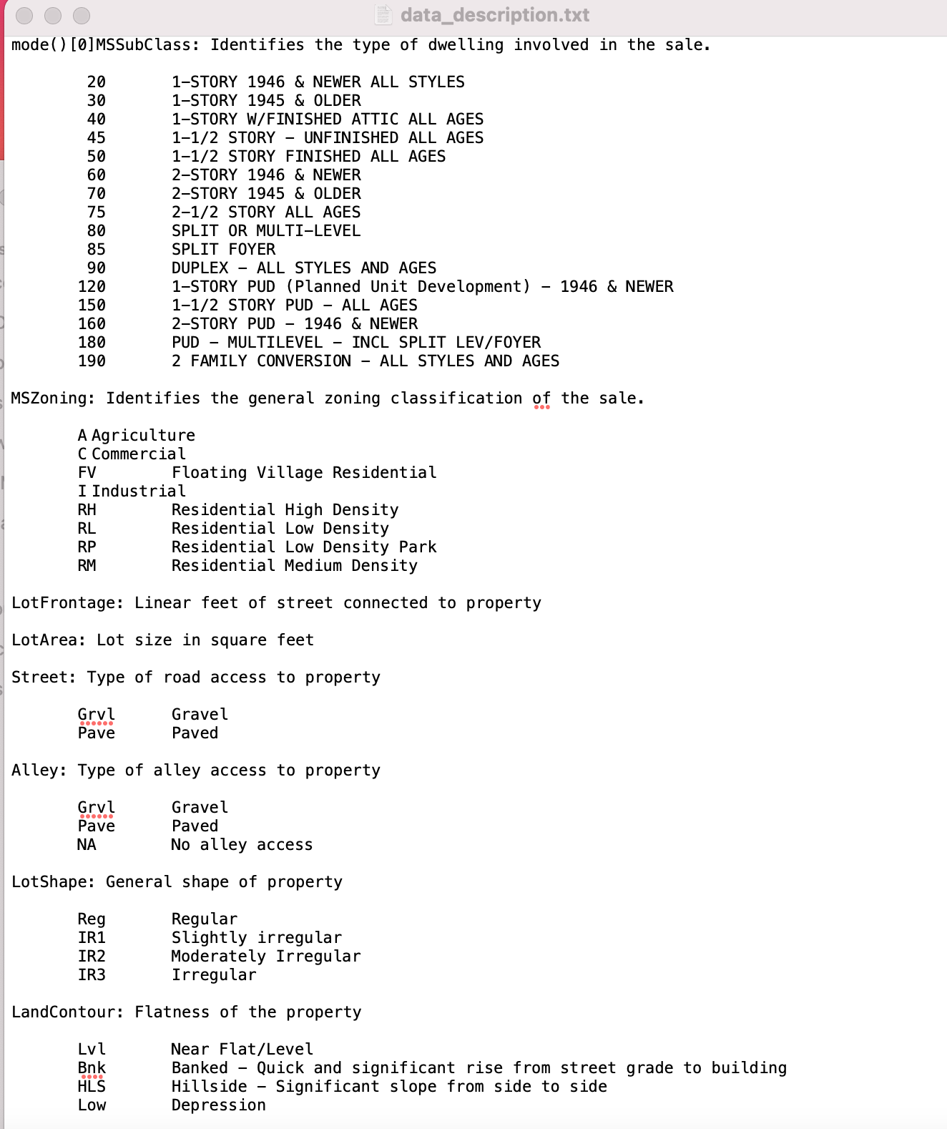
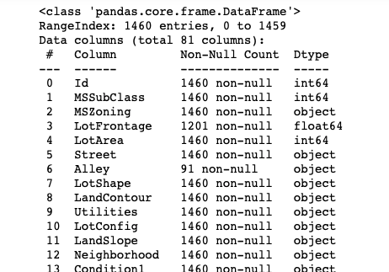
Documentation
Data set contains information from the Ames Assessor's Office for individual residential properties sold in Ames, Iowa from 2006 - 2010
Kaggle provides a data description text as part of the data package.
There are 81 features containing numeric, and categorical data (nominal and ordinal)
Some numerical features are actually categorical
NA has different context and likely to be confused as null

Slide 7
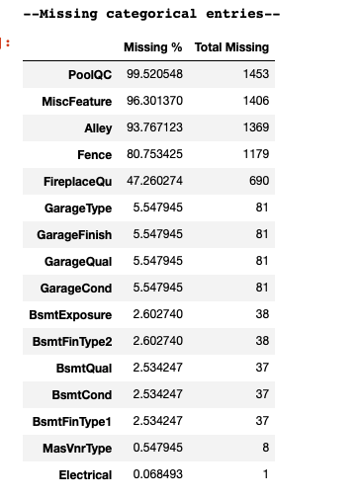
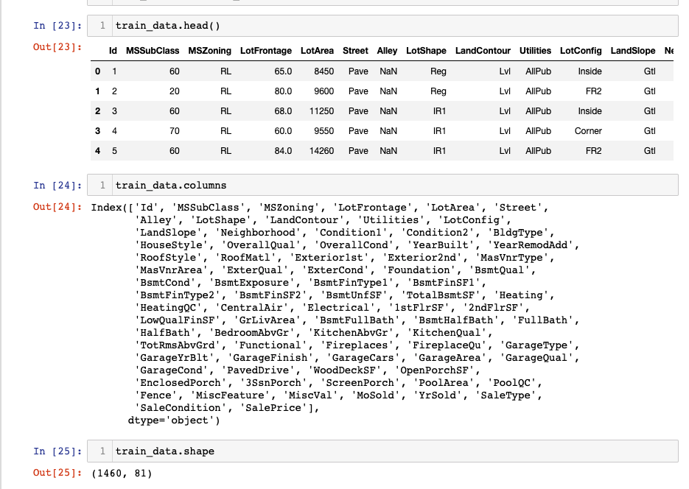
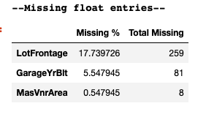
Missing Values (training.csv)
Training data set: 1460 rows 81 columns
38 numerical, 43 categorical
Basic queries for missing and null values can’t be done upfront.

Slide 8
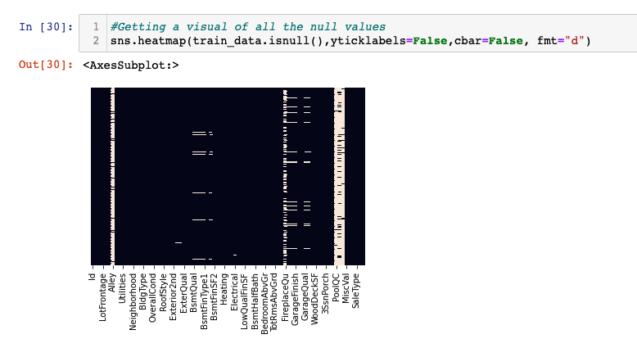
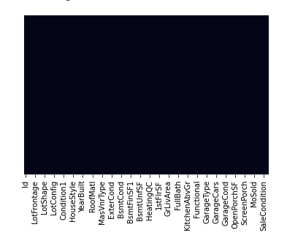
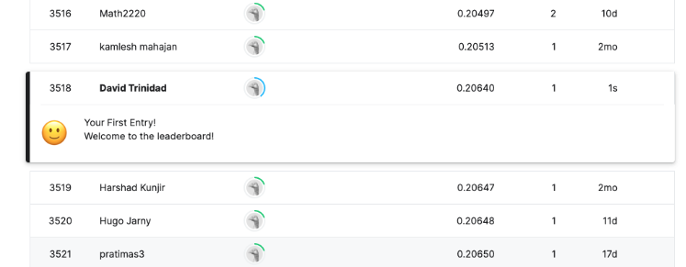
Baseline Submission
Goal: Just to get a baseline score
Loaded the dataset
Checked for null values
Dropped features that had >1000 NA
Converted Categorical/Object data into integers
Filled NAs with “0”
Split training data into training & Dev sets
Preformed Linear Regression
Submitted CSV file to Kaggle

Slide 9
Solution/Approach Description
Handling missing values
EDA
Visualize Response Variable (‘SalePrice’)
Correlation Matrix
Data Cleaning
Creating New Feature Columns
Converted Numerical Data to Categorical Strings
Label Encoding
Address Missing Values
Identify features with missing values (truly missing)

Slide 10
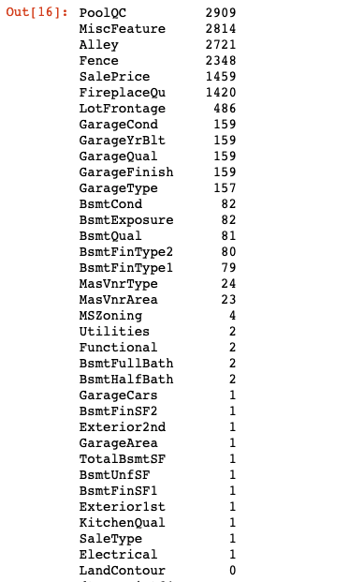
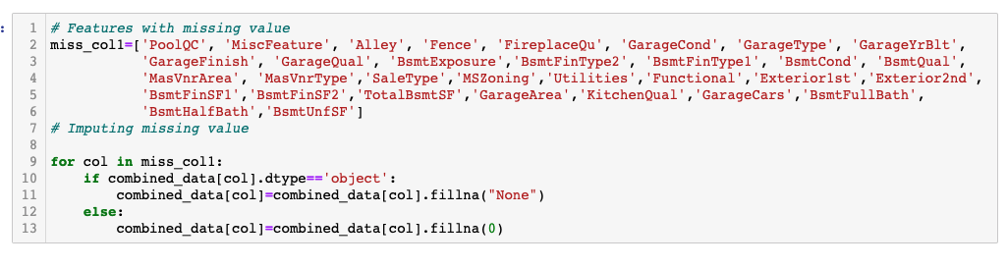
Missing Values
To clean this up created looped through all columns and filled dtype[‘object’] with “None”. In the beginning I was filling all the ‘na’ with “0” as if it were really null however as stated in the earlier slides, “NA” could mean different things while Pandas will treat it as missing data

Slide 11
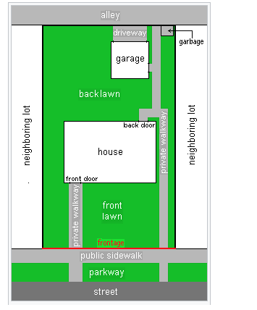
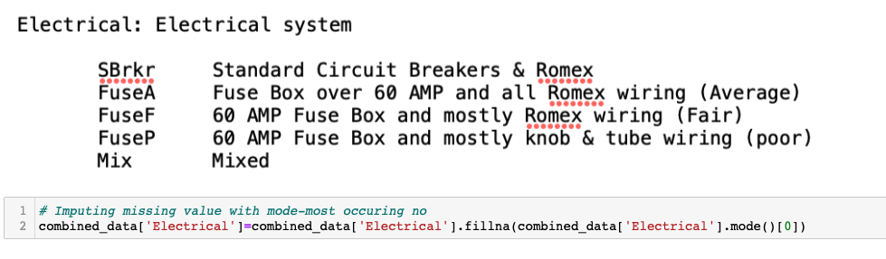
LotFrontage
Missing Values
'Electrical'- Describes the electrical system in the house. There are 5 features where 3 of them are ranked from poor to average whereas the other two don't provide any context on how they rank out of the three. So in this instance i will just treat it as a categorical and fill the missing values with the mode
'LotFrontage'- by definition is the boudary in front of the plot adjacent to the home. I think it would be a safe assumption to use the median value of the neighborhood to fill in these missing values

Slide 12
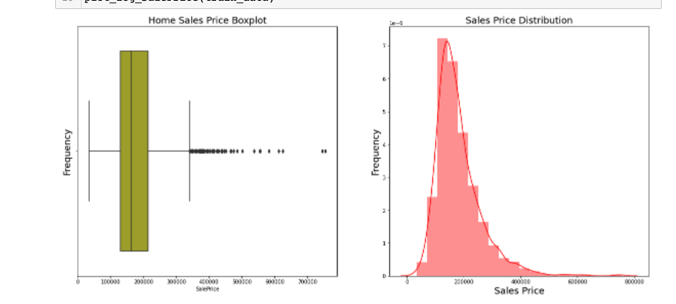
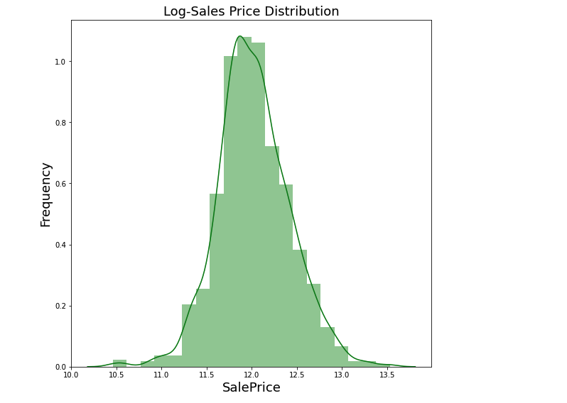
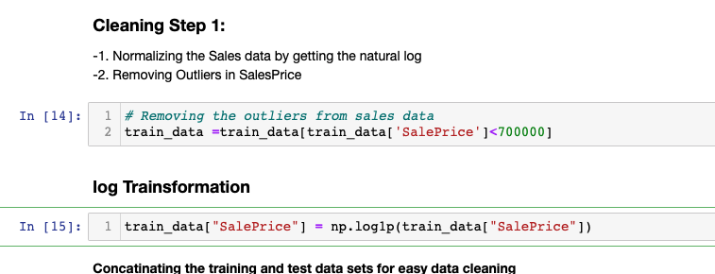
Visualizing the Response Variable
Visualizing the Sales Price Data. The Box plot shows that there are two outliers. I also see a bell shaped curve with a right tail.
I decided to take the log of the Sales Price to help normalize the data

Slide 13
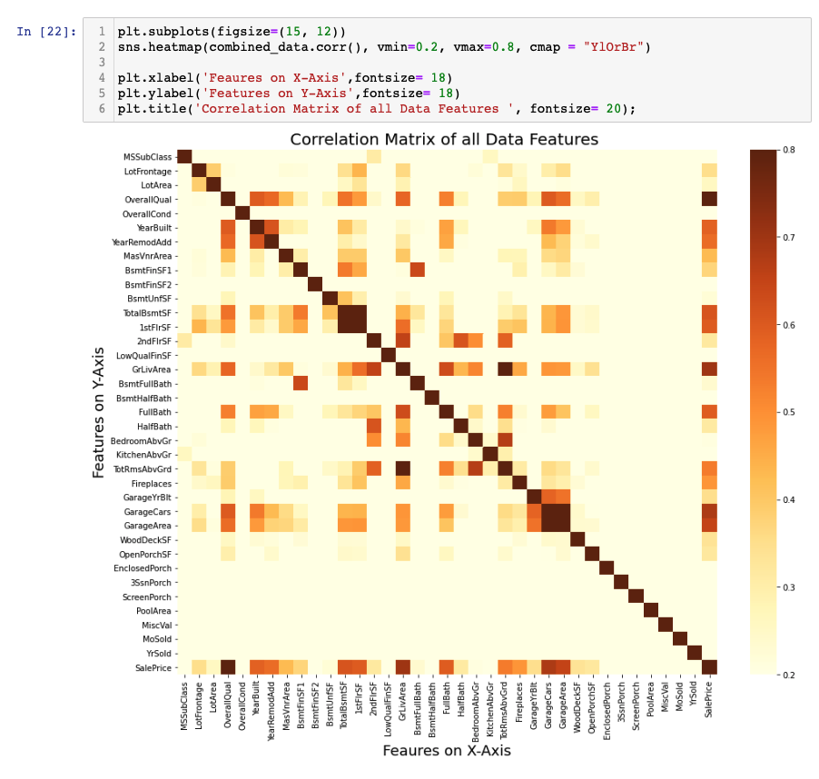
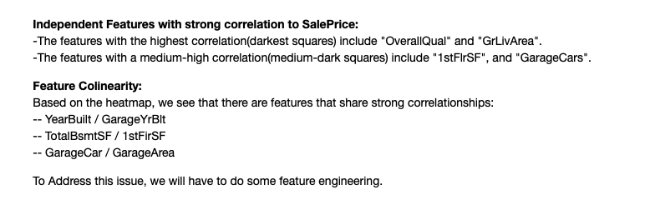
EDA- Data Visualization (cont)
I Plotted a Correlation matrix between all data features to see which ones have a strong connection to sales price.

Slide 14
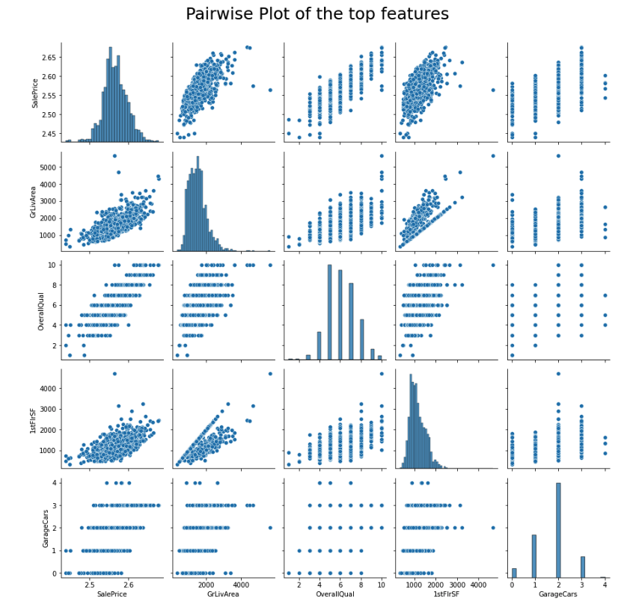
EDA - Visualizing the features that strongly correlated to sales price
Here I plotted a pairwise plot to get a better insight on Ground Living area, 1st floor Square Footage, Garage Cars
-each feature has a positive correlation to the response variable.
-each feature also displays a bell shaped histogram
-I also see some obvious outliers for Groundliving space and 1stFloor Square Footage.

Slide 15
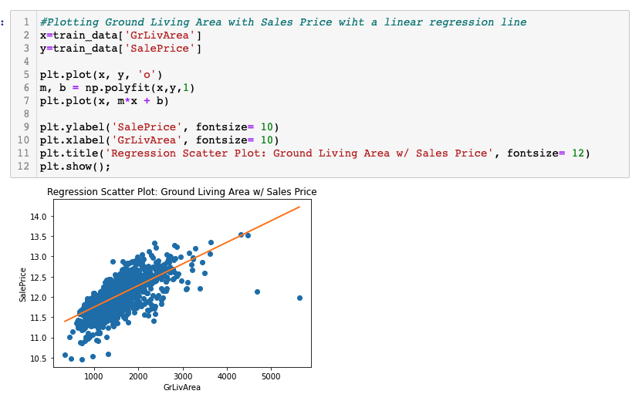
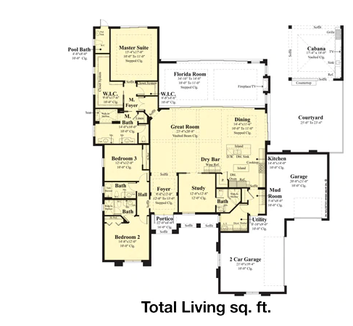
EDA- Data Visualization of Ground Living Area
[GrLivArea] captures the square footage of the ground living area. This only includes the total living area on the ground floor of the house (excluding basement, and garage)
Here we see two outliers which in my first few iterations, however doing so resulted in a lower RMSE score. This leads me to believe that cutting off those outliers could mean that I’m leaving out some important information

Slide 16
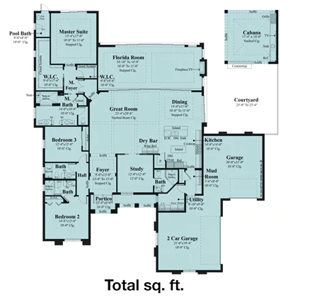
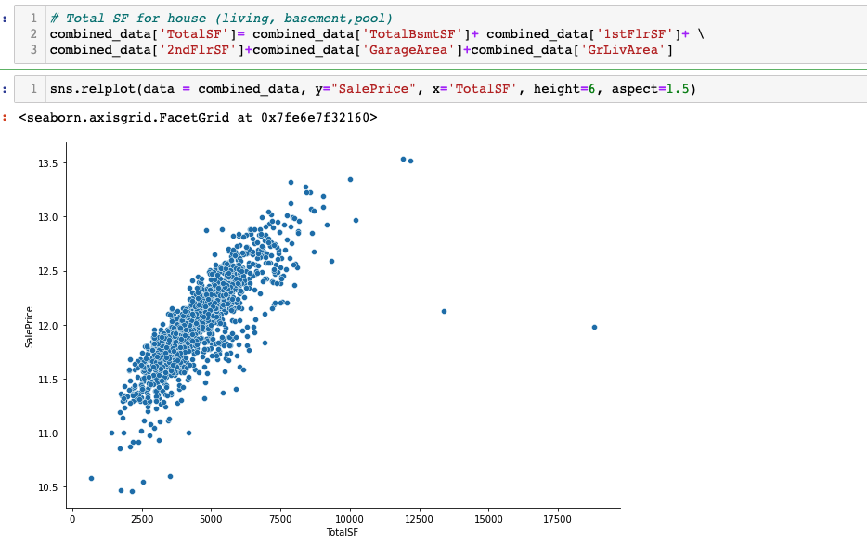
Creating New Data Features
TotalSF [total Square Footage] - Created a new data feature for combining the specific features that are measured in Square Feet to represent the overall square feet of the property. footage since it has an influence on price as you can see on the scatter plot.

Slide 17
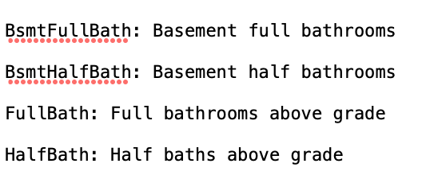
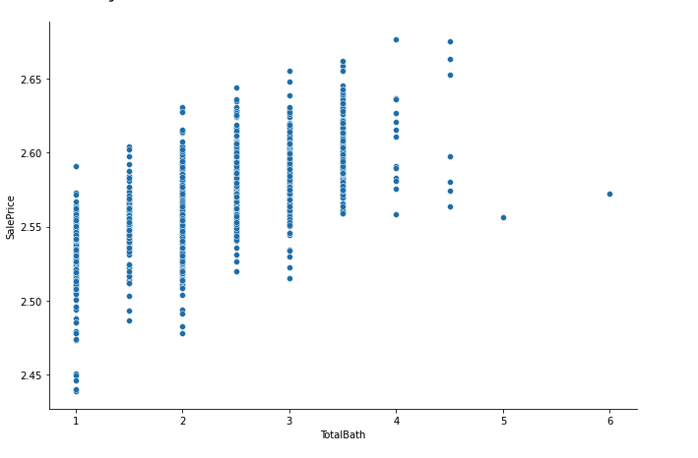
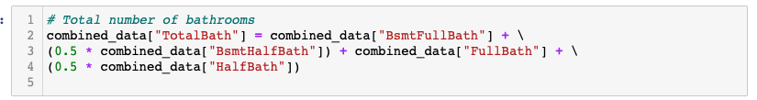
Creating New Data Features: Combining all Bathroom Features to one column
TotalBath [total number of bathrooms] - By virtue of combining features to simplify the dataset, I combined all the bathrooms.
*Note- This was actually omitted from the final dataset since it did lead to a lower RMSE score from Kaggle

Slide 18
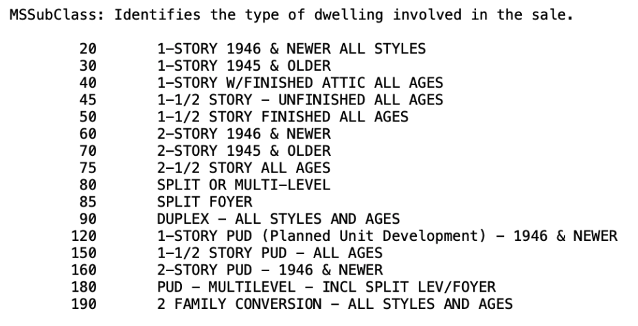
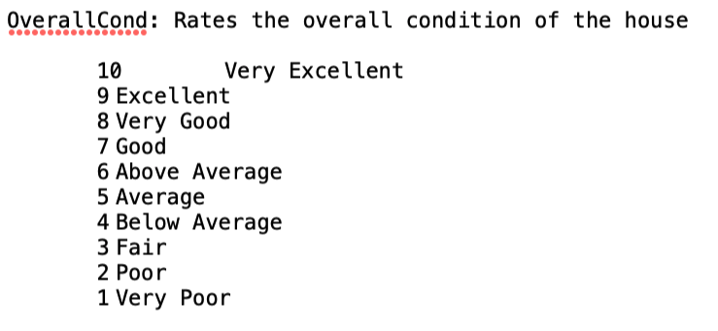


Converting Numerical data to Categorical
Within the dataset there were a few columns that were read as numerical but were actually categorical. For this instance, I converted them to strings. From here I can then apply them to the encoding method on the next slide

Slide 19
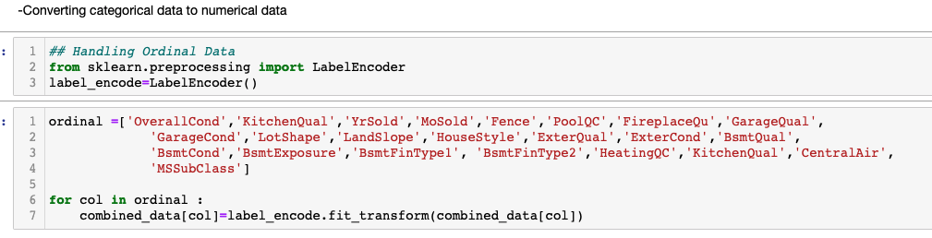
Label Encoding for Ordinal Variables
The Last step of the Data Preparation process is converting the categorical labels into into a numeric. My dataset now can be apple to machine learning models.

Slide 20
Summary of Data Preparation
Normalized “SalePrice” by taking the natural log of the data
Removed Outliers: [Sales data (>7000), GrLivArea (>4500)]
Missing Features:
Added “None” to null object features
Added “0” to null numeric features
‘LotFrontage’- filled the median value from the neighborhood feature column
‘Electrical’ - Filled the median value with the mode
Created New Feature
“TotalSF”: [1stFlrSF, 2ndFlrSF, ‘GarageArea’, GrLivArea’]
“TotalBath:” ["BsmtFullBath"] + ["BsmtHalfBath"]) ["FullBath"] + "HalfBath"]
Converted Numerical Data to Categorical Strings
MSSubClass, OverallCond, YrSold, MoSold
Label Encoding for Ordinal features using sklearn LabelEncoder, and pandas.get_dummies

Slide 21
Model Development and testing workflow
Calculate Root mean Squared with default params and 5 fold cross validation
—--------------------------
Models:
Lasso,
Random Forest,
Elastic Net,
Kernel Ridge
Gradient Boosting
Use GridSearchCV method to Find The best Parameters for each model
Calculate Root mean Squared using best parameter output from GridSearchCV.
Start: Data Cleaning and Feature Engineering
Submit Prediction and check result
Make Prediction using the model with the lowest RMSE
This diagram describes the iterative process of data cleaning through model development. The Regression models I will be using to make my prediction include Lasso, Random Forest, Elastic Net, Kernel Ridge, and Gradient Boosting.
For every score I received from my prediction, would lead me to alter my training data set. There was a lot of trial and error during this phase

Slide 22
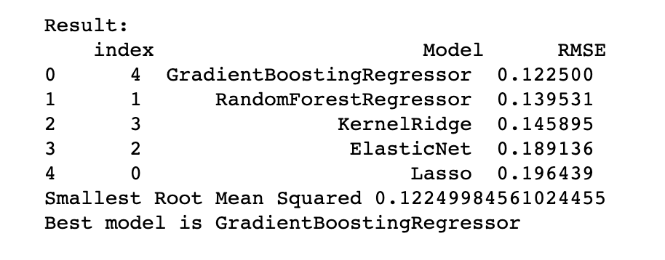
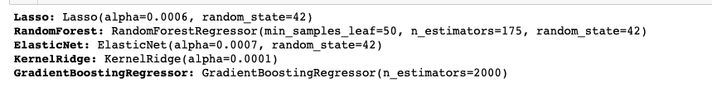
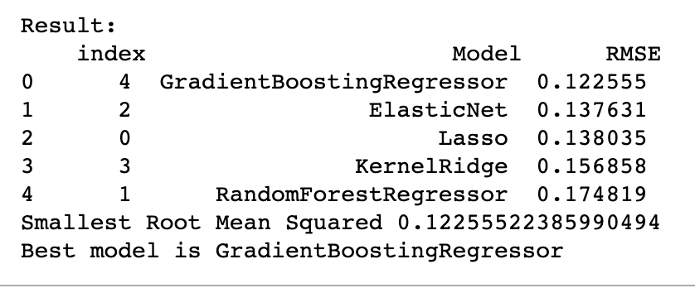
Result: The gradientBoostingRegressor turned out to be the best model
RSME using Default
Results from GridSearchCV
Regression Models Ranked after using New parameters
The Gradient Boosting Regressor came out on top. Interestingly the default parameters and parameters from the GridSearchCV are almost the same.

Slide 23
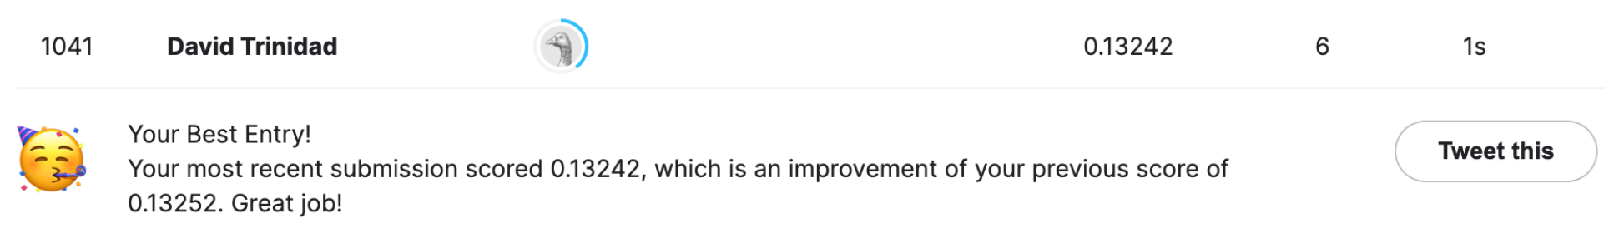
Comparing Baseline Score and Final
Baseline Entry
Final Entry
Considering how popular this dataset is, and how many people have entered being ranked 1041 out of 4391 isn’t too bad. I do intend to continue to refine my model to improve my score.

Slide 24
Trial and error Experimentation -
Things that I tried but lead to worse scores
Using Averages (mean) | To fill in missing values for numerical data, I found better results using the median number over the average. It’s likely that this helped limit bias from my prediction
Removing Outliers | During the EDA process I dove deep into a lot of the numerical data. I initially tried to set ranges to exclude them however in most cases this resulted in worse scores. For example there were two outliers for ground floor square foot which originally I excluded, but lead to an accuracy worse than my baseline.
Generating New Features/combining features | -Combining the bathroom data features (i.e. halfbath, full bath…) -Combining Quality Grade Features (OverallQual, GaraeQual…)
Removing Columns | In the beginning I just removed columns from the set that either had very little correlation or had too many missing values. However, doing that likely removed area

Slide 25
Further improvements to be made
Given time constraints and personal circumstances there are some things I wish I could have implemented.
Turn my code into a software package for easier implementation
Applying other supervised ML methods like SVM and Neural Network
Applying Dimensionality Reduction (PCA)
Explore deep learning and clustering techniques
Improve the Categorical Feature encoding or imputation. For example assigning more meaningful values which would require so research.

