Slide 1

Bash command processing
Course Project on the Introduction to Data Science course, fall 2020 Dmitrijs trizna, Phuong Pham and Sara pyykölä

Slide 2
Bash in a nutshell
A command line interpreter*
Popular and efficient classic
Special structure
Notes:
First off, to understand our project, you need to know what we really are processing. So what is bash and what is command? 1. Bash, as in Bourne Again SHell, is a command line interpreter, shortly put shell. That means that Bash translates pieces of a text written by the user, called commands, to different actions within the computer; just like what would happen when an user clicks an application icon, but now via one line of text. 2. Bash can nowadays be used with many different operating systems and it has been around over 30 years, so it has attracted a wide popularity and is known for its efficiency and speed. Bash has even made an appearance in the Matrix: Reloaded -movie in 2003! 3. Bash commands have a special structure, which makes them unique. The structure has many intricate details, like aliases, different prefixes and order and values of the text, which makes bash commands very condensed and fast to write, but time-consuming in the terms of reading and learning of it.

Slide 3
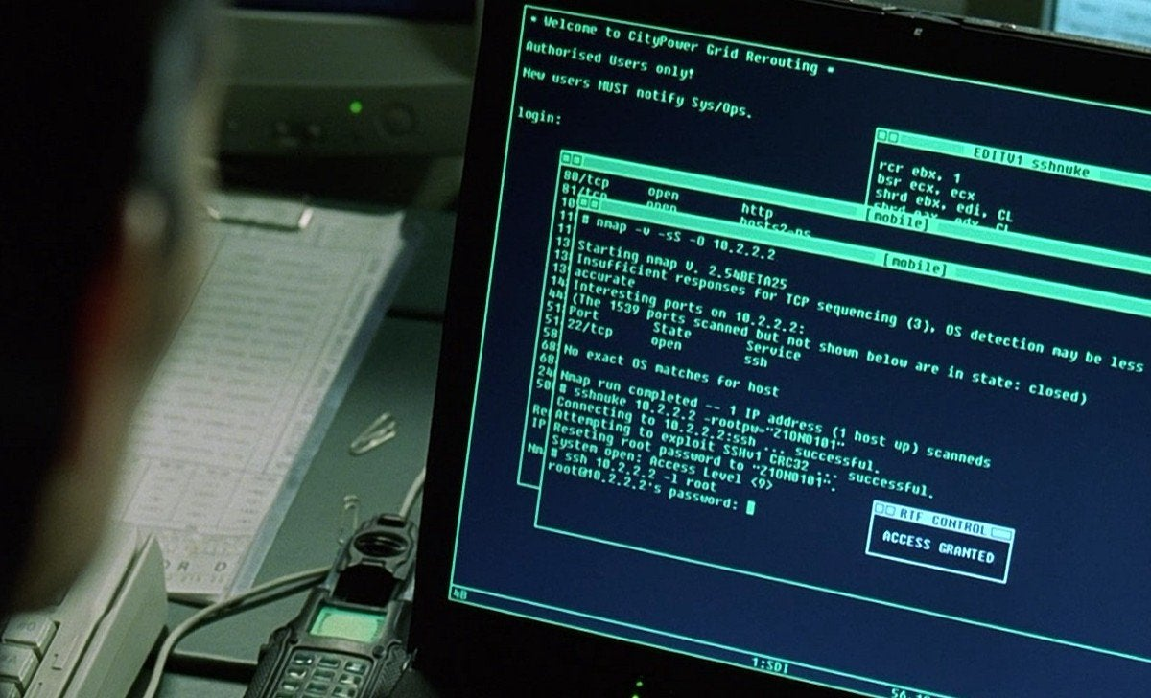
Bash IN A NUTSHELL
Notes:
First off, to understand our project, you need to know what we really are processing. So what is bash and what is command? 1. Bash, as in Bourne Again SHell, is a command line interpreter, shortly put shell. That means that Bash translates pieces of a text written by the user, called commands, to different actions within the computer; just like what would happen when an user clicks an application icon, but now via one line of text. 2. Bash can nowadays be used with many different operating systems and it has been around over 30 years, so it has attracted a wide popularity and is known for its efficiency and speed. Bash has even made an appearance in the Matrix: Reloaded -movie in 2003! 3. Bash commands have a special structure, which makes them unique. The structure has many intricate details, like aliases, different prefixes and order and values of the text, which makes bash commands very condensed and fast to write, but time-consuming in the terms of reading and learning of it.

Slide 4
ENGINEERING PROBLEM
How to transform this…
To this?
for a in `find . -name '*.py'` ; do cp "$a" "$a.cp" ; echo "Added line" > "$a" ; cat "$a.cp" >> "$a"; rm "$a.cp"; done
[1, 0, 2, 382, 54, 0.12, 0.045, 3, 14, 228, 907, 0.899, 0.22, 1.55, 493, ...]
Notes:
1. As such, bash commands have no ready-made automated tool to process or analyze them and implementing machine learning models on them can as such be tricky: how we can modify something that is a mix of natural language and a code to a format understood by a machine learning model? This has proved an interesting niche for engineers looking for new ways to benefit from bash and a specific point of view for cybersecurity specialists, since bash is used in many applications’ programming.

Slide 5
Our Project
Problem
Solution
Applications
No tools to pre-process bash commands
Pre-processing library
Engineering, Education, Security
Notes:
2. Our solution and the goal of this project was then to create the most basic form of this new tool with some machine learning models in it, ready to be applied straight out of the box, 3. which in turn could assist computer engineers, security specialists and educational personnel with regards to the machine learning and the usage of bash.

Slide 6
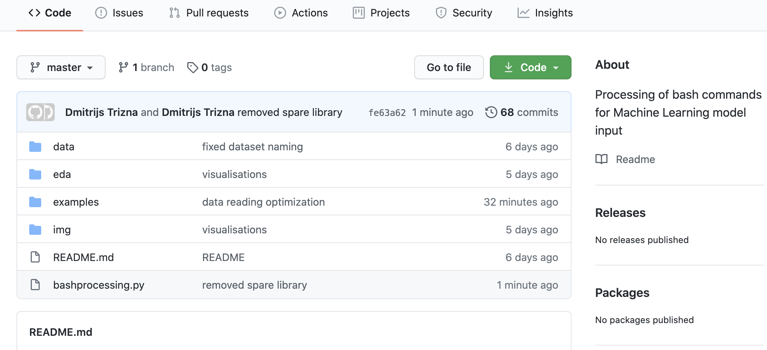
REPOSITORY AVAILABLE TO EVERYONE ..
Notes:
Without further ado, let’s present our tool!

Slide 7
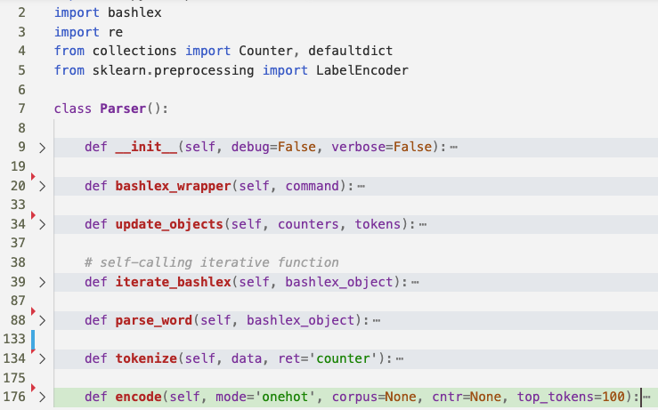
noticeable amount of code...
Notes:
Without further ado, let’s present our tool!

Slide 8
NOW YOU CAN ...

Slide 9
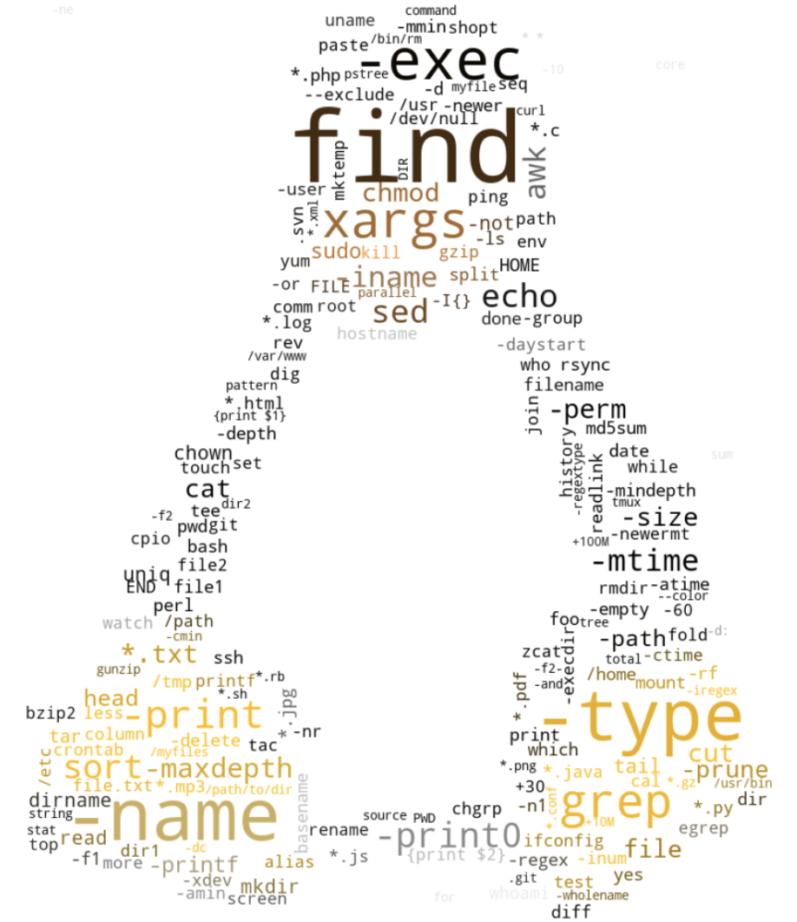
TOKENIZE
Notes:
Once we had our tool and classifiers ready, we made some analysis on the data. First off we made an analysis to find the most frequent commands in the data set. Bonus points for those who recognize the shape of word cloud, not that we’re counting anything ;)

Slide 10
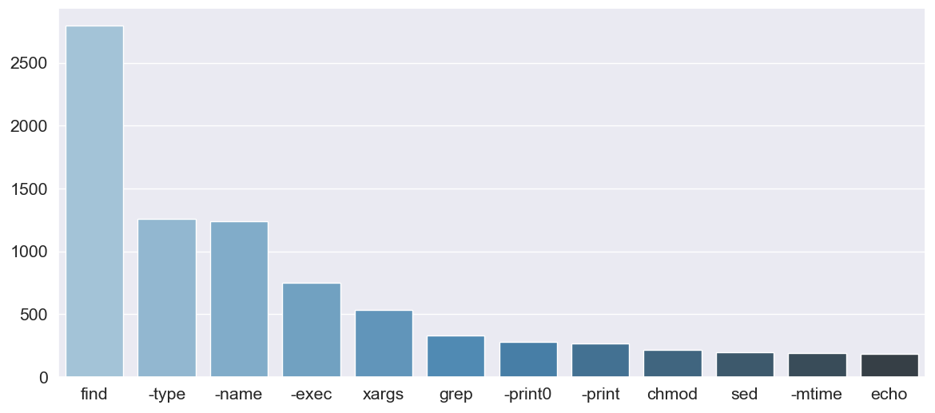
COUNT
Notes:
Here is a bar chart of most common elements in the data, counted as absolute occurrences.

Slide 11
ENCODe: EASY AS 3 lines of code
>>> onehot[0]
array([1, 1, 0, 0, 0, 0, 1, 0, 0, 1, 0, 0, 0, ....
>>> pprint(tfidf) # in proc
...
‘for’: 0.214608098422191,
'–exec’: 0.899112344311334,
...
>>> data_corpus[0]
['top', '-b', '-d2', '-s1', '|', 'sed', '-e', '1,/USERNAME/d', '|', 'sed', '-e', '1,/^$/d’]
Notes:
Without further ado, let’s present our tool!

Slide 12
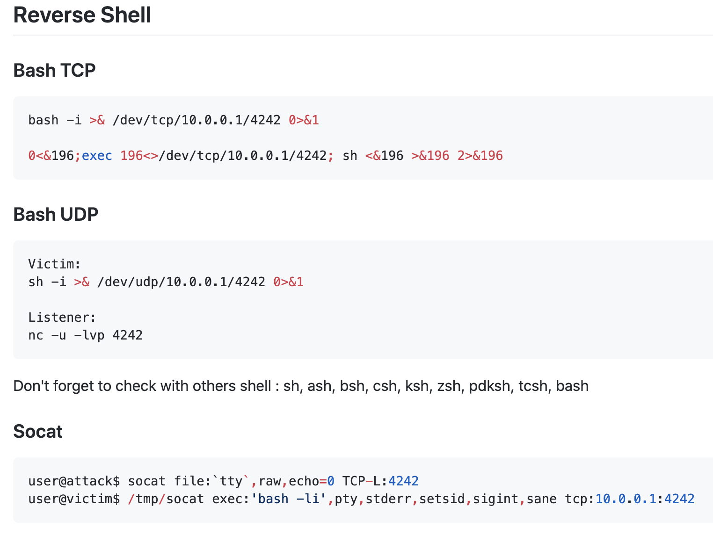
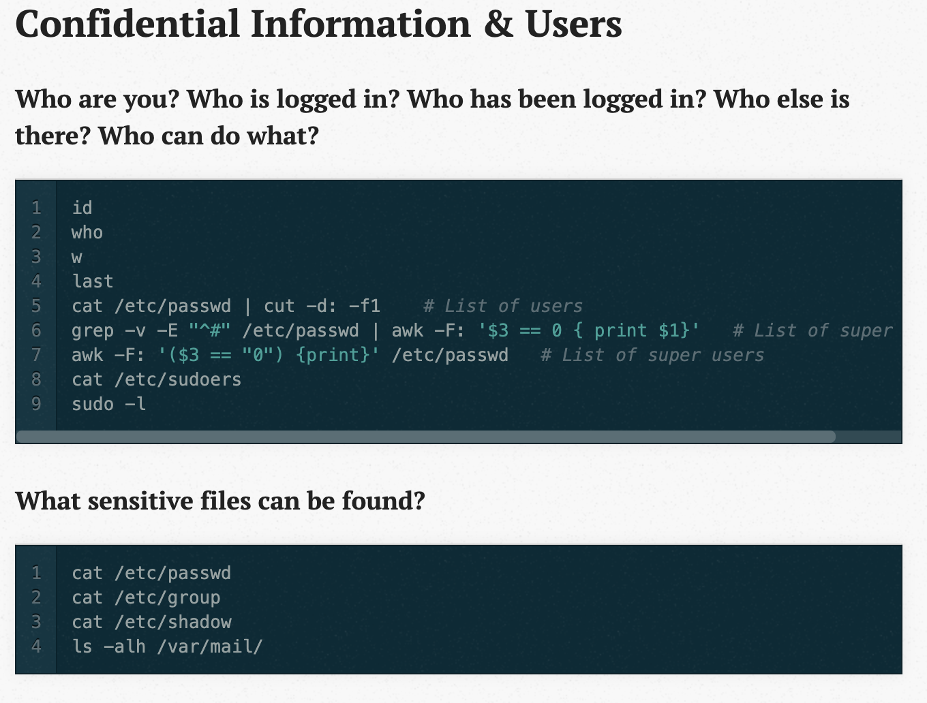
Proof of concept: SECURITY classification

Slide 13
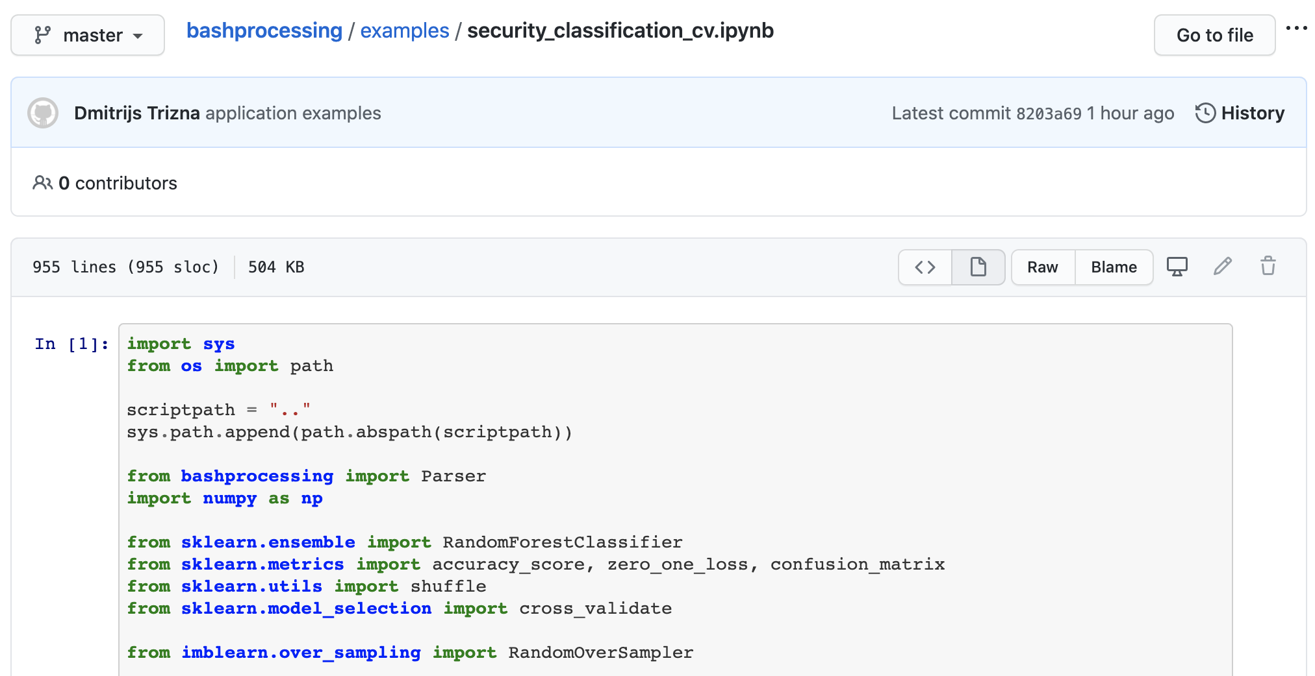
Proof of concept: SECURITY classification

Slide 14

Proof of concept: SECURITY classification
% python3 examples/security_classification_tpot_pipeline.py
[!] Preprocessing of dataset... 12729\12730 [!] Dataset oversampling... [!] Training with cross validation...
test_accuracy: 0.995 % train_accuracy: 0.9971 %
test_f1: 0.6983 % train_f1: 0.8306 %
test_precision: 0.853 % train_precision: 0.9539 %
test_recall: 0.6103 % train_recall: 0.7362 %

Slide 15
FUTURE WORK ON LIBRARY
Add TF-IDF encoding (IN PROCESS)
Release to PyPi (so you can just ..):
pip install bashprocessing
POS tagger (FLAG, VALUE, BINARY, etc.)

Slide 16

The END! Thank you for watching! Any questions?

Slide 17
Sources
Our project technical report & GitHub repository: https://github.com/dtrizna/bashprocessing
Bashlex parsing library: https://github.com/idank/bashlex
NL2Bash paper and dataset: https://arxiv.org/abs/1802.08979, https://github.com/TellinaTool/nl2bash
Malicious commands:
https://blog.g0tmi1k.com/2011/08/basic-linux-privilege-escalation/
https://github.com/swisskyrepo/PayloadsAllTheThings/blob/master/Methodology%20and%20Resources/Reverse%20Shell%20Cheatsheet.md
https://github.com/rebootuser/LinEnum/blob/master/LinEnum.sh
Matrix screenshot: https://www.reddit.com/r/MovieDetails/comments/7s2qem/matrix_reloaded_using_the_real_crc32_exploit_to/

