Slide 1
My Contacts UCF
COP 4331 GROUP 3

Slide 2
Members
Irene Tanner : Project Manager & Front-end Design
Dylan Roberts : Javascript & UML & helped with API
Nathan Cunanan : HTML & CSS
Chris Gardner: SQL Testing and API
Andres Olano : Database & Hosting
Matthew Stone : API and Testing
Ajay Ammanuel : Javascript
Bryan Ocbina : API and Testing
Notes:
Dylan will mention Irene, and then talk about himself, and then will pass it off to Nathan, then down this powerpoint list. Ajay and Bryan will be near the end, and closest to the computer. For remainder of powerpoint, just motion to either Ajay or Bryan when to go to next slide.

Slide 3
Basics
Stack: LAMP
Successes: Database, Front End Design, Communication
Difficulties: API, Version Control, Backups
Notes:
Dylan will speak.

Slide 4
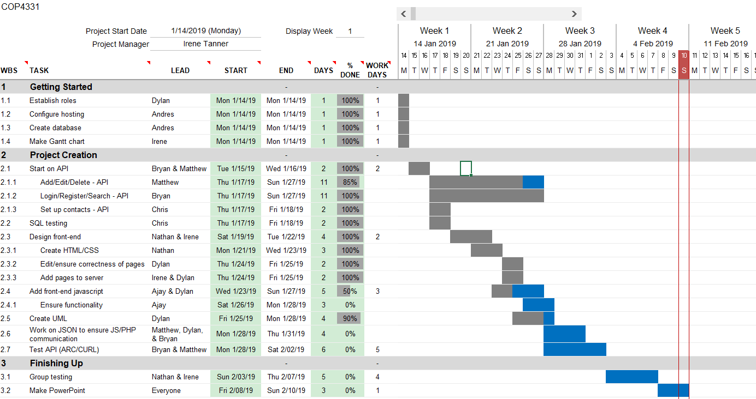
Gantt Chart
Notes:
Dylan will talk about this

Slide 5

Front-End Design (HTML & CSS)
Bootstrap was used in this project to aid in the layout/design for Cascading Style Sheets (CSS)
Used the Sublime Text application to create the HTML and CSS of the Front-End design
Not having the right margin for texts or input boxes centered were fixed by identifying the suitable coordinates using testing in Google Chrome
Notes:
Nathan will speak

Slide 6
SQL Injections
Common attack vector on web-based applications
Attack on user inputs to access unauthorized information
Prepared Statements
Prepare
Bind
Execute
Example
$query = $connection->prepare("INSERT INTO User(UserName, Password, FName, LName) VALUES (?,?,?,?)");
Notes:
Bryan will cover

Slide 7
Password Security
Built-in php password hash/verify functions
Passwords are hashed using Bcrypt as opposed to MD-5
MD-5 is cryptographically broken
Bcrypt is an algorithm specifically designed for handling passwords
Salt and high work factors built-in
high work factors make it incredibly difficult to brute-force
Notes:
Bryan will cover

Slide 8
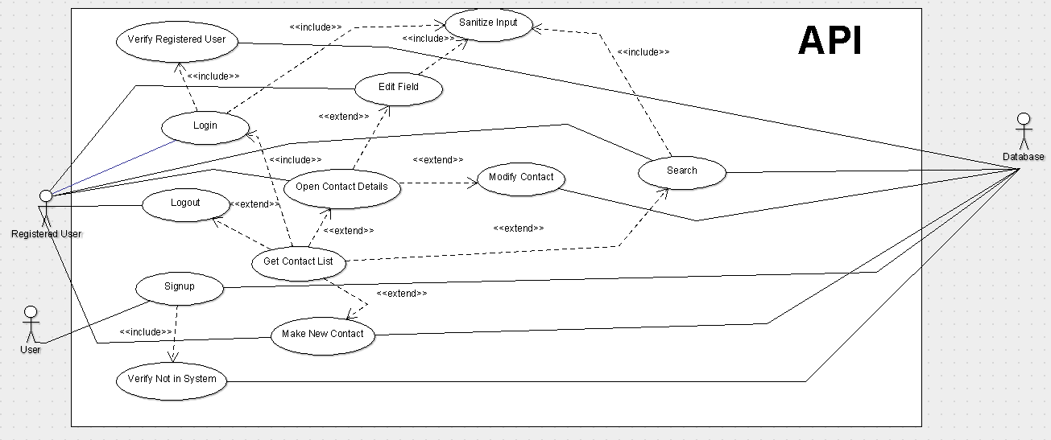
UML
Notes:
Dylan will talk about this

Slide 9
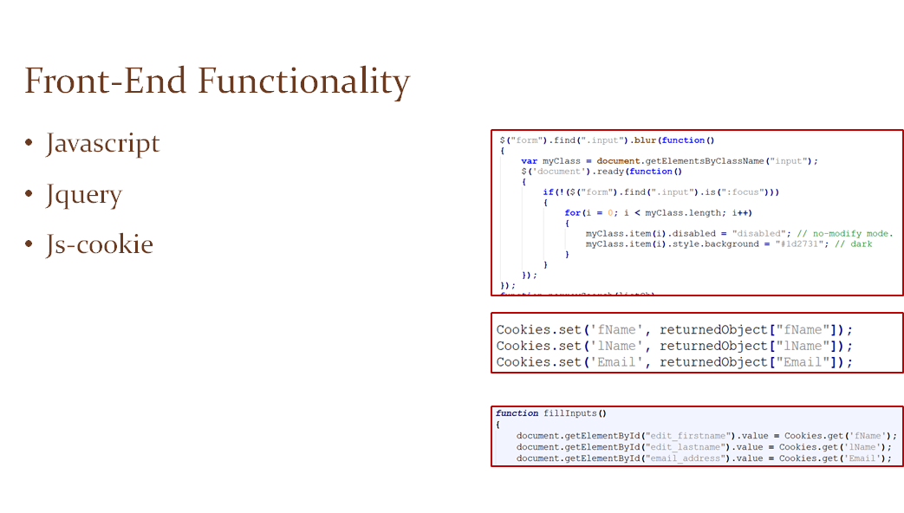
Notes:
Dylan will talk about this

Slide 10
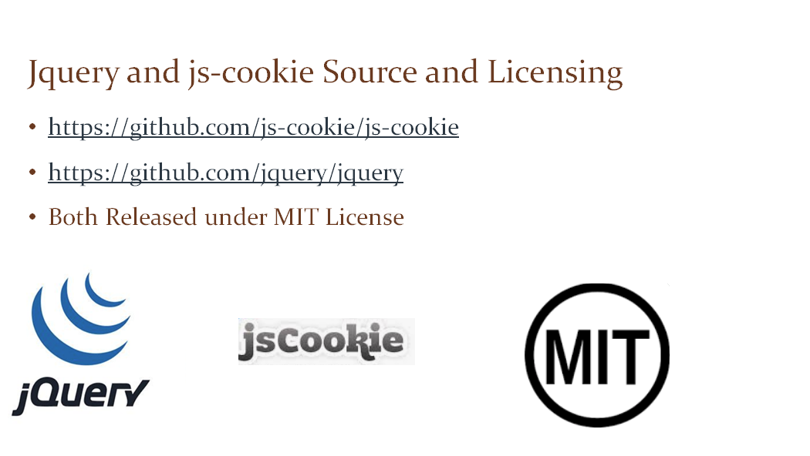
Notes:
Dylan will talk about this

Slide 11
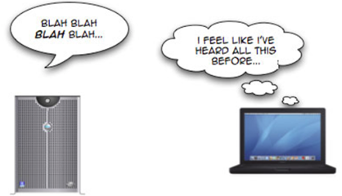
Javascript Difficulties
Front-end functionality challenges:
Toggling Editing Mode
Browser Cache
Notes:
Dylan will talk about this

Slide 12


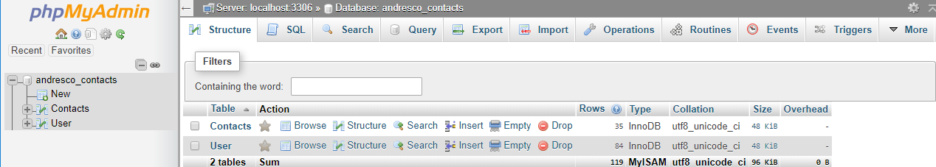
Database & Hosting
HostGator
Comodo SSL Certificate
MySQL
PhpMyAdmin
Notes:
Andres will speak

Slide 13
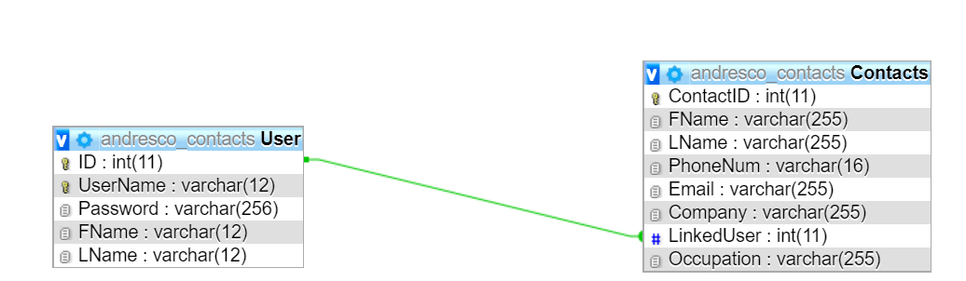
ERD
Notes:
Andres will speak

Slide 14
Demo
https://www.mycontactsucf.com
ARC Testing
Post https://mycontactsucf.com/mainPHP.php
{
"apiRequestType": "verifyValidGetContactListForUser",
"UserName":"DEMO",
"Password":"UCF"
}
Notes:
First, Bryan will do the ARC test. Then Ajay will do the application demo

Slide 15
Questions?
Notes:
anyone can answer a question so long as it’s within their expertise

