Slide 1
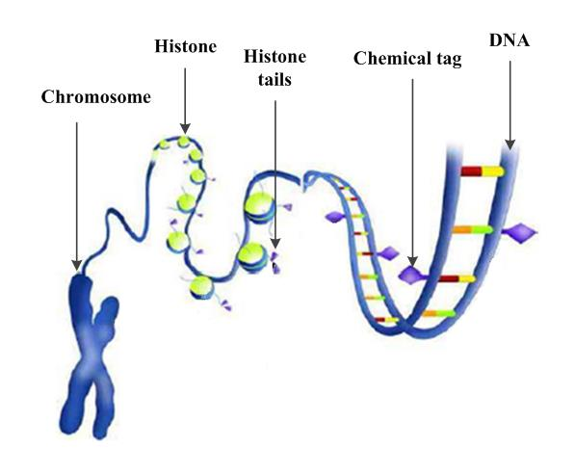
PROJECT REPORT
Solving Equations Using Genetic Algorithms
Course | : | Project 1
Course ID | : | IT3910E
Instructor | : | Assoc. Prof. Tran Dinh Khang
Group | : | HelaX

Slide 2

Table of Contents
Introduction
Method
Results
Discussion
Conclusion

Slide 3




1. Introduction
$$f\left(x\right)=0$$
$$→x=?$$
$$f(x)$$
is an elementary function (polynomial, trigonometric,…)
$$x$$
is a real root of the equation

Slide 4

2. Method
2.1. Input Handling
2.2. Genetic Algorithm

Slide 5
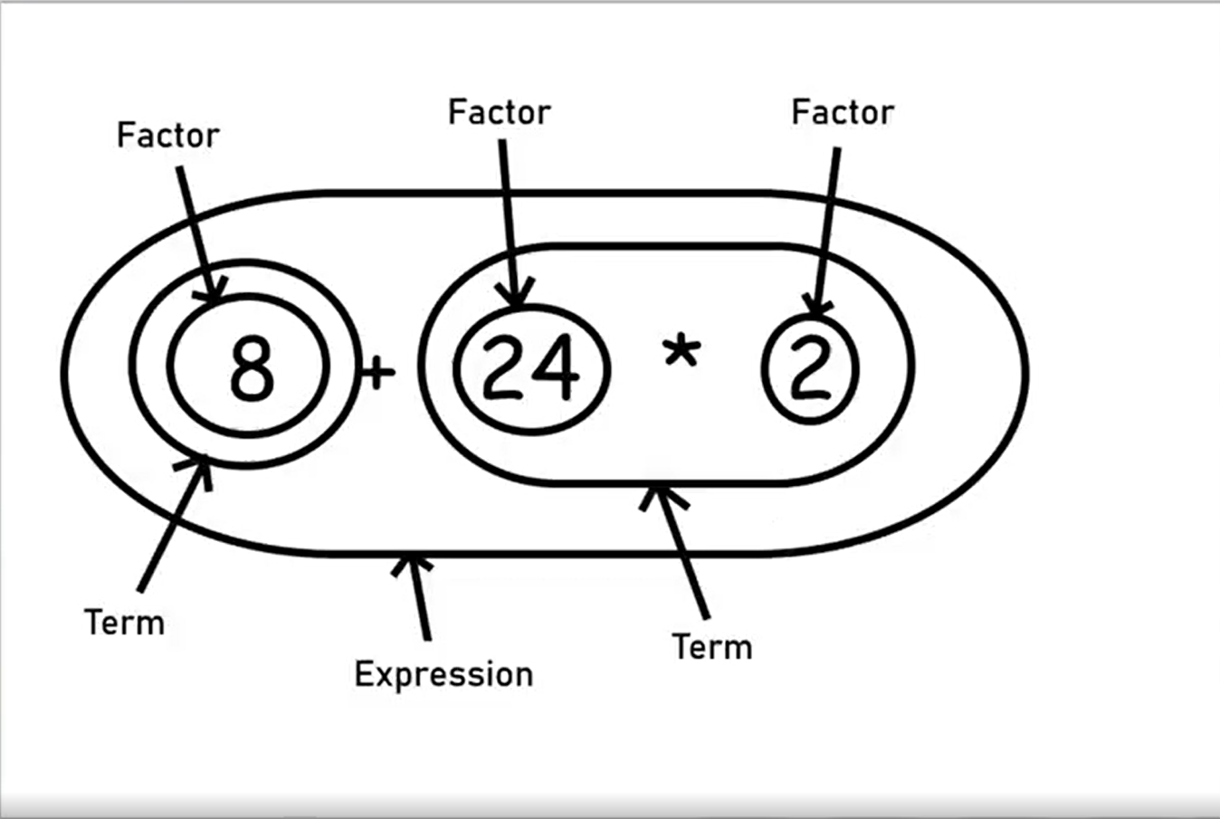
2.1. Input Handling
Order of precedence:

Slide 6
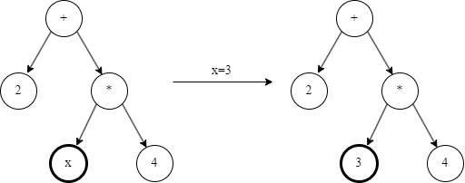
2.1. Input Handling
User input:
2 + x * 4
F(x)
Abstract Syntax Tree:

Slide 7
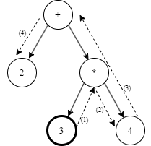
2.1. Input Handling
User input:
2 + x * 4
F(x)
Abstract Syntax Tree:

Slide 8
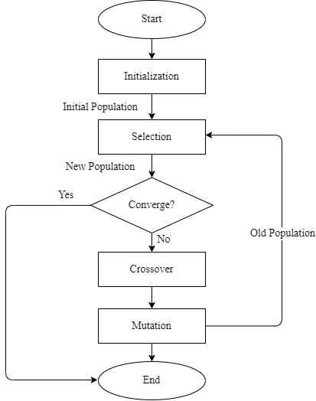
2.2. Genetic Algorithm
General of Genetic Algorithm
Initialization
Fitness Assignment
Selection
Reproduction
Termination

Slide 9
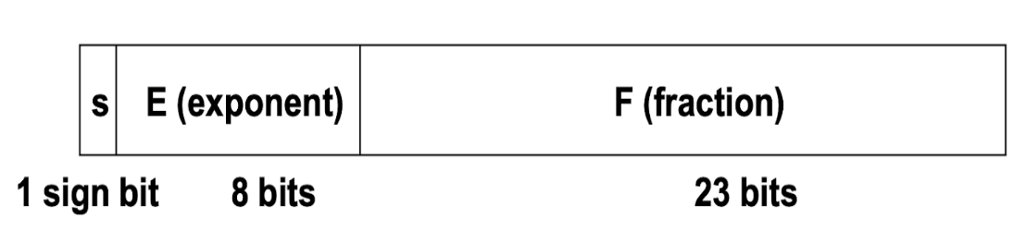
2.2. Genetic Algorithm
Search Space
$$value={\left(−1\right)}^{−s}×1.F×2^{E−bias}$$

Slide 10
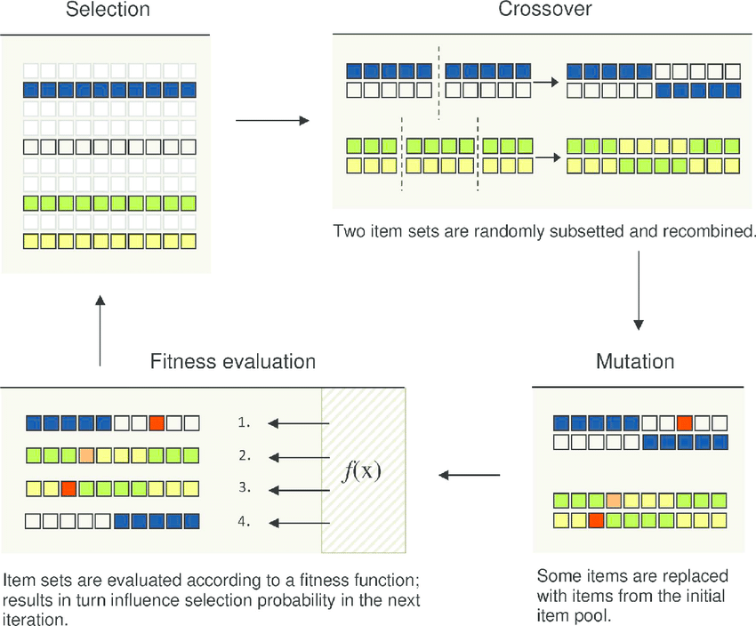
2.2. Genetic Algorithm
Operators

Slide 11
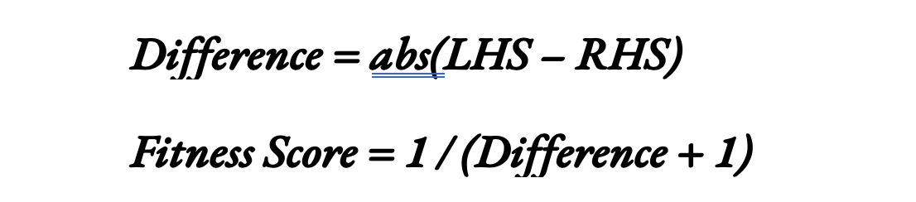
2.2. Genetic Algorithm
Fitness Score
When Difference --> 0 => Fitness Score --> 1

Slide 12

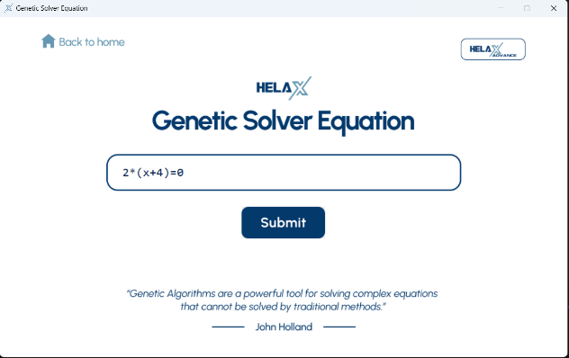
3. Results
Menu
User Input

Slide 13
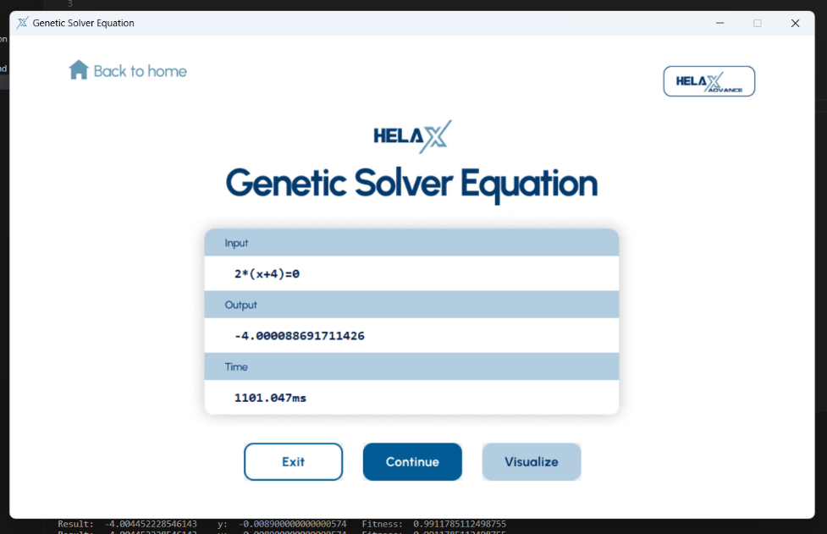
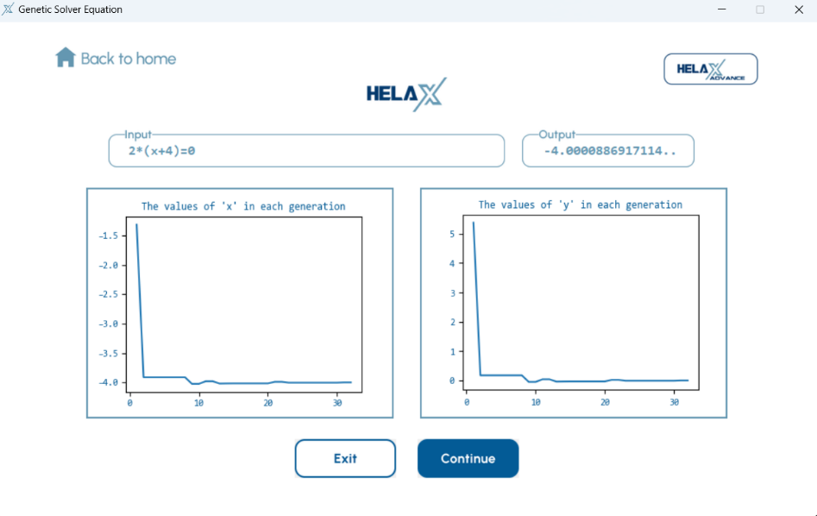
3. Results
Result
Visualize

Slide 14
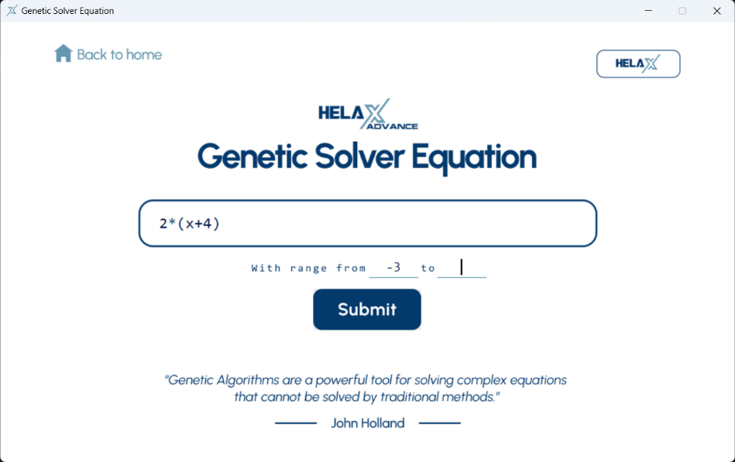
3. Results
Custom Interval to solve

Slide 15
3. Results
DEMO

Slide 16
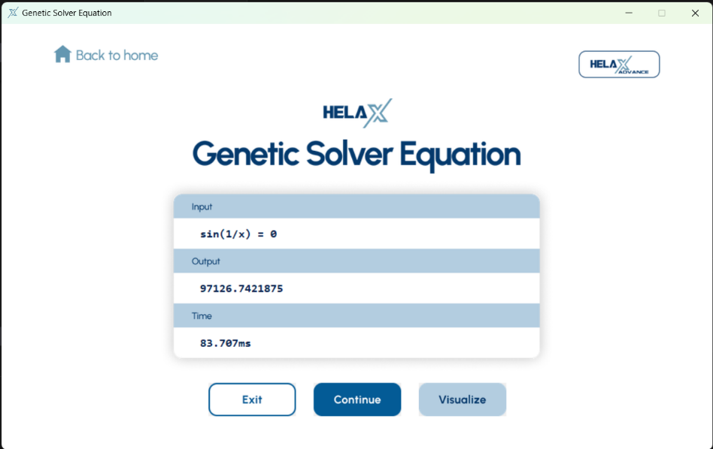
4. Discussion
No Solution Condition
Slow Convergence

Slide 17

5. Conclusion
Easy to find solution but sometime fail
Try more advance algorithm
More user-friendly GUI

Slide 18
Thank you!

