Slide 1
HUST-PC
Computers & IT Equipment
Members
Instructor
Phan Dinh Truong (Leader)
Prof. Trinh Thanh Trung
Le Tuan Anh
Vu Tuan Minh
Dinh Nguyen Cong Quy
Bui Minh Quang
Notes:
- Giới thiệu: (Tên, Nhóm)
- Mục đích: The Purpose of this project is provide you with information about this project and report the results the team has worked on in the past time

Slide 2
Table of Content
1. Instruction
2. Requirement Analysis
3. Design
4. Development & Testing
5. Summary
Notes:
In this project, we will focus 5 parts:

Slide 3
1. Instruction
- Project HUST-PC: Website selling assembled computers and IT equipment.
- The brand currently have 3 stores.
- The user places an order, customizes the configuration, and chooses the store to pick up.
- HUST-PC imports components from the store and assembles them.
- The system notifies when the computer/device is assembled.
Notes:
Computers and IT equipment website The HUST-PC brand is a shop specializing in selling assembled computers and IT equipment. Currently, this brand has 3 different stores. When users order computers and IT equipment, they can customize the machine's configuration and choose a store to pick up. HUST-PC will import components from one of its stores and assemble. When the computer/equipment is assembled, the system will notify the customer.

Slide 4
Objectives
Flexible and convenient e-Commerce platform
Users can customize the configuration and choose a store to receive goods.
The project will ensure the import of components from one of the 3 stores and assemble the computers
HUST-PC will notify the customer when the computer/device assembly is complete.
Notes:
- The goal of the project is to build a flexible and convenient e-commerce platform for the procurement of assembled computers and IT equipment.
- Users can customize the computer configuration according to their personal needs and choose a store to receive goods.
- The project will ensure the import of components from one of the three stores and assemble the computers when the order is placed.
- HUST-PC will notify the customer when the computer/device assembly is complete.

Slide 5
2. Requirement Analysis
Functional Requirements
Functional Requirements
- Search Products
- View Product Details
- Add to Cart
- Build PC
- Place Order
- Manage Products
- Manage Orders
- User-friendly interface
- High Performance and Reliability
- Information security
Notes:
a) User-friendly interface
The interface should be easy to use, user-friendly.
Ensure a convenient and interactive buying experience.
b) High performance and reliability
The system must operate stably, respond quickly to requests from users.
Ensure information security and avoid system errors.
c) Information security
Protect users' personal information and payment transactions.
Use security measures such as data encryption and user authentication.

Slide 6
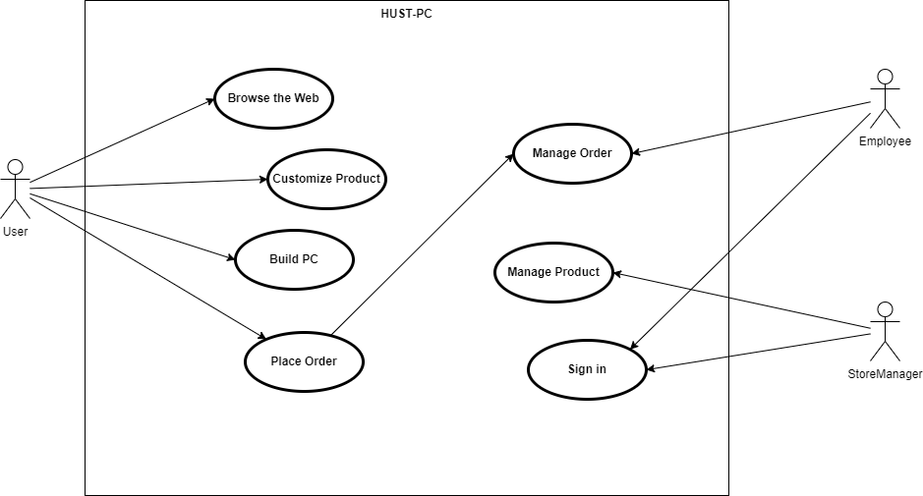

Slide 7
3. Design System
User Interface Process
- Research requirements and interface specification
- Define interface structure
- Design the interface template
- Evaluate and adjust the interface template
Notes:
The goal of interface design is to create a good user experience and increase interactivity.
Review analyzed functional and non-functional requirements to understand user needs.Specify the necessary interface components such as menus, search boxes, product lists, shopping carts, etc.
Defines the general structure of the interface, including the layout, the component hierarchy, and the overview view.Arrange elements and position them to create a streamlined and easy-to-use interface. Create initial interface templates using design tools such as Photoshop, Sketch, Figma, ...Create multiple templates to choose from and assess fit with project requirements and goals.
Evaluate interface templates based on criteria such as user experience, structural soundness, and aesthetics.Adjust and improve the interface template based on feedback and contributions from users and the development team.

Slide 8
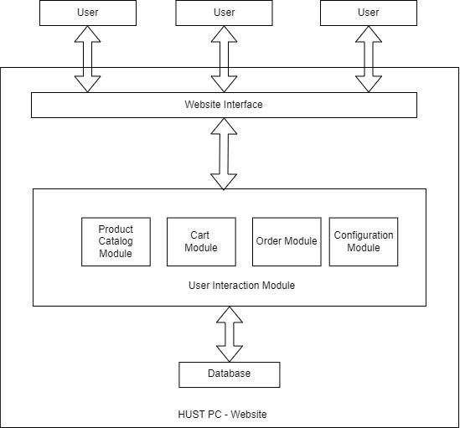
Software Design

Slide 9
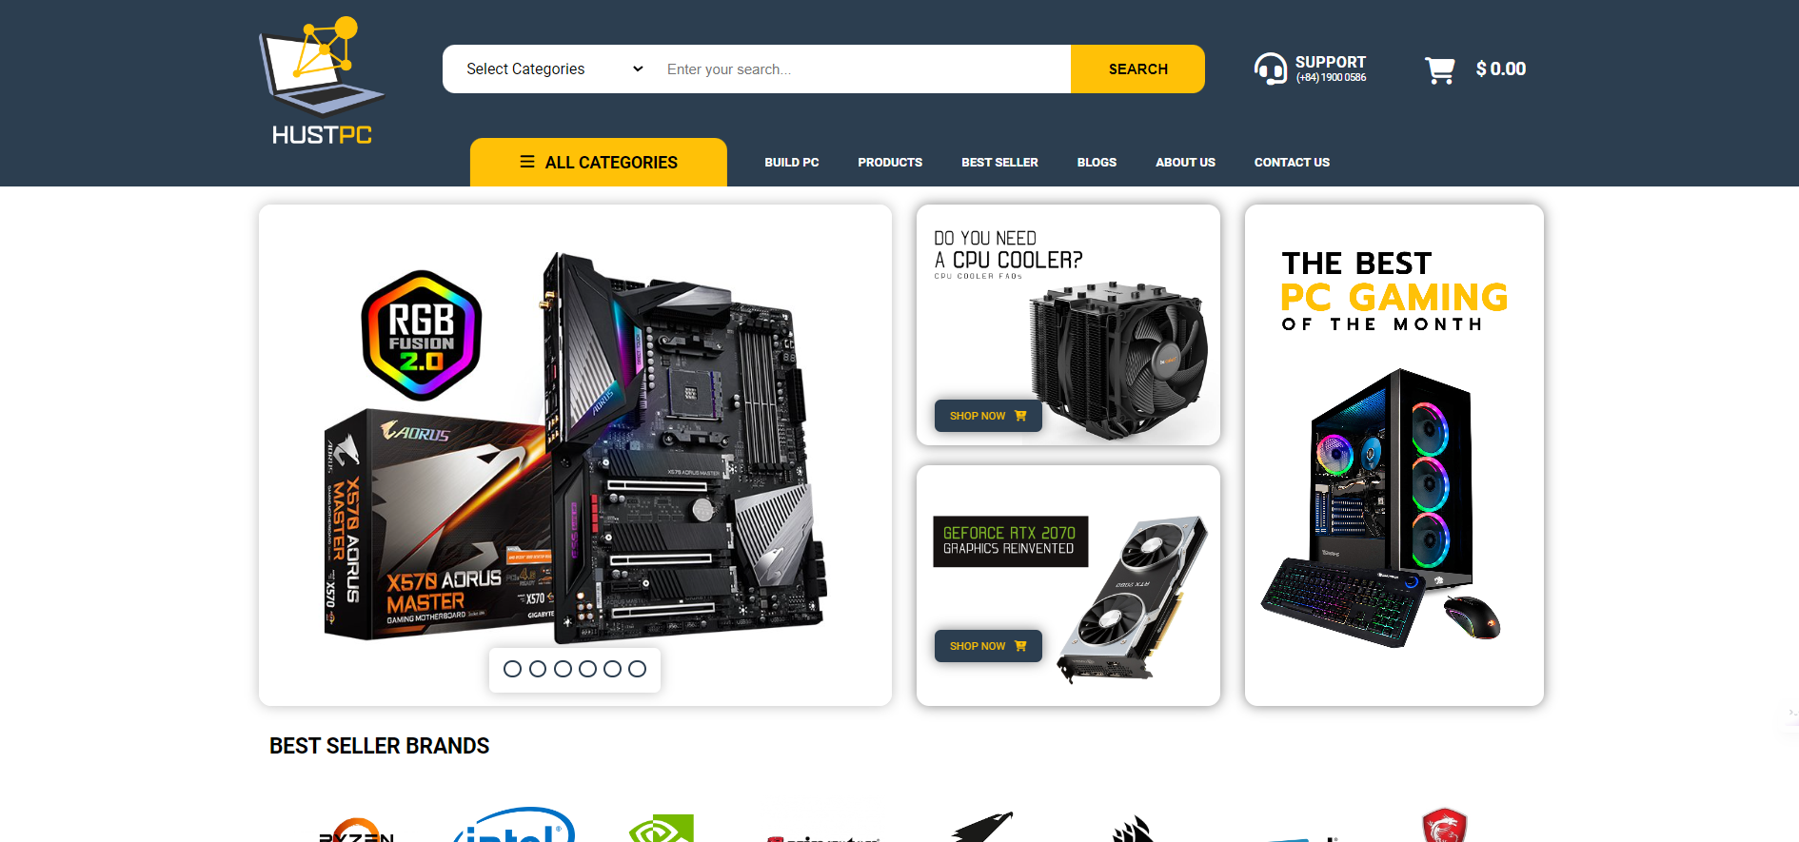
User Interface

Slide 10
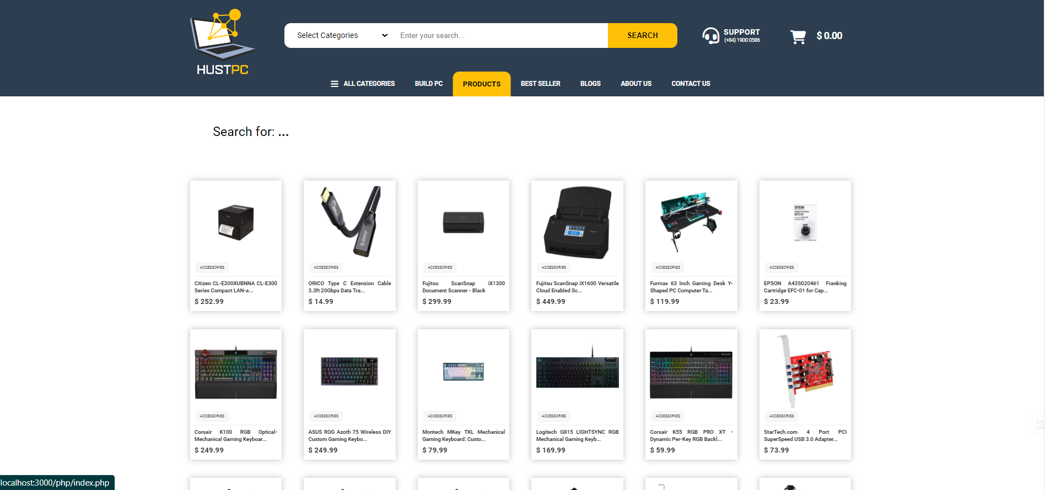
User Interface

Slide 11
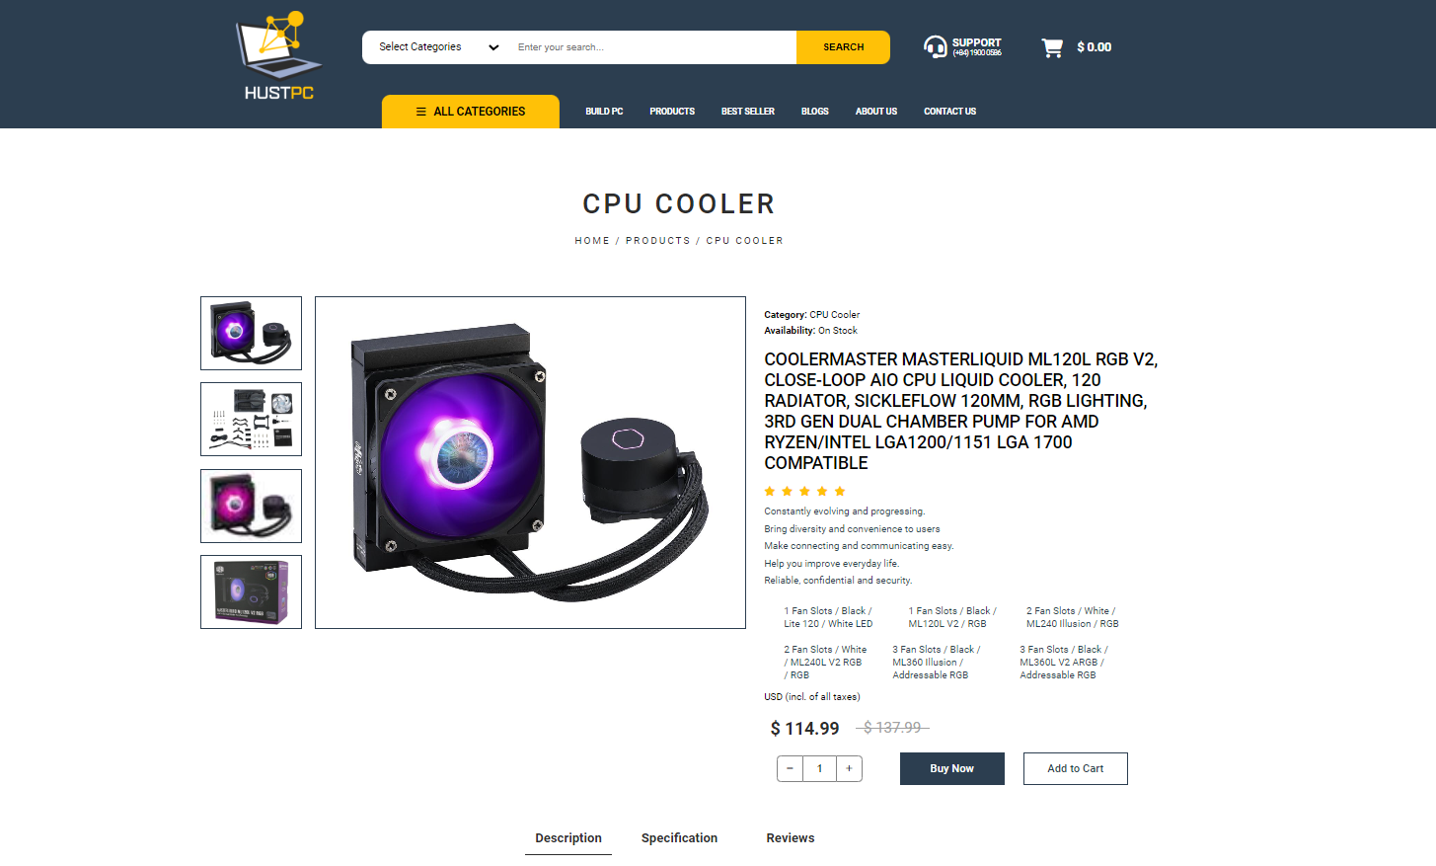
User Interface
Notes:
The goal of interface design is to create a good user experience and increase interactivity.

Slide 12
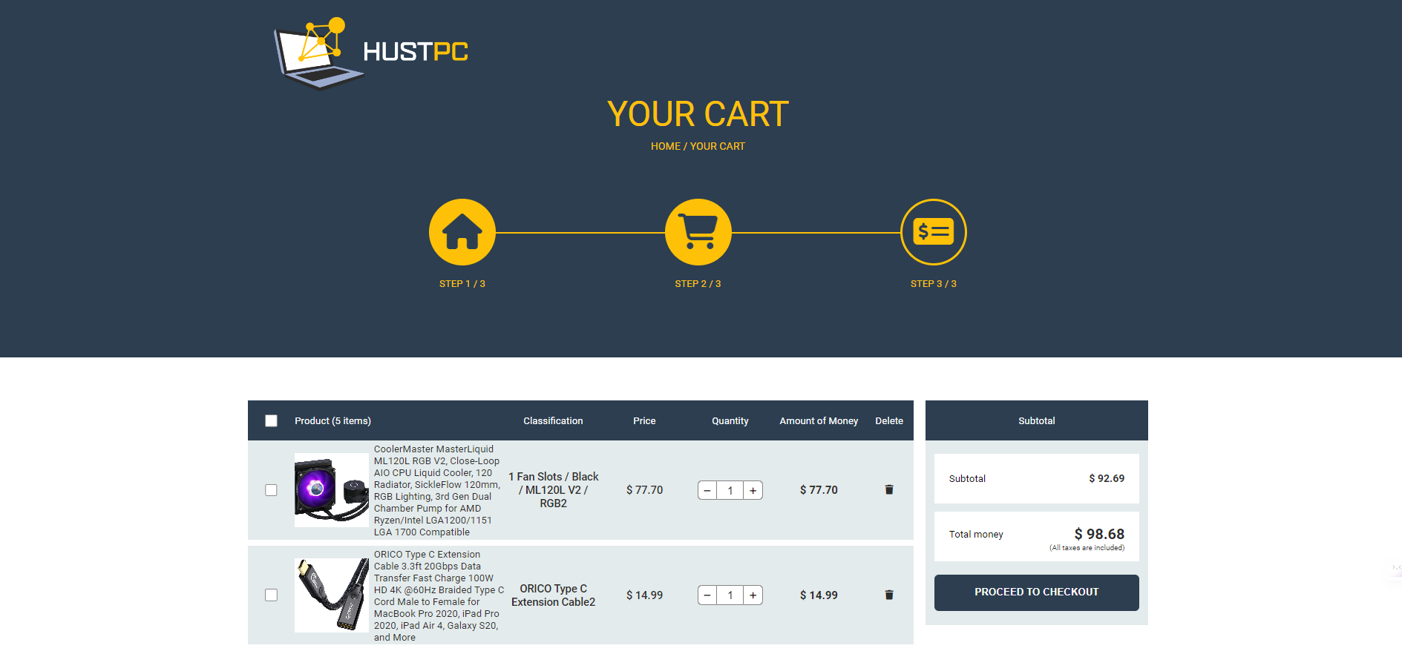
User Interface

Slide 13
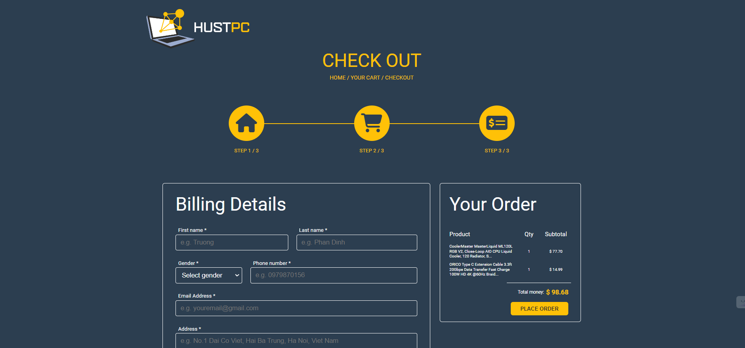
User Interface

Slide 14
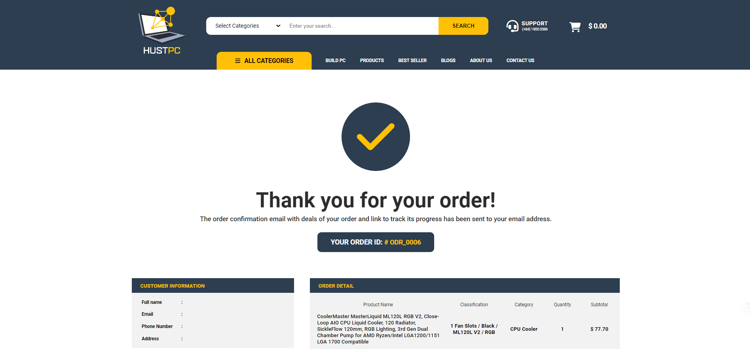
User Interface

Slide 15
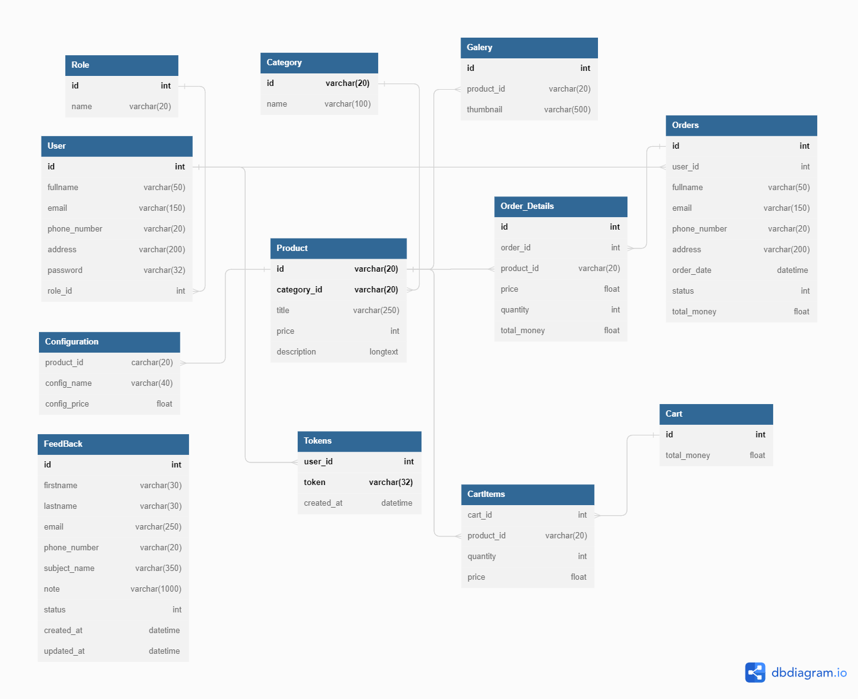
Database Design

Slide 16






4. Development & Testing
Tools and Environment
- Front End: HTML / CSS / Javascript
- Back End: PHP
- Database: MySQL
- Project Management: GitHub

Slide 17
5. Summary
Project HUST-PC has succeeded in building an effective sales website and good user experience.
Through the development process, we have learned and understood the software development process and project management.
Thank you for the support and contributions of the entire team and lecturers during the implementation of this project.
Notes:
- Project Hust-PC is a cross-platform sales website, providing products and services related to computers and technology. - Website is designed with the goal of bringing a convenient shopping experience, product variety and good service quality.

Slide 18
5. Summary
Achievements
Integrated product search and filter function, helping users to search and select suitable products
Building a convenient shopping cart and payment process, ensuring convenience and safety for customers
Provide order management function, help customers track order status and contact suppliers
User-friendly interface design, create an easy and attractive shopping experience.
Notes:
The goal of interface design is to create a good user experience and increase interactivity.
Review analyzed functional and non-functional requirements to understand user needs.Specify the necessary interface components such as menus, search boxes, product lists, shopping carts, etc.
Defines the general structure of the interface, including the layout, the component hierarchy, and the overview view.Arrange elements and position them to create a streamlined and easy-to-use interface. Create initial interface templates using design tools such as Photoshop, Sketch, Figma, ...Create multiple templates to choose from and assess fit with project requirements and goals.
Evaluate interface templates based on criteria such as user experience, structural soundness, and aesthetics.Adjust and improve the interface template based on feedback and contributions from users and the development team.

Slide 19
Q&A
Thanks for watching!

