Slide 1
HUST-PC
E-Commerce and Logistic
Team: HELARICA
Instructor
Phan Dinh Truong (Leader)
Prof. Trinh Thanh Trung
Le Tuan Anh
Vu Tuan Minh
Dinh Nguyen Cong Quy
Bui Minh Quang
Notes:
- Giới thiệu: (Tên, Nhóm)
- Mục đích:
The purpose of our presentation is to deliver a brief and general understanding of the software requirements for the project. We will focus on illustrating the external interface, the functional and non-functional requirements for the website.

Slide 2
Project Overview
Project HUST-PC: Website selling assembled computers and IT equipment.
The brand currently have 3 stores.
The user places an order, customizes the configuration, and chooses the store to pick up.
HUST-PC imports components from the store and assembles them.
The system notifies when the computer/device is assembled.

Slide 3
Objectives
Flexible and convenient e-Commerce platform
Users can customize the configuration and choose a store to receive goods.
The project will ensure the import of components from one of the 3 stores and assemble the computers
HUST-PC will notify the customer when the computer/device assembly is complete.
Notes:
- The goal of the project is to build a flexible and convenient e-commerce platform for the procurement of assembled computers and IT equipment.
- Users can customize the computer configuration according to their personal needs and choose a store to receive goods.
- The project will ensure the import of components from one of the three stores and assemble the computers when the order is placed.
- HUST-PC will notify the customer when the computer/device assembly is complete.

Slide 4
Function Overview
Data management
Order control
Choose product
Manager
Employee
Customize configuration
Customer
View product
Data access
Store management
Place Order

Slide 5
User interface
Homepage
Product Details Page
Shopping Cart Page
Product Listing Page
PC Customize Page
Checkout Page
Notes:
Homepage
Provide an overview of the website's offerings and allow users to easily navigate to different sections of the website
Product Listing Page
- Display a list of products based on the user's search query or selected category.
Product Details Page
- Provide detailed information about a specific product
Shopping Cart Page
- Display the items that the user has added to their cart
Checkout Page
- Allow users to enter their billing and shipping information and complete their purchase.
Product Listing Page
- Display a list of products based on the user's search query or selected category.

Slide 6
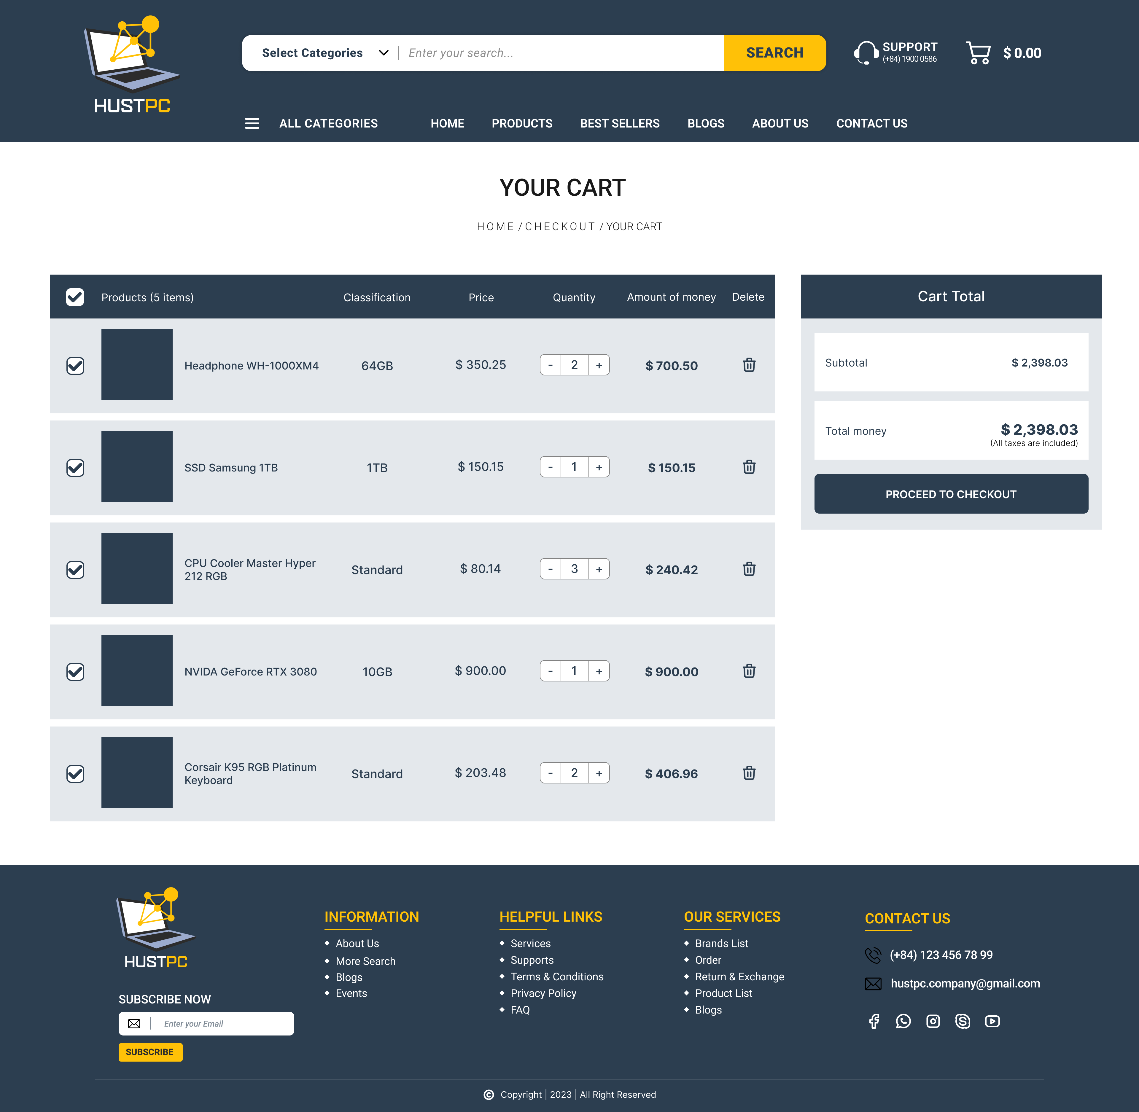
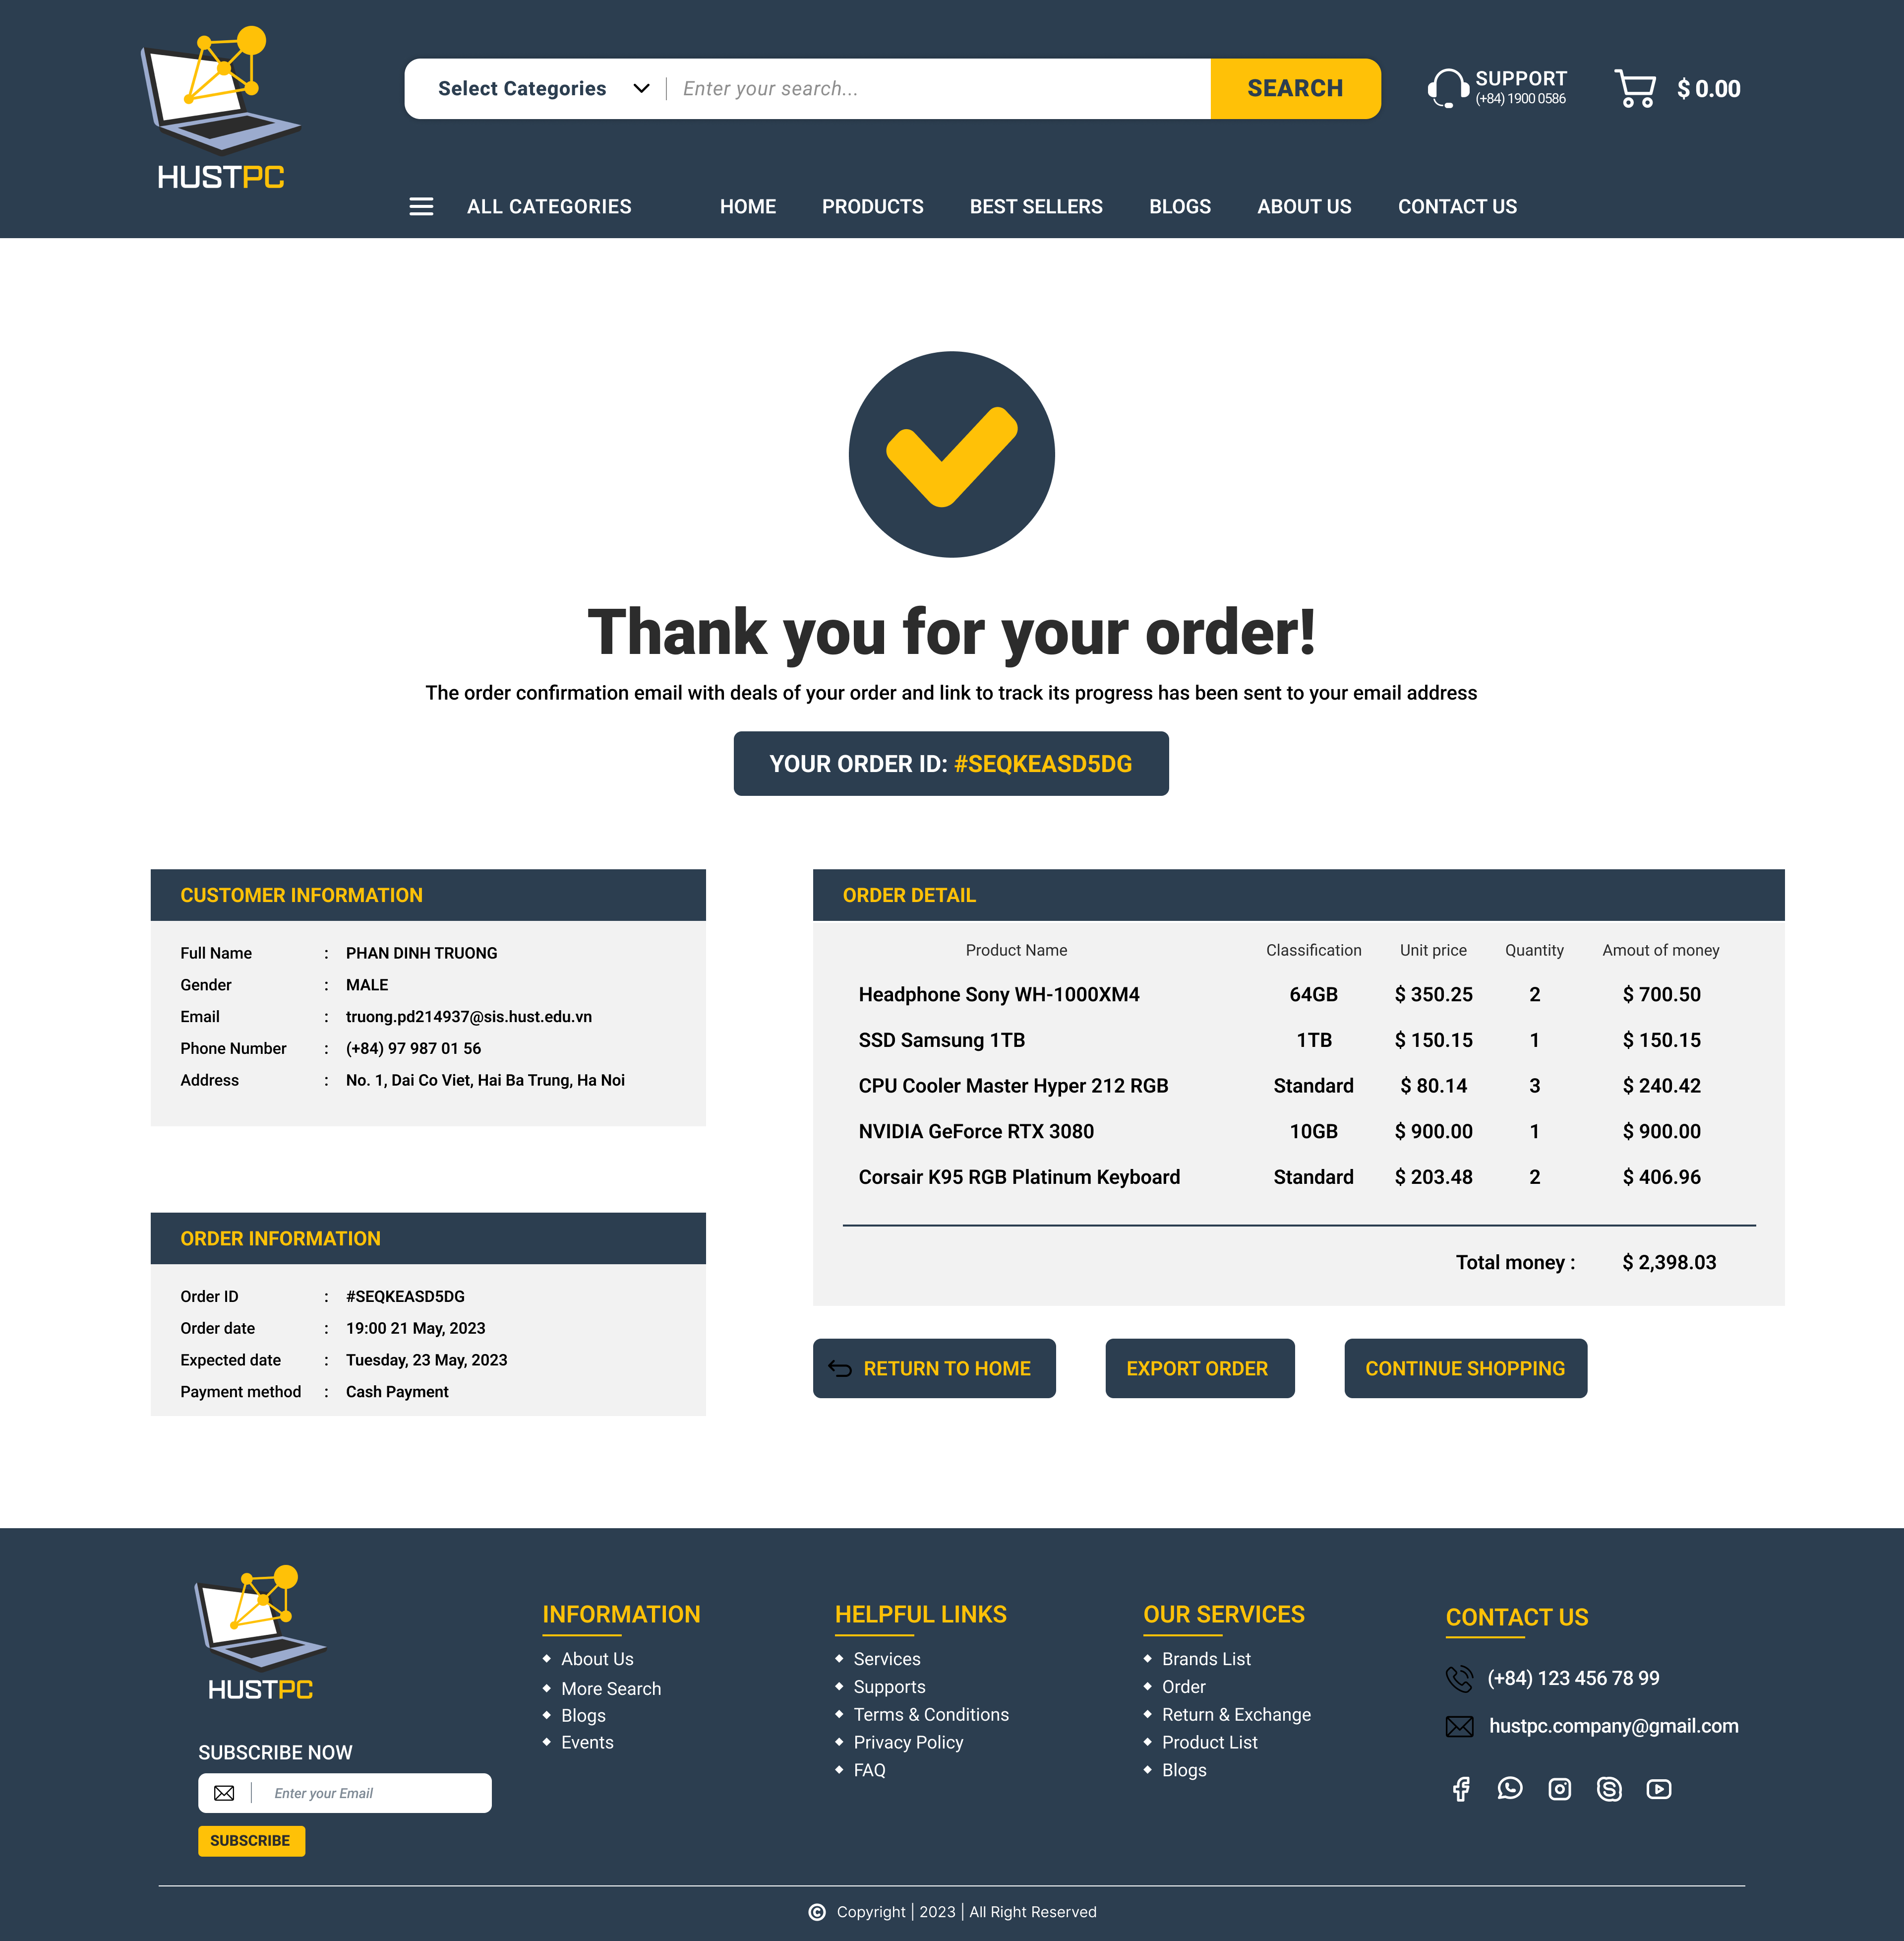
User interface

Slide 7
HW & SW Interface
Hardware Requirements
Server: minimum of 4GB RAM, 2 CPU cores, and 50GB of storage space.
Network: internet connection with a minimum bandwidth of 10Mbps.
Database: should be able to handle a large amount of data and should be scalable.
Software Requirements
Operating System: Windows or Linux
Web Server: Apache or Nginx to serve the web pages to the users.
Programming Language: HTML/CSS, Javascript, PHP
Database Management System: MySQL
Notes:
Hardware Requirements
The hardware requirements for the software system are as follows:
Server: The system will require a server to host the software and store the data. The server should have a minimum of 4GB RAM, 2 CPU cores, and 50GB of storage space.
Network: The system will require a stable and reliable internet connection with a minimum bandwidth of 10Mbps.
Database: The system will require a database to store the data. The database should be able to handle a large amount of data and should be scalable.
Software Requirements
The software requirements for the software system are as follows:
Operating System: The server should run on a stable and secure operating system such as Linux or Windows Server.
Web Server: The system will require a web server such as Apache or Nginx to serve the web pages to the users.
Programming Language: The system will be developed using a programming language such as Java, Python, or Ruby on Rails.
Database Management System: The system will require a database management system such as MySQL, PostgreSQL, or MongoDB to manage the database.

Slide 8




Network Communication
Email
Web browser
NW Protocol
Security
Notes:
In this section, we will learn about the network communication requirement in the HUST-PC project. Network communication plays an important role in connecting and interacting with customers and users. Below is a description of the requirements related to network communication:
1. Email: HUST-PC will support sending and receiving emails to notify customers about product updates, order status and promotion information.
2. Web browser: HUST-PC will provide an online interface through a web browser so that users can access the system, view products, customize configuration and place orders.
3. Network Protocols: HUST-PC will use network protocols such as HTTP/HTTPS to establish and maintain a connection between the web browser and the server.
4. Security of communication: HUST-PC will apply security measures such as SSL/TLS encryption to ensure the safety of data transmission between customers and the system.
Thereby, HUST-PC will create a safe and convenient network communication environment for customers and users to access and use the service.

Slide 9
Q&A
Thanks for listening!

