Slide 1
Bank Capital Models and Bivariate Normal Probability Calculations
Dale T. Smith, PhD
Senior Quantitative Analyst
Norcross, GA
Joint Mathematics Meeting, San Diego, CA, January 12, 2013

Slide 2
Bank Capital Models and Bivariate Normal Probability Calculations
Dale T. Smith, PhD
Senior Quantitative Analyst
Norcross, GA
Joint Mathematics Meeting, San Diego, CA, January 12, 2013

Slide 3

Why Banks Hold Capital
The Basic Accounting Equation: Assets = Liabilities + Equity
Hierarchy of Liabilities: Swap counterparties, bank loans, senior obligations, junior obligations, equity.
Accounting rules require banks to hold reserves to protect against losses. Non-banks have to do similar reserving, in particular insurance companies.
Insurance companies and banks have to model and forecast their entire balance sheet, including new business assumptions when loans and other products reach maturity.
Balance Sheet – snapshot of assets, liabilities, and equity at a particular time. Income Statement – how does the balance sheet change from one reporting period to the next.
Basic references: Löffler and Posch, Credit Risk Modeling using Excel and VBA, Chapters 5 and 6 and Hoogbruin, “Credit Risk: Demystifying Economic Capital”.
© 2012 Fiserv, Inc. or its affiliates.

Slide 4
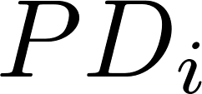
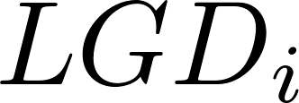

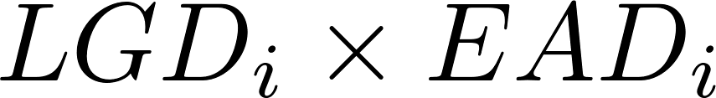

One Factor Model – Inputs For Capital Calculation
: Probability of Default.
: Loss Given Default.
: Exposure at Default.
If a default is detected, the loss is calculated as .
: Correlation with a common factor.
Most important parts of the model - inputs!
© 2012 Fiserv, Inc. or its affiliates.

Slide 5

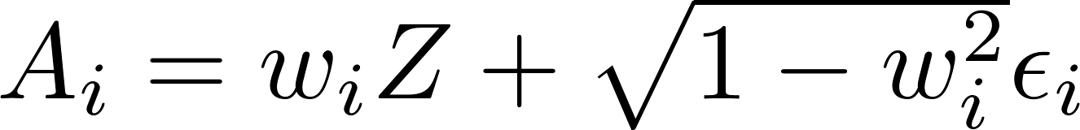
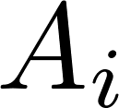

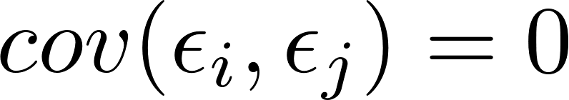
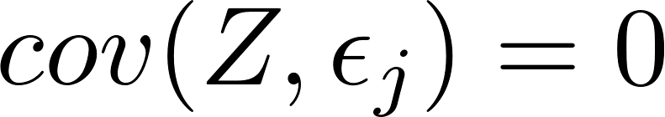
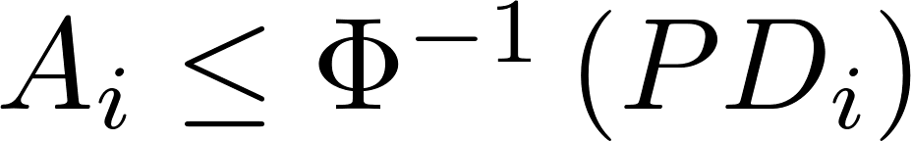
One Factor Model – Description of Asset Value Approach
Asset values are simulated using a single common factor (the economy) and an idiosyncratic shock.
A threshold for default is calculated for each borrower using the PD and the standard normal probability integral.
Asset values are a random variable:
The are standard normal with correlation . and .
If the loss is calculated as
and accumulated to get the portfolio expected loss. Also record each loan’s losses to build a loss distribution for each loan.
We now have a simulated loss distribution.
© 2012 Fiserv, Inc. or its affiliates.
Notes:
http://ssrn.com/abstract=643267

Slide 6
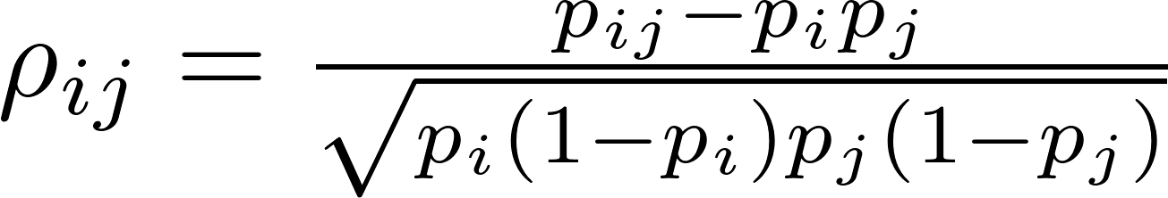
One Factor Model – Default Correlation
Standard deviation of losses requires correlation to introduce diversification benefits.
Modeled as .
. Default correlation is then
The joint probability of default is calculated as
or
© 2012 Fiserv, Inc. or its affiliates.

Slide 7
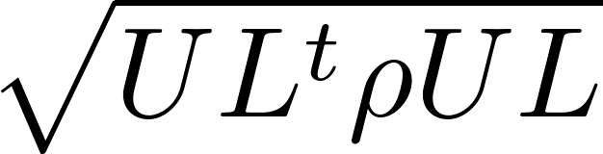
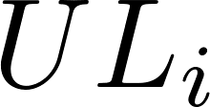
Economic Capital
Portfolio Expected Loss: Average of the loss distribution. Normal cost of doing business.
Portfolio Unexpected Loss: . UL is the vector of unexpected losses (standard deviations) of each loan loss distribution. Must hold capital against each loan to account for this in proportion to the contribution of each loan (derivative of PUL with respect to ).
Economic Capital: Percentile of the loss distribution. Capital level required so the firm stays solvent over a certain period of time with a certain probability. Losses at this level or greater lead to a rating downgrade (or in an extreme case, bankruptcy or negative equity). Probability depends on the bank’s desired credit rating.
Economic Capital is similar to Value at Risk and suffers from the same objections.
© 2012 Fiserv, Inc. or its affiliates.

Slide 8
Extensions to the One Factor Model
Multi-factor model.
Use the t-distribution instead of the normal distribution.
Random LGD.
Correlated PD and LGD.
Credit migrations (Löffler and Posch, Credit Risk Modeling using Excel and VBA, Chapters 3 and 4).
Expected shortfall.
© 2012 Fiserv, Inc. or its affiliates.

Slide 9
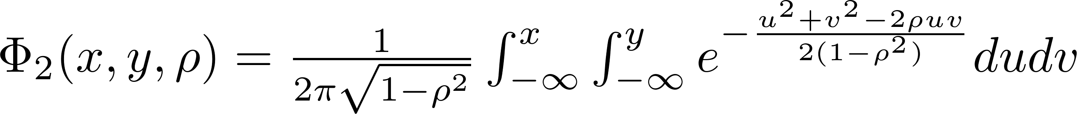
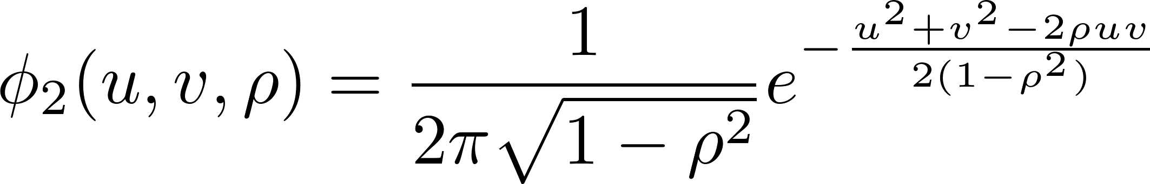
Bivariate Normal Probability Integral
X, Y both normal random variables with mean 0 and unit variance.
Also
© 2012 Fiserv, Inc. or its affiliates.

Slide 10
Uses for Pricing Options
European option on an asset with a known dividend payable before expiration (bivariate, Roll-Geske-Whaley).
European option on an asset with two known dividends payable before expiration (trivariate, Welch-Chen, Stephen-Whaley).
The case with three known dividends before expiration probably uses the quadvariate integral, but has not been published so far.
Explicit formulas, such as the two quoted immediately above, are useful as control variates for variance reduction in Monte Carlo simulations used to calculate the value of exotic options.
Rainbow options (bivariate, trivariate, multivariate, Ouwehand-West). A rainbow option is exposed to two or more sources of risk, such as natural resource deposits (price and quantity are random). Often these are calls or puts on the best or worst assets in a portfolio of stocks, and are heavily dependent on correlation.
Non-linear trading strategies (trivariate, Bana and Martin (2012)).
© 2012 Fiserv, Inc. or its affiliates.

Slide 11
A Need for Good Algorithms
West (2005):
Espen Haug relates a story to me of how his book (Haug 1998) has received a rather scathing review at the Amazon website by one reader; and the underlying reason for the problem is in actual fact the inaccuracy of the cumulative normal approximation in his book, this inaccuracy is in turn inherited by the bivariate cumulative approximation. As a consequence, option prices where the bivariate cumulative is used can be negative, under not absurd inputs!
Hoogbruin.
Hull, Options, Futures, and Other Derivatives (web site technical note).
Neither author discusses the problems with their algorithms (Hull mentions his is accurate to 4 digits).
© 2012 Fiserv, Inc. or its affiliates.

Slide 12
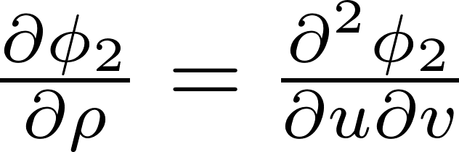
A Need for Good Algorithms
Graeme West, “Better Approximations to Cumulative Normal Functions”, WILMOTT, p. 70-76, May, 2005.
Bivariate Normal requires a good algorithm for the univariate normal. Need double precision (15 – 16 digits).
Poor algorithms produce impossible results, such as negative prices.
The Genz algorithm (2004), is used in the open-source QuantLib library (incorporating modifications by West (2005) and in the R package mvtnorm. Matlab package is tvtl (Genz website http://www.math.wsu.edu/faculty/genz/software/software.html).
Genz and others use Plackett’s formula
© 2012 Fiserv, Inc. or its affiliates.

Slide 13

Future Directions
Further extensions of Genz (2004).
Tackling the infinite integral directly via bivariate or trivariate orthogonal polynomials.
Polar coordinates are useful near (Jäckel, 2005).
Transforming the infinite integral to a finite interval. This will probably introduce a singularity in the integrand which may be difficult to handle.
The t-distribution and trivariate cases (for both the normal and t-distribution) are more difficult. No work so far on the quadvariate case, but it may be of some interest due to the option pricing formulas previously mentioned or other applications.
Calculations on a GPU.
© 2012 Fiserv, Inc. or its affiliates.

Slide 14
Summary
A One Factor Model is used to simulate a loss distribution.
Joint default correlations rely on asset correlations from the One Factor Model, and are required to calculate the reserve against unexpected losses via the dispersion of the loss distribution.
Bivariate Normal/t probabilities are the key to joint default probabilities.
A need for fast and high precision algorithms.
© 2012 Fiserv, Inc. or its affiliates.

Slide 15
References
Alan Genz and Frank Bretz, Computation of Multivariate Normal and t Probabilities, Lecture Notes in Statistics 195, Springer, 2009.
Ali Bana and Richard Martin, “Non-Linear Momentum Strategies”, RISK, November 2012.
Espen Haug, The Complete Guide to Option Pricing Formulas, 2nd Edition, McGraw-Hill, 2006.
Gunter Löffler and Peter N. Posch, Credit Risk Modeling using Excel and VBA, Second Edition, Wiley, 2011.
John Hull, Options, Futures, and Other Derivatives, Eighth Edition, Prentice Hall, 2012.
© 2012 Fiserv, Inc. or its affiliates.

Slide 16
References
DefaultRisk.com
Alan Genz, “Numerical Computation of Rectangular Bivariate and Trivariate Normal and t Probabilities“, Statistics and Computing, v. 14, p. 251-260, 2004.
R. Geske, “On the Valuation of American Call Options on Stocks with Known Dividends: A Comment“, Journal of Financial Economics, v. 9, p. 213-215, 1981.
Peter-Paul Hoogbruin, “Credit Risk: Demystifying Economic Capital“, GARP Risk Review, September/October (32), p. 34-41, 2006.
© 2012 Fiserv, Inc. or its affiliates.

Slide 17
References
Peter Jäckel, “A note on multivariate Gauss-Hermite quadrature”, May 2005.
Xuefei Mi, Tetsuhisa Miwa and Torsten Hothorn, “mvtnorm: New Numerical Algorithm for Multivariate Normal Probabilities“, The R Journal, v. 1, no. 1, p. 37-39, May 2009.
Peter Ouwehand and Graeme West, “Pricing Rainbow Options“, WILMOTT Magazine, p. 74-80, May 2006.
R. Roll, “An Analytic Valuation Formula for Unprotected American Call Options on Stocks with Known Dividends“, Journal of Financial Economics, v. 5, p. 251-258, 1977.
© 2012 Fiserv, Inc. or its affiliates.

Slide 18
References
J. Stephan and R. E. Whaley, “Intraday Price Changes and Trading Volume Relations in the Stock and Stock Options Market“, The Journal of Finance, v. 45, p. 191-220, 1990.
R. L. Welch and D. M. Chen, “On the Properties of the Valuation Formula for an Unprotected American Call Option with Known Dividends and the Computation of Its Implied Standard Deviation“, Advances in Futures and Options Research, v. 3, p. 237-256, 1988.
Graeme West, “Better Approximations to Cumulative Normal Functions“, WILMOTT Magazine, p. 70-76, May, 2005.
R. E. Whaley, “On the Valuation of American Call Options on Stocks with Known Dividends“, Journal of Financial Economics, v. 9, p. 207-211, 1981.
© 2012 Fiserv, Inc. or its affiliates.

Slide 19
Bank Capital Models and Bivariate Normal Probability Calculations
Dale T. Smith, PhD
Senior Quantitative Analyst
Norcross, GA
Joint Mathematics Meeting, San Diego, CA, January 12, 2013
www.riskandperformance.fiserv.com

