Slide 1
Work in progress research
An approach for meeting room activity monitoring and analysis
R. Taranovs, V. Jesilevskis, G. Miezitis, D. Bliznjuks, E. Klavins, A. Kalnins, V. Zagursky

Slide 2
The General Motivations of the Proposed Approach
General motivation — enhancing quality and efficiency of meeting room usage.
Motivations:
The need of unified and open platform for human occupied rooms’ environment monitoring;
Existing solution are proprietary, have limited functionality and sometimes are not scalable.

Slide 3
The General Motivations of the Proposed Approach
Tasks:
Create scalable and open solution;
Provide user friendly graphical interface;
Eliminate system configuring for end users;
Increase system availability by using cloud based solutions.

Slide 4
A Full-Solution Architecture
Capabilities:
Foundation layer for “Smart Offices” solutions
Simple WEB UI
Cloud Powered Backend API for unlimited scaling and storage
Vendor tolerant Configuration and common gateway

Slide 5
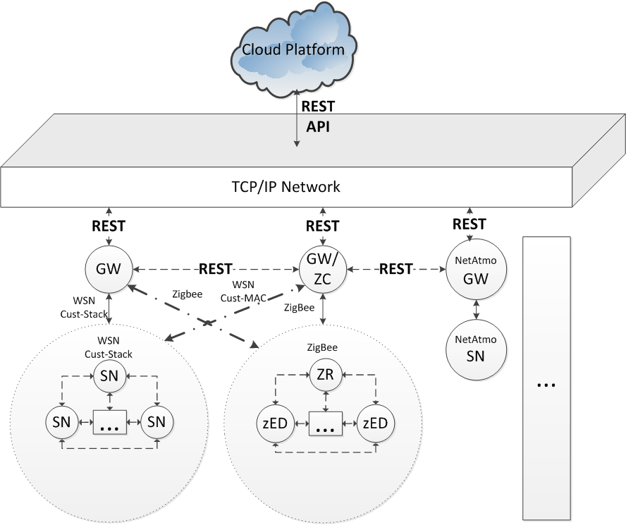
RTU Part’s WSN Architecture
Legend:
SN – Sensor Node
ZR – ZigBee Router
ZC – ZigBee Concentrator
zED – ZigBee End Device
GW – Gateway
Cust-MAC – Custom Medium Access Control Protocol

Slide 6
IoT Tasks Solved by Custom WSN
Micro-climate in the office and especially in meeting rooms:
Humidity sensors.
Temperature sensors.
Air quality monitoring:
CO₂ saturation sensor.
Presence detection:
Based on PIR sensors.
Energy-efficient meeting rooms:
Light intensity sensors allow:
Detects if light is switched-on in empty room.
Helps to define necessary amount of light in the meeting room.

Slide 7
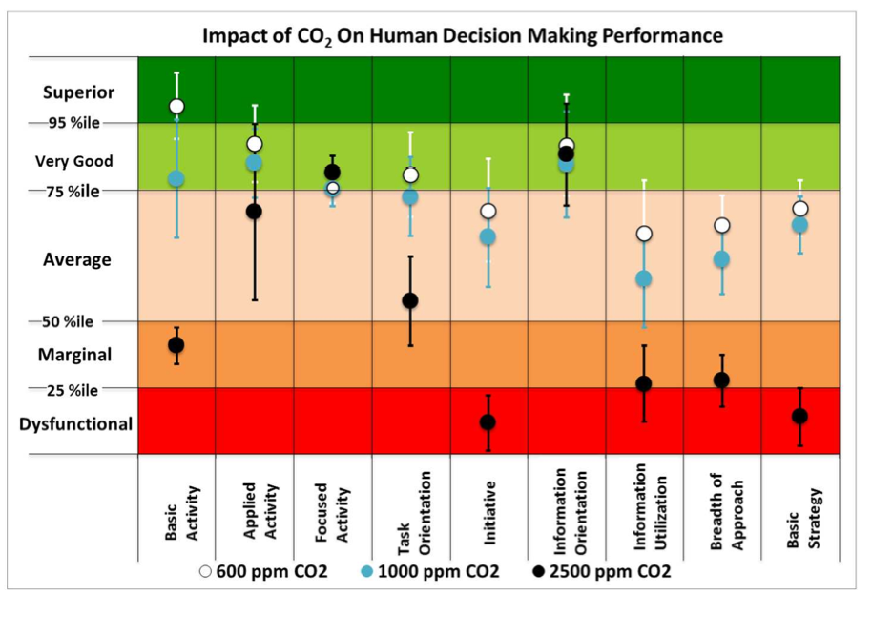
CO2 effects on humans

Slide 8
CO2 concentration in RTU classroom

Slide 9
Existing systems
Typical applications
Environment for device (e.g. server) protection.
Indoor air quality.
Ventilation system monitoring.
Noise measurement.
Systems in developement:
Tyndall BEEM – energy consumption, light, temperature, humidity.
Smart Sensor System for Ergonomic Assessment of Working Environment – temperature, humidity, light and noise.
BMWSN – temperature, humidity, light, human detection.
Handheld devices – e.g. IEQ Chek – temperature, humidity, CO2.

Slide 10
Custom WSN Advantages vs. Proprietary Solutions
No | Custom-WSN solution | Proprietary solution
Usability | Flexible amount of SNs in a room | Use-cases are pre-defined.
Sensor variety | Different sensors’ utilization for monitoring purposes | Static sensor-wise solutions.
Protocol stack | Communication protocols can be chosen according to current task. | Solutions are designed for particular tasks and can be reused in other circumstances with possible limitations.
Integration | Fast integration with other systems. | Pre-developed API as integration and access interface.
Costs | Reduced costs due to cheaper hardware. | Higher, because of already produced hardware and software.
Development time | Longer. | Shorter to longer if additional features must be implemented.

Slide 11
WSN Protocol Stack. Physical Layer
Physical layer:
Nordic Semi PHY radio chip selected.
Automatic re-transmission on PHY layer via pipe mechanism.

Slide 12
WSN Protocol Stack. Data Link Layer
MAC&LLC layer:
IEEE 802.15.4 MAC-like protocol but with smaller memory footprint.
Link quality indicators are placed in MAC packet.
LLC layer enables error control.

Slide 13
WSN Protocol Stack. Networking Layer
Networking layer:
At phase 1 a flooding-type protocol is proposed.
As next an AODV type protocol should be provided.

Slide 14
WSN Protocol Stack. Application Layer
Application layer:
Is responsible for detecting sensors onboard of SN.
Provide SN’s self-location procedure.
Elliptic-curve based cryptography of sent data.

Slide 15
Gateway as a Coordinator and Cloud Interface
Gateway tasks:
Serves as protocol translator from WSN to TCP/IP networks.
Provides interface to Cloud-Computing service. Here Windows Azure.
Configure and coordinate elements across its WSN.
Aggregate and pre-process sensorial data from WSN:
Sends data to the Cloud server according to aggregation algorithm.
May do some data-processing if requested.

Slide 16
Next Research Topics
Communication protocol stack enhancement with energy-aware features for Data Link, Networking and Application layers.
Location procedure establishment with better precision.
Continue security-related studies.
Enhance IoT solution with wearables technology, like Goolge glass.

