Slide 1
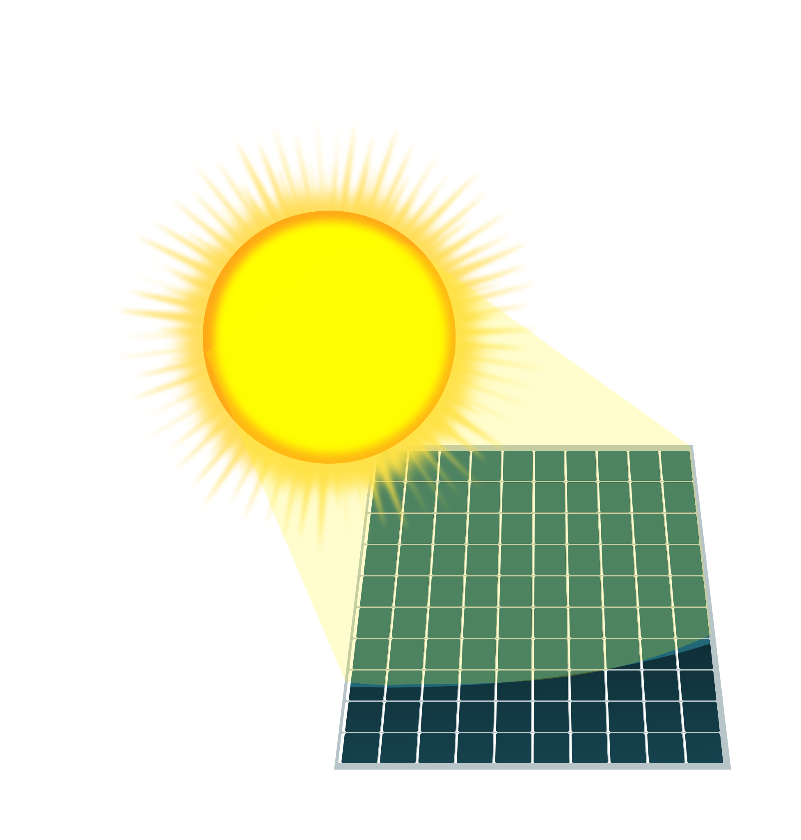


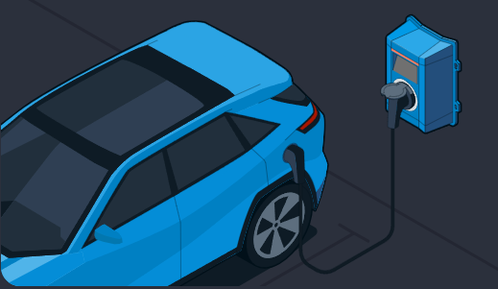
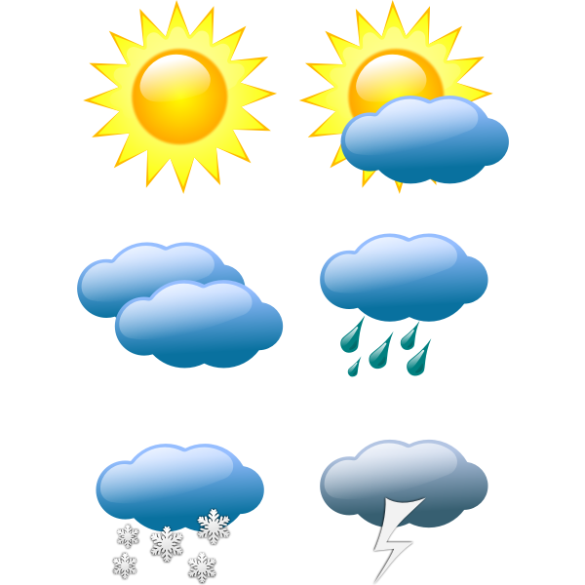
Solar W
AC Load W
Battery %
 | Charge Mode
 | Charging Current
 | Charge W
 | Charge Time
Forecast kWh | Worst | Expected
Remaining Today
Tomorrow

