Slide 1
Technical University of Denmark
Department of Health Technology
Sense-making of
Raw Mobile Sensing Data
Mobile Sensing at UbiComp/ISWC 2025
Miklos Havlik (s240069)
Supervisors: Jakob Eyvind Bardram | Nigel Sjolin Grech
March 2026

Slide 2
Background
• UbiComp/ISWC 2025 — Aalto University, Espoo, Finland (Oct 12–16, 2025)
• Premier venue for ubiquitous, pervasive, and wearable computing research
• UbiLife study: mobile sensing data from ~82 participants during the conference (Oct 9–29)
• Data collected via the CARP mobile sensing app on participants’ smartphones
• Dataset: >1 million records across 15 data streams
• Streams include: step count, activity recognition, location, battery, screen events, heartbeat, weather, air quality, and self-reported surveys
• Goal: understand movement, behavior, and wellbeing during an academic conference

Slide 3
Data Streams Overview
Data Stream | Records | Participants
Step count | 447,625 | 79
Heartbeat | 204,811 | 81
Activity | 199,336 | 78
Location | 133,082 | 80
Battery state | 18,119 | 61
Screen events | 5,657 | 22
Weather | 3,854 | 67
Air quality | 3,837 | 67
Triggered tasks | 11,795 | 82
Survey | 765 | 59

Slide 4
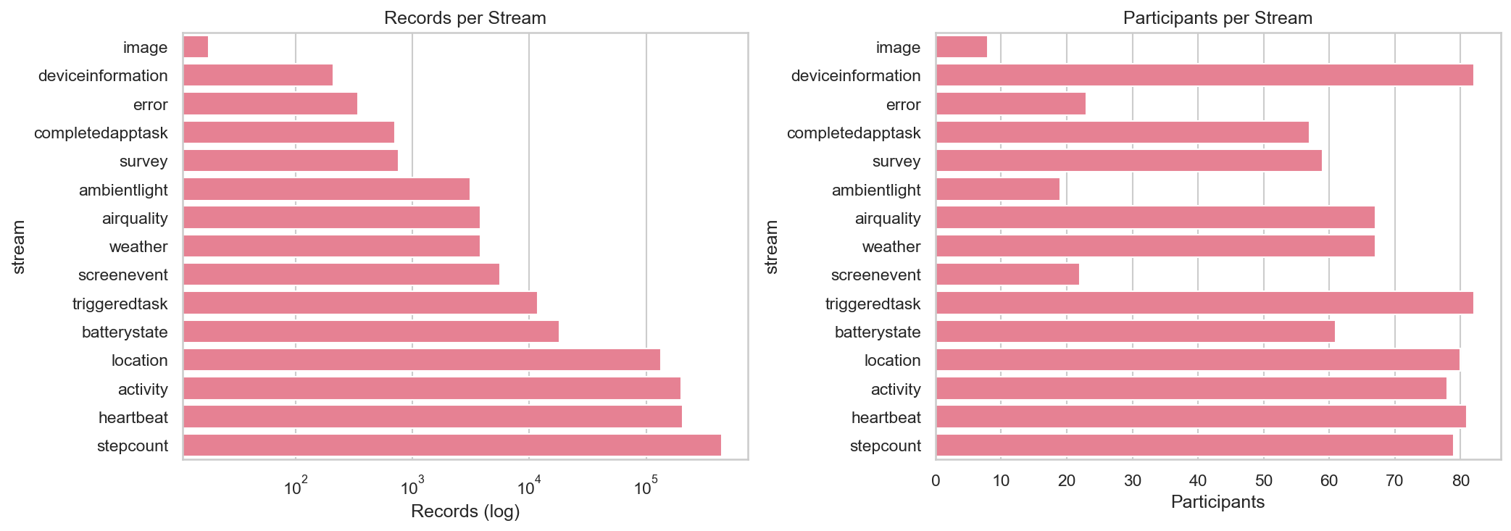

Slide 5
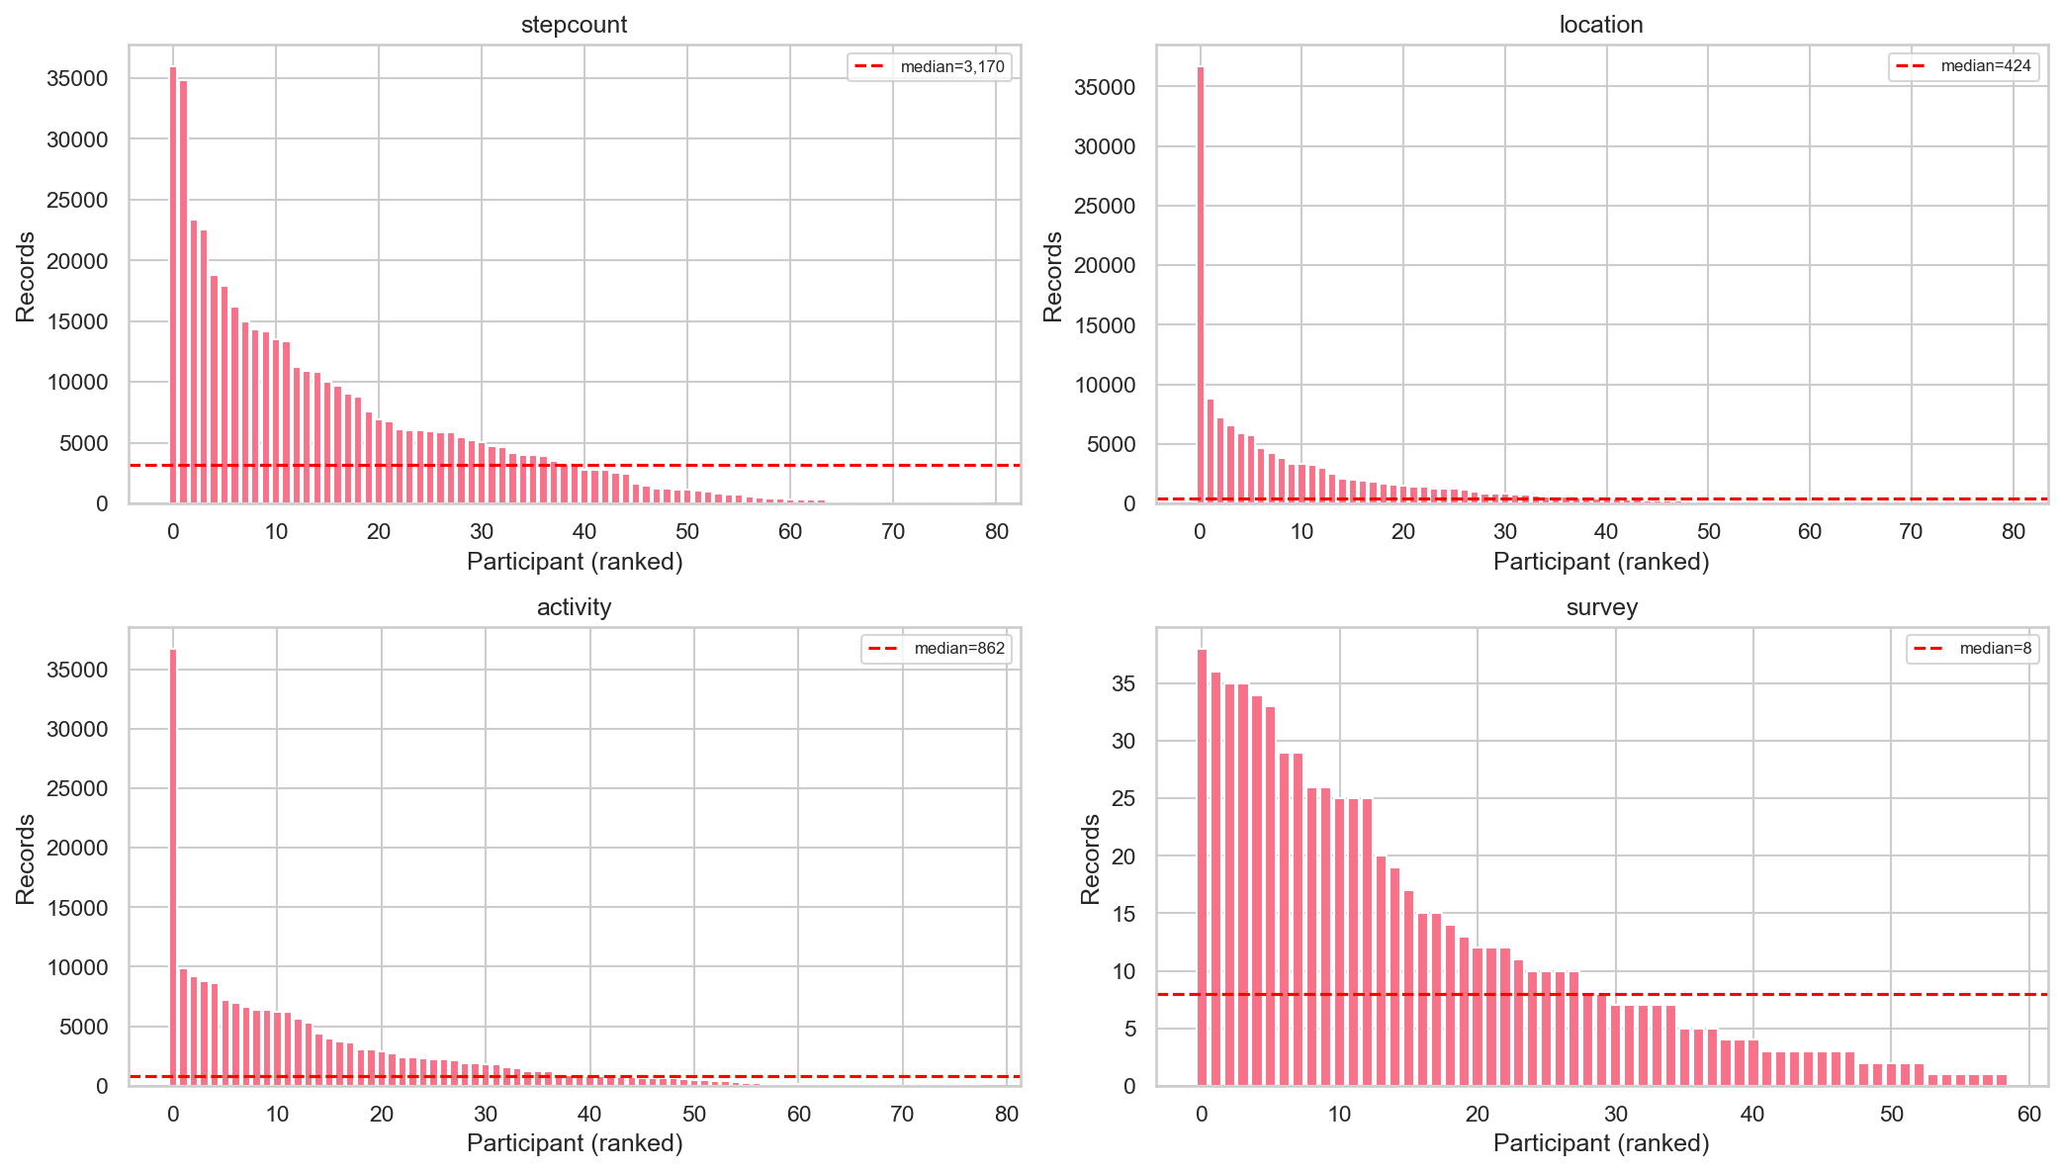
Records per Participant
• Large spread in data contribution across participants
• Step count: ranges from <1,000 to >30,000 entries per person

Slide 6
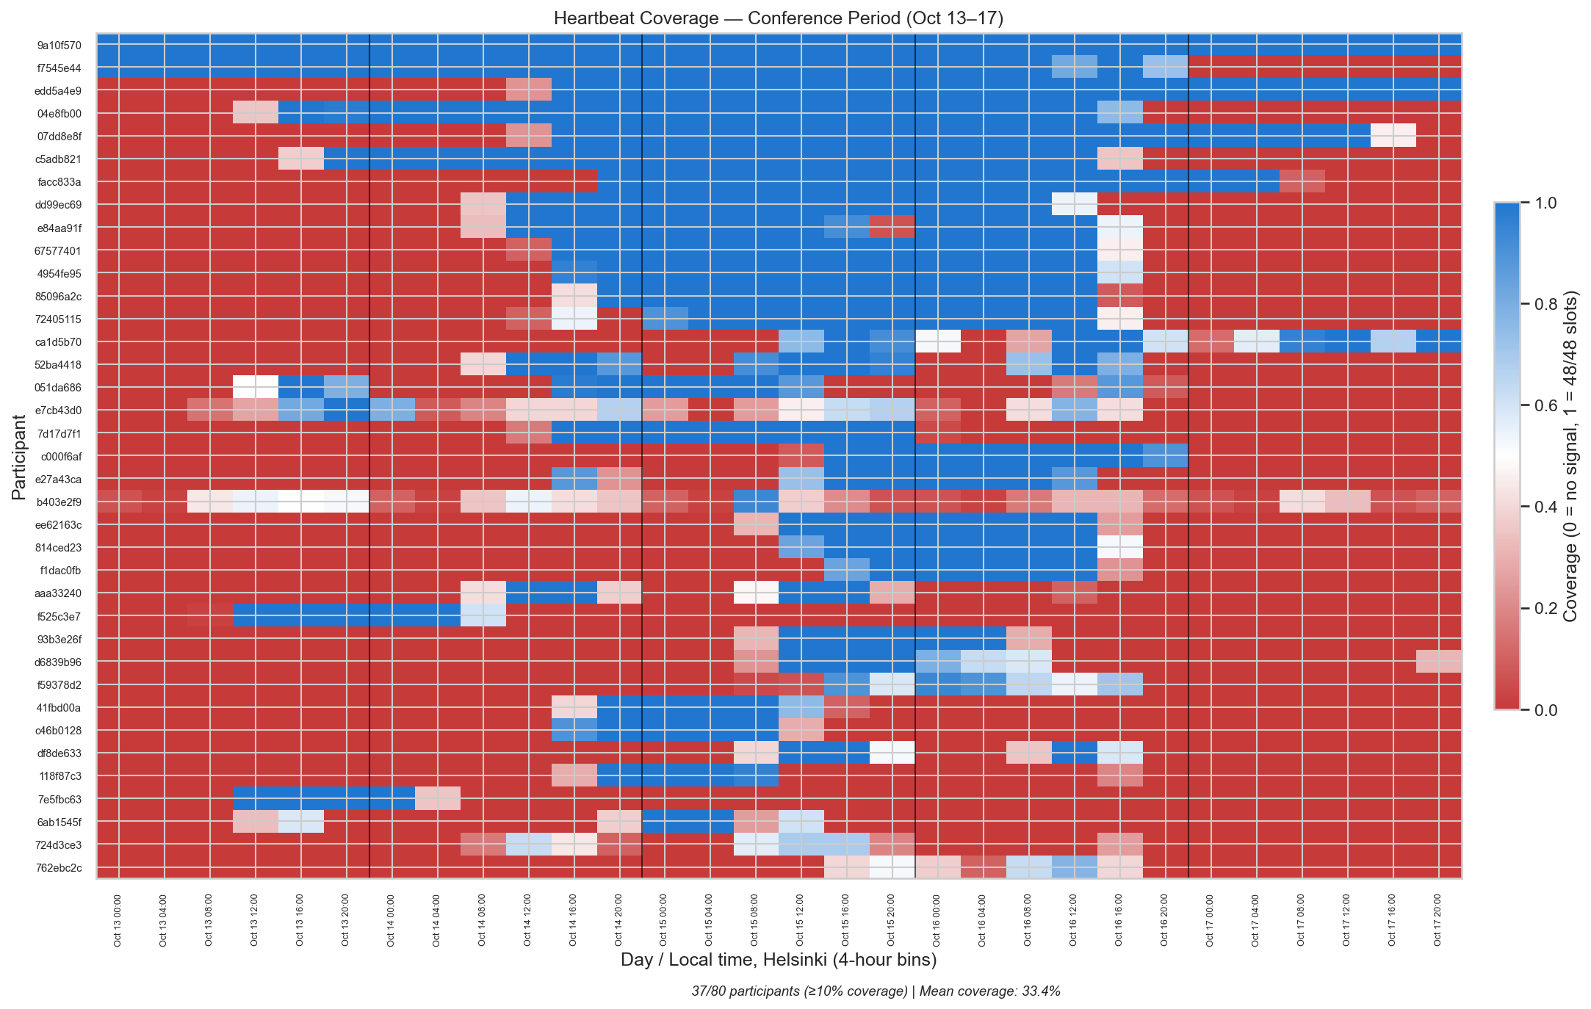
Temporal Coverage — Heartbeat Heatmap
• Data collection: Oct 9–29; main conference: Oct 13–17
• Mean heartbeat coverage during conference: 33.4%
• Night hours (00:00–06:00) show consistently lower coverage

Slide 7
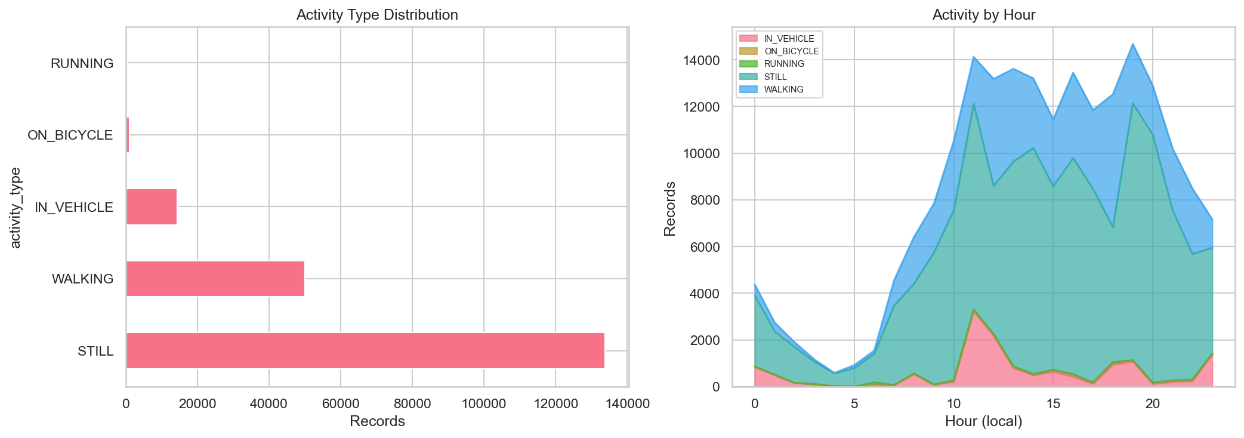
Activity Recognition
• Five activity types: STILL, WALKING, IN_VEHICLE, RUNNING, ON_BICYCLE
• STILL dominates nighttime (00:00–06:00)
• WALKING peaks during conference hours (09:00–18:00)

Slide 8
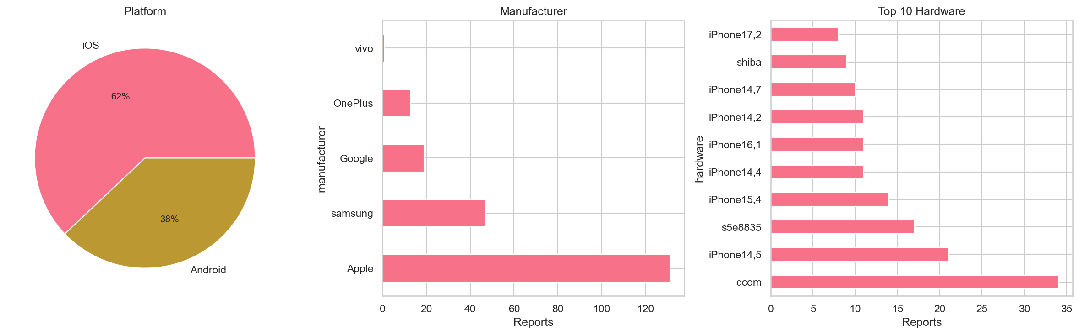
Device Diversity
• Both iOS and Android platforms represented
• Manufacturers: Apple, Samsung, Google

Slide 9
Survey Overview
Survey Type | Submitted | Participants
Daily stress | 70 | 36
Daily sleep | 64 | 36
Onboarding | 39 | 38
BFI-10 (Big Five) | 44 | 42
WHO-5 (wellbeing) | 37 | 37
Session ratings | 129 | 7–30
Keynote ratings | 76 | 18–35

Slide 10
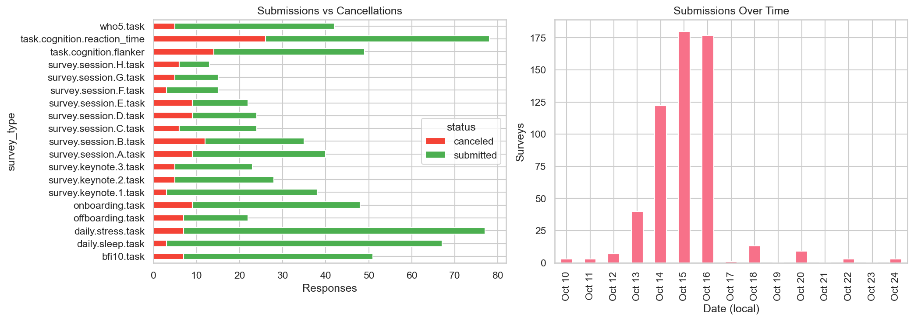
Survey Overview
• 711 survey triggers, 561 submitted (78.9% completion)
• Submissions peaked Oct 14–16

Slide 11
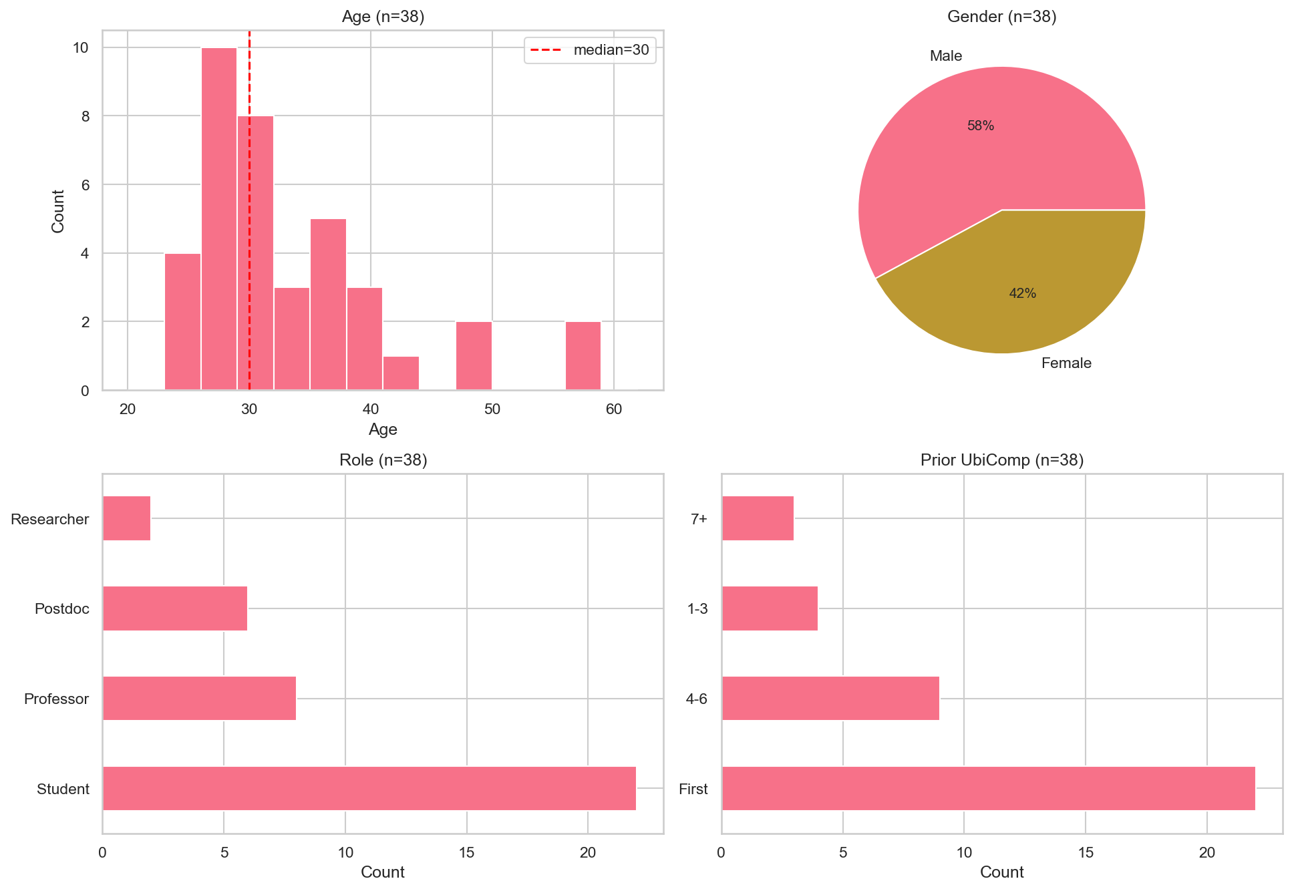
Demographics
• 38 participants with valid age data (median 30, range 23–58)
• Gender: 58% male, 42% female
• Roles: 58% students, 21% professors, 16% postdocs, 5% researchers
• 58% attending UbiComp for the first time
• 23.7% had attended 4–6 previous editions

Slide 12
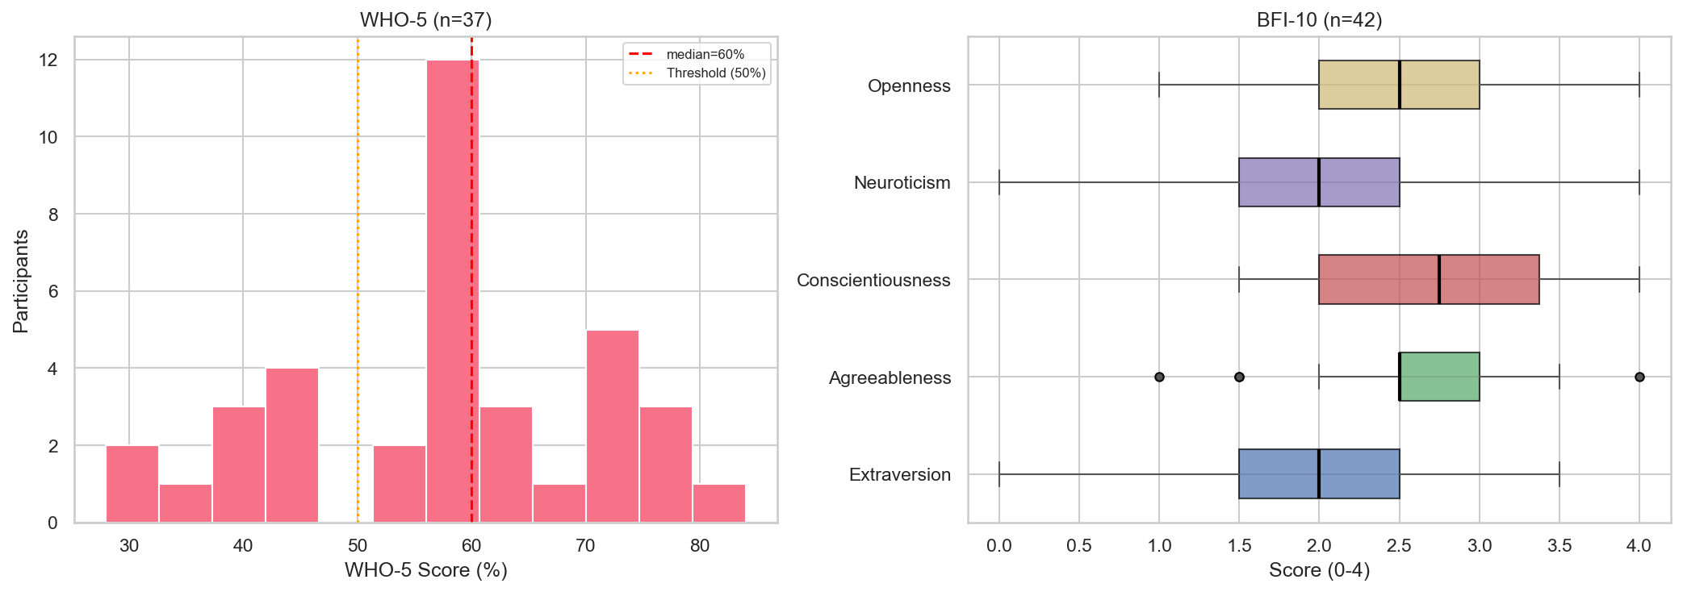
Wellbeing (WHO-5) & Personality (BFI-10)
WHO-5 Well-Being Index (n=37)
BFI-10 Personality (n=42, scale 0–4)
• Scores: 28%–84%, median 60%, mean 57.4%
• 27.0% below 50% depression-risk threshold
• (vs. 15–20% in general population)
• Conscientiousness highest (2.74) — typical for academics (ref 2.5-2.8)
• Neuroticism lowest (1.92) but widest spread (ref 2.0-2.5)
• Moderate extraversion (2.07) (ref 2.3 – 2.7)
• Agreeableness (2.68) (ref 2.5-2.8)
• Openness (2.42) (ref 2.5-3.0)

Slide 13
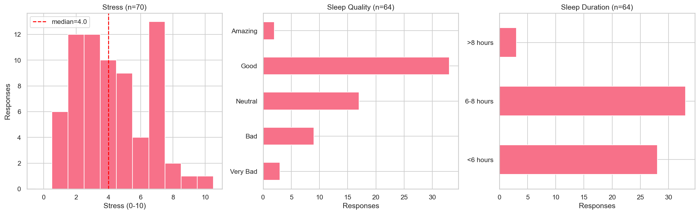
Daily Stress & Sleep
Stress (70 responses, 36 participants)
Sleep (64 responses)
• Scale 0–10; median 4.0, mean 4.3 — moderate overall
• 51.6% reported "Good" quality, but ...
• 43.8% slept fewer than 6 hours
• Only 4.7% got more than 8 hours

Slide 14
Data Preparation
1. Filtering to Conference Period (Oct 13–16)
• Screen events kept 99.1%, step count 87.9%, activity 83.3%
• Location 70.0%, ambient light 64.0%, heartbeat 51.9%
2. Step-Count Processing
• Raw cumulative pedometer → per-interval step deltas
• Clip negative values (counter resets) to zero; fill NaN with zero
3. Survey Parsing
• Raw JSON columns with nested answer structures → clean typed columns
• Custom parsers for each survey type: onboarding, stress, sleep, WHO-5, BFI-10, event ratings
• WHO-5: five items (0–5) → raw sum × 4 = percentage score
• BFI-10: ten items with reverse coding → five personality trait scores

Slide 15
Processed Outputs
~22 MB across 17 Parquet files
Sensor Data (9 files)
Survey Data (6 files)
File | Rows | Participants
stepcount | 393,300 | 77
activity | 166,047 | 77
location | 93,209 | 78
heartbeat | 106,244 | 80
weather | 3,050 | 65
airquality | 3,033 | 65
batterystate | 13,263 | 58
screenevent | 5606 | 22
ambientlight | 1,993 | 19
File | Rows | Participants
survey_onboarding | 38 | 38
survey_daily_stress | 70 | 36
survey_daily_sleep | 64 | 36
survey_who5 | 37 | 37
survey_bfi10 | 42 | 42
survey_event_ratings | 205 | 38
• All sensor tables share common metadata: participant_id, timestamp, sequenceId, studyDeploymentId
• Survey tables use cleaned snake_case column names

Slide 16
Data Quality Notes
Heartbeat gaps
Mean coverage of 33.4% during the conference indicates frequent device disconnections. Affects reliability of keep-alive signals as a proxy for app uptime.
Night-time blind spots
All sensors show ~50% lower coverage after midnight. Analyses involving overnight behavior should account for systematic missingness.
Per-participant variance
Step-count records range from <1,000 to >30,000 across participants. Normalization or per-capita rates needed for fair cross-participant comparisons.

