Slide 1
Patient Safety Track
Team LADS
Akshat, Darren Tung, Liam, Shivani

Slide 2
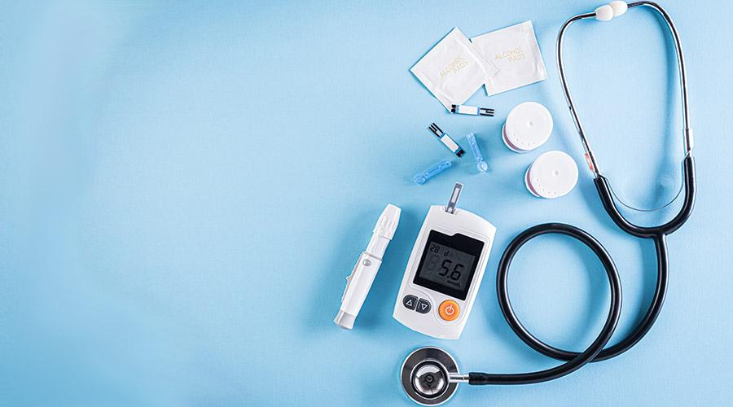
Addressing the Root Causes: Understanding the Factors Behind Adverse Events in Medical Device Usage
Despite advancements, medical devices still pose risks. This analysis aims to identify the core factors triggering adverse events. By investigating underlying issues such as design flaws, user errors, and inadequate training, we aim to pinpoint solutions. Unraveling these complexities is crucial for enhancing patient safety and advancing healthcare standards.
Approach:
Data Cleaning
Data pre-processing
Data Visualization
Visualization inference
Modelling: (Best) Machine learning model: XGBoost\ (AUC vs baseline score 50%)
Conclusion and Inference

Slide 3

Data Cleaning
complicated data structure. MUCH time spent extracting it (vs other tracks)
BIG dataset. 2022 (7GB), 2023 (3GB)
many empty values
mixed data types. Eg. Age contains both text “65 years” & numerical 65

Slide 4


Data limitations
Due to lazy / slipshod / voluntary reporting…
incomplete, inaccurate, untimely, unverified, or biased data
under-reporting of events
lack of information about frequency of device use

Slide 5
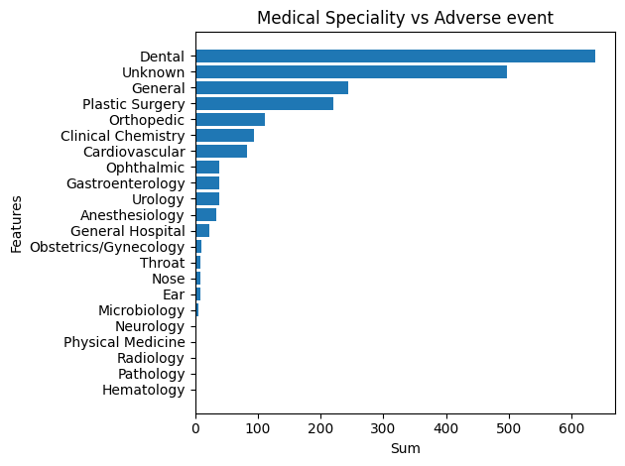
Device-Related Adverse Events
Within healthcare, significant occurrences of patient problems, resulting in adverse events linked to medical devices, are notably prevalent in diverse specialties including Dental, General Surgery, Plastic Surgery, Orthopedics, Clinical Chemistry, and Ophthalmic care.
Understanding these specific contexts is essential for targeted improvements in device design, usage protocols, and patient safety measures

Slide 6
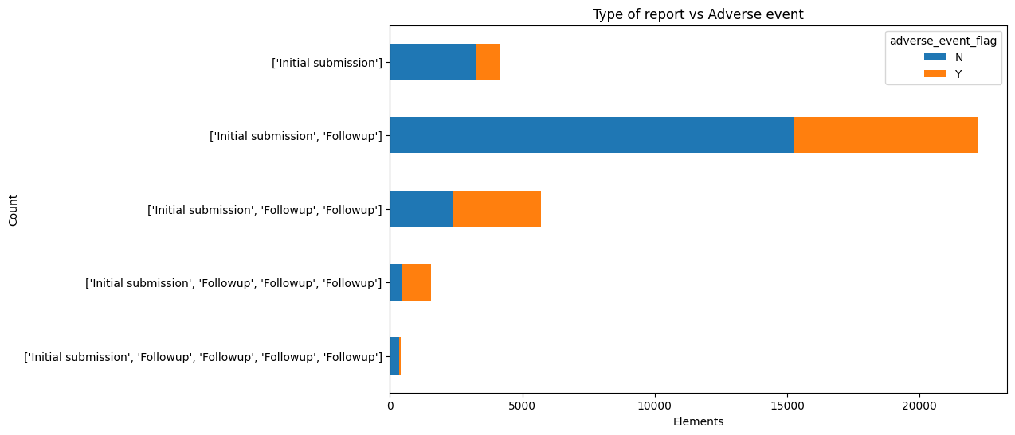
Follow-Up Frequency Insights
Many adverse events are identified during the first follow-up appointments. As the frequency of follow-ups decreases, the rate of adverse events also declines substantially.
regular and consistent follow-ups are IMPORTANT!
May mitigate the occurrence of adverse events
Notes:
May mitigate the occurrence of adverse events, promoting the overall safety and well-being of patients.

Slide 7
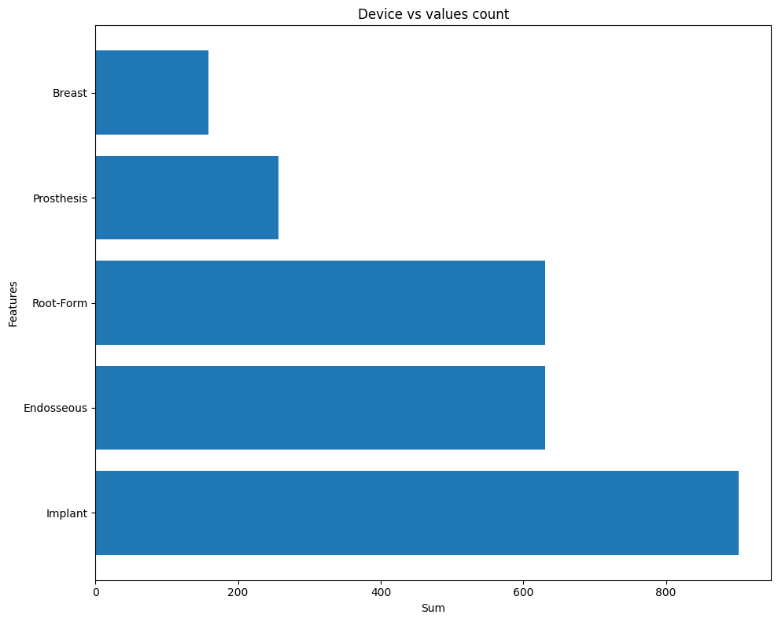
Device Adverse Events
In the visualization provided, we have presented the total count of adverse events associated with devices across various industries.
Upon analysis, it is evident that the majority of adverse events occur in cases where devices are implanted. Specifically, within the realm of implantable devices, the prevalence is higher in endosseous implants, followed by root form implants and prosthetics.

Slide 8
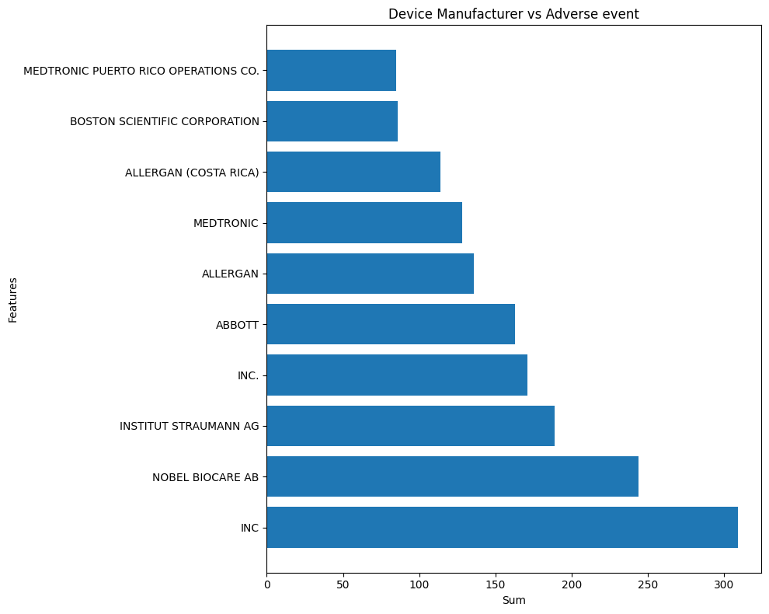
Manufacturer Adverse Events
In this visualization, we have depicted manufacturers whose devices have been associated with the highest number of adverse events.
This insight holds significant value, as it enables us to proactively engage with the respective manufacturers. We can consider reaching out to them for potential improvements or explore the possibility of diversifying our sources of supply to enhance product safety and quality.

Slide 9
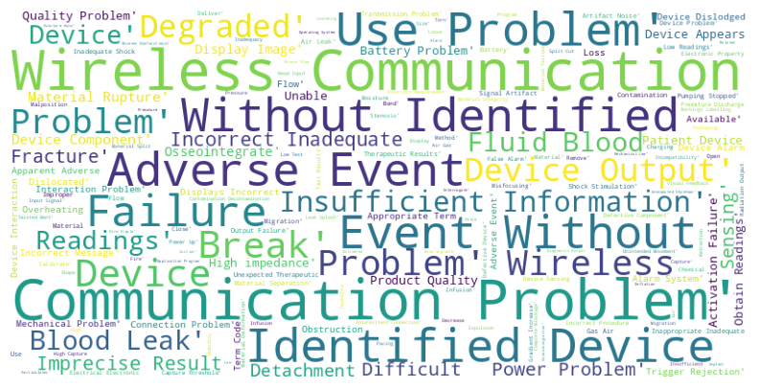
Unraveling the Link Between Product Challenges and Adverse Events
In medical devices, wireless communication issues pose a critical risk to patient safety, causing potential failures in timely data transmission and device coordination.
Device output failures further exacerbate the problem, highlighting the imperative need for robust systems to prevent adverse events and ensure reliable healthcare outcomes.

Slide 10
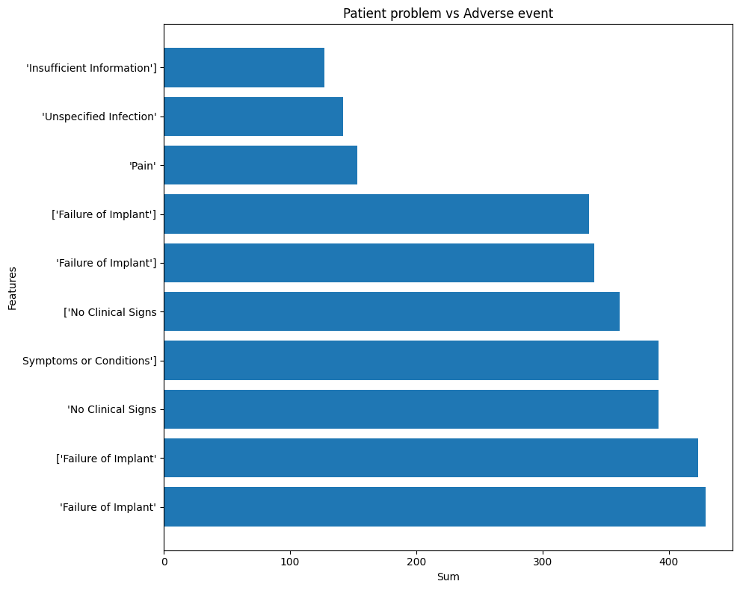
Adverse Event Insights
In this visualization, we have highlighted the specific problems reported by patients during adverse events.
These issues represent the most frequently occurring challenges reported in such situations. This insight provides valuable guidance for us to exercise caution when these events are reported. By identifying these common problems, we can proactively address potential adverse events, enhancing our ability to prevent them in the future.

Slide 11
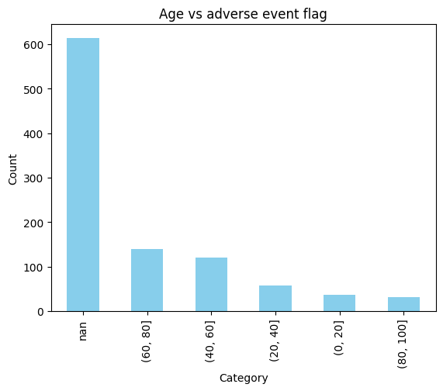
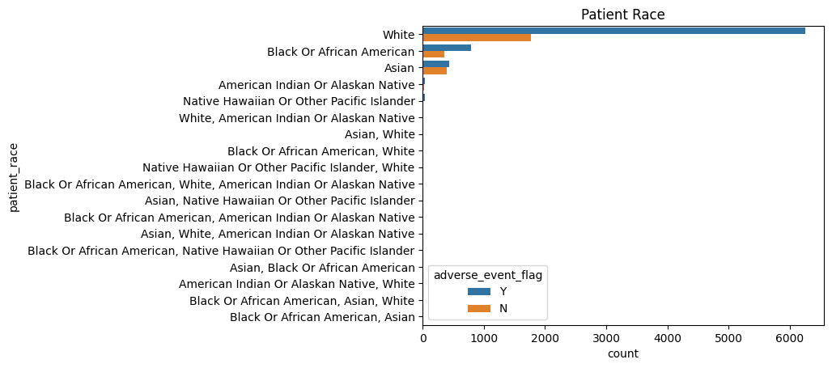
Demographic Factors Influence
Race Related Analysis
Age Related Analysis
Variations in healthcare quality, accessibility, and cultural competence contribute to discrepancies in outcomes. Limited access to advanced medical facilities and specialized care might lead to a higher reliance on devices that are prone to errors, thereby increasing the impact on these communities.
Representation and Reporting: Higher representation of these groups in healthcare systems could lead to a higher likelihood of reporting adverse events. In contrast, underreporting within the Asian population might skew the data, making it seem like they are less affected by faulty medical devices.
Age-Related Factors: Adverse events from device errors are most prevalent in the 60-80 age group, potentially due to age-related declines in sensory perception and manual dexterity, increasing the risk of device misuse.
Midlife Challenges: The 40-60 age group follows closely, facing diverse health challenges, possibly influencing device-related errors. Awareness campaigns and tailored device designs can address age-specific concerns, enhancing overall patient safety.

Slide 12
Summary
Our analysis pinpointed patient age, implantable device types, and follow-up frequency as major factors contributing to adverse events.
Addressing age-related challenges, refining device designs, and emphasizing consistent follow-ups are key strategies. By focusing on these areas, we can significantly enhance patient safety, minimize errors, and ensure optimal healthcare outcomes.

Slide 13
Modelling
Baseline score to beat: 50% (random guess of Adverse or Not)
2 models: XGBoost Classifier, Random Forest
ROC AUC Scores
Random Forest: 99%
XGB: 98%
Notes:
XGBoost: Gradient Boosting (Predict residuals and use results to predict next tree)
Random Forest: Randomly trains trees and averages results

Slide 14
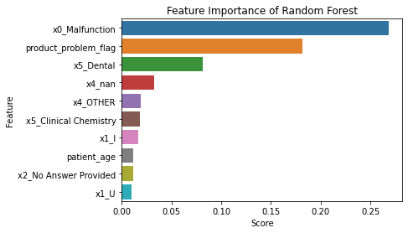
Feature Importance
Notes:
X0 = Event Type
X5 = OpenFDA Medical Specialty Description
X4 = Event Location
X1 = Previous Use Code
X2 = Patient Sex

Slide 15
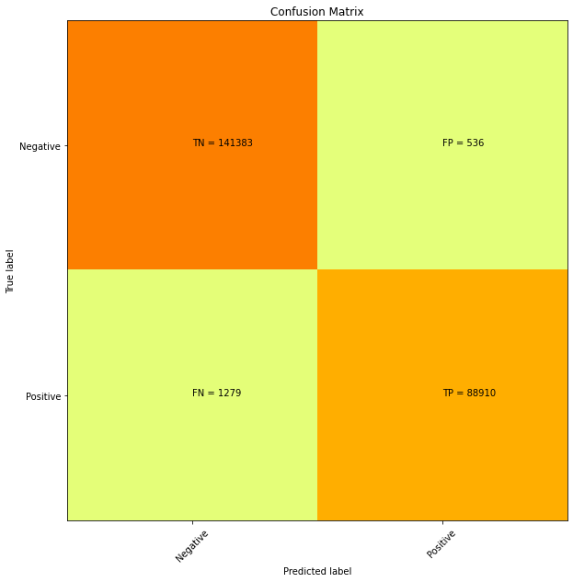

Confusion Matrix

Slide 16

Future work
Approach
Predict also Severity of Adverse Event (eg. “Death”, or simply “Intervention Required” etc)
Dataset
earlier years
Other FDA datasets (eg. 501k Risk Classification of products, Product recall data)
Alternative/more reliable datasets (eg. Patient interviews)
Model
Adverse
Not
Death
Disability
Intervention needed

Slide 17
Code Link
https://drive.google.com/drive/folders/10S4sfU0Ibugiqso3w-k-5532IMhTwUb9?usp=sharing

