Slide 1

Building Cloud Native Microservices with Spring Cloud
David Turanski, Pivotal Software

Slide 2

Microservices
…the microservice architectural style is an approach to developing a single application as a suite of small services, each running in its own process and communicating with lightweight mechanisms, often an HTTP resource API.
http://martinfowler.com/articles/microservices.html

Slide 3
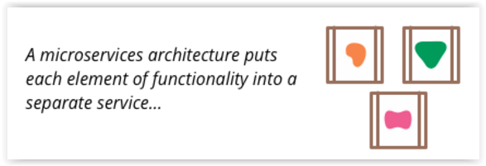
Microservices Architecture
E
L
Services managed as products, with their own lifecycle
Smart endpoints and dumb pipes
Decentralized
Code
Data
Deployment
Governance
T
Notes:
These are choreographed using simple RESTish protocols rather than complex protocols such as WS-Choreography or BPEL or orchestration by a central tool.

Slide 4
Microservices in the Cloud
Cloud Native: Application architecture suitable for deployment on modern cloud platforms
http://12factor.net/
Decompose applications into smaller services that can be independently developed, deployed, and scaled
Services communicate via remote protocols, e.g. REST, messaging
Agility: Maximum flexibility, minimum time to market
Simple yet complex!

Slide 5
Microservices Ecosystem
Make jar not war:
Self contained apps, no external containers required
DevOps friendly
Make docker not jar….
New patterns and runtime services
Service Discovery, Circuit Breaker, Client Side Load Balancing, Dynamic Routing, Leader Election, Canary Deployment, …

Slide 6

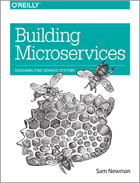
Recommended Reading

Slide 7



Spring Ecosystem
Spring Boot
Popular way to quickly build microservice applications
Spring Cloud
Family of projects to support microservice applications
Notes:
RabbitMQ – Routing use case
Kafka – High speed ingest use cases

Slide 8
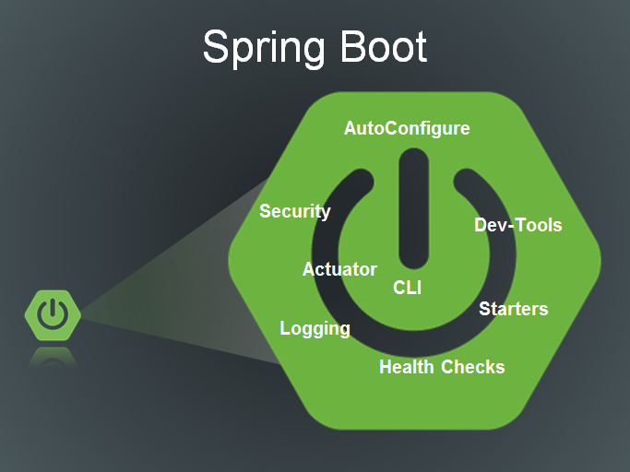

Slide 9





Spring Cloud
Hystrix
Eureka
Ribbon
Zuul
Feign
Service Discovery
Leader Election,
Global locks
Config Server
Distributed Tracing

Slide 10

Spring Cloud: There’s a lot of stuff here…
Spring Cloud Config
Spring Cloud Netflix
Spring Cloud Bus
Spring Cloud for Cloud Foundry
Spring Cloud Cluster
Spring Cloud Consul
Spring Cloud Security
Spring Cloud Sleuth
Spring Cloud Data Flow
Spring Cloud Stream
Spring Cloud Stream Starters
Spring Cloud Task
Spring Cloud Zookeeper
Spring Cloud for Amazon Web Services
Spring Cloud Connectors
Spring Cloud Starters
Spring Cloud CLI
Distributed/versioned configuration
Service registration and discovery
Routing
Service-to-service calls
Load balancing
Circuit Breakers
Global locks
Leadership election and cluster state
Distributed messaging

Slide 11
Spring Cloud Config

Slide 12
Config Server
12 factor: Strict separation of configuration from code
Things are likely to change in different enviroments
This does not include internal configuration
Environment variables are good but hard to centrally manage
Namespace support for application, Spring profile, and version
{application}-{profile}-{label}.properties
Or repo per application, or repo per profile
Encrypted property values
Spring-cloud-bus: pub-sub refresh to all config clients
Push notification e.g., via webhooks

Slide 13
Spring Cloud Config
POST /refresh
POST /env
POST /env/reset

Slide 14
Spring Cloud Bus

Slide 15
Push Notification

Slide 16
Demo: Spring Cloud Config
Notes:
To change specific properties: curl -X POST http://localhost:8888/bus/env -d info.foo=zoob -d info.bar=bobo
Update logging levels at runtime:
curl -X POST http://localhost:8888/bus/env -d logging.level.com.example=DEBUG
curl -X POST http://localhost:8888/bus/env -d logging.level.com.example=INFO
To activate GitHub webhooks: ngrok http 8888

Slide 17
References
https://projects.spring.io/spring-cloud/
http://cloud.spring.io/spring-cloud-static/spring-cloud.html
https://cloud.spring.io/spring-cloud-config/

Slide 18

Questions?

Slide 19
Thank You.

