Slide 1
Apollo Client React
Dang Tuan Vu

Slide 2


Start
Requirements
Development
Setup
Data
Production
Integration
Apollo Link (networking)
Caching
Testing
Performance
Structure

Slide 3
START

Slide 4
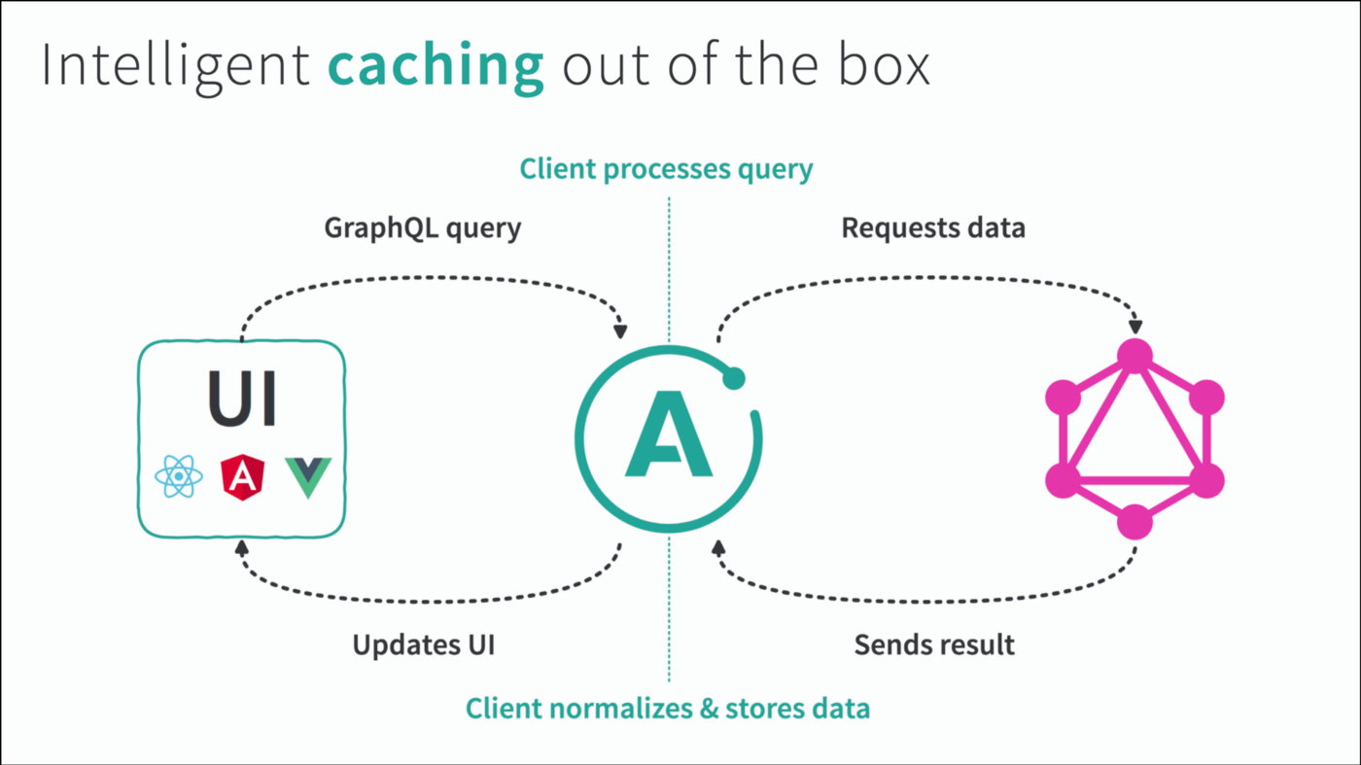
Start – Structure
Reference: https://blog.apollographql.com/apollo-client-2-0-beyond-graphql-apis-888807b53afe

Slide 5
Start – Requirements
Javascript
ReactJS
GraphQL
MySQL & SQL (Optional)

Slide 6
DEVELOPMENT

Slide 7
Development – Setup
Create a ReactJS app
Install required components
Apollo-boost: Package containing everything you need to set up Apollo Client.
@apollo/react-hooks: React hooks-based view layer integration.
GraphQL: Package to parse your GraphQL queries.
Optional components:
Apollo-Link and et al: control flow of GraphQL requests and fetching GraphQL results, e.g. using automatic persisted queries

Slide 10
PRODUCTION

Slide 12
END

Slide 13
APPENDIX

