Slide 1
Apollo Client React
Dang Tuan Vu

Slide 2


Start
Requirements
Development
Setup
Data
Production
Integration
Apollo Link (networking)
Caching
Testing
Performance
Structure

Slide 3
START

Slide 4
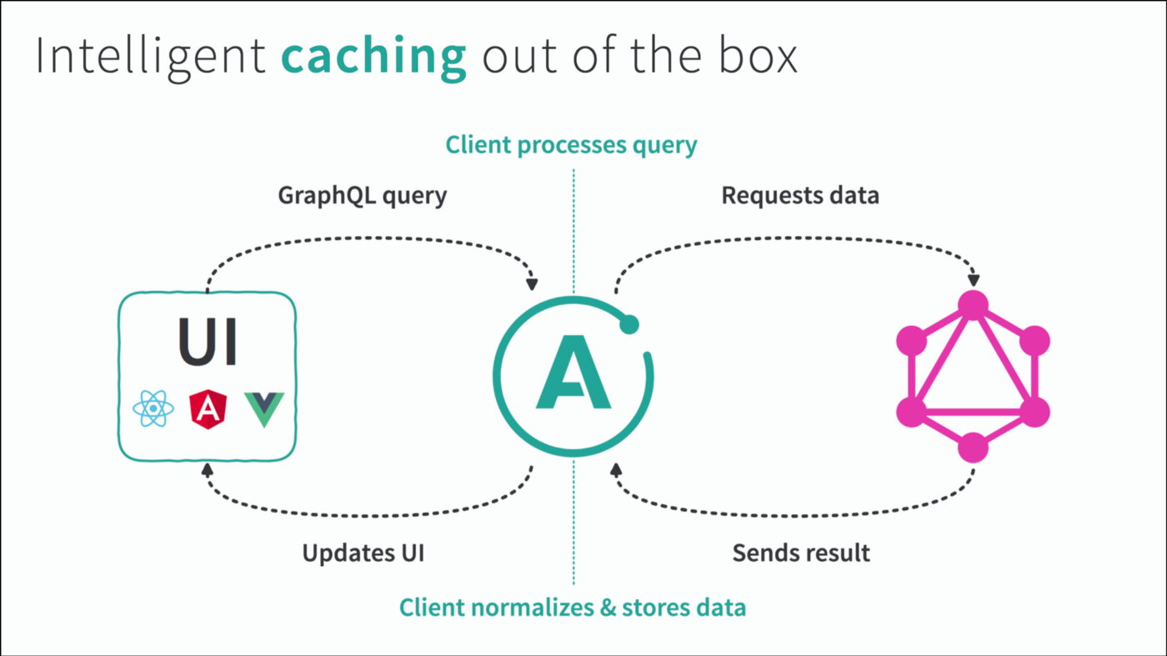
Start – Structure
Reference: https://blog.apollographql.com/apollo-client-2-0-beyond-graphql-apis-888807b53afe

Slide 5
Start – Requirements
Javascript
ReactJS
GraphQL
MySQL & SQL (Optional)

Slide 6
DEVELOPMENT

Slide 7
Development – Setup
Create a ReactJS app: npx create-react-app my-app
Install required components
Apollo-boost: Package containing everything you need to set up Apollo Client.
@apollo/react-hooks: React hooks-based view layer integration.
GraphQL: Package to parse your GraphQL queries.
Add a component from Apollo Provider to wrap the react app

Slide 8
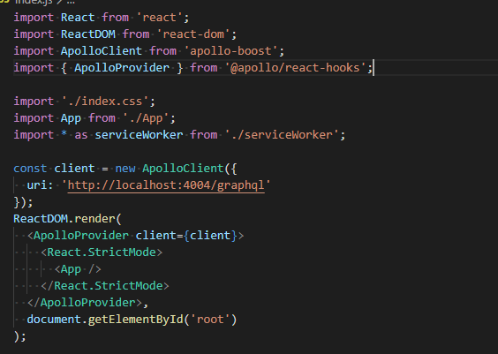
Development – Setup
Add a component from Apollo Provider to wrap the react app

Slide 9
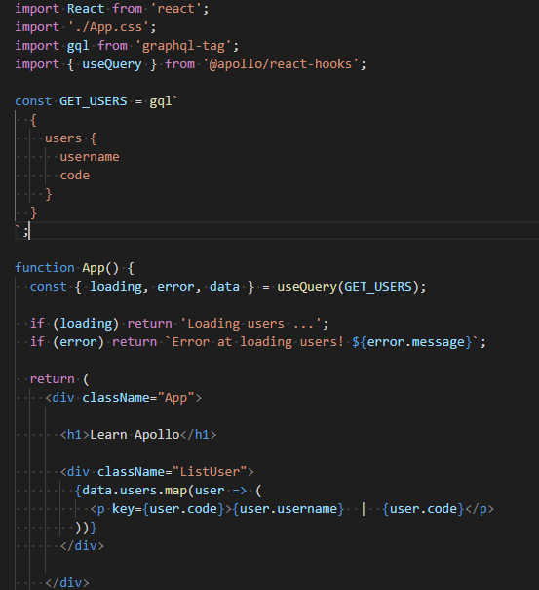
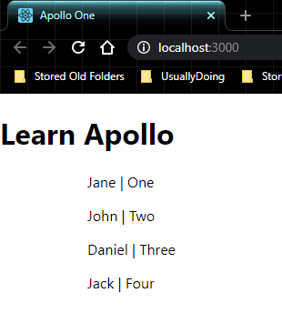
Development – Data
Query

Slide 10
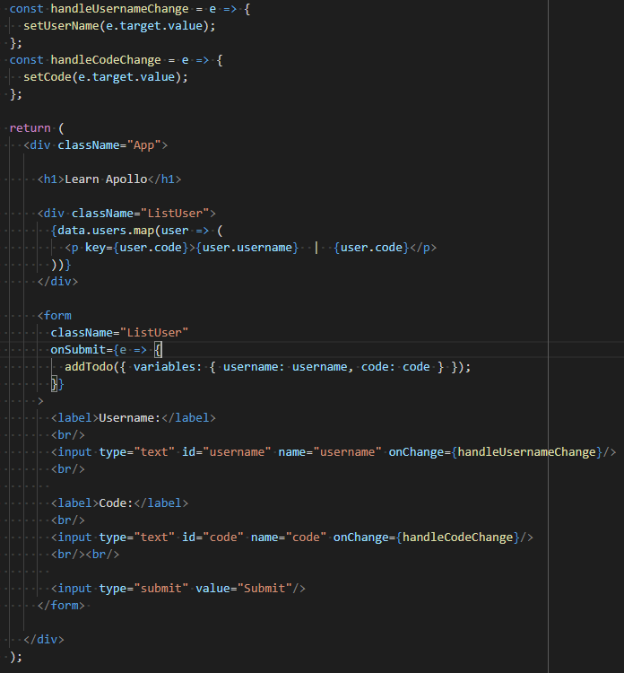
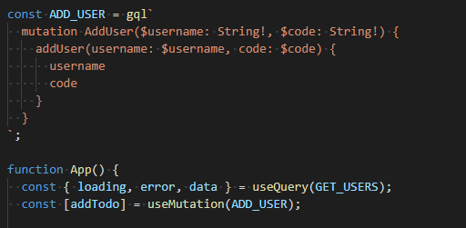
Development – Data
Mutation

Slide 11
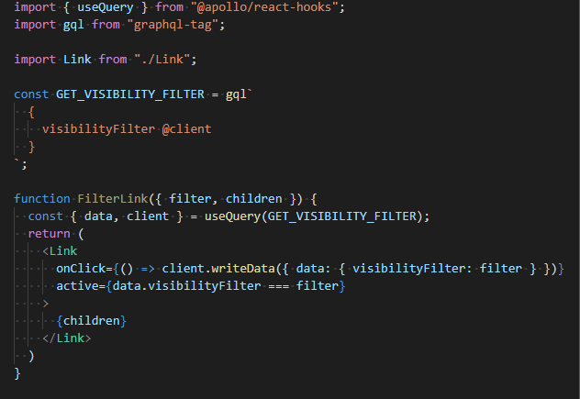
Development – Data
Local State: store inside Apollo cache by 2 way
Leverage Apollo Client

Slide 12
Development – Data
Local State: store inside Apollo cache by 2 way
Leverage Apollo Client

Slide 13
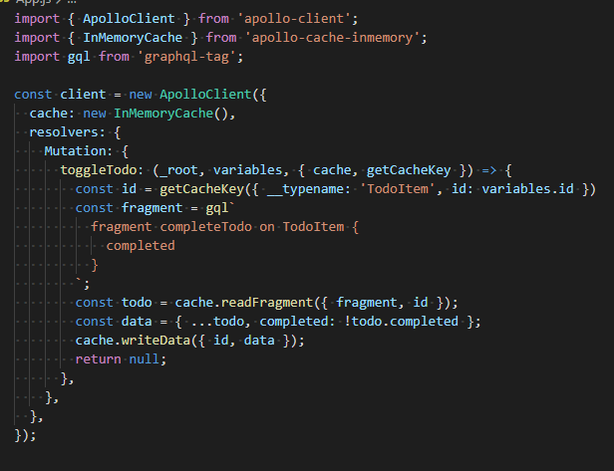
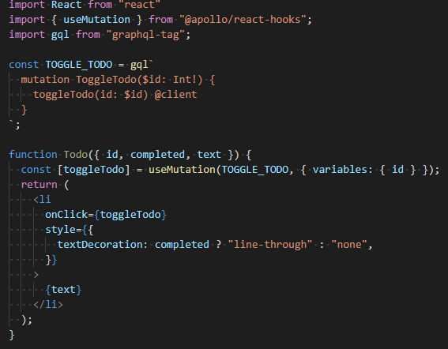
Development – Data
Local State: store inside Apollo cache by 2 way
Local resolver

Slide 14
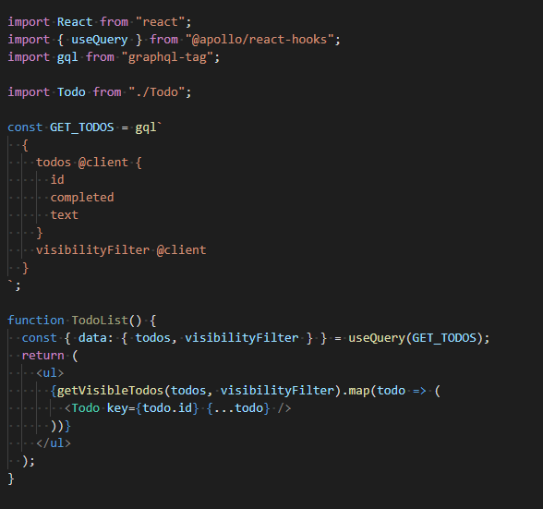
Development – Data
Local State: store inside Apollo cache by 2 way
Local resolver
Details at https://www.apollographql.com/docs/react/data/local-state/

Slide 15
Development – Data
Subscriptions (notify event from the server to clients)
Details at https://www.apollographql.com/docs/react/data/subscriptions/
Example at https://github.com/the-road-to-graphql/fullstack-apollo-subscription-example

Slide 16
Development – Data
Pagination:
Display a list that contains too much data to be either fetched or shown at once.
2 primary ways: numbered pages (offset), and cursors

Slide 17
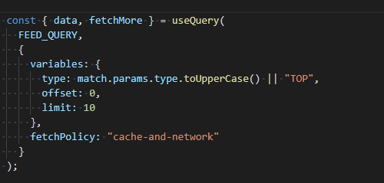
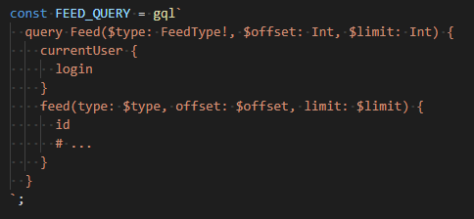
Development – Data
Pagination - offset:
Add offset and limit to query.

Slide 18
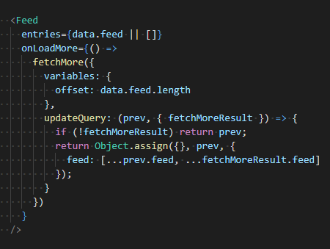
Development – Data
Pagination - offset:
Use fetchMore to load the next part

Slide 19
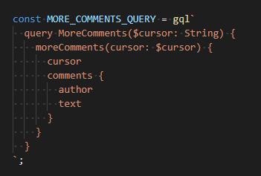
Development – Data
Pagination - cursor:
Declare cursor in GraphQL string

Slide 20
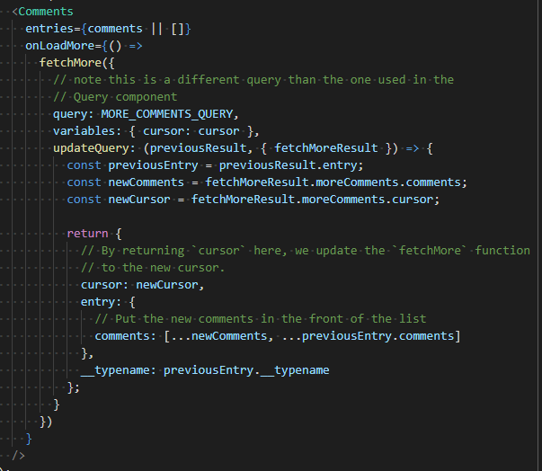
Development – Data
Pagination - cursor:
Use fetchMore to load the next part

Slide 21
Development – Data
Error handling:
GraphQL errors: errors in the GraphQL results that can appear alongside successful data
Server errors: server internal errors that prevent a successful response from being formed
Transaction errors: errors inside transaction actions like update on mutations
UI errors: errors that occur in your component code
Apollo Client errors: internal errors within the core or corresponding libraries

Slide 22
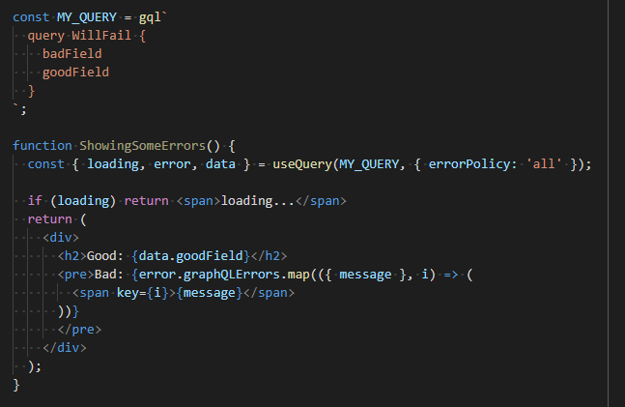
Development – Data
Error handling

Slide 23
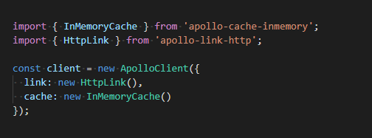
Development – Caching
Install package apollo-cache-inmemory
Add cache to Apollo Client

Slide 24
Development – Caching
The InMemoryCache normalizes query results before saving them to the cache by
Splitting the results into individual objects
Assigning a unique identifier to each object
Storing the objects in a flattened data structure

Slide 25
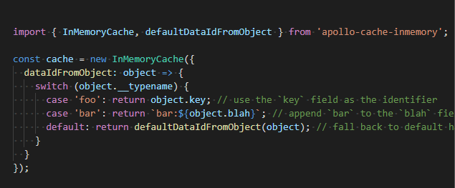
Development – Caching
The InMemoryCache customization for configuration sample

Slide 26
Development – Caching
Method to interact with cache:
readQuery
readFragment
writeQuery
writeFragment

Slide 27
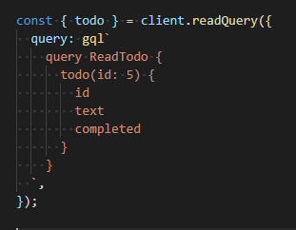
Development – Caching
Method readQuery runs GraphQL queries directly on your cache

Slide 28
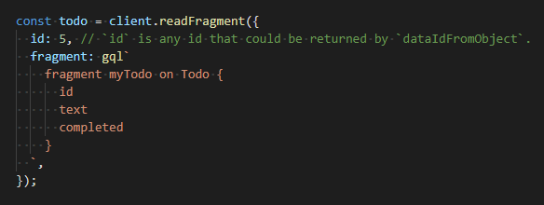
Development – Caching
Method readFragment reads data from any normalized cache object that was stored as part of any query result.

Slide 29
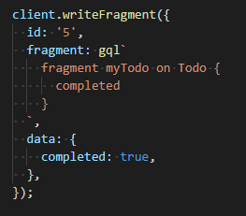
Development – Caching
Method writeQuery & writeFragment write arbitrary data to the cache

Slide 30
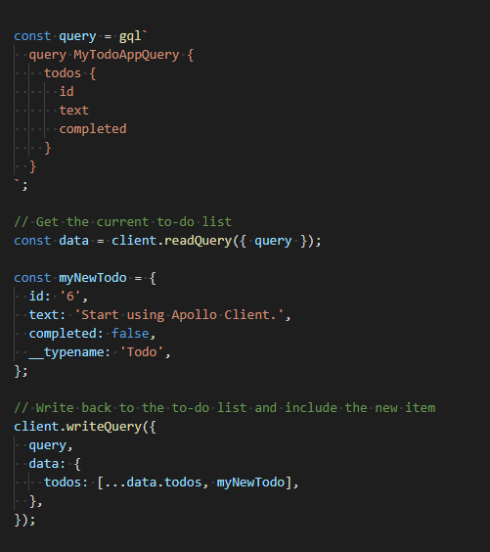
Development – Caching
Combine readQuery
and writeQuery

Slide 31
Development – Testing
Install package @apollo/react-testing
Using Test-renderer: https://reactjs.org/docs/test-renderer.html
In order to test component which use features from Apollo Client
Use a mock provider from @apollo/react-testing

Slide 32
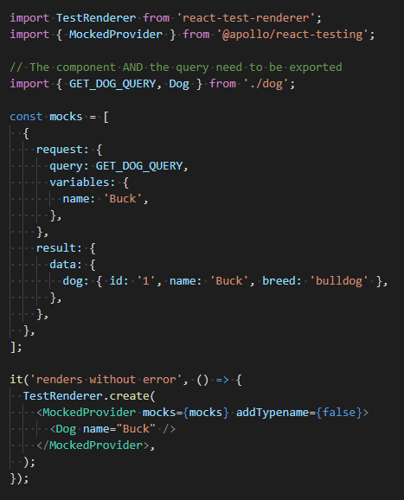
Development – Testing
Sample

Slide 33
PRODUCTION

Slide 34
Production – Performance
Redirecting to cached data
Prefetching data
Query splitting
Automatic persisted queries

Slide 35
Production – Integration
The list of integrated client:
React
Vue
Angular
Ember
Web components
Store queries in a file and load it with Webpack

Slide 36
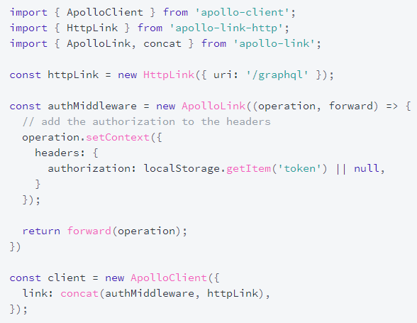
Production - Networking
Using Apollo Link to config network layer (header, context, authorization, …)

Slide 37
END

