Slide 1
Apollo Server
Dang Tuan Vu

Slide 2


Start
Sample application
Requirements
Development
Schema
Data
Production
Integration
Deployment
Federation
Testing
Performance
Security
Structure

Slide 3
START

Slide 4
Start – Structure
Apollo Servers
Service A
Resolvers
Client App
Gateway
Apollo Server
typeDefs (Schema)
…
configuration
Service B
… services
Reference: https://www.apollographql.com/docs/apollo-server

Slide 5
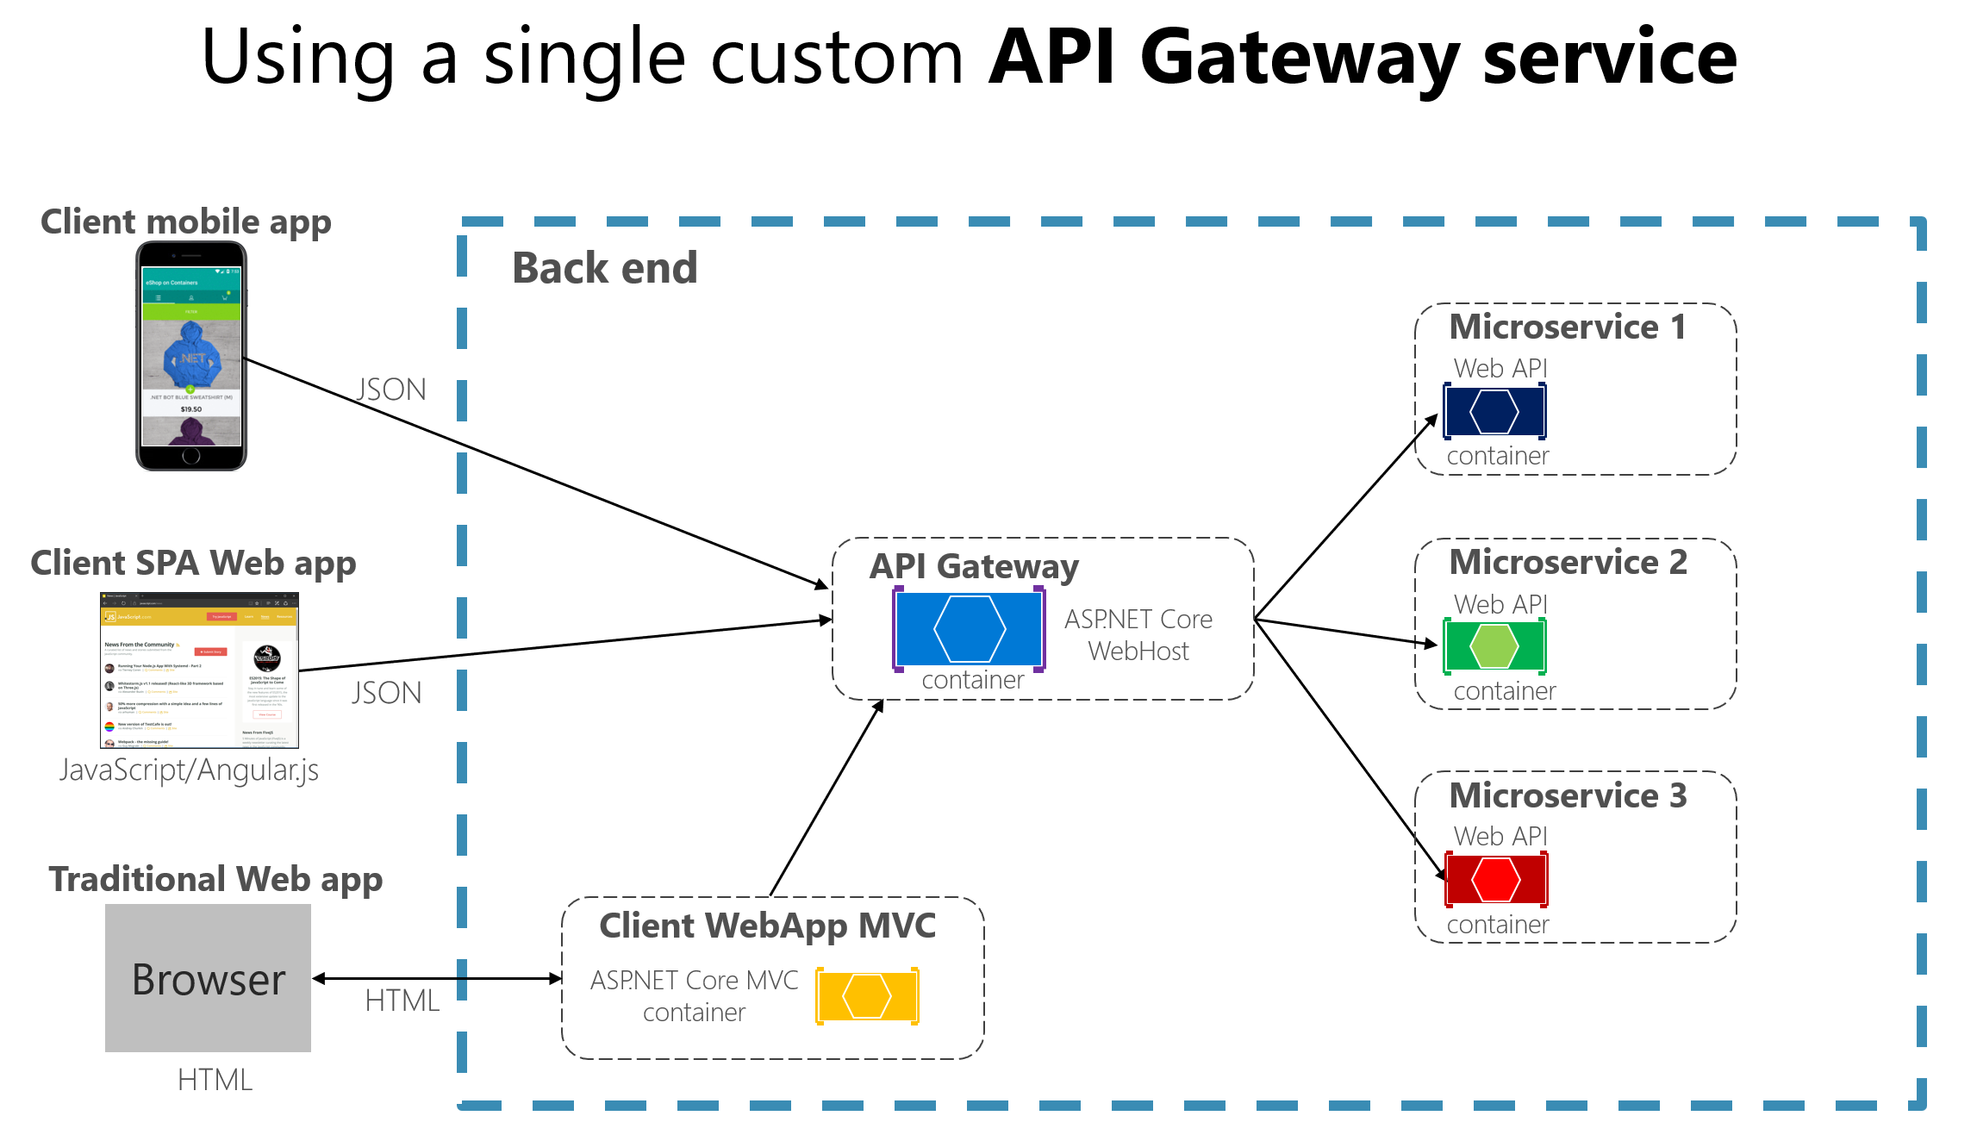
Sample gateway implementation in C#
Reference: https://docs.microsoft.com/en-us/dotnet/architecture/microservices/architect-microservice-container-applications/direct-client-to-microservice-communication-versus-the-api-gateway-pattern

Slide 6
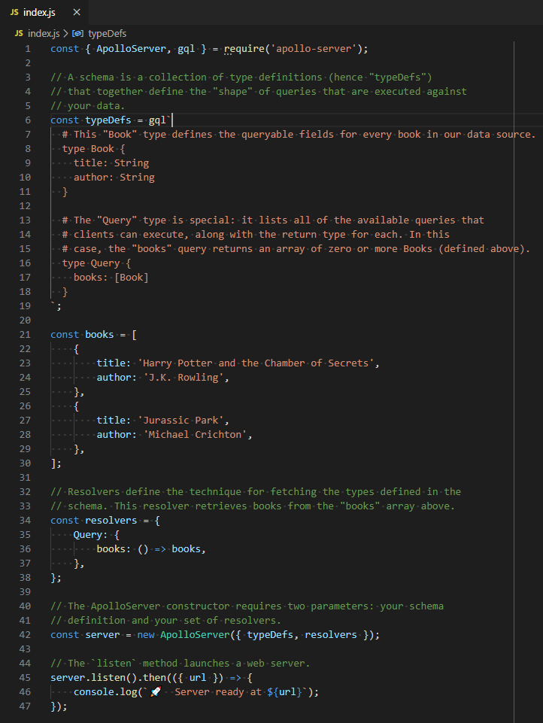
Start – Sample Application
Reference: https://www.apollographql.com/docs/apollo-server/getting-started/

Slide 7
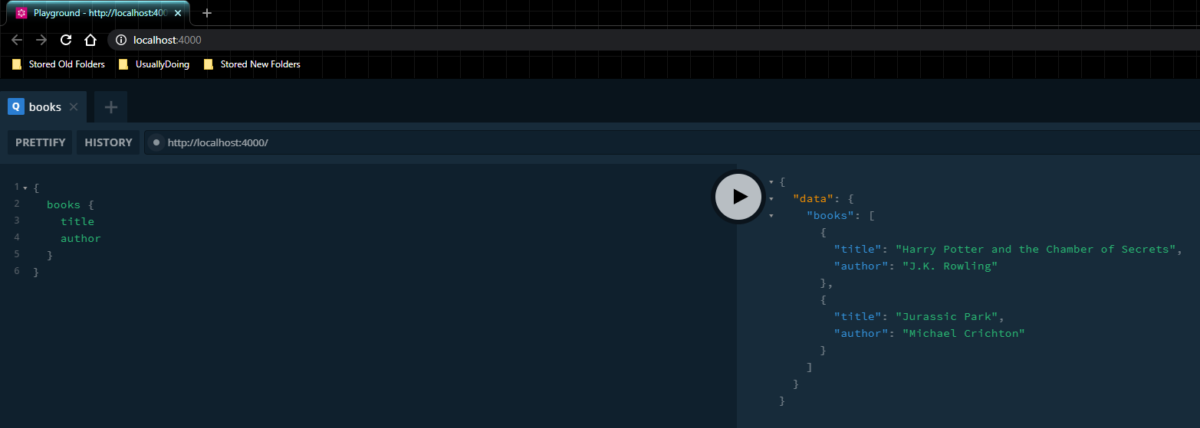
Start – Sample Application
Reference: https://www.apollographql.com/docs/apollo-server/getting-started/

Slide 8
Start – Requirements
Javascript
NodeJS
GraphQL
MySQL & SQL (Optional)

Slide 9
DEVELOPMENT

Slide 10
Sample program’s design
An elementary student management program with features:
Officers add a new student
Officers add a new teacher
Officers add a new course definition
Teacher create a course
Teacher update student grade in the course
Students update information
Student register courses
Officers update course information

Slide 11
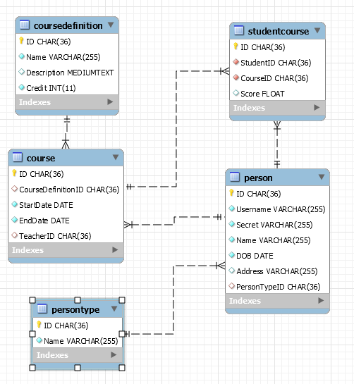
Sample program’s design
Schema

Slide 12
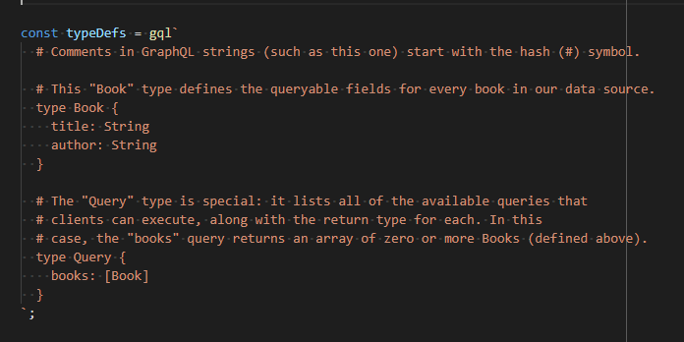
Development – Schema
Define a structure of a schema for users to query.

Slide 13
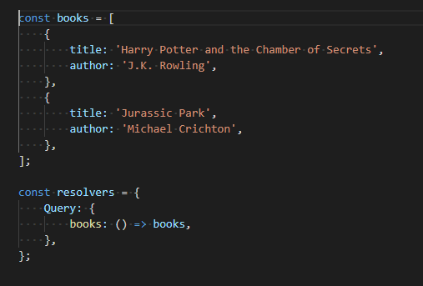
Development – Data
Has a resolver to map functions from schema to actions in the services.

Slide 14
Development – Data
Has a data-source rest for retrieving data from a REST service.

Slide 15
Development – Data
Handles errors in / out of the resolvers

Slide 16
Development – Data
Uploads files

Slide 17
Development – Data
Subscriptions (notify event from the server to clients)

Slide 18
Development – Federation

Slide 19
Development – Testing

Slide 20
PRODUCTION

Slide 21
Production – Performance

Slide 22
Production – Security

Slide 23
Production – Integration

Slide 24
Production – Deployment

Slide 25
END

Slide 26
APPENDIX

Slide 27
GraphQL vs REST
 | GraphQL | REST
Core | The description of a resource is NOT determined by its urls. | The description in a resource is determined by its urls.
Recognition | Scalable | Scalable
 | Rapid changes on client side despite the | Flexibility on data structures and formats
Limitation | Use only a single route. | Need to retrieve multiple requests if need more than 1 object shapes
 | Is complicated for a simple application. | Over-fetching and under-fetching

