Slide 1
Apollo Server
Dang Tuan Vu

Slide 2


Start
Sample application
Requirements
Development
Schema
Data
Production
Integration
Deployment
Federation
Testing
Performance
Security
Structure

Slide 3
START

Slide 4
Start – Structure
Apollo Servers
Service A
Resolvers
Client App
Gateway
Apollo Server
typeDefs (Schema)
…
configuration
Service B
… services
Reference: https://www.apollographql.com/docs/apollo-server

Slide 5
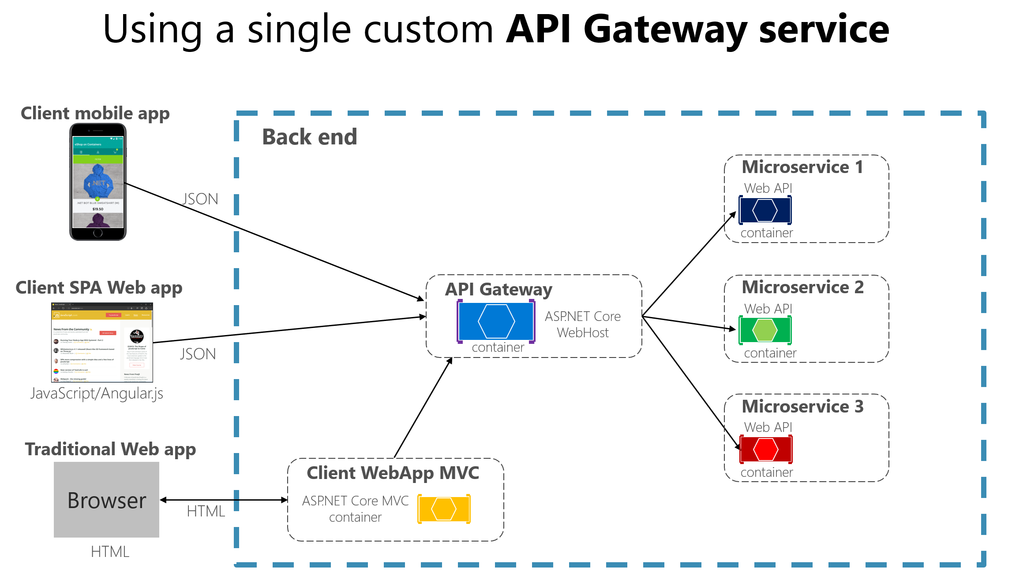
Sample gateway implementation in C#
Reference: https://docs.microsoft.com/en-us/dotnet/architecture/microservices/architect-microservice-container-applications/direct-client-to-microservice-communication-versus-the-api-gateway-pattern

Slide 6
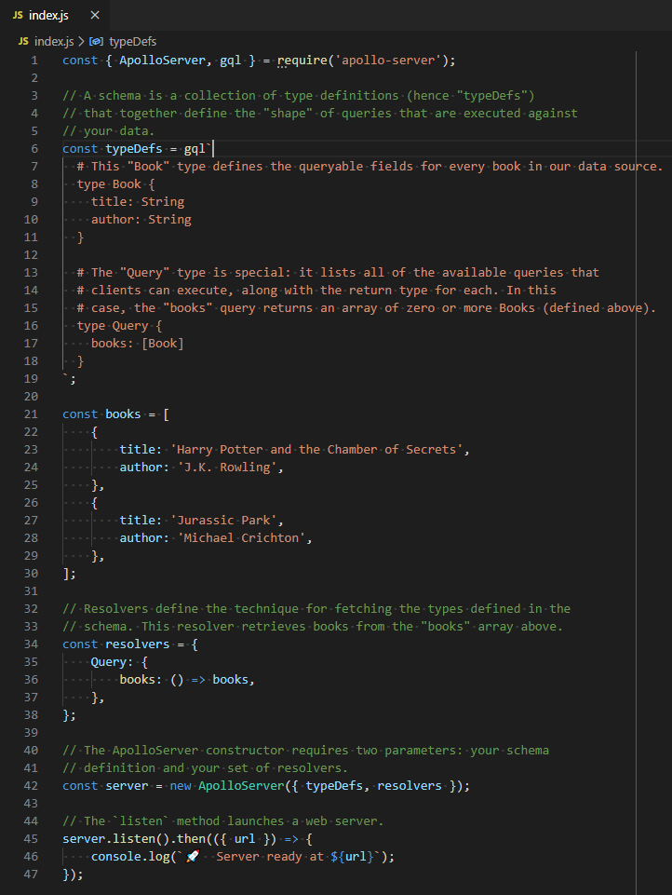
Start – Sample Application
Reference: https://www.apollographql.com/docs/apollo-server/getting-started/

Slide 7
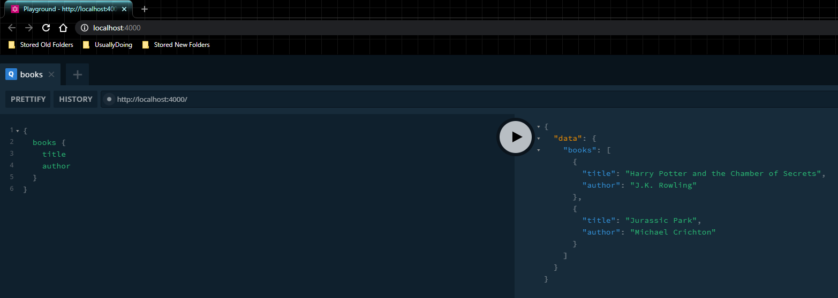
Start – Sample Application
Reference: https://www.apollographql.com/docs/apollo-server/getting-started/

Slide 8
Start – Requirements
Javascript
NodeJS
GraphQL
MySQL & SQL (Optional)

Slide 9
DEVELOPMENT

Slide 10
Sample program’s design
An elementary student management program with features:
Officers add a new student
Officers add a new teacher
Officers add a new course definition
Teacher create a course
Teacher update student grade in the course
Students update information
Student register courses
Officers update course information

Slide 11
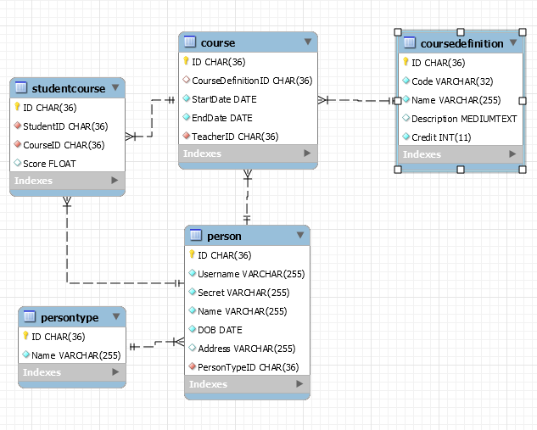
Sample program’s design
Schema

Slide 12
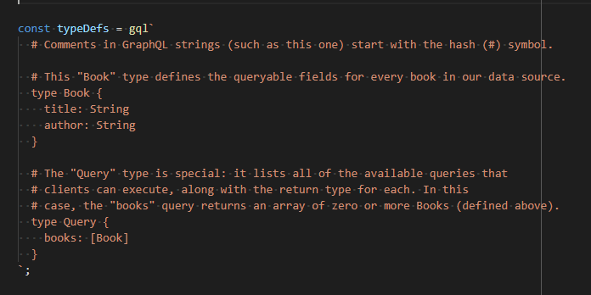
Development – Schema
Define a structure of a schema for users to query.

Slide 13
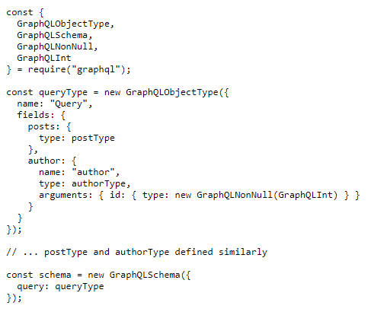
Development – Schema
Another way is to define schema using GraphQLObjectType and GraphQLSchema

Slide 14
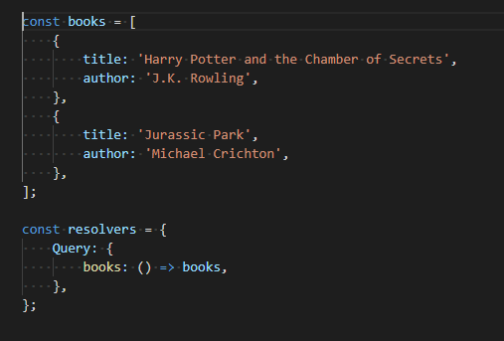
Development – Data
Has a resolver to map functions from schema to actions in the services.

Slide 15
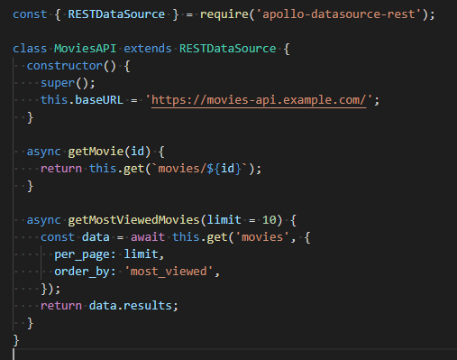
Development – Data
Has a data-source rest for retrieving data from a REST service.

Slide 16
Development – Data
Handles errors in / out of the resolvers
Predefines: AuthenticationError, ForbiddenError, UserInputError
Implement error by extend class ApolloError

Slide 17
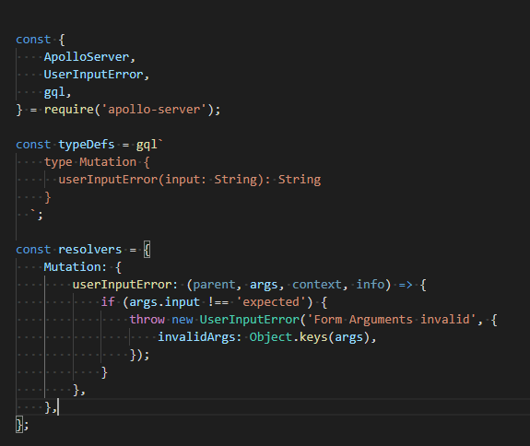
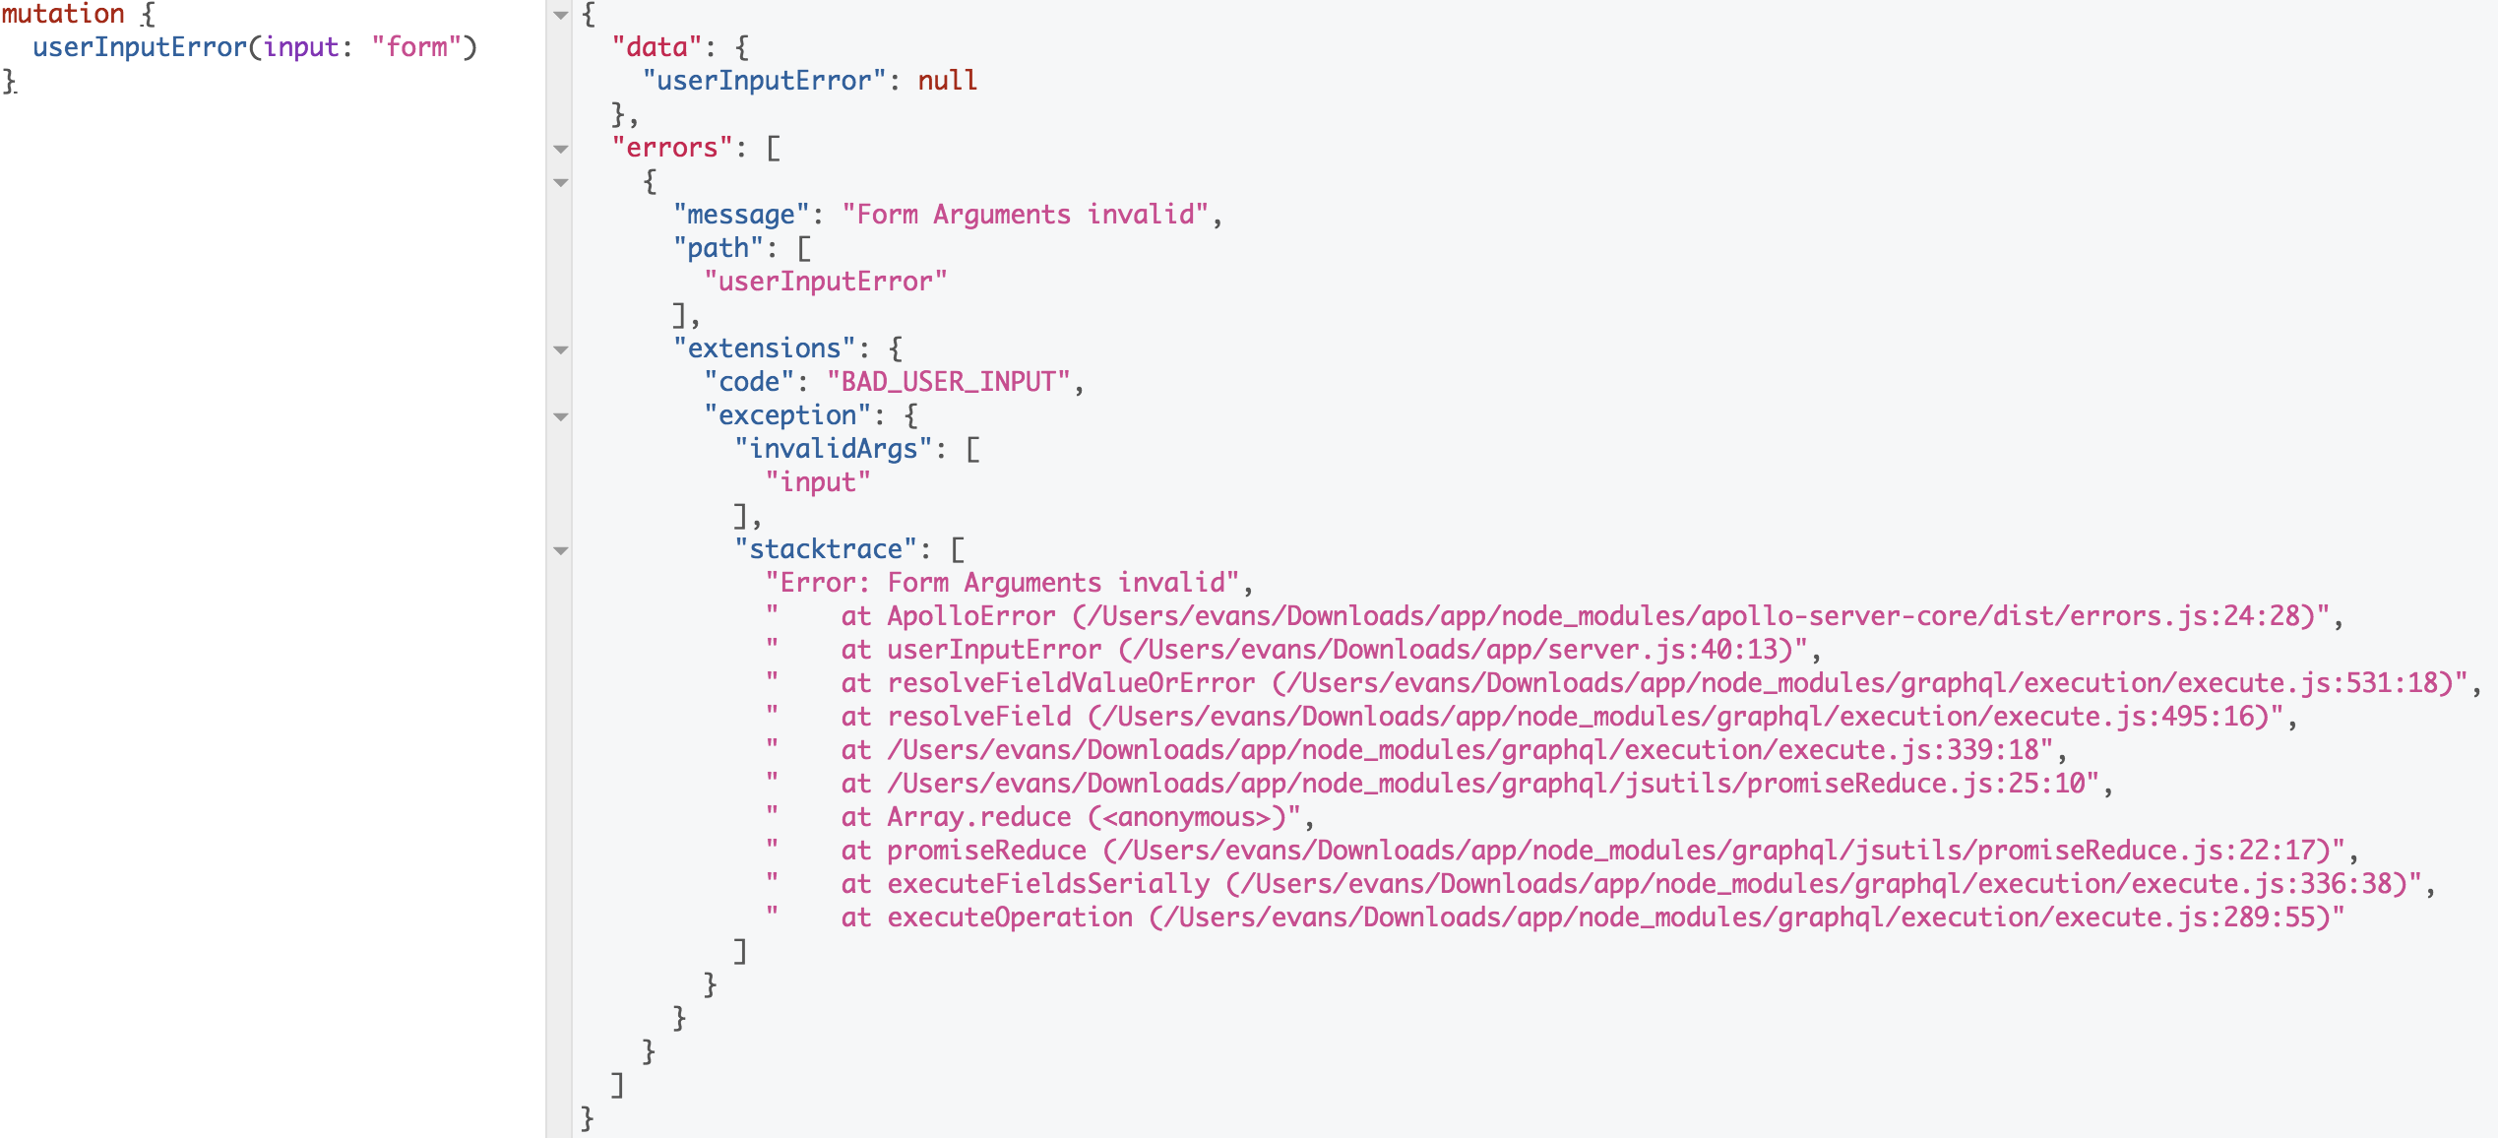
Development – Data
Handles errors in / out of the resolvers

Slide 18
Development – Data
Uploads files
Sample: https://github.com/jaydenseric/apollo-upload-examples

Slide 19
Development – Data
Subscriptions (notify event from the server to clients)
Details at https://www.apollographql.com/docs/apollo-server/data/subscriptions/
Example at https://github.com/the-road-to-graphql/fullstack-apollo-subscription-example

Slide 20
Development – Federation
Have a set of different services
These services have relationships in data schemas.
Build a gateway to support a gateway to support queries through services, not need to query multiple times.

Slide 21
Development – Federation
Have a set of different services
These services have relationships in data schemas.
Build a gateway to support a gateway to support queries through services, not need to query multiple times.

Slide 22
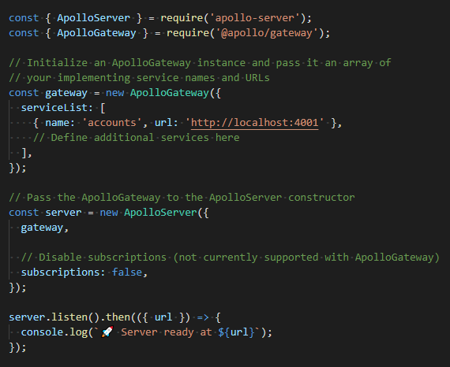
Development – Federation
A sample gateway

Slide 23
Development – Federation
Schemas between services – reuse type
Transform a normal type into an entity with key directive (primary key fields) in the original service.
In other services, declare a stub of that entity with conditions: adding extend and external keywords; key directive and primary key fields must be the same as in the original service
Schemas between services – duplicate value types (scalar, interface, and so on)
Types must be identical in name and contents

Slide 24
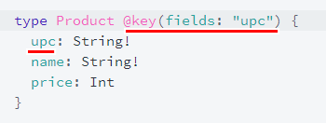
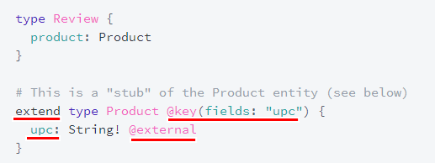
Development – Federation
Schemas between services sample
Product service
Review service

Slide 25
Development – Federation
Demonstration: https://github.com/apollographql/federation-demo

Slide 26
Development – Testing
Based on GraphQL, Apollo server implements Mocks
Testing parts can be developed without implementations of other backend components.
Let UI components and features be developed quickly.

Slide 27
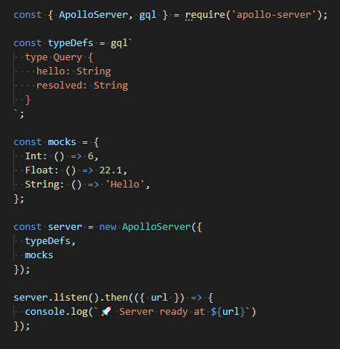
Development – Testing
A sample test server:

Slide 28
PRODUCTION

Slide 29
Production – Performance
Cache
Apollo Server supports cache on every field in a type in schemas.
Input properties are time limit for caching and scope of caching.
Time limit is in second.
Scope of caching (possible values = PUBLIC / PRIVATE) is to share between sessions (!?).

Slide 30
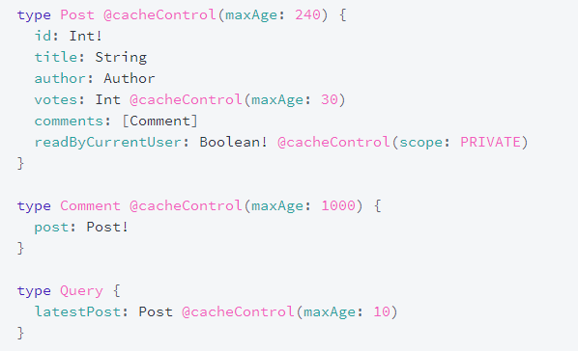
Production – Performance
Cache

Slide 31
Production – Performance
Automatic persisted queries
Is designed to improve network performance by sending smaller requests
The mechanism is based on a lightweight protocol extension between Apollo Client and Server

Slide 32
Production – Performance
Automatic persisted queries
How it works:
Client hashes the query into a 64 bytes string.
Client sends the hash string to the server.
If the server find that hash in its registry, the server will use the query serialized by that hash and send back the result.
If the server does NOT find that hash, the server requests the client to send the full query with a hash string, which it will be stored in registry for future requests.

Slide 33
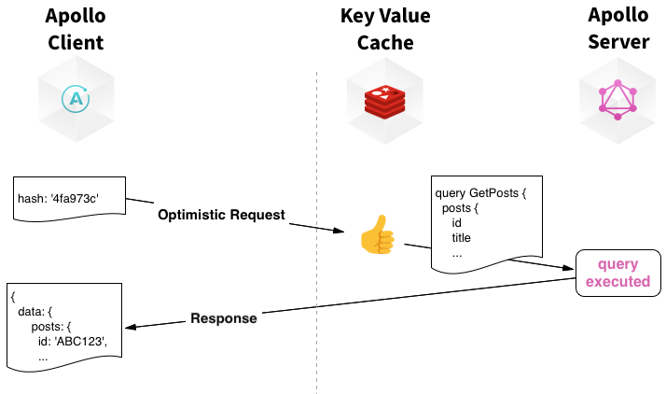
Production – Performance
Automatic persisted queries

Slide 34
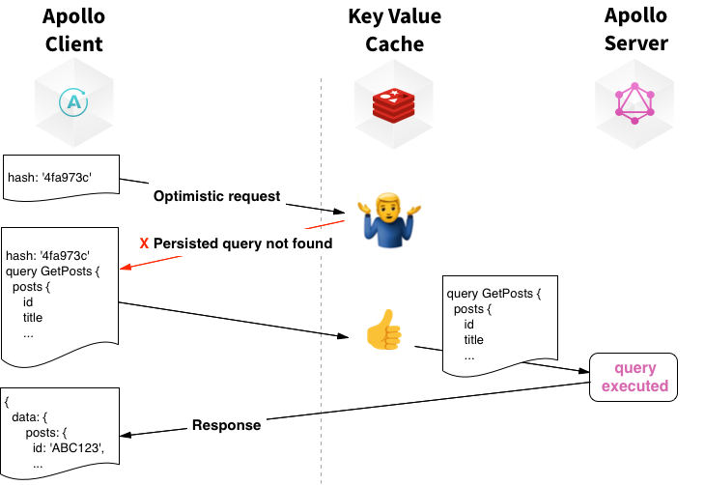
Production – Performance
Automatic persisted queries

Slide 35
Production – Security
How to control who can see and interact with the data
Authentication is determining whether a user is logged in or not, and subsequently figuring out which user someone is.
Authorization is then deciding what the user has permission to do or see.
Terminating SSL
Details at https://www.apollographql.com/docs/apollo-server/security/terminating-ssl/

Slide 36
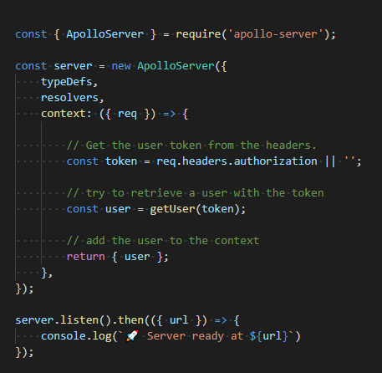
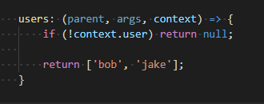
Production – Security
Check user and add in the Context argument (to use later in any resolver)

Slide 37
Production – Integration
Support integration with popular NodeJS middlewares:
Express: apollo-server-express
Fastify: apollo-server-fastify
Hapi: apollo-server-hapi
Koa: apollo-server-koa

Slide 38
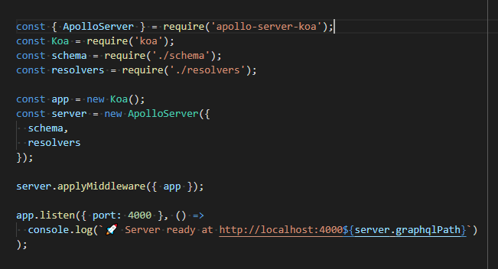
Production – Integration
Sample with Koa

Slide 39
Production – Deployment
Instructions for these below services:
Heroku – https://www.heroku.com/
AWS Lambda
Now – https://zeit.co/home
Netlify – https://www.netlify.com/
Azure – https://azure.microsoft.com/en-us/

Slide 40
END

Slide 41
APPENDIX

Slide 42
GraphQL vs REST
 | GraphQL | REST
Core | The description of a resource is NOT determined by its urls. | The description in a resource is determined by its urls.
Recognition | Scalable | Scalable
 | Rapid changes on client side despite the | Flexibility on data structures and formats
Limitation | Use only a single route. | Need to retrieve multiple requests if need more than 1 object shapes
 | Is complicated for a simple application. | Over-fetching and under-fetching

