Slide 1
Apollo Server
Dang Tuan Vu

Slide 2


Start
Sample application
Requirements
Development
Schema
Data
Production
Integration
Deployment
Federation
Testing
Performance
Security

Slide 3
START

Slide 4
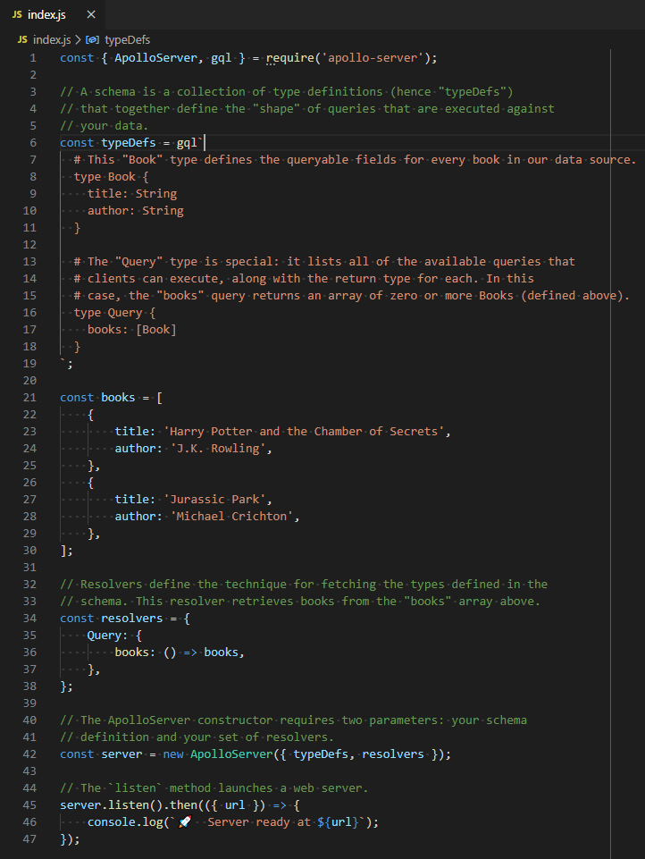
Start – Sample Application
Reference: https://www.apollographql.com/docs/apollo-server/getting-started/

Slide 5
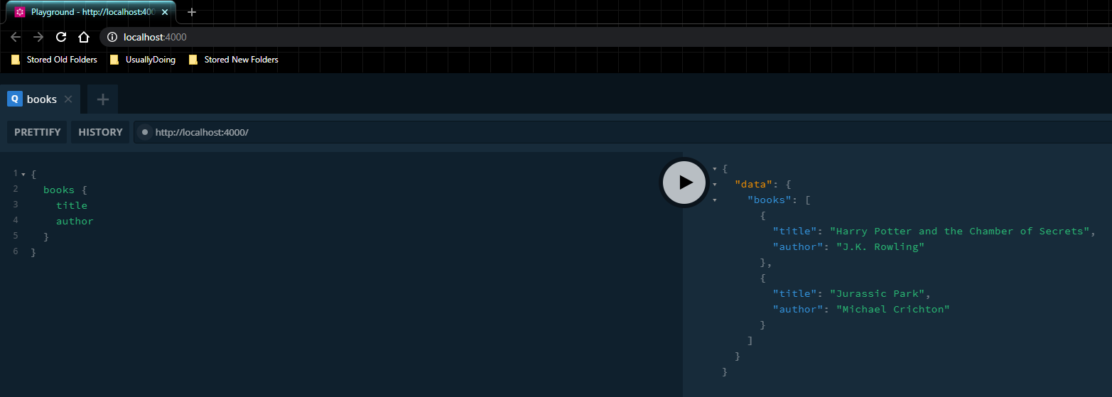
Start – Sample Application
Reference: https://www.apollographql.com/docs/apollo-server/getting-started/

Slide 6
Start – Requirements
Javascript
NodeJS
GraphQL
MySQL & SQL (Optional)

Slide 7
DEVELOPMENT

Slide 8
Sample API Server

Slide 10
Development – Schema

Slide 11
Development – Data

Slide 12
Development – Federation

Slide 13
Development – Testing

Slide 14
PRODUCTION

Slide 15
Production – Performance

Slide 16
Production – Security

Slide 17
Production – Integration

Slide 18
Production – Deployment

Slide 19
END

Slide 20
APPENDIX

Slide 21
GraphQL vs REST
 | GraphQL | REST
Core | The description of a resource is NOT determined by its urls. | The description in a resource is determined by its urls.
Recognition | Scalable | Scalable
 | Rapid changes on client side despite the | Flexibility on data structures and formats
Limitation | Use only a single route. | Need to retrieve multiple requests if need more than 1 object shapes
 | Is complicated for a simple application. | Over-fetching and under-fetching

