Slide 1
Apollo Server
Dang Tuan Vu

Slide 2


Start
Sample application
Requirements
Development
Schema
Data
Production
Integration
Deployment
Federation
Testing
Performance
Security

Slide 3
START

Slide 4
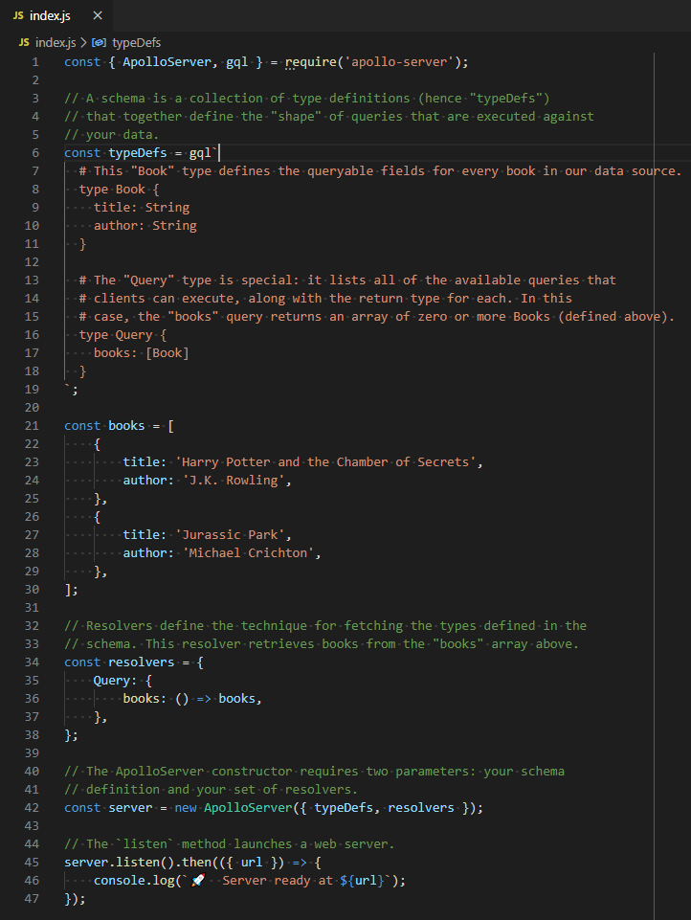
Start – Sample Application
Reference: https://www.apollographql.com/docs/apollo-server/getting-started/

Slide 5
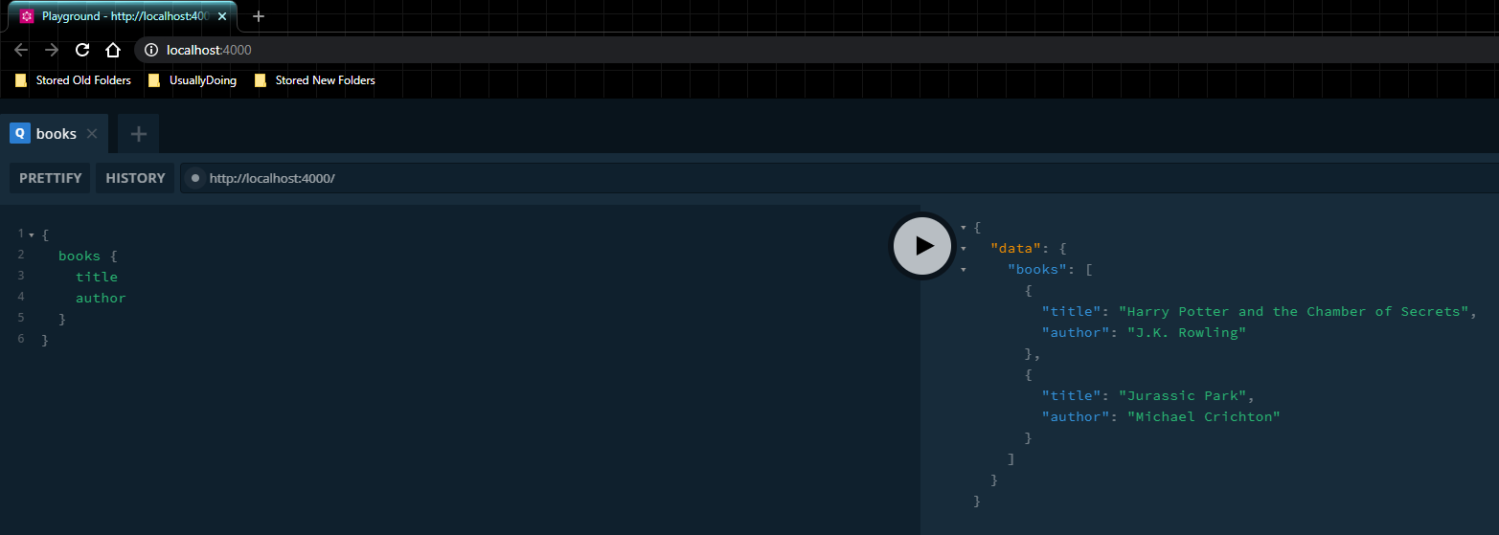
Start – Sample Application
Reference: https://www.apollographql.com/docs/apollo-server/getting-started/

Slide 6
Start – Requirements
Javascript
NodeJS
GraphQL
MySQL & SQL (Optional)

Slide 7
DEVELOPMENT

Slide 8
Development – Schema

Slide 9
Development – Data

Slide 10
Development – Federation

Slide 11
Development – Testing

Slide 12
PRODUCTION

Slide 13
Production – Performance

Slide 14
Production – Security

Slide 15
Production – Integration

Slide 16
Production – Deployment

Slide 17
END

