Slide 1
Gravitational Simulation for 3-Body Problems
Final Presentation
David Xiong

Slide 2
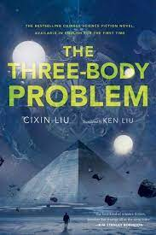
Problem Review
Physics based simulation made in Unity with C# scripts to model 3-body gravitational problems
Very chaotic and have no closed form
Can be used to describe more complex astronomical systems

Slide 3
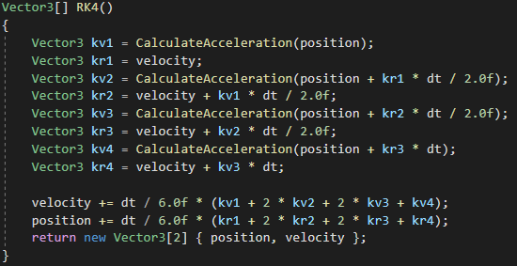
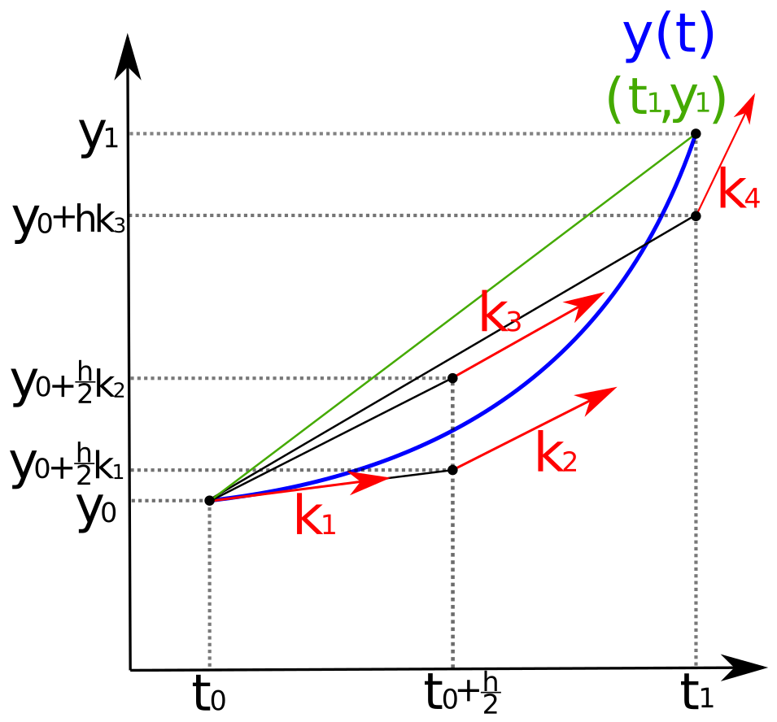
Implementation
Input: initial positions, velocities, mass of gravitational body
Output: Runs the simulation, objects move in real-time
Euler and Runge-Kutta 4 integrators
Implemented stable designs

Slide 4
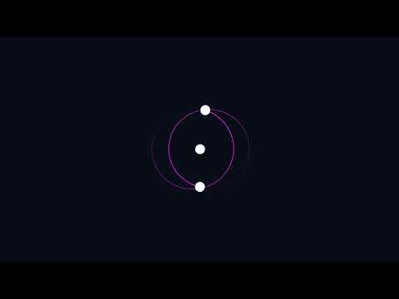
Results
https://youtu.be/7iVgyd_7PAg

Slide 5
Conclusion
3-body problem are CHAOTIC
Small perturbations turn big
Computationally hard to get fidelity
Future Work
More frames per second -- smaller dt
Implicit Integrator

Slide 6
Questions?

