Slide 1
Results of security analysis of LWC finalists

Slide 2
分类
Primitive | Scheme | Type
Ascon | Ascon, ISAP | SPN
Keccak | Elephant, ISAP | SPN
Spongent | Elephant | SPN
GIFT | GIFT-COFB | SPN
PHOTON | PHOTON-BEETLE | SPN
Skinny | Romulus | SPN
SPARKLE | SPARKLE | ARX
TinyJAMBU | TinyJAMBU | Stream
Xoodyak | Xoodyak | Stream
Grain | Grain-128AEAD | Stream

Slide 3
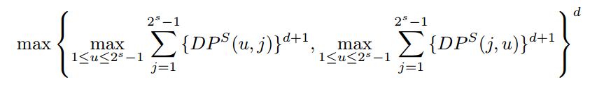
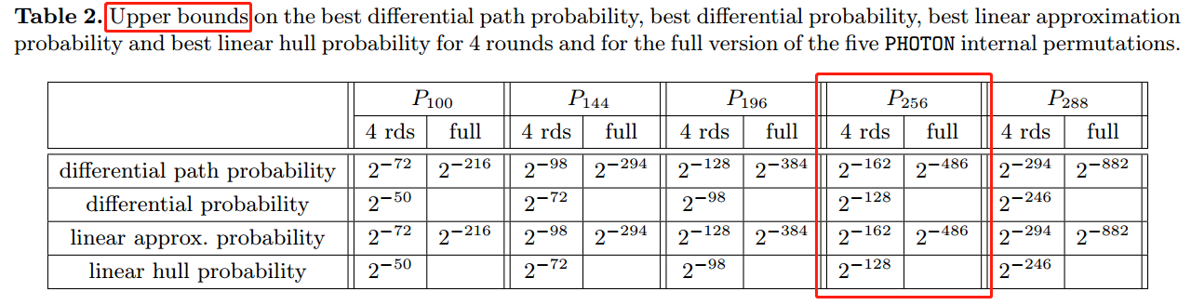
PHOTON-256
Improving the Upper Bound on the Maximum Differential and the Maximum Linear Hull Probability for SPN Structures and AES

Slide 4
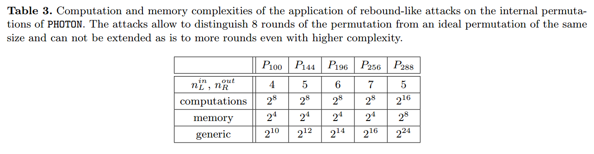
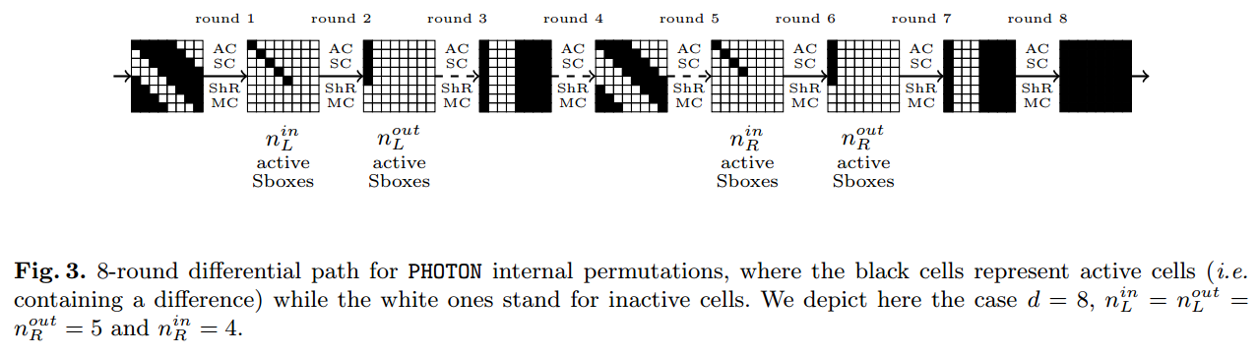
PHOTON-256

Slide 5
Rebound
The Rebound Attack: Cryptanalysis of Reduced Whirlpool and Grøstl
Super-Sbox
Super-Sbox Cryptanalysis: Improved Attacks for AES-Like Permutations
Rebound Distinguishers: Results on the Full Whirlpool Compression Function
Non-full active diff path
Non-full-active Super-Sbox Analysis: Applications to ECHO and Grøstl
Start-from-the-middle
Improved Cryptanalysis of the Reduced Grøstl Compression Function, ECHO Permutation and AES Block Cipher

Slide 6
PHOTON-256
PHOTON specification
The PHOTON family of lightweight hash functions
Rebound-like
Improved rebound attack on the finalist grøstl
统计积分
Statistical integral distinguisher with multi-structure and its application on AES
零和划分
Zero-sum partitions of PHOTON permutations

Slide 7
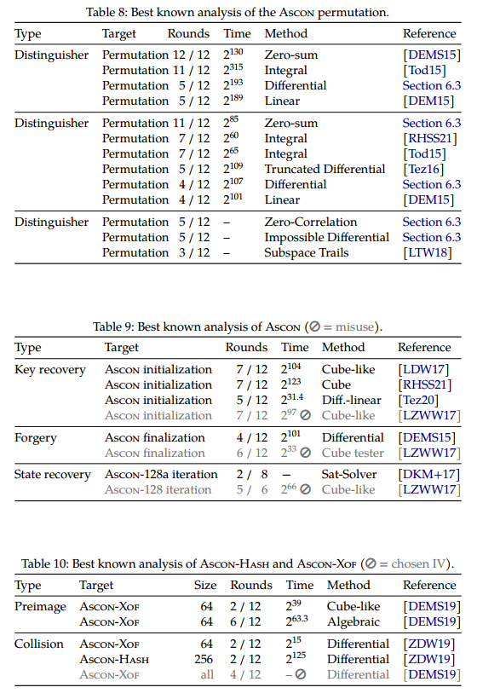
Ascon
差分/线性
截断差分
零相关、不可能差分
子空间
积分
零和
立方
代数

Slide 8
Elephant
插值
Spongent
差分/线性
积分
Keccak
差分/线性
代数

Slide 9
ISAP
Keccak-p
Ascon-p

Slide 10
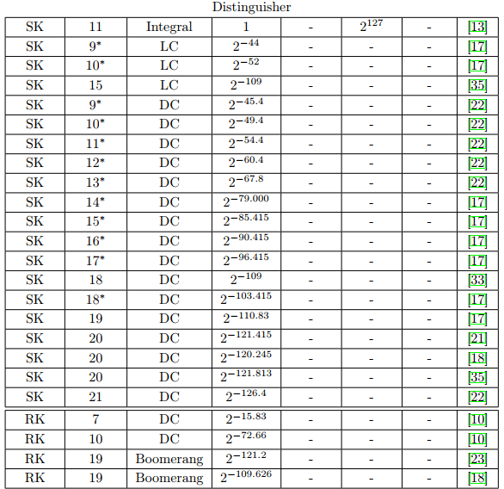
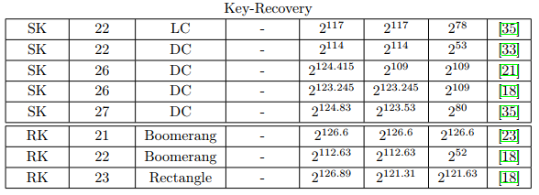
GIFT-COFB
差分/线性
Boomerang，Rectangle（RK setting）
积分
中间相遇

Slide 11
Romulus
Skinny
差分/线性、中间相遇、不可能差分、积分、滑动、不变子空间、代数
相关调柄不可能差分
Romulus-H
原像

Slide 12
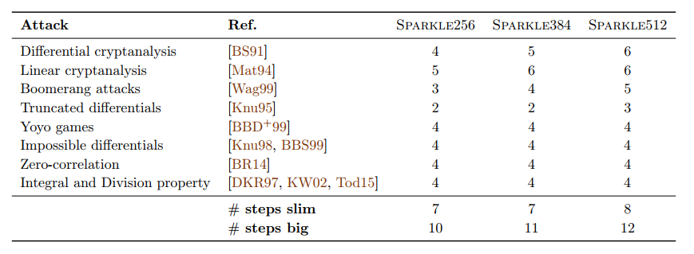
SPARKLE
对置换
差分/线性，截断差分
飞去来器
Yoyo
不可能差分、零相关
积分、可分性
滑动、旋转
不变子空间、非线性不变量
对Sponge
差分/线性
不可能差分、零相关
猜测确定

Slide 13
TinyJAMBU
差分/线性
代数
滑动

Slide 14
Xoodyak
立方
条件立方
零和

Slide 15
Grain-128AEAD
线性逼近
相关性
动态立方
可分性

Slide 16
完

Slide 17
Specifications

Slide 18
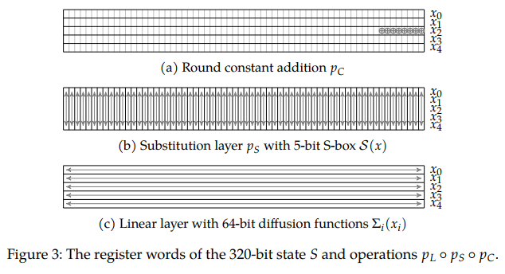
Ascon-p

Slide 19
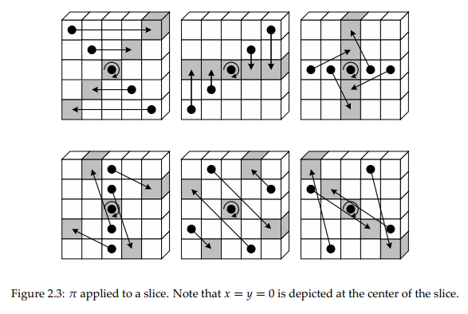
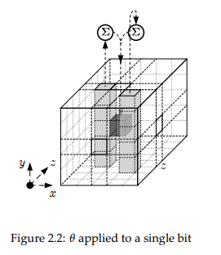
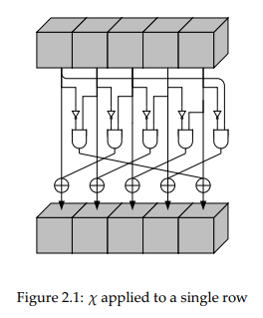
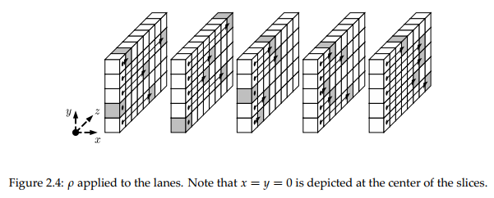
Keccak-p

Slide 20
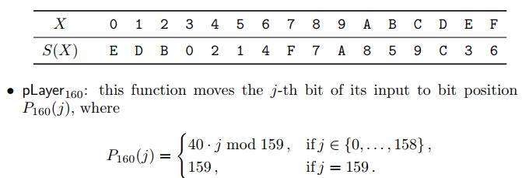
Spongent-160

Slide 21
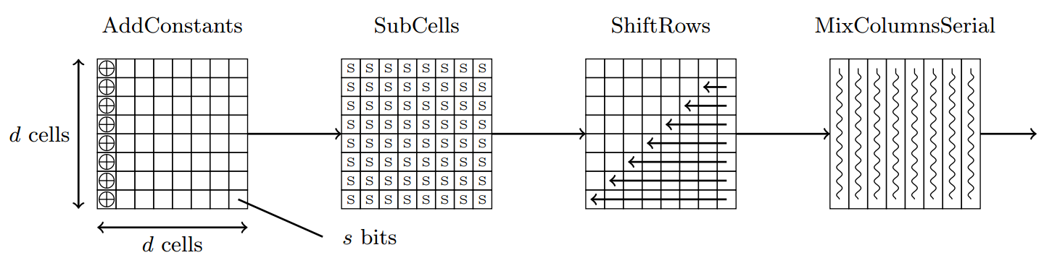
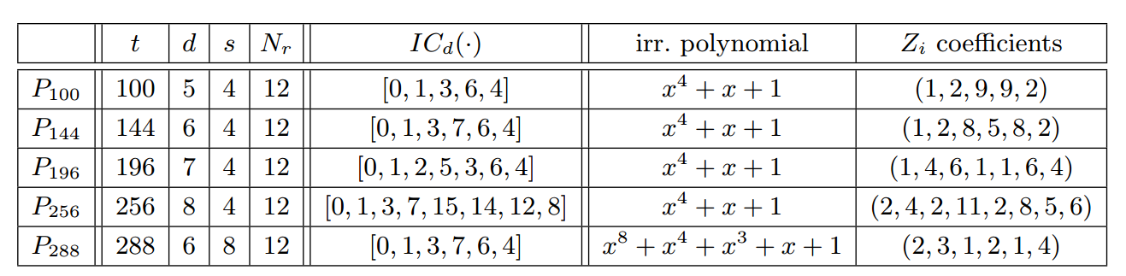
PHOTON

Slide 22
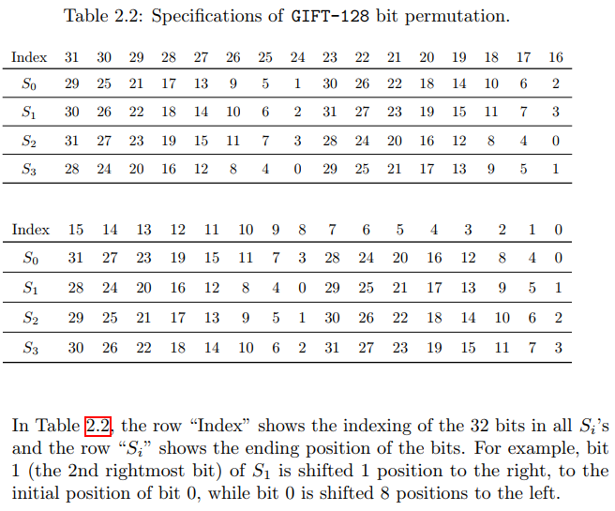
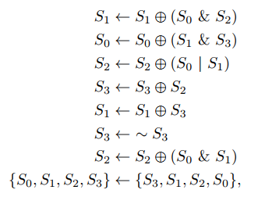
GIFT-128

Slide 23
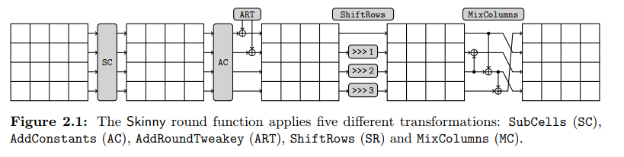
Skinny

Slide 24
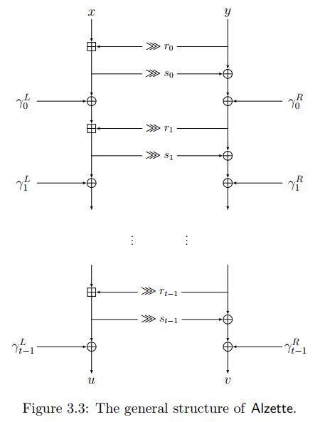
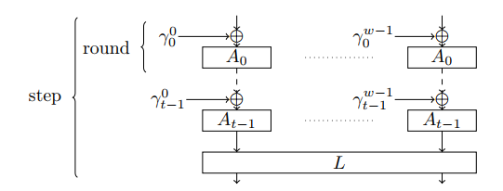
SPARKLE

Slide 25
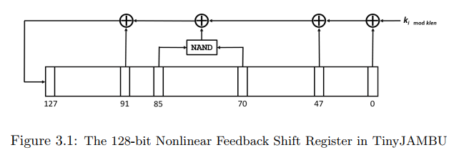
TinyJambu

Slide 26
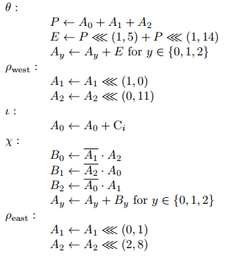
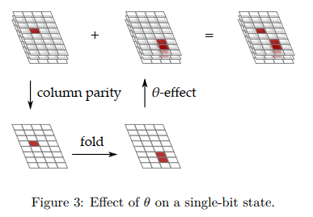
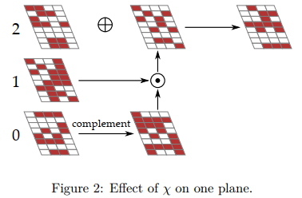
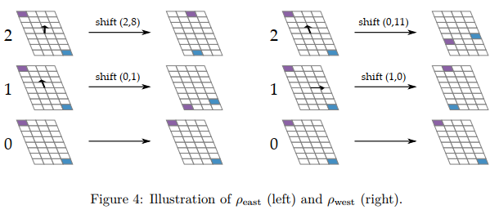
Xoodyak

Slide 27
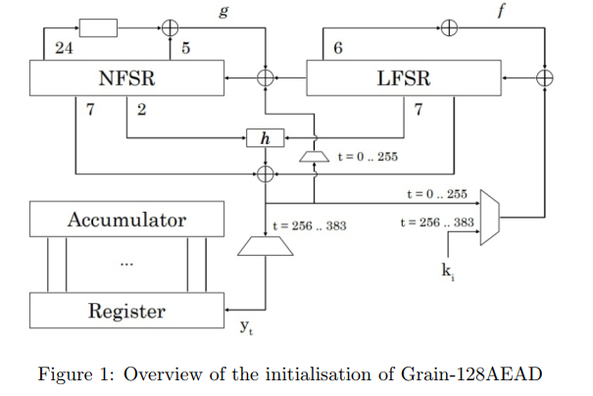
Grain-128

Slide 28
Additional

Slide 29
Ascon
差分/线性 特征
Heuristic Tool for Linear Cryptanalysis with Applications to CAESAR Candidates
截断差分
Truncated, Impossible, and Improbable Differential Analysis of Ascon
差分线性
Cryptanalysis of Ascon
DLCT: A New Tool for Differential-Linear Cryptanalysis
Analysis of Ascon, DryGASCON, and Shamash Permutations

Slide 30
Ascon
代数估计
A zero-sum property for the KECCAK-f permutation with 18 rounds
Higher-order differential properties of Keccak and Luffa
可分性
Structural Evaluation by Generalized Integral Property
On the division property of S-boxes
零和
New zero-sum distinguishers on full 24-round Keccak -f using the division property
立方攻击
Misuse-Free Key-Recovery and Distinguishing Attacks on 7-Round Ascon
Conditional Cube Attack on Round-Reduced ASCON
Cryptanalysis of round-reduced ASCON

Slide 31
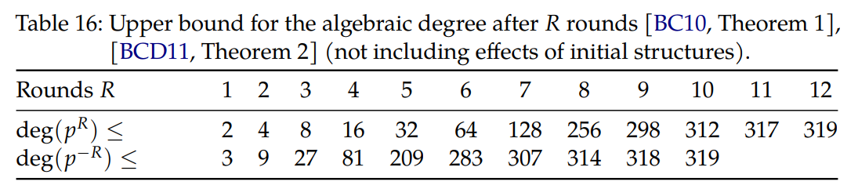
Ascon

Slide 32
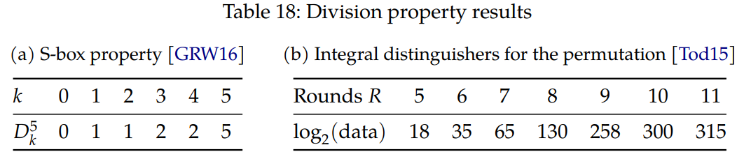
Ascon

Slide 33
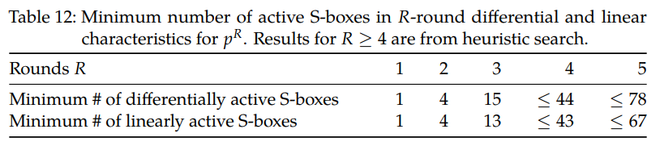
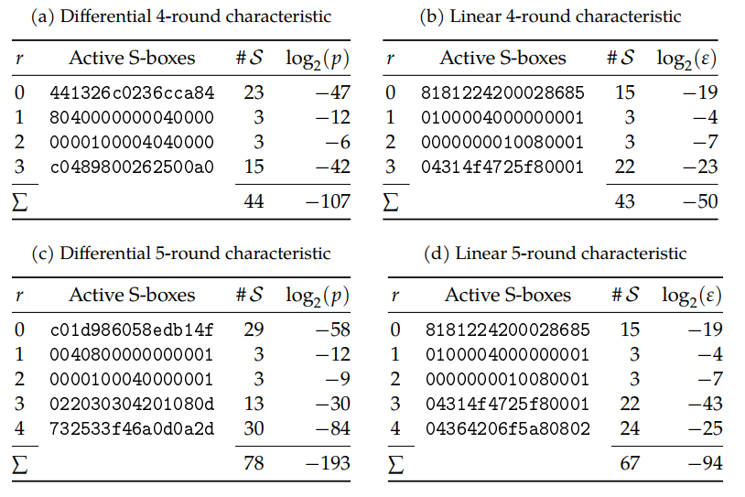
Ascon
搜索方法：stack-based heuristic search

Slide 34
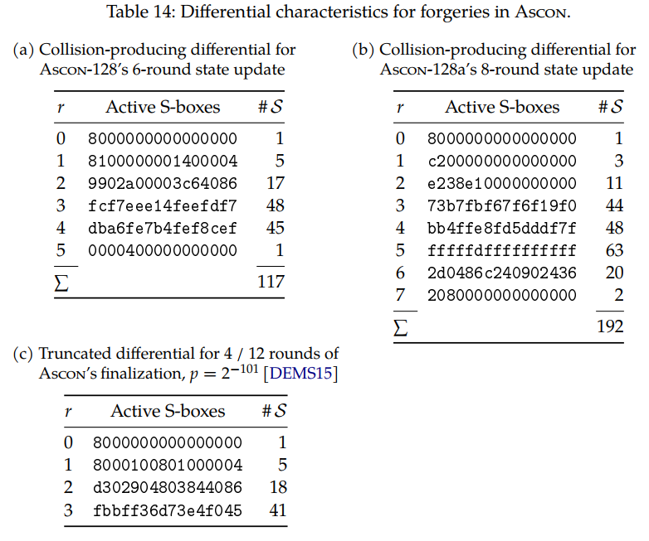
Ascon
有约束
Collision
输入、输出差分capacity为0
Forgery
输入差分capacity为0

Slide 35
Ascon
截断差分
根据undisturbed bits推断

Slide 36
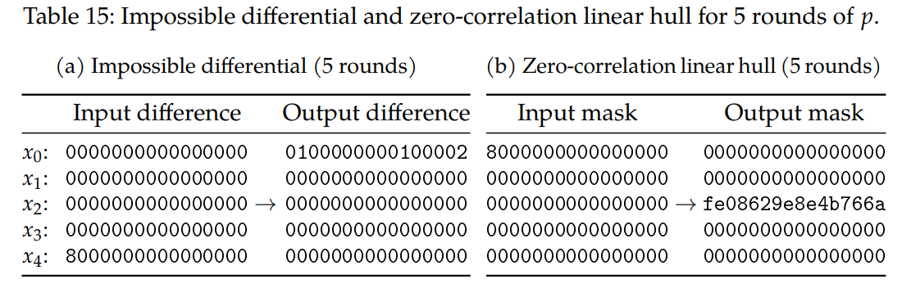
Ascon
An automated search tool

Slide 37
Keccak
差分
New Techniques for Searching Differential Trails in Keccak
New techniques for trail bounds and application to differential trails in Keccak
Internal Differential Boomerangs: Practical Analysis of the Round-Reduced Keccak-f Permutation
Differential Biases in Reduced-Round Keccak
Differential Cryptanalysis of Keccak Variants
Differential Propagation Analysis of Keccak
Collision Attacks on Up to 5 Rounds of SHA-3 Using Generalized Internal Differentials

Slide 38
Keccak
Rotational Cryptanalysis of Round-Reduced Keccak
Unaligned Rebound Attack: Application to Keccak

Slide 39
Keccak
Algebraic Collision Attacks on Keccak
Improved Preimage Attacks on 4-Round Keccak-224/256
Algebraic Attacks on Round-Reduced Keccak/Xoodoo
New Results on the SymSum Distinguisher on Round-Reduced SHA3
Cryptanalysis of Round-Reduced KECCAK Using Non-linear Structures
Distinguishing Property for Full Round KECCAK-f Permutation
Non-full Sbox Linearization: Applications to Collision Attacks on Round-Reduced Keccak
New Collision Attacks on Round-Reduced Keccak
Linear Structures: Applications to Cryptanalysis of Round-Reduced Keccak
Practical Distinguishers against 6-Round Keccak-f Exploiting Self-Symmetry
New Attacks on Keccak-224 and Keccak-256
State-Recovery Attacks on Modified Ketje Jr

Slide 40
Keccak
Preimage Attacks on Round-Reduced Keccak-224/256 via an Allocating Approach
Preimage Attacks on the Round-reduced Keccak with Cross-linear Structures

Slide 41
Keccak
立方
New Conditional Cube Attack on Keccak Keyed Modes
MILP-aided cube-attack-like cryptanalysis on Keccak Keyed modes
Finding Ordinary Cube Variables for Keccak-MAC with Greedy Algorithm
Practical Key-recovery Attacks on Round-Reduced Ketje Jr, Xoodoo-AE and Xoodyak
Cube-Attack-Like Cryptanalysis of Round-Reduced Keccak Using MILP
New MILP Modeling: Improved Conditional Cube Attacks on Keccak-Based Constructions
Improved Conditional Cube Attacks on Keccak Keyed Modes with MILP Method
Conditional Cube Attack on Reduced-Round Keccak Sponge Function
Cube Attacks and Cube-Attack-Like Cryptanalysis on the Round-Reduced Keccak Sponge Function
Conditional
cube attack on round-reduced River Keyak
Cube-like Attack on
Round-Reduced Initialization of Ketje Sr

Slide 42
Keccak
零和
Higher-Order Differential Properties of Keccak and Luffa
A zero-sum property for the Keccak- f permutation with 18 rounds
Zero-Sum Distinguishers for Iterated Permutations and Application to Keccak- f and Hamsi-256

Slide 43
Spongent
46轮截断差分
A distinguisher on PRESENT-like permutations with application to SPONGENT
Estimating the Probabilities of Low-Weight Differential and Linear Approximations on PRESENT-Like Ciphers
SPONGENT: The Design Space of Lightweight Cryptographic Hashing
Spongent: A Lightweight Hash Function

Slide 44
Spongent
可分性，不超过12轮
MILP-aided bit-based division property for primitives with non-bit-permutation linear layers
MILP-Aided Bit-Based Division Property for Primitives with Non-Bit-Permutation Linear Layers
Finding Integral Distinguishers with Ease
零和，21轮
零相关，推出一个积分区分器
Links Among Impossible Differential, Integral and Zero Correlation Linear Cryptanalysis

Slide 45
Spongent
Rebound

Slide 46
PHOTON-256
PHOTON specification
The PHOTON family of lightweight hash functions
Rebound-like
Improved rebound attack on the finalist grøstl
统计积分
Statistical integral distinguisher with multi-structure and its application on AES
零和划分
Zero-sum partitions of PHOTON permutations

Slide 47
PHOTON-256
Multiple limited-birthday distinguishers and applications

Slide 48
GIFT-128
差分
18轮，109，23轮恢复密钥
MILP-based Differential Attack on Round-reduced GIFT
线性
9轮，45.99（聚集）
积分
11轮

Slide 49
Skinny
The SKINNY Family of Block Ciphers and Its Low-Latency Variant MANTIS
Security Analysis of SKINNY under Related-Tweakey Settings
Cryptanalysis of Reduced round SKINNY Block Cipher

Slide 50
SPARKLE
Alzette
差分（Matsui）
7轮26
8轮>31
线性（MILP、SAT）
8轮17
不变子空间
2轮59维
非线性不变量
线性化

Slide 51
TinyJambu
差分
线性
代数

Slide 52
Xoodyak

Slide 53
Grain

