Slide 1
Results of security analysis of LWC finalists

Slide 2
Contents
Primitive | Scheme | Type | Specification | Cryptanalysis
Ascon-p | Ascon, ISAP | SPN | Slide | Slide
Keccak-f[200,400] | Elephant, ISAP | SPN | Slide | Slide
XOODOO | Xoodyak | SPN | Slide | Slide
Spongent-Π[160,176] | Elephant | SPN (PRESENT) | Slide | Slide
GIFT-128 | GIFT-COFB | SPN (PRESENT) | Slide | Slide
PHOTON-256 | PHOTON-BEETLE | SPN (AES) | Slide | Slide
Skinny-128 | Romulus | SPN | Slide | Slide
SPARKLE | SPARKLE | ARX | Slide | Slide
TinyJAMBU | TinyJAMBU | Stream | Slide | Slide
Modified Grain-128a | Grain-128AEADv2 | Stream | Slide | Slide

Slide 3
Summary
 | full rounds | diff | linear | integral | zero-sum | cube | rebound
Ascon-p | 12 | 5 | 5 | 11 | 12 | 7
Keccak-f | 16 | 8 | 4 |  | 24 | 9 | 8
XOODOO | 12 | 3 | 3 |  | 12
Spongent-Π[160] | 80 | 46 | 80 | 11 | 21 |  | 19
GIFT-128 | 40 | 27 | 22 | 11 |  |  | 15
PHOTON-256 | 12 | 5 | 5 | 10 | 12 |  | 8
Skinny-128-384 | 56 | 28 | 15 | 11 |  |  | 22
SPARKLE | 7 | 6 | 6 | 4
TinyJAMBU | 384 | 338
Grain-128AEADv2 | 512 |  |  |  |  | 184

Slide 4
Summary
每个算法被每种密码分析攻击到的最长轮数

Slide 5
Summary
每个算法被每种密码分析攻击到的最长轮数/全轮轮数

Slide 6
Summary
对SPN
对扩散层强的，包括Ascon、Keccak、PHOTON，积分类的分析更强。
对扩散层较弱的，包括GIFT、Spongent、Skinny，差分/线性类的分析更强。

Slide 7
Specifications

Slide 8
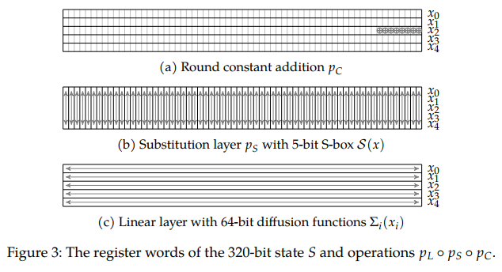
Ascon-p

Slide 9
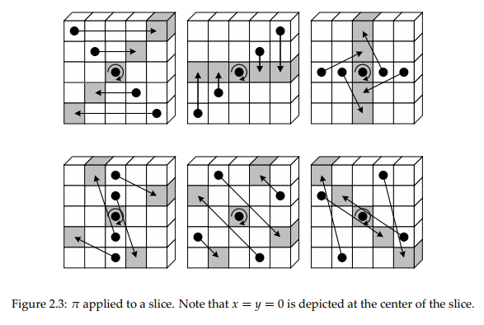
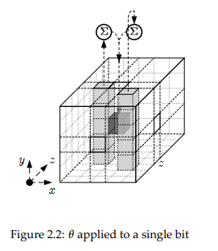
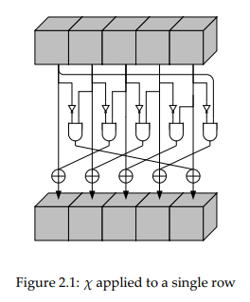
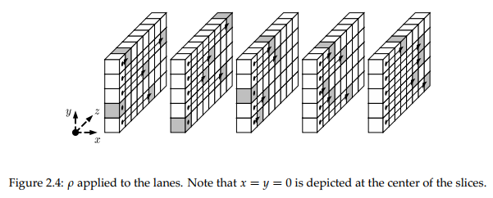
Keccak-p

Slide 10
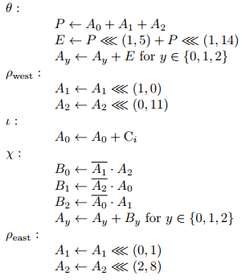
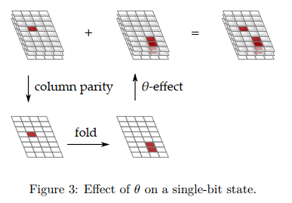
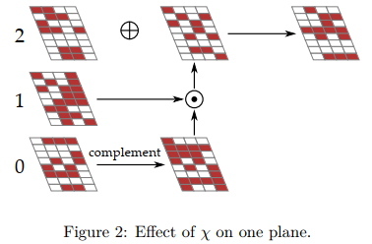
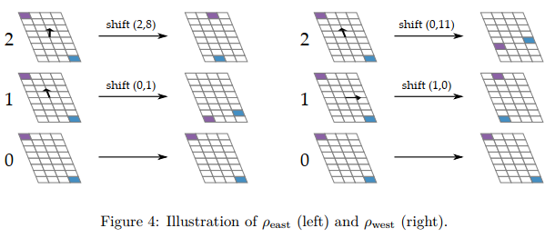
Xoodyak

Slide 11
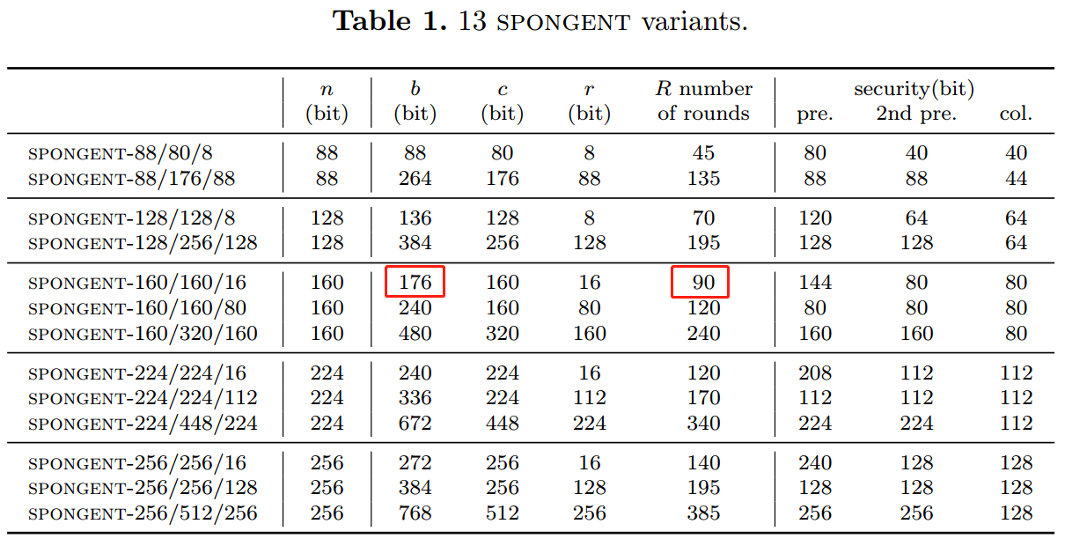
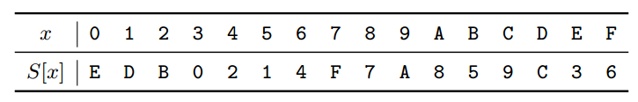
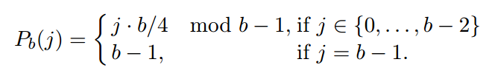
Spongent

Slide 12
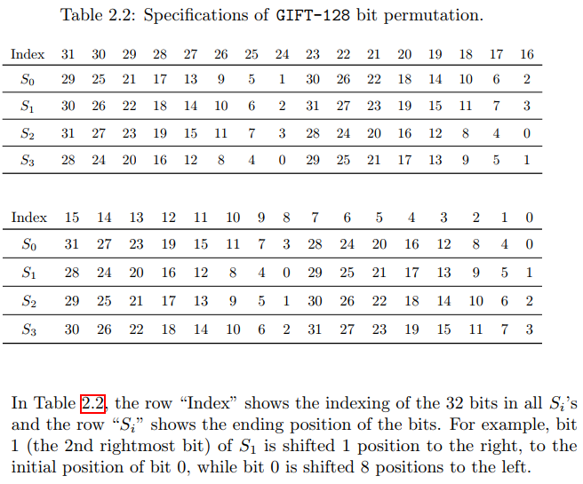
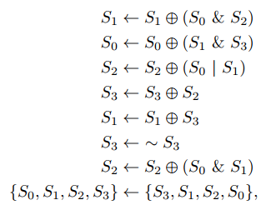
GIFT-128

Slide 13
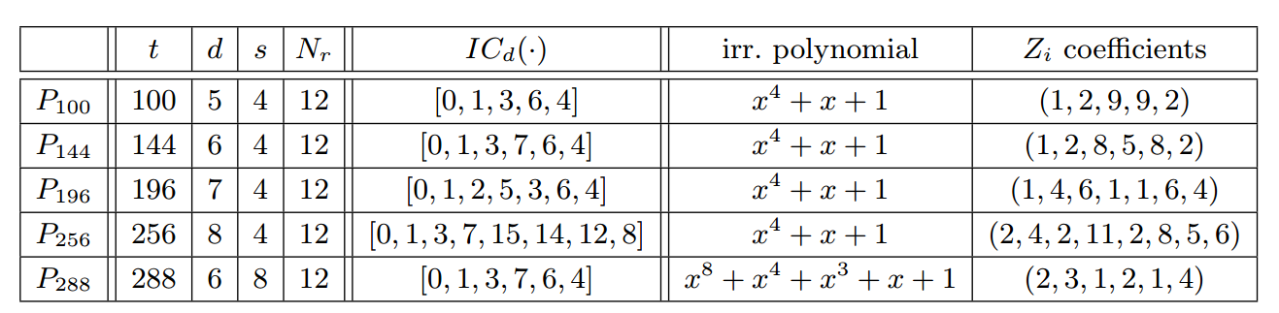
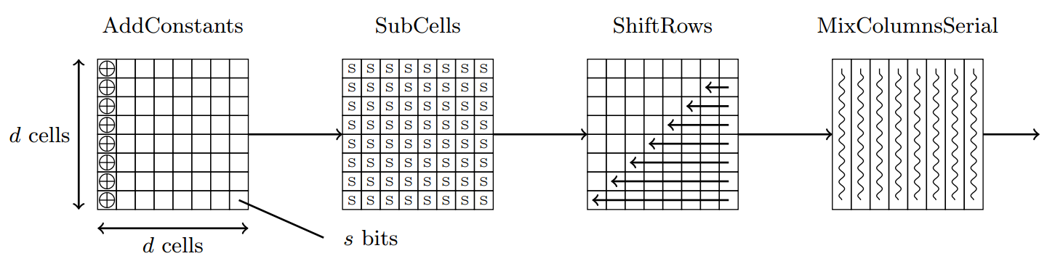
PHOTON

Slide 14
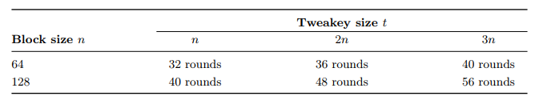
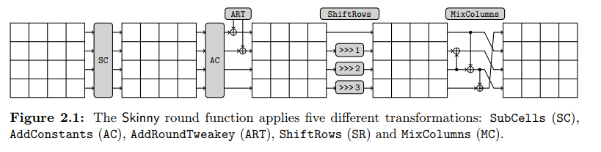
Skinny

Slide 15
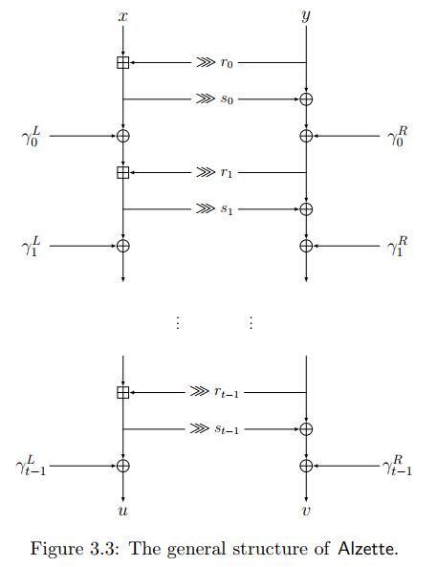
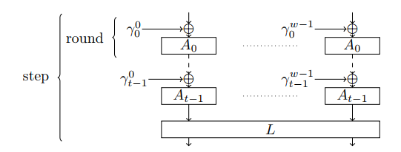
SPARKLE
General structure

Slide 16
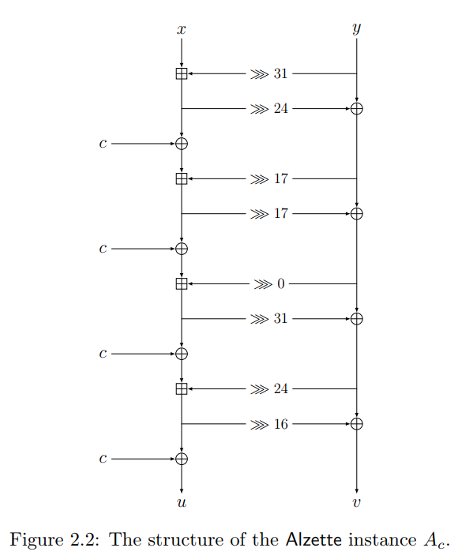
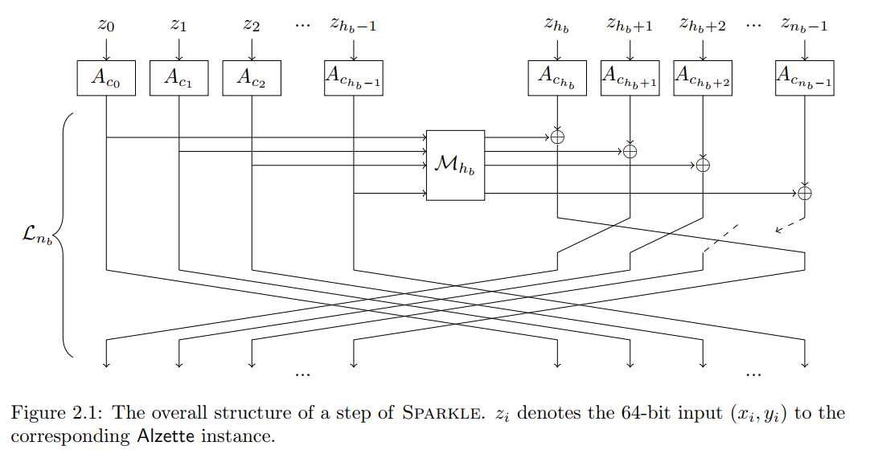
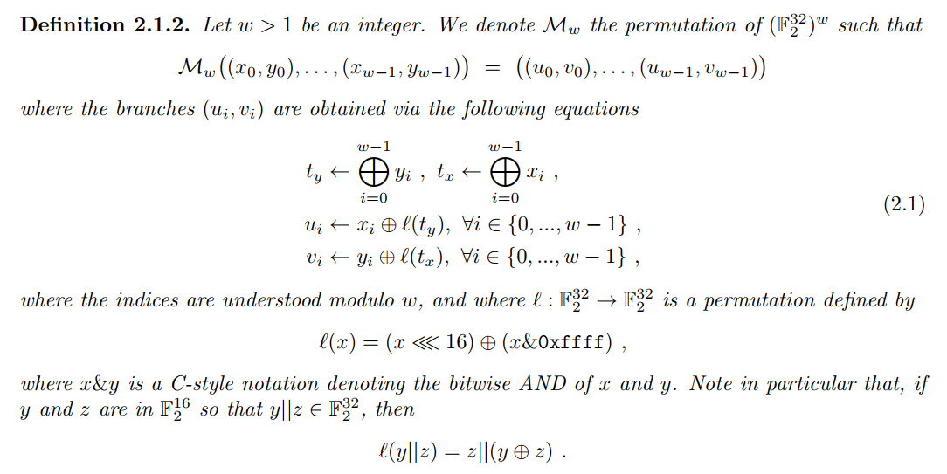
SPARKLE

Slide 17
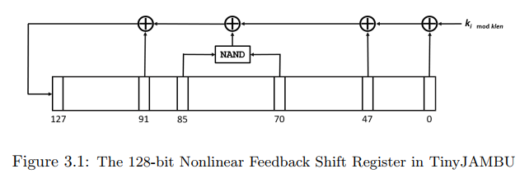
TinyJambu

Slide 18
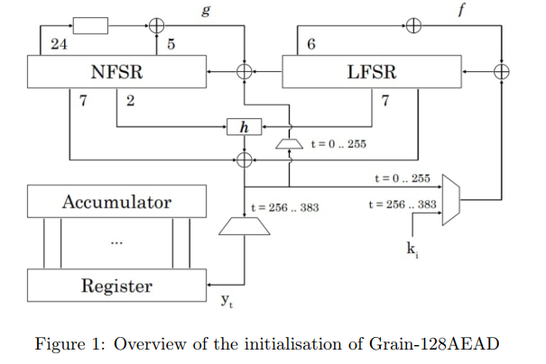
Grain-128

Slide 19
Cryptanalysis
Grouped by primitives

Slide 20
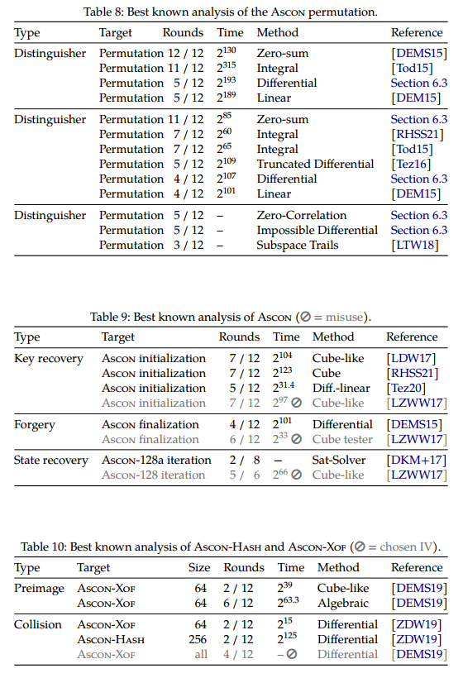
Ascon
差分/线性
截断差分
零相关、不可能差分
子空间
积分
代数、零和
立方

Slide 21
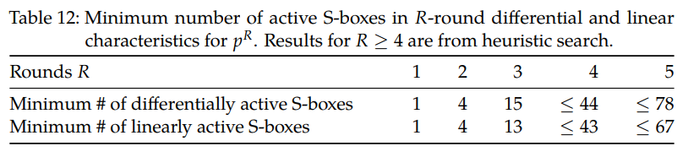
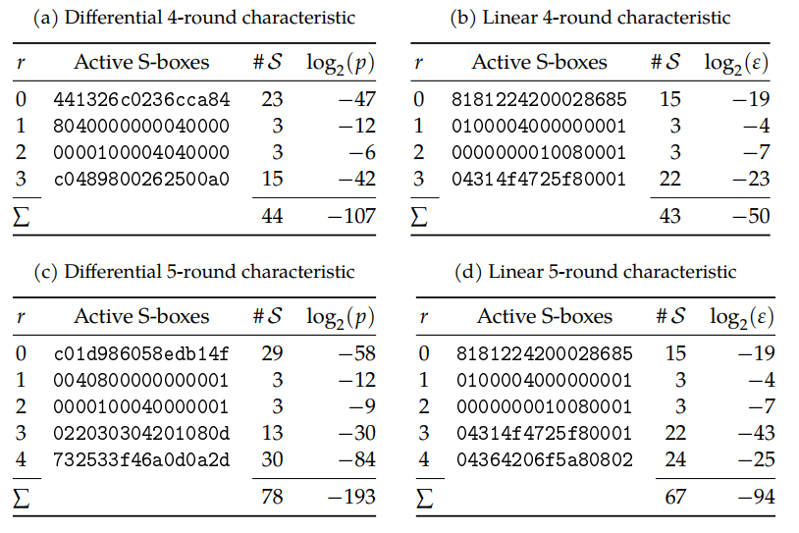
Ascon
差分/线性 特征
搜索方法：stack-based heuristic search
Heuristic Tool for Linear Cryptanalysis with Applications to CAESAR Candidates

Slide 22
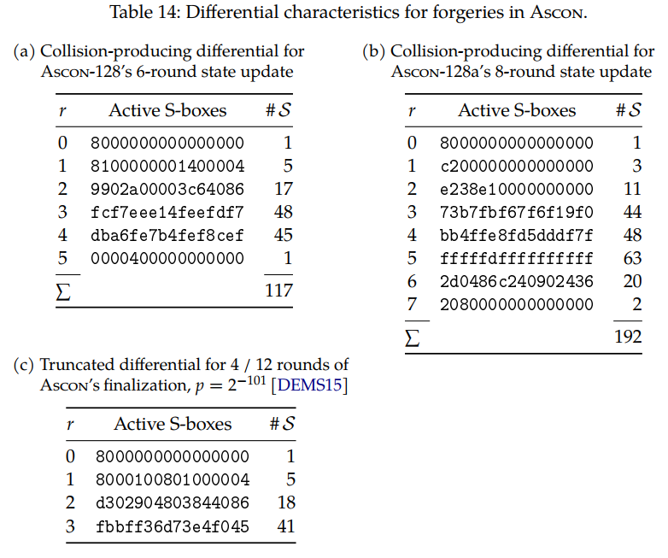
Ascon
有约束
Collision
输入、输出差分capacity为0
Forgery
输入差分capacity为0

Slide 23
Ascon
截断差分
根据undisturbed bits推断
Truncated, Impossible, and Improbable Differential Analysis of Ascon

Slide 24
Ascon
差分线性
Cryptanalysis of Ascon
DLCT: A New Tool for Differential-Linear Cryptanalysis
Analysis of Ascon, DryGASCON, and Shamash Permutations

Slide 25
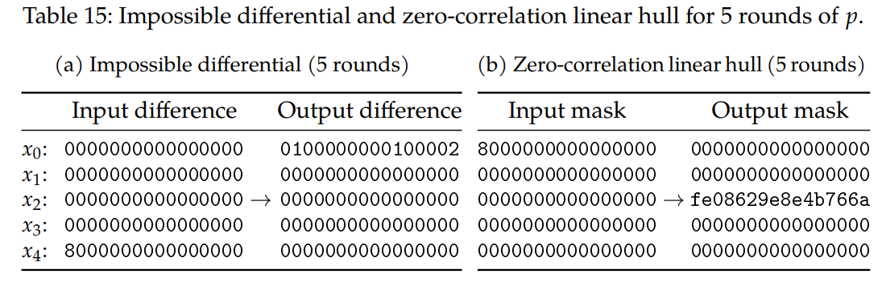
Ascon
不可能差分/零相关

Slide 26
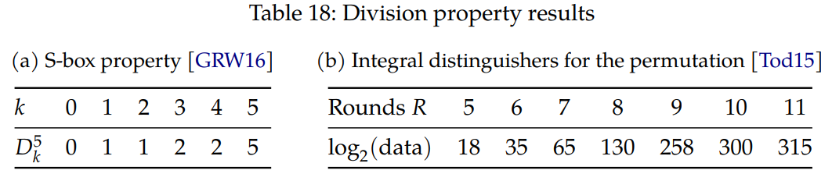
Ascon
可分性
Structural Evaluation by Generalized Integral Property
On the division property of S-boxes

Slide 27
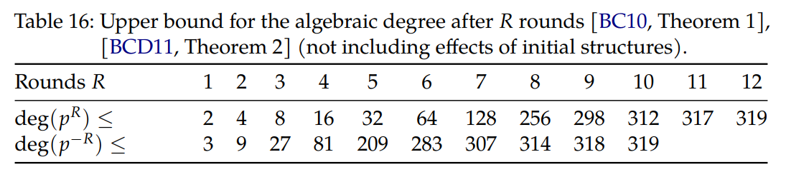
Ascon
代数估计与零和区分器
S盒使用Keccak的S盒的仿射变换
A zero-sum property for the KECCAK-f permutation with 18 rounds
Higher-order differential properties of Keccak and Luffa
New zero-sum distinguishers on full 24-round Keccak -f using the division property

Slide 28
Ascon
立方攻击
7轮
Misuse-Free Key-Recovery and Distinguishing Attacks on 7-Round Ascon
Conditional Cube Attack on Round-Reduced ASCON
Cryptanalysis of round-reduced ASCON

Slide 29
Ascon
子空间
用1-linear structures得到正向3轮（298维）
Searching for Subspace Trails and Truncated Differentials

Slide 30
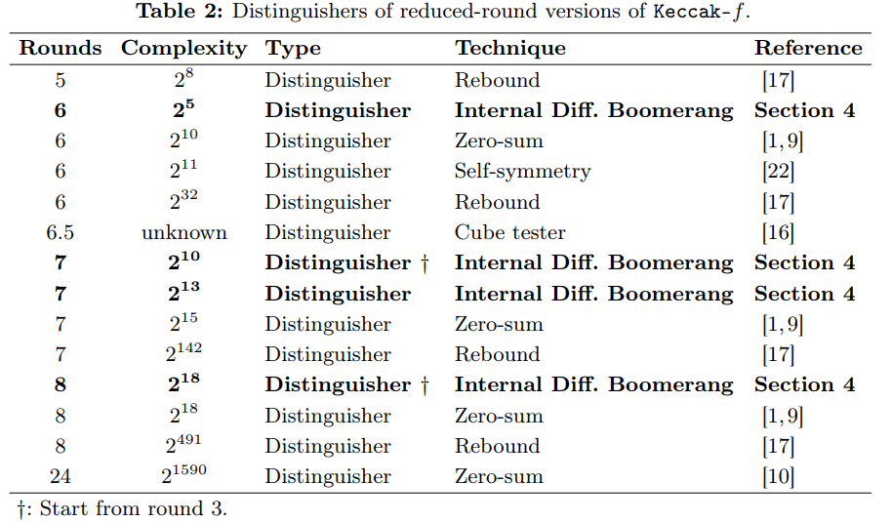
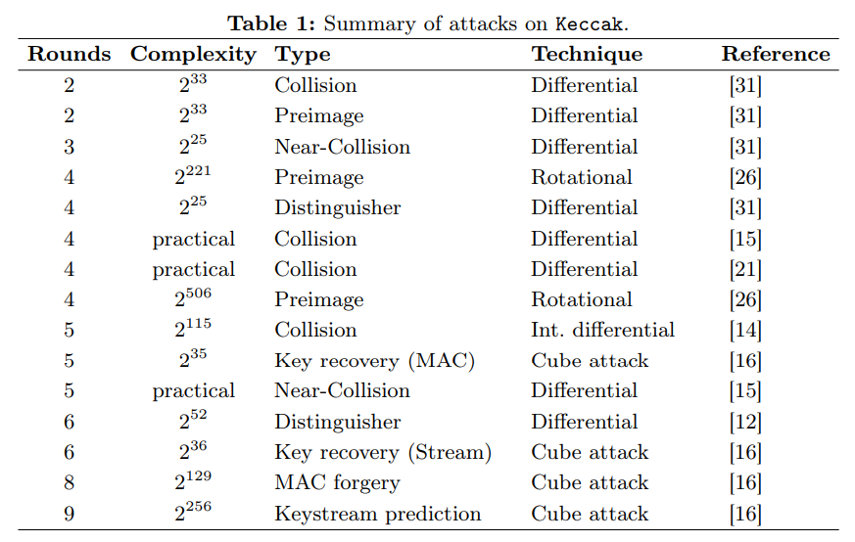
Keccak
Rounds | b=200 | b=400 | b=800 | b=1600
1 | 2 | 2 | 2 | 2
2 | 8 | 8 | 8 | 8
3 | 20 | 24 | 32 | 32
4 | 46 | [56,63] | [56,104] | [56,134]
5 | [58,89] | [58,147] | [58,247] | [58,372]
6 | [108,142] | [108,278] | [108,556] | [108,1112]
Round | 最优重量
1 | 2
2 | 8
3 | 13
4 | 49

Slide 31
Keccak
差分
New Techniques for Searching Differential Trails in Keccak
New techniques for trail bounds and application to differential trails in Keccak
Differential Biases in Reduced-Round Keccak
Differential Cryptanalysis of Keccak Variants
Differential Propagation Analysis of Keccak

Slide 32
Keccak
Improved Differential Attacks for ECHO and Grøstl
Internal Differential Attack
Collision Attacks on Up to 5 Rounds of SHA-3 Using Generalized Internal Differentials
Internal Differential Boomerangs: Practical Analysis of the Round-Reduced Keccak-f Permutation
结合Internal Diff和Boomerang
与Boomerang不同点
p2q2现变为pq2，四元组变为二元组

Slide 33
Keccak
零和
根据可分性：24轮1573。
Higher-Order Differential Properties of Keccak and Luffa
A zero-sum property for the Keccak- f permutation with 18 rounds
Zero-Sum Distinguishers for Iterated Permutations and Application to Keccak- f and Hamsi-256
New zero-sum distinguishers on full 24-round Keccak-f using the division property

Slide 34
Keccak
SymSum
SymSum: Symmetric-Sum DistinguishersAgainst Round Reduced SHA3
Outperform ZeroSum by a factor of 4
New Results on the SymSum Distinguisher on Round-Reduced SHA3
结合线性化，扩展2-3轮
Interpolation Attacks on Round-Reduced Elephant, Kravatte and Xoofff
8轮Elephant-Delirium

Slide 35
Keccak
立方
New Conditional Cube Attack on Keccak Keyed Modes
MILP-aided cube-attack-like cryptanalysis on Keccak Keyed modes
Finding Ordinary Cube Variables for Keccak-MAC with Greedy Algorithm
Practical Key-recovery Attacks on Round-Reduced Ketje Jr, Xoodoo-AE and Xoodyak
Cube-Attack-Like Cryptanalysis of Round-Reduced Keccak Using MILP
New MILP Modeling: Improved Conditional Cube Attacks on Keccak-Based Constructions
Improved Conditional Cube Attacks on Keccak Keyed Modes with MILP Method
Conditional Cube Attack on Reduced-Round Keccak Sponge Function
Cube Attacks and Cube-Attack-Like Cryptanalysis on the Round-Reduced Keccak Sponge Function
Conditional cube attack on round-reduced River Keyak
Cube-like Attack on Round-Reduced Initialization of Ketje Sr
New Distinguisher on Reduced-Round Keccak Sponge Function

Slide 36
Keccak
Algebraic Collision Attacks on Keccak
Improved Preimage Attacks on 4-Round Keccak-224/256
Algebraic Attacks on Round-Reduced Keccak/Xoodoo
Cryptanalysis of Round-Reduced KECCAK Using Non-linear Structures
Distinguishing Property for Full Round KECCAK-f Permutation
Non-full Sbox Linearization: Applications to Collision Attacks on Round-Reduced Keccak
New Collision Attacks on Round-Reduced Keccak
Linear Structures: Applications to Cryptanalysis of Round-Reduced Keccak
Practical Distinguishers against 6-Round Keccak-f Exploiting Self-Symmetry
New Attacks on Keccak-224 and Keccak-256
State-Recovery Attacks on Modified Ketje Jr
Preimage Attacks on Round-Reduced Keccak-224/256 via an Allocating Approach
Preimage Attacks on the Round-reduced Keccak with Cross-linear Structures
Rotational Cryptanalysis of Round-Reduced Keccak
Unaligned Rebound Attack: Application to Keccak

Slide 37
Xoodyak
条件立方
6轮
零和
12轮

Slide 38
Spongent
差分/线性
Estimating the Probabilities of Low-Weight Differential and Linear Approximations on PRESENT-Like Ciphers
46轮截断差分
Links between Truncated Differential and Multidimensional Linear Properties of Block Ciphers and Underlying Attack Complexities
A distinguisher on PRESENT-like permutations with application to SPONGENT
多维线性→截断差分→MitM扩展

Slide 39
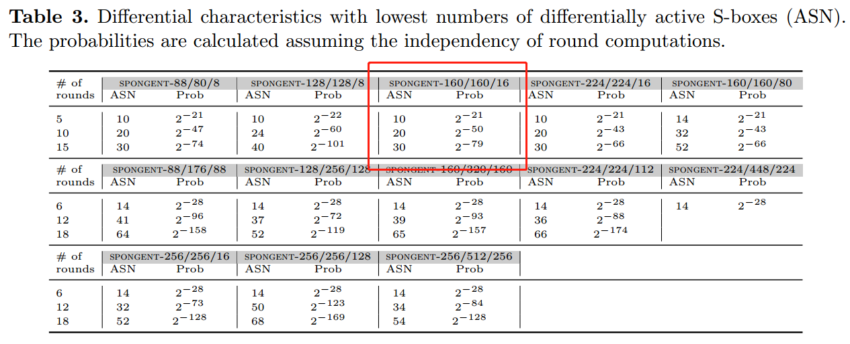
Spongent

Slide 40
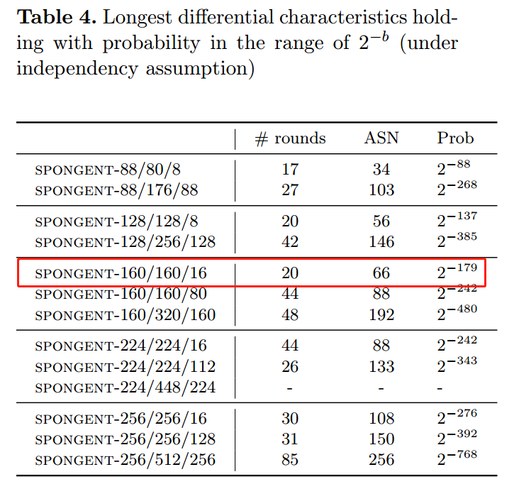
Spongent

Slide 41
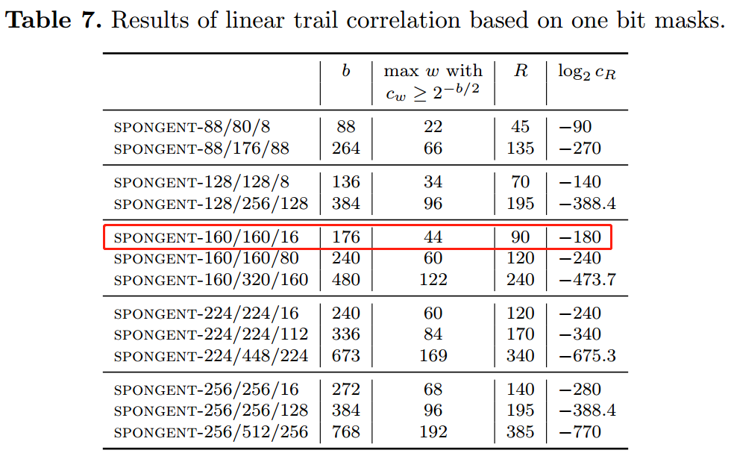
Spongent
S盒设计使得一个线性逼近只包含一条线性迹

Slide 42
Spongent
可分性，不超过12轮
MILP-aided bit-based division property for primitives with non-bit-permutation linear layers
MILP-Aided Bit-Based Division Property for Primitives with Non-Bit-Permutation Linear Layers
Finding Integral Distinguishers with Ease
零和，21轮
零相关推出积分区分器
Links Among Impossible Differential, Integral and Zero Correlation Linear Cryptanalysis

Slide 43
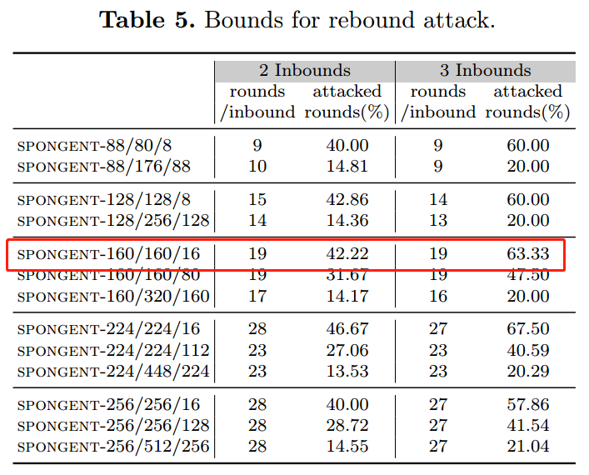
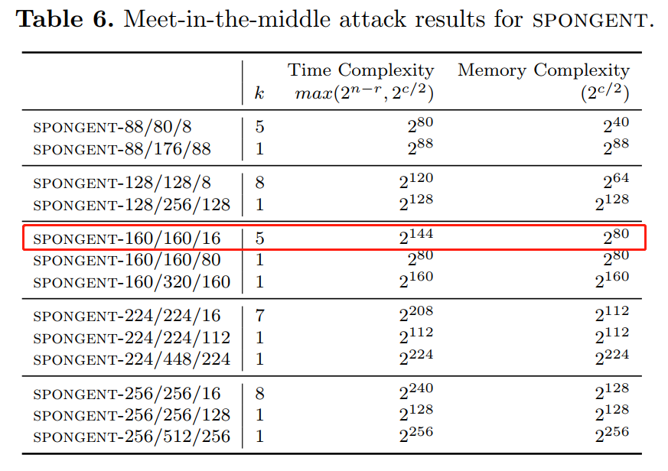
Spongent

Slide 44
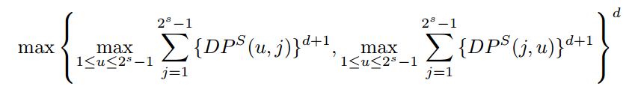
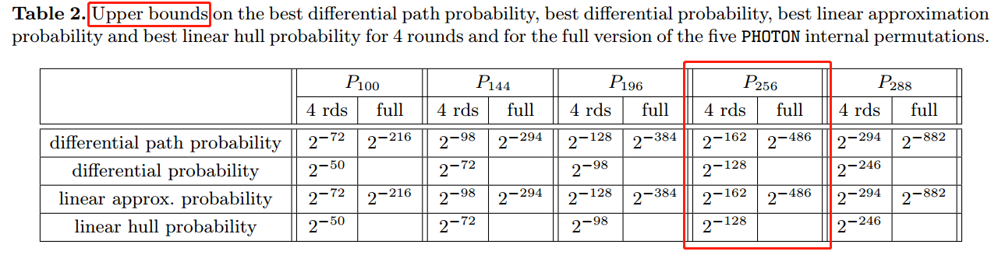
PHOTON-256
Improving the Upper Bound on the Maximum Differential and the Maximum Linear Hull Probability for SPN Structures and AES

Slide 45
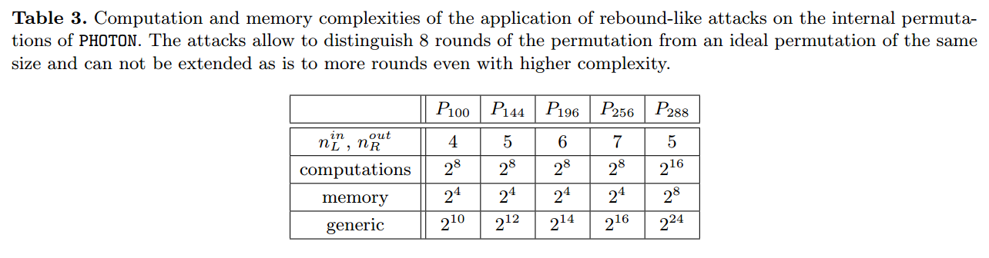
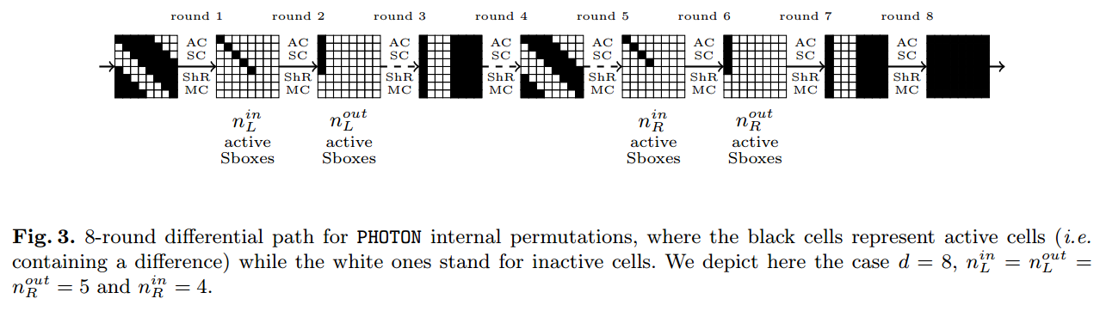
PHOTON-256

Slide 46
PHOTON-256
Rebound
The Rebound Attack: Cryptanalysis of Reduced Whirlpool and Grøstl
Improved rebound attack on the finalist grøstl
Super-Sbox
Super-Sbox Cryptanalysis: Improved Attacks for AES-Like Permutations
Rebound Distinguishers: Results on the Full Whirlpool Compression Function
Non-full active diff path
Non-full-active Super-Sbox Analysis: Applications to ECHO and Grøstl
Start-from-the-middle
Improved Cryptanalysis of the Reduced Grøstl Compression Function, ECHO Permutation and AES Block Cipher

Slide 47
PHOTON-256
统计积分
Statistical integral distinguisher with multi-structure and its application on AES
积分到统计积分。known-key setting下，区分器扩展两轮。并通过多结构降低复杂度
零和划分
Zero-sum partitions of PHOTON permutations
Multiple limited-birthday distinguishers and applications

Slide 48
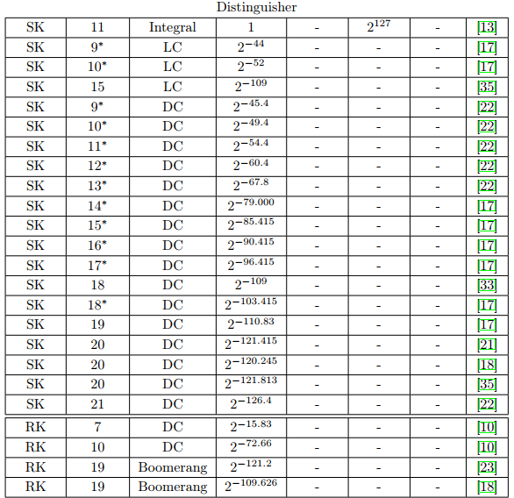
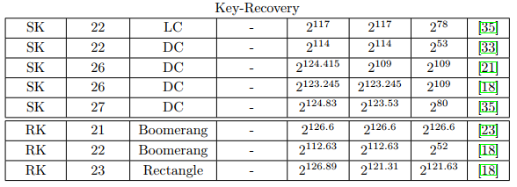
GIFT-128
差分/线性
Boomerang，Rectangle（RK setting）
积分
中间相遇

Slide 49
GIFT-128
差分
18轮，109，23轮恢复密钥
考虑聚集，26轮，123.245
MILP-based Differential Attack on Round-reduced GIFT
线性
9轮，45.99（聚集）
积分
11轮

Slide 50
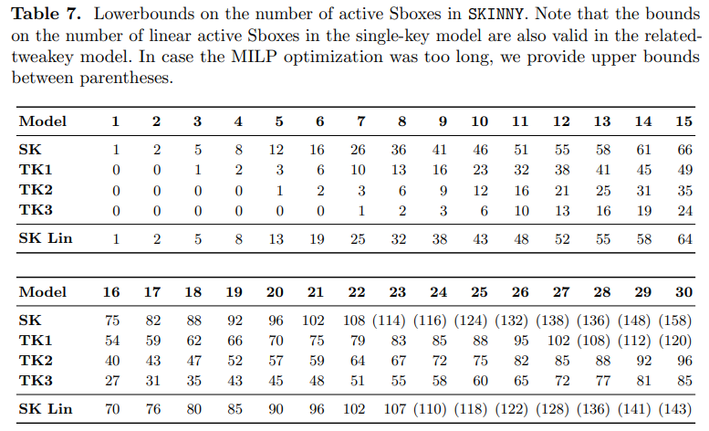
Skinny-128-384
差分/线性
RK-不可能差分
n-n/128
19轮
n-2n/128
23轮
RK-Rectangle
28轮

Slide 51
Skinny-128-384
Security Analysis of SKINNY under Related-Tweakey Settings
Cryptanalysis of Reduced round SKINNY Block Cipher
Generalized Related-Key Rectangle Attacks on Block Ciphers with Linear Key Schedule

Slide 52
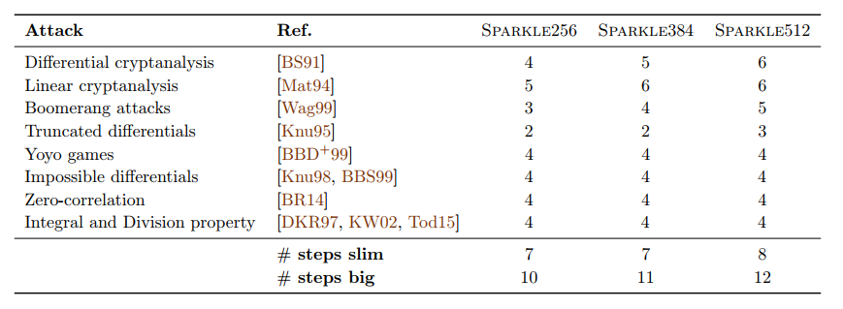
SPARKLE

Slide 53
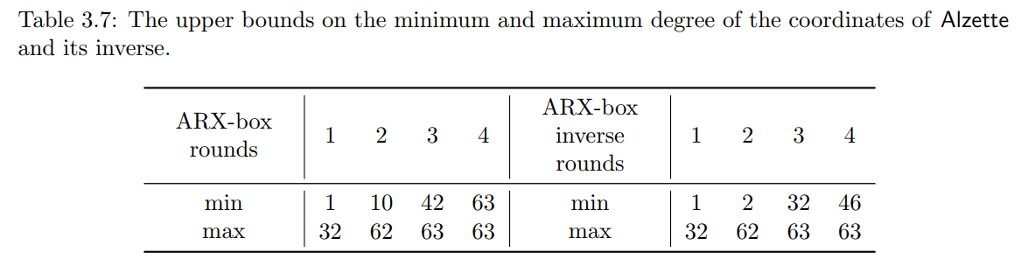
SPARKLE
Alzette（4轮）
差分（Matsui）
7轮26
8轮>31
线性（MILP、SAT）
8轮17
不变子空间
2轮59维
可分性传播

Slide 54
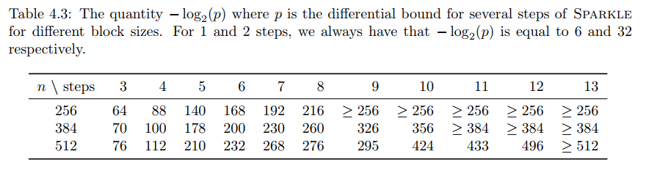
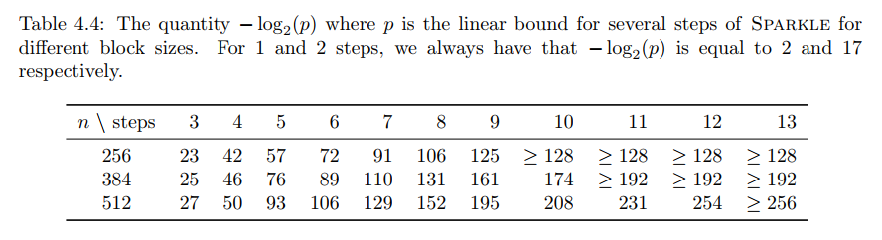
SPARKLE
差分/线性

Slide 55


SPARKLE
差分/线性
Sponge上
ID/ZC

Slide 56



SPARKLE
截断差分/多维线性
根据线性层得到截断差分，再计算概率
不可能差分/零相关
4轮
Boomerang
Sponge中怎么用？
Yoyo
4轮

Slide 57
SPARKLE
代数度
3轮后>=16
可分性
4.5轮迹

Slide 58


TinyJAMBU
差分
384轮70.68>64（考虑聚集）
线性
384轮偏差41
代数
滑动

Slide 59
Grain-128AEAD
线性逼近
偏差>77
快速相关攻击
在AE模式下不成立
复杂度114，要求同key同nonce。而AE方案要求同key同nonce的数据限制在80以内。
条件差分，动态立方（基于可分性），相关密钥
能攻Grain-128a，但还不能攻此AE

Slide 60
Cryptanalysis
Grouped by cryptanalysis

Slide 61
差分
Single-key setting下经典差分区分器
primitives | #rounds | weight
Ascon-p | 5 | [,193]
Keccak-f | 6 | [108,]
XOODOO
Spongent-Π[176] | 17, 18 | 91, 99
GIFT-128 | 26 | 123.245
PHOTON-256 | 4 | [128,]
Skinny-128-384 | 13 | 123
SPARKLE-512 | 12 | [496,]
TinyJAMBU | 338 | 70.68
Grain-128AEADv2

Slide 62
差分
Related-key/tweak setting下
经典差分
Skinny, TK3, 13轮51.8
Boomerang, rectangle
28轮Skinny
23轮GIFT

Slide 63



差分
Improved Differential Attacks for ECHO and Grøstl
Internal Differential Attack。对Groestl，P和Q结构类似。
Collision Attacks on Up to 5 Rounds of SHA-3 Using Generalized Internal Differentials
用于攻击Keccak
Internal Diff Boomerang
攻击8轮Keccak
与Boomerang不同点
p2q2现变为pq2，四元组变为二元组

Slide 64
差分
对Spongent的46轮截断差分
Links between Truncated Differential and Multidimensional Linear Properties of Block Ciphers and Underlying Attack Complexities
A distinguisher on PRESENT-like permutations with application to SPONGENT
多维线性→截断差分→MitM扩展

Slide 65
Integral
可分性
统计积分
Zero-sum
代数度估计
代数度上界
基于可分性
Symmetric Sum

Slide 66
Cube
primitives | #rounds
Ascon | 7
Keccak | 9
Xoodyak | 6
Spongent-Π[160]
GIFT-128
PHOTON-256
Skinny-128-384
SPARKLE
TinyJAMBU
Grain-128a | 184

Slide 67
Rebound
用截断差分找到至少一对正确对的复杂度估计
The Rebound Attack: Cryptanalysis of Reduced Whirlpool and Grøstl
09年Mendel等提出rebound攻击，计算找到满足差分的一对值的复杂度
攻击了7.5轮Whirlpool，8.5轮Maelstrom，6轮Grostl-256
Super-Sbox Cryptanalysis: Improved Attacks for AES-Like Permutations
将中间一轮全活跃扩展到中间两轮全活跃。将两个SB层看作一层，一列作为Super-Sbox。
Improved rebound attack on the finalist grøstl
将中间两轮全活跃扩展到中间三轮全活跃
9轮Grostl-256，10轮Grostl-512，PHOTON-224/32/32提高了1轮（从8到9）
Non-full-active Super-Sbox Analysis: Applications to ECHO and Grøstl
扩散不必是1-8的传播，也可以4-5
How to Improve Rebound Attacks
中间一些步骤复杂度计算优化

Slide 68
其它
差分-线性
MITM
ID/ZC
子空间

Slide 69
完

