Slide 1


Understanding Integer Overflow in C/C++
Will Dietz
Peng Li
John Regehr
Vikram Adve

Slide 2
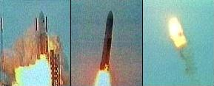
Why Integer Overflows in C/C++
Overflows are a serious source of bugs!
Ariane 5 Rocket Explosion (‘96)
“Top 25 Most Dangerous Software Errors” ~MITRE 2011
What can we do about this?
Overflow
Notes:
Why C/C++? => Safety-critical, security-critical, /unforgiving/
** Ariane 5: Truncation error on cast of floating point value to 16-bit integer
(about 30s after launch, self-destructed shortly thereafter)
What can we do? => Ongoing research, but in order to build a solution we need to first understand the *nature* of overflow in real code

Slide 3
Towards an Understanding
How can we classify integer overflows?
How common are overflows in real code?
How common are undefined overflows?
Undefined Program has no meaning
When and for what purpose is it used intentionally?
Objective: Answer these empirically for real code
Notes:
...Unfortunately we couldn’t find sufficient data in the literature, and so we set out to build that understanding.

Slide 4






Everywhere We Looked
Intentional overflow occurs often
Over 200 locations in SPEC CINT2000
Undefined overflow bugs in most programs analyzed
Even skilled developers get this wrong
Microsoft’s SafeInt, CERT’s IntegerLib
Notes:
“widely used, and generally well-respected software such as”

Slide 5
What’s Coming
Integer Overflows in C/C++
Overflow Taxonomy
IOC: Integer Overflow Checker
Results:
Case Study: SPEC CINT2000
Overflows in Real Applications
Time Bombs
Conclusions

Slide 6
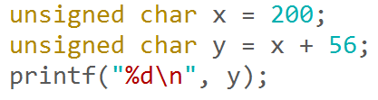
What is Integer Overflow?
Simply: Value doesn’t fit in data type
Integer Arithmetic, Shifts, Casts, …
Example:
What does this code print?
??
0
Notes:
What’s /really/ happening here?
Two extension operations
Full-width signed addition
Truncation/wraparound

Slide 7
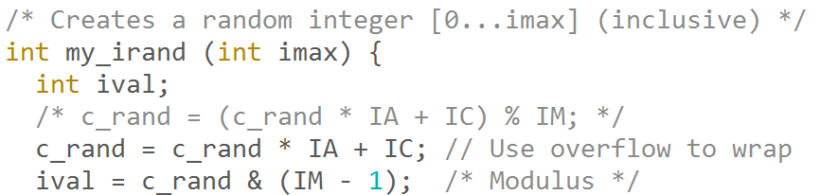
Overflows are useful
Overflow has many legitimate uses in real code
Hashing, PRNG, Cryptography, ...
Example from 175.vpr:

Slide 8
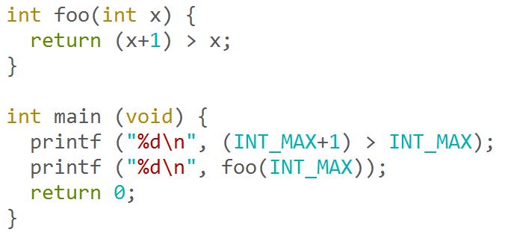
Not always so simple
What does this code do?
GCC, LLVM, Intel: Print “0” then “1”
Why?
Notes:
May seem artificial, but code like this is not at all uncommon with function inlining, macro expansion, etc
Expression “INT_MAX + 1 > INT_MAX” evaluated twice

Slide 9
Undefined Behavior
In C/C++, some integer operations are undefined
Undefined Program has no meaning
What operations are undefined?
Expression | Result
UINT_MAX + 1 | 0
INT_MAX + 1 | Undefined
SHRT_MAX + 1 | SHRT_MAX+1 if INT_MAX > SHRT_MAX, otherwise undefined
1 << 31 | INT_MIN in ANSI C/C++98; Undefined in C99/C++11
1 << 32 | Undefined
INT_MIN % -1 | Undefined in C11, otherwise undefined in practice
… | …
Notes:
Integer sign matters
Platform-specific dataype size matters
Standard used matters
…what? ☺
** Most developers don’t know these rules ** (don’t
TODO: Redo table as animated bits (across multiple slides?) using the code snippet styling used elsewhere
(make bullets for the points you want to make!)
** OVERFLOW BEHAVIOR IS TRICKY!!! **
Many non-intuitive arcane rules, many /sets/ of rules…
Many developers don’t know these rules

Slide 10
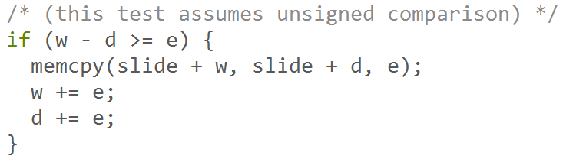
Well-defined can be bugs too
Real bug we found in gzip:
What happens when d > w?
Expression overflows to large value making check pass
Went 7 years undetected, fixed twice
Overflows are tricky!
Notes:
** Mention that “w” and “d” are unsigned!
** Linux kernel anecdote:
“7 vulnerabilities were fixed incorrectly before we
patched them --- 5 were fixed incorrectly once, 1 twice, and 1 was
still wrong after three fixes.”
Transition into next slide: Overflow taxonomy

Slide 11
Overflow Taxonomy
 | Undefined behavior | Defined behavior
Intentional | Design error “Time Bomb” | Legal May not be portable
Unintentional | Likely bug | Implementation error
Intent
Defined by language
All 4 potentially sources of bugs…
…but none are necessarily vulnerabilities
How frequently do these occur in real code?
Notes:
Challenge: How to determine programmer intent?

Slide 12
Tool Needed
IOC: Integer Overflow Checker
Based on Clang, LLVM’s C/C++ frontend
Automatic checking of integer behavior
Example output from OpenSSL bug:
Download now: http://embed.cs.utah.edu/ioc
Coming soon to a Clang release near you
Great for bug finding!
<lhash.c, (464:20)> : Op: >>, Reason :
Unsigned Right Shift Error: Right operand is negative or is
greater than or equal to the width of the promoted left operand,
BINARY OPERATION: left (uint32): 4103048108 right (uint32): 32.
Notes:
Make valgrind argument?
No one today accepts memory unsafe behavior in their programs
Why do we accept unintentional overflows?
TODO: Motivate tool for use beyond our own studies!
TODO: Highlight that as a dynamic checker, it only reports overflows that occur on a particular execution (can’t prove no overflows exist on some untested input)

Slide 13
Case Study: SPEC CINT2000
Built the 12 CINT2000 benchmarks with IOC
Ran using the “ref” data sets
Analyzed each reported overflow by hand
Found 219 distinct locations of overflow:
Notes:
**Have useful things to say about this data**
Undefined (signed) overflows more common than expected
Full list of idioms used in paper!

Slide 14
CINT2000: Overflows by Type
~1/3 overflows used undefined behavior!
Well-defined overflows occurred much more frequently than expected
Overflow of all types occurs frequently
Notes:
Overflows happen frequently

Slide 15
CINT2000: Overflows by Idiom
Hashing is by far the most common
Other:
Compute INT_MAX
-INT_MIN
Unused values
Type promotion
Many legitimate uses of overflow
Notes:
This answers “Why do these overflows exist? What was the programmer trying to do?”
** only explain one of the “other” ones
** clarify idiom classification is subjective

Slide 16
Bug Hunting: Open Source Applications
Experiment: Build applications with IOC, run “make test” or similar
Found undefined overflows are nearly everywhere:
Bug reports: well received, fixed promptly
Only three were free of undefined overflow
Kerberos, libpng, libjpeg
Highly skilled programmers get this wrong
Microsoft’s SafeInt, CERT’s IntegerLib
Undefined Overflows are (nearly) everywhere
Notes:
“Only three”: All of which have had quite a few security vulnerabilities in the past
TODO: How many bugs fixed?
TODO: “only three” begs for “out of how many”! Answer this?

Slide 17
Time Bombs: SPEC 2006
Experiment: Replace undefined behavior with random value
Standards-conforming compiler breaks SPEC!
Changing standards complicate ensuring correct behavior
Benchmark | ANSI C/C++98 | C99/C++11
400.perlbench | Pass | Pass
401.bzip2 | Pass | Fail
403.gcc | Fail | Fail
433.milc | Fail | Fail
435.gromacs | Pass | Pass
436.cactusADM | Pass | Fail
445.gobmk | Pass | Pass
464.h264ref | Pass | Fail
482.sphix3 | Pass | Fail

Slide 18
Conclusions:
Overflows are a serious source of bugs
…but there are many legitimate uses of overflow
Overflows of all types occur frequently in real code
Overflow can be extremely tricky to get right
Highly skilled developers get this wrong
Check your code with IOC (or similar)
Look forward to IOC shipping with Clang soon!
http://embed.cs.utah.edu/ioc
Security solution unclear, research needed!
Thank you! Questions?

Slide 19
FAQ 1
Why not just use –fwrapv?
Only addresses undefined part of problem
Still many bugs!
Data makes it clear that developers don’t know where overflows are occurring
Performance implications
Loop bounds
“x+1>x”, “x*2/x”, etc
Why not use well-defined behavior?

Slide 20
FAQ 2
SPEC works for everyone, are the overflows you found actual bugs?
Undefined behavior is bug waiting to happen
Code should never deviate from what you intend!
Volume of integer overflow CVE’s indicates overflows can be serious problems

Slide 21
FAQ 3
SPEC experiment was subjective, isn’t that a problem? (and perhaps should have been checked by others?)
No! ☺
Few miscategorizations don’t change the important conclusions
Examples of ways overflows are used intentionally
There’s a variety of ways overflows are used
(Results don’t generalize anyway)
Listing of all reported overflows in paper, full details happily available upon request.

Slide 22
FAQ 4
If I know the exact platform/compiler/build system/etc, why should I care?
You don’t have to, of course.
We all have deadlines or projects that aren’t mission critical.
Data indicates developers often get this wrong, even when considering it explicitly.
Most code lives for a long time, and environment often changes. Undefined has been known to break with a compiler upgrade, for example.
Checking your software with IOC doesn’t hurt anymore than checking with valgrind

