Slide 1
Rstudio shortcuts and commands that will not safe your life
(But definitely will make it easier)
David U. Garibay-Treviño, M.Sc.

Slide 2
Why are we here?
Coding can be a very fun activity
However, sometimes we have either very close deadlines, or huge modifications to make.
This presentation is here to help you become more productive while coding, and perhaps impress many of your friends!

Slide 3
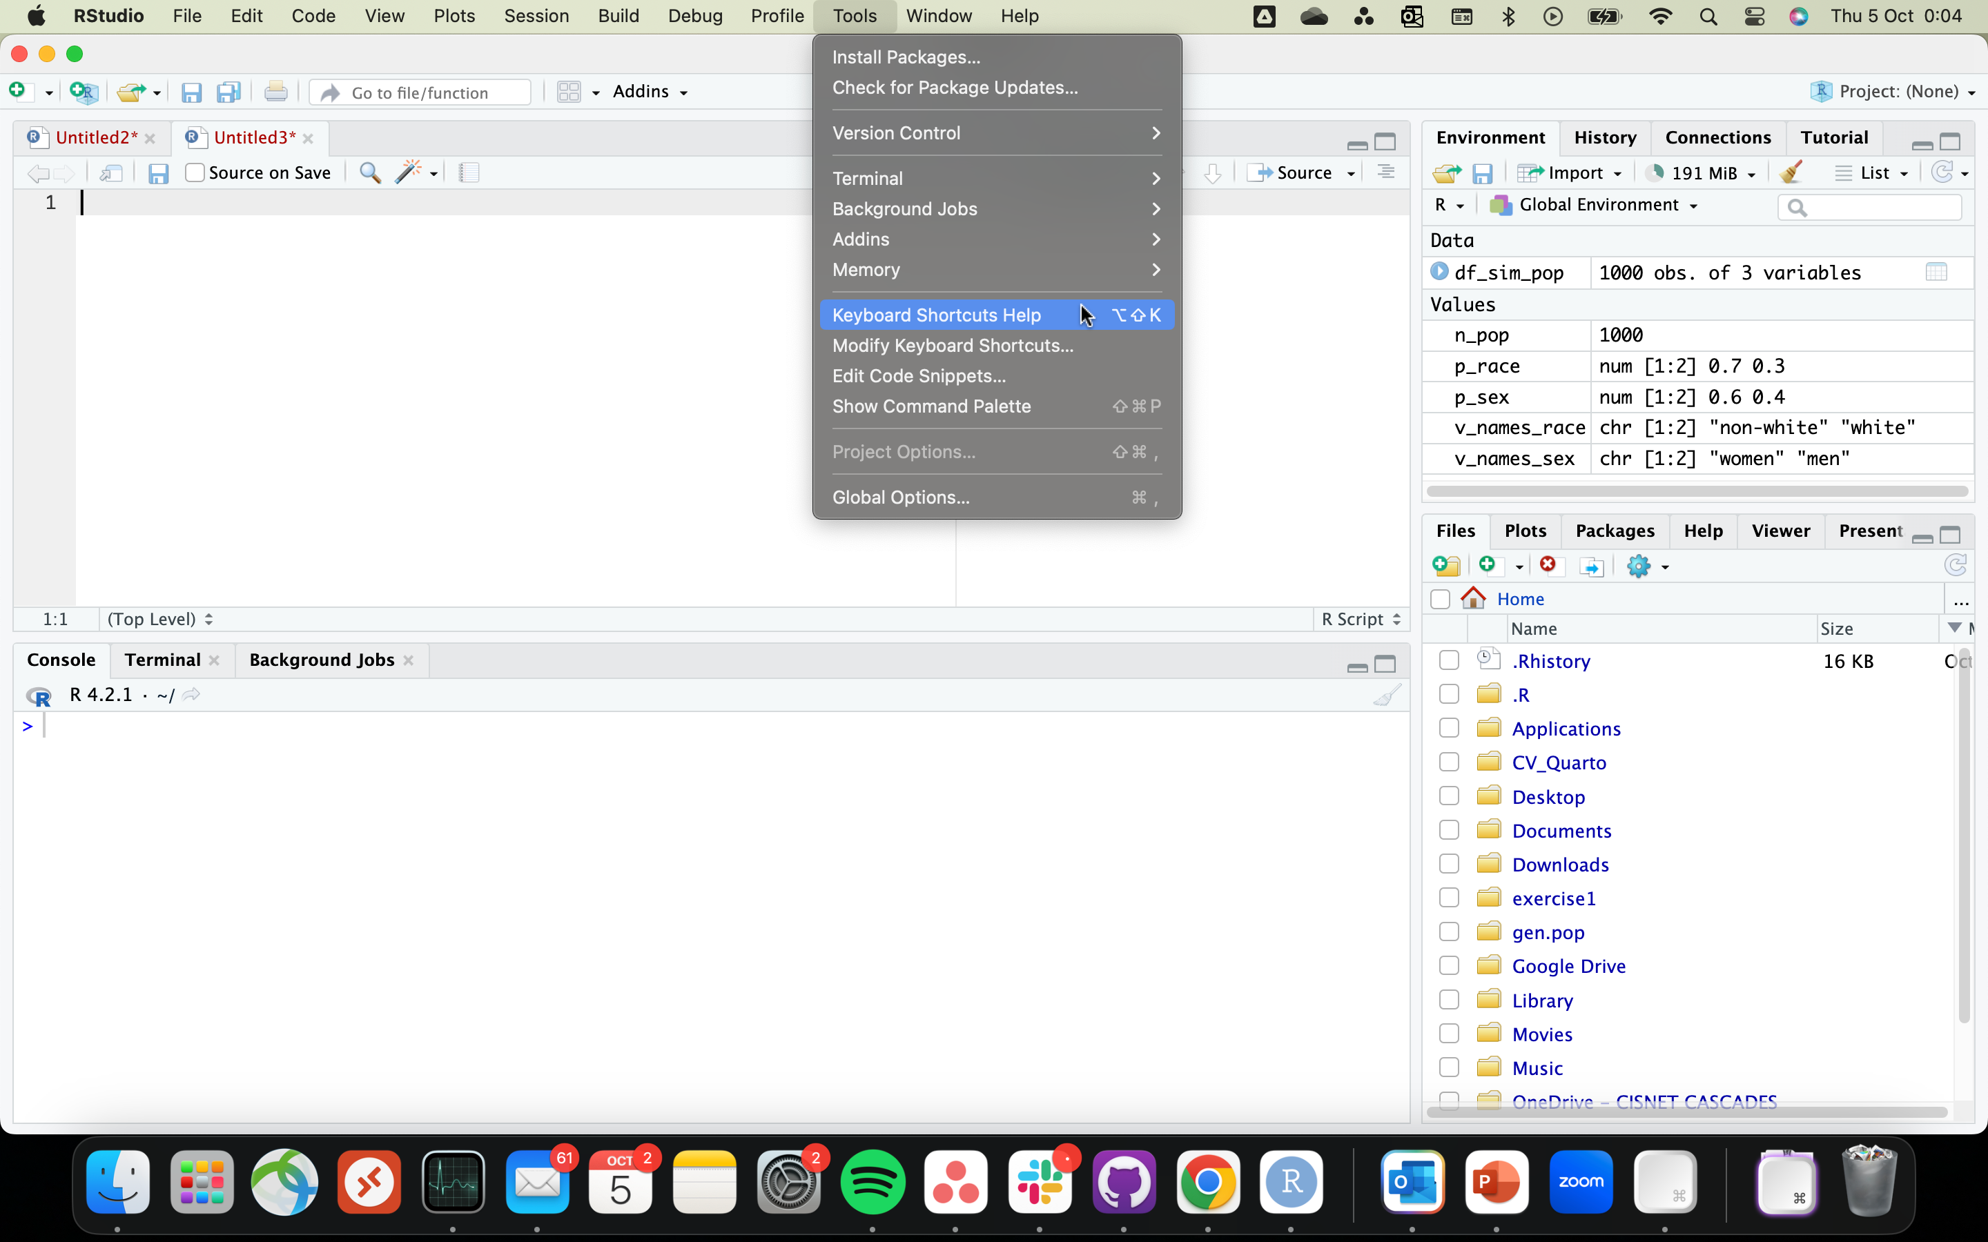
First things first
Most of the things that will be shown can be found in the Keyboard shortcuts help.
You can access it as shown in the left figure or we can start using shortcuts!

Slide 4


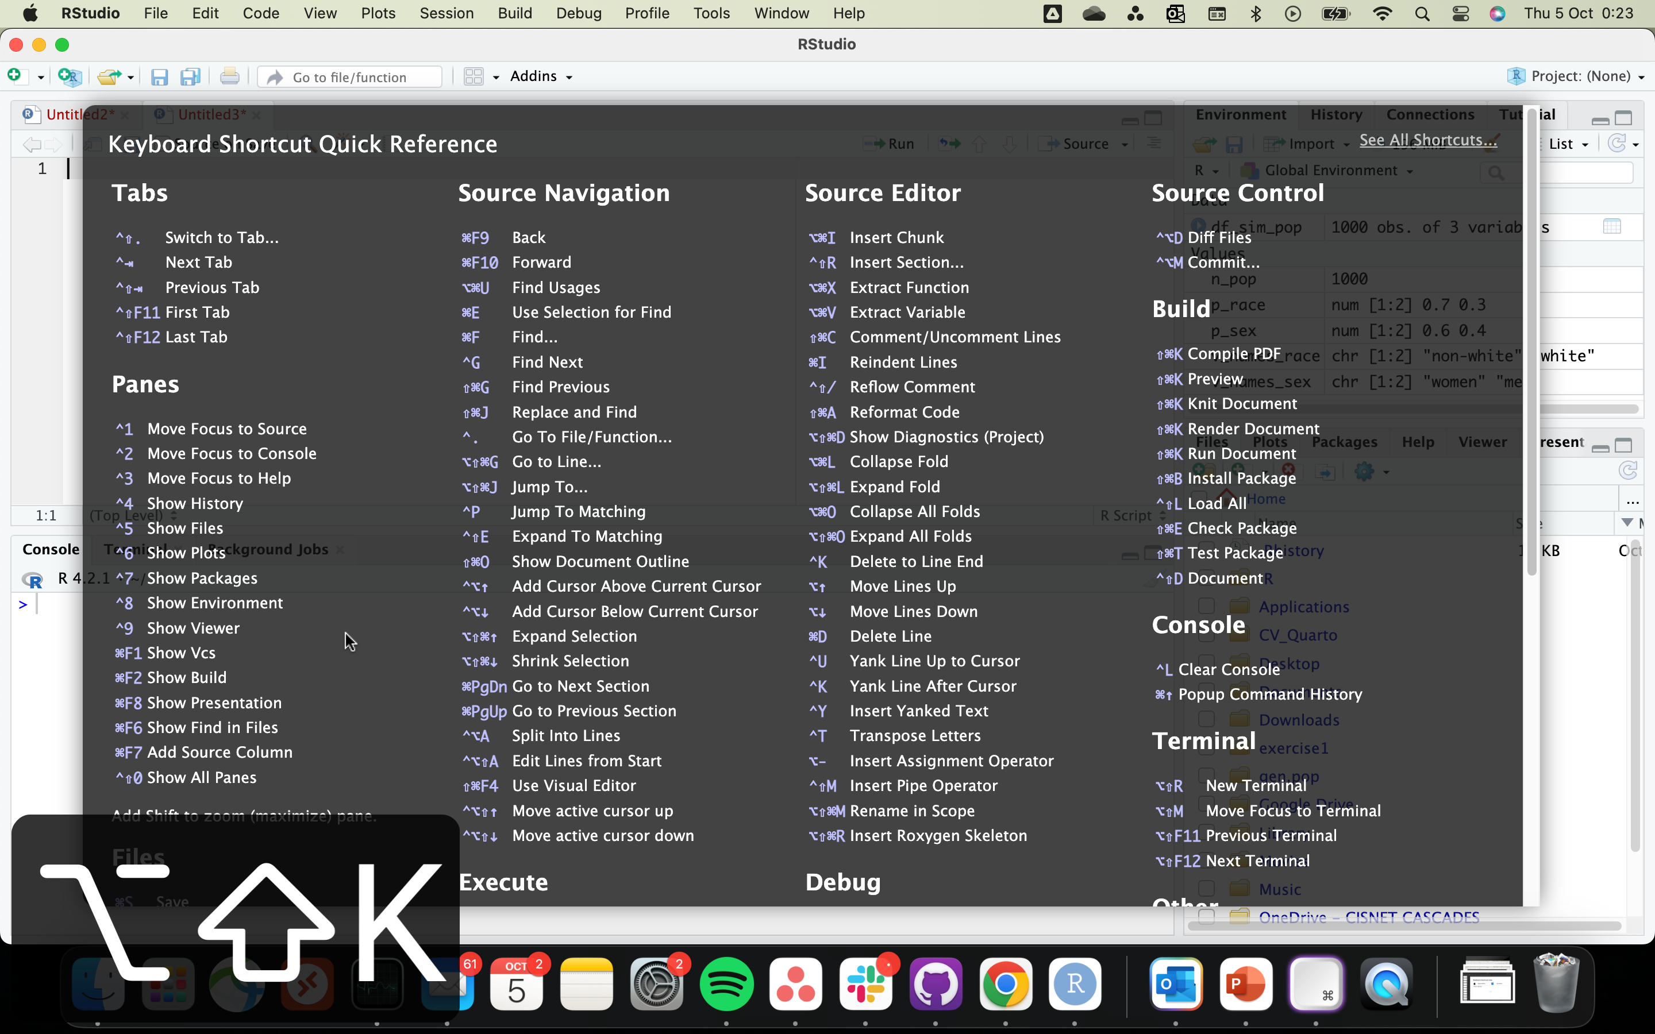
Keyboard shortcuts help
Option+Shift+K
Alt+Shift+K

Slide 5
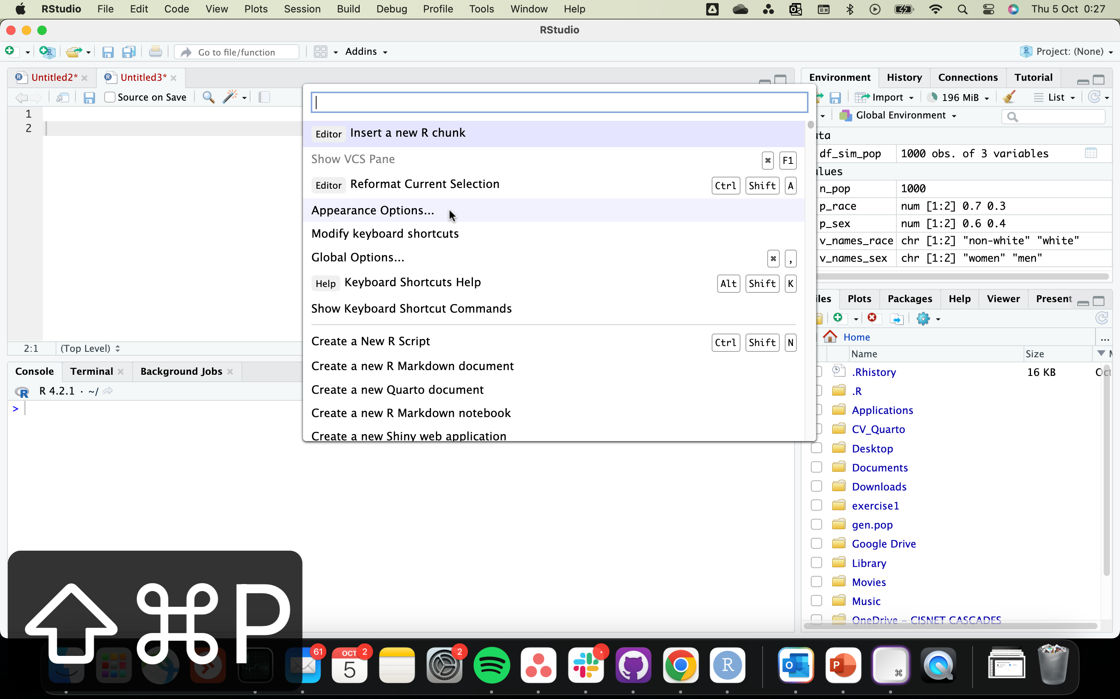
Show command palette
Cmd+Shift+P
Ctrl+Shift+P

Slide 6
List of useful commands
Command | Mac | Windows
Assignment operator (<-) | Option+- | Alt+-
Pipe operator (%>%) | Cmd+Shift+M | Ctrl+Shift+M
(Un)comment lines | Cmd+Shift+C | Ctrl+Shift+C
Go to file/function | Ctrl+. | Ctrl+.
Find in files | Cmd+Shift+F | Ctrl + Shift + F
Search inside active Tab | Cmd+F | Ctrl+F
Run from document beginning to current line | Cmd+option+B | Ctrl+Alt+B
Run from current line to document end | Cmd+option+E | Ctrl+Alt+E

Slide 7
List of useful commands (2)
Command | Mac | Windows
New script | Cmd+Shift+N | Ctrl+Shift+N
Comment line(s) | Cmd+Shift+C | Ctrl+Shift+C
Insert section break | Cmd+Shift+R | Ctrl+Shift+R
Insert code chunk (Rmd, Quarto) | Cmd+Option+I | Ctrl+Alt+I
Focus to source (Script) | Ctrl+1 | Ctrl+1
Focus to console | Ctrl+2 | Ctrl+2
Focus to terminal | Ctrl+3 | Ctrl+3
Focus to help | Ctrl+4 | Ctrl+4
Show plots | Ctrl+6 | Ctrl+6

Slide 8
14. Code Snippets
RStudio offers a very useful feature for inserting common chunks of code, called code snippets. One of our favorites is the lib snippet that saves you a bit of typing when calling the library() function to load an R package:

Slide 9
How do I use code snippets?
Snippets can be recognized on your auto-completion list by a {snippet} tag.
Write the snippet name, press Shift + Tab, or Tab twice to use it. If your input is needed to complete it – just fill out positions with elements that are important. You can cycle through them with Tab.
Some of the snippets which are available by default include:
Declarations – lib, req, fun, ret, mat
Loops – for, while, switch
Conditionals – if, el, and ei for conditionals
Apply family functions – apply, lapply, sapply, etc.
S4 classes/methods definitions – sc, sm, and sg.
Shiny App template – shinyapp

Slide 10
18. Multicursor Support
RStudio supports multiple cursors. Simply click and drag your mouse while holding down option on a Mac, or Alt on Windows/Linux.

Slide 11
Code Completion
A suggestion list will pop up as you type or can be accessed manually by either pressing Tab or Ctrl + Space. You can adjust the settings in Global Options -> Code -> Completion. To fill in the suggested phrase you have to press either Tab or Enter. Pressing Ctrl + Space with the auto-completion list open will close it. You can navigate through the suggestion list with arrows or just hover over the item before filling it in.

Slide 12
Paths
When you need to type a path, can use file path auto-complete which can be brought up by pressing the auto-completion shortcut (Tab or Ctrl + Space) from a pair of double or single quotes.
By default it starts in your working directory, you can navigate from the root location like in shell console starting with “/”, or step-up levels in the directory tree by stacking “../”

Slide 13
Shortcuts to run R code
Leverage the following shortcuts to make running your R code easier:
Ctrl + Enter – Runs the current line and jumps to the next one, or runs the selected part without jumping further.
Alt + Enter – Allows running code without moving the cursor to the next line if you want to run one line of code multiple times without selecting it.
Ctrl + Alt + R – Runs the entire script.
Ctrl + Alt + B/E – Run the script from the Beginning to the current line and from the current line to the End

Slide 14
Move code blocks through the R script
Moving lines of code up and down is easily achieved with an Alt + Up/Down combination; there is no need to cut and paste. You can move a single active line that way, or even a whole selection. If you need to remove something Ctrl + D will delete the current line/selection in no time.

Slide 16
Select eveything inside a parenthesis, brackets or []

Slide 17
I should create an example R code where I use all of these shortcuts

Slide 18
References
https://support.posit.co/hc/en-us/articles/200711853-Keyboard-Shortcuts-in-the-RStudio-IDE
https://www.dataquest.io/blog/rstudio-tips-tricks-shortcuts/
https://appsilon.com/rstudio-shortcuts-and-tips/#:~:text=Reformat%20R%20scripts&text=Ctrl%20%2B%20Shift%20%2B%20A%20%E2%80%93%20Does,selected%20part%20of%20a%20code.
https://www.youtube.com/watch?v=U373PGg8Y_0&ab_channel=BusinessScience

