Slide 3
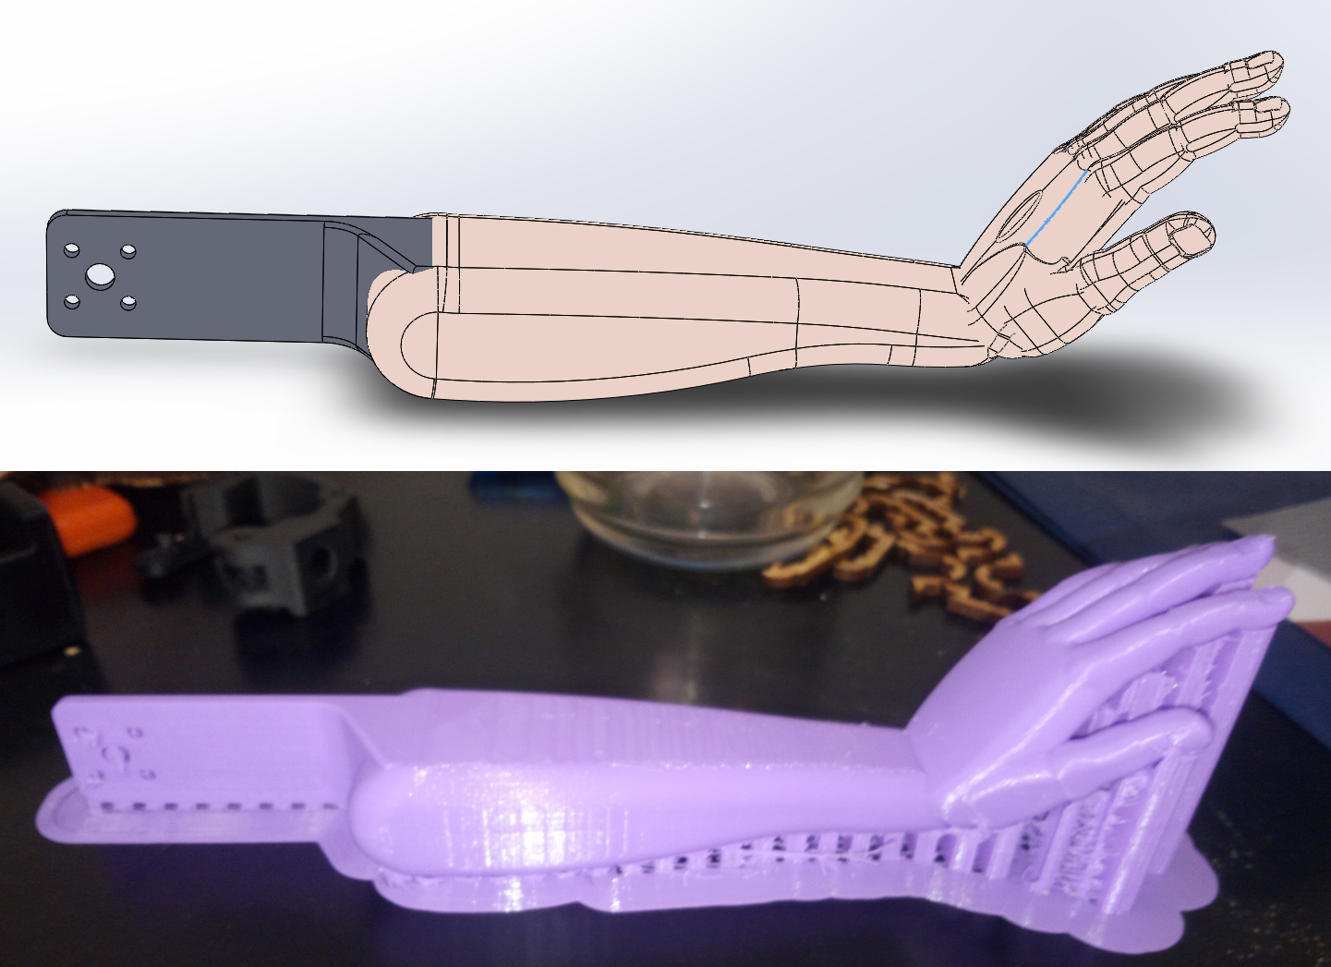

Slide 4
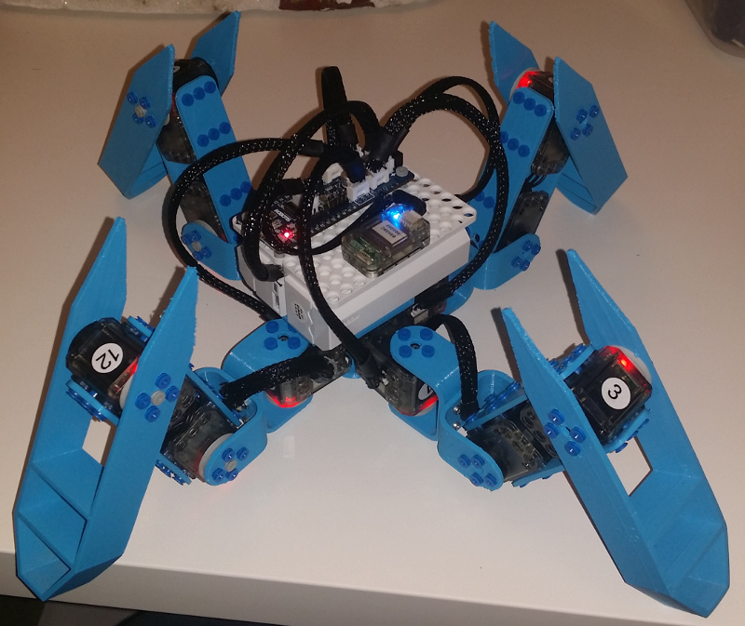
Same Microcontroller (OpenCM9.04c)
Same servomotors (Dynamixel XL-320)
Reusable code

