Slide 1



Spotify
MUSIC ON DEMAND, ANYTIME, ANYWHERE
Auraina Ejaz
Duaa Khan
Fatima Irfan Khan

Slide 2
Index
PRESENTATION FLOW
Project Overview
Concepts + Softwares
Implementation
Visualisations
Data Sources

Slide 3

Project Overview

Slide 4

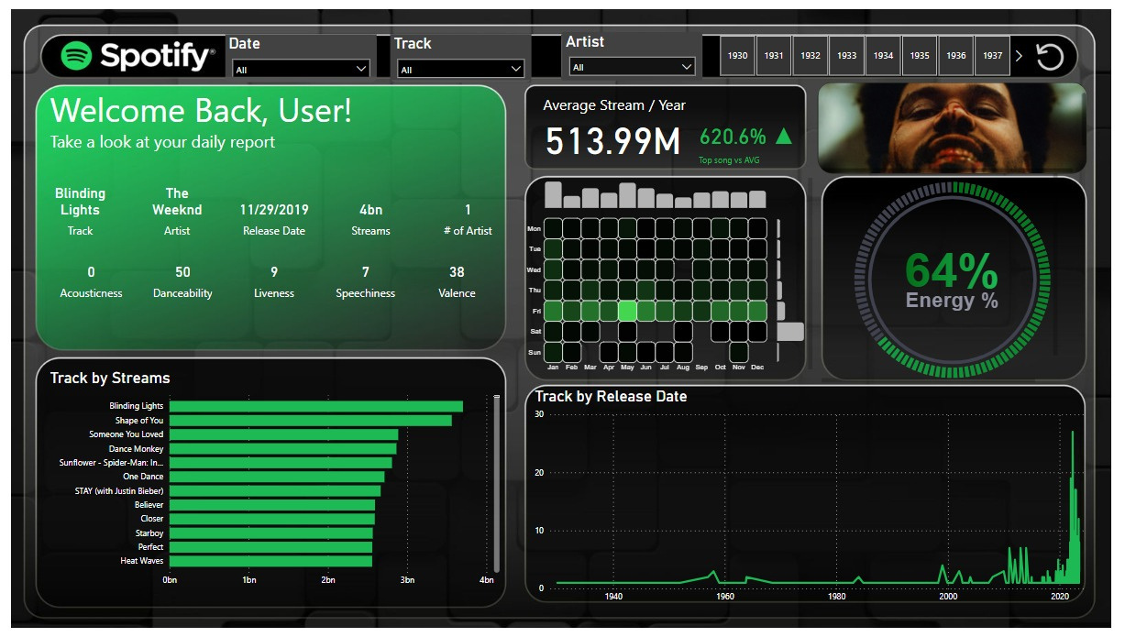
This project utilizes Kaggle's Spotify dataset to extract insights into user preferences and music industry trends. Employing Power BI, the analysis involves cleaning and preprocessing data, identifying key patterns, and creating an interactive dashboard for visual representation. The goal is to offer stakeholders a concise and user-friendly tool for informed decision-making based on comprehensive music consumption patterns.

Slide 5
Concepts + Softwares

Slide 6
DATA COLLECTION
KAGGLE
.
Concepts
(ETL)
DATA CLEANING AND PREPROCESSING
SPOTIFY DEVELOPERS' DASHBOARD
Softwares
DATA ANALYSIS
POWER BI
DATA VISUALISATIONS
BRAVO FOR POWER BI

Slide 7
Implementation

Slide 8
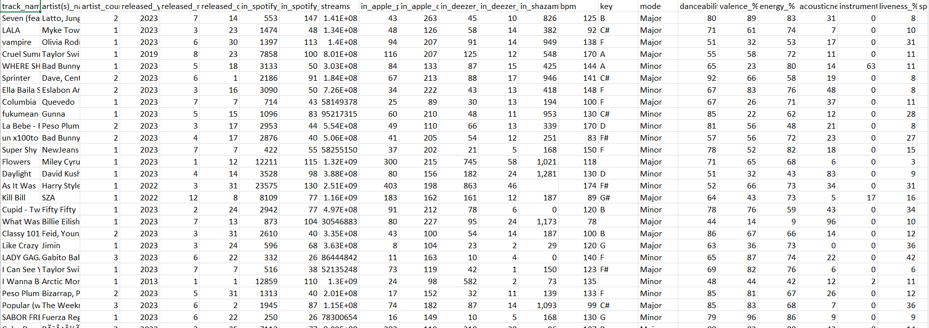
Kaggle Dataset
CONSISTED OF 25 COLUMNS
CLEANING AND PREPROCESSING
HANDLING OF MISSING DATA, DUPLICATES AND OUTLIERS
USE OF BRAVO TOOL
CALENDER TABLE

Slide 9
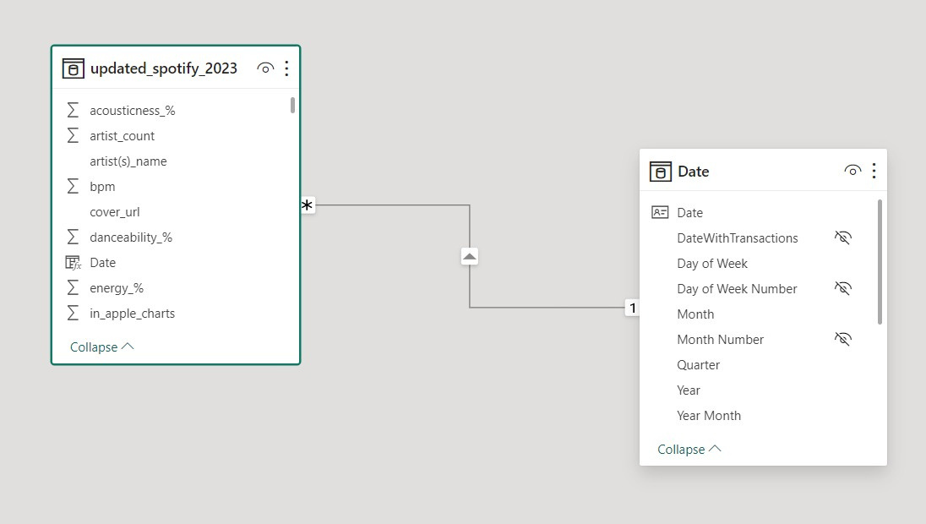

ER DIAGRAM

Slide 10
DAX MEASURES
AND OTHER FUNCTIONS
COLUMNS FOR VISUALISATIONS WHICH PROVIDE INSIGHTS
DATA ANALYSIS

Slide 11
Visualisations

Slide 12
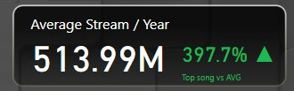
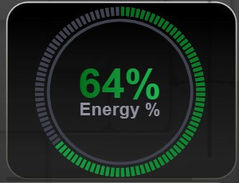
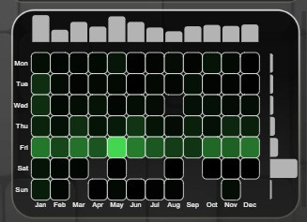
CARDS
UNIT CHART
HEATMAP

Slide 13
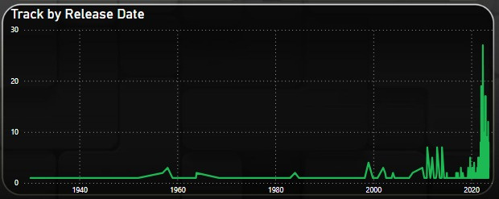
Line Graph

Slide 14

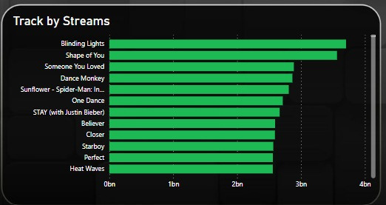
Bar Graph

Slide 15
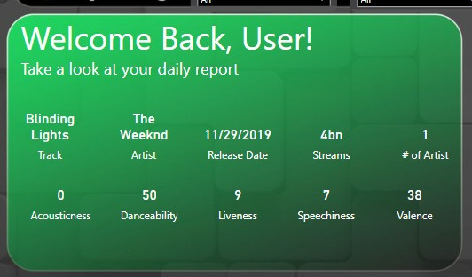
OVERALL SUMMARY OF THE TOP ARTIST
CARD/SLICER VISUALISATIONS
TIMELINE SLICER WHICH SHOWS ALL THE ARTISTS AND SONGS FROM DIFFERENT ERA
Interactive Slicers, allowing us to select the date, type of track, and artist

Slide 16
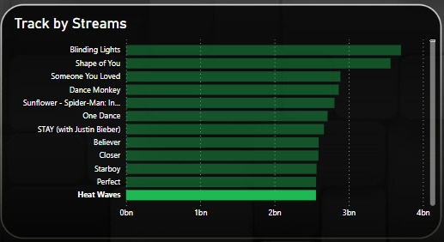

BARCHART SYNCED WITH PICTURES

Slide 17
Thankyou

