Slide 1
MARKETING MIX MODELING
Meridian MMM +
SHAP Explainability
A Bayesian analysis of channel contribution, saturation, ROI and future investment scenarios
Marketing Analytics Assignment
Prepared by Duaa Zahur
Paid Search
Shopping
PMAX
Video
Facebook
Instagram
Notes:
<number>

Slide 2
Executive summary
The model points to a focused reallocation strategy, not a blanket budget increase.
KEY OUTCOMES
0.710
5.41
63.5%
+$760.5k
Holdout R²
Paid Search mROI
Meta contribution
Best profit change
Good generalization
Best scale opportunity
Facebook + Instagram
Paid Search +50%
What the evidence says
Recommended action
Meta channels drive the largest volume, but Google Paid Search delivers the strongest financial efficiency and still has substantial headroom. PMAX and Shopping are closer to saturation, while Video is below break-even.
Scale Paid Search first, maintain controlled investment in Meta, trim PMAX and Shopping, and review Video. Avoid distributing incremental budget equally across all channels.
Posterior means shown unless stated otherwise.
<number>
Notes:
<number>

Slide 3
Assignment coverage and point alignment
All six required tasks are represented in the analysis and in this deck.
RUBRIC MAP
EDA
10 pts
Data preparation
15 pts
1
2
Missing values, spend trends, seasonality, outliers
Daily modeling table, media, controls, train/validation
✓
✓
Meridian MMM
25 pts
ROI & mROI
20 pts
3
4
Bayesian training, fit, contribution, adstock, saturation
Channel efficiency, under/over-investment
✓
✓
SHAP explainability
15 pts
Scenario simulation
15 pts
5
6
Summary, dependence, importance vs MMM
Revenue, purchases, ROI and recommendations
✓
✓
<number>
Notes:
<number>

Slide 4
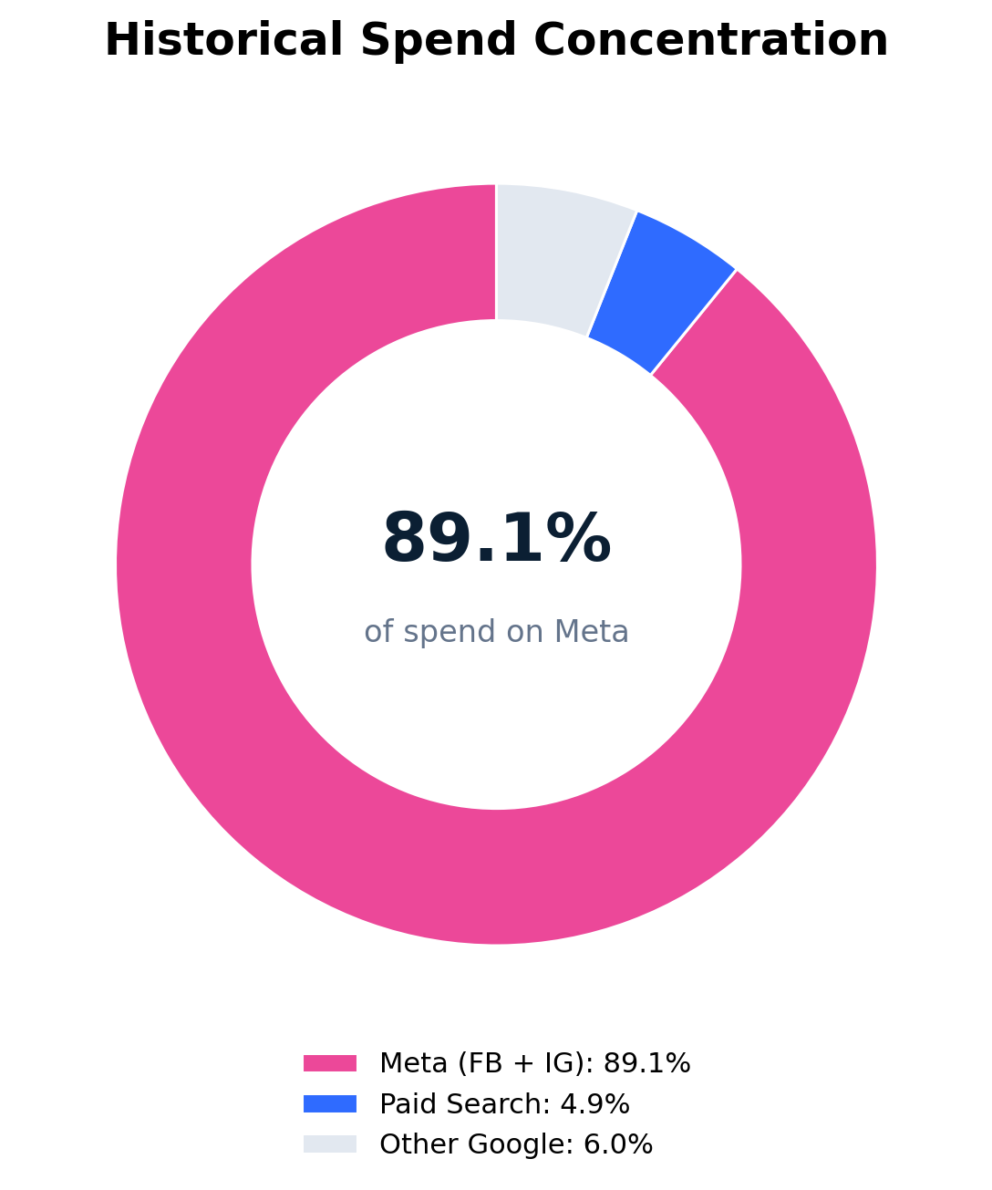
Data scope and modeling choice
A single complete organization-level time series was selected for consistency and interpretability.
DATA SELECTION
Selected organization profile
Channels retained
Industry
Beauty & Fitness
Google Paid Search
Category
Face & Body Care
Google Shopping
Currency
USD
Google PMAX
Period
21 Nov 2020 - 19 May 2024
Google Video
Observations
1,276 daily rows
Meta Facebook
Paid channels
6
Meta Instagram
Control variables
16
Why one organization?
A complete, continuous daily series avoids mixing different currencies, business models and demand patterns.
<number>
Notes:
<number>

Slide 5
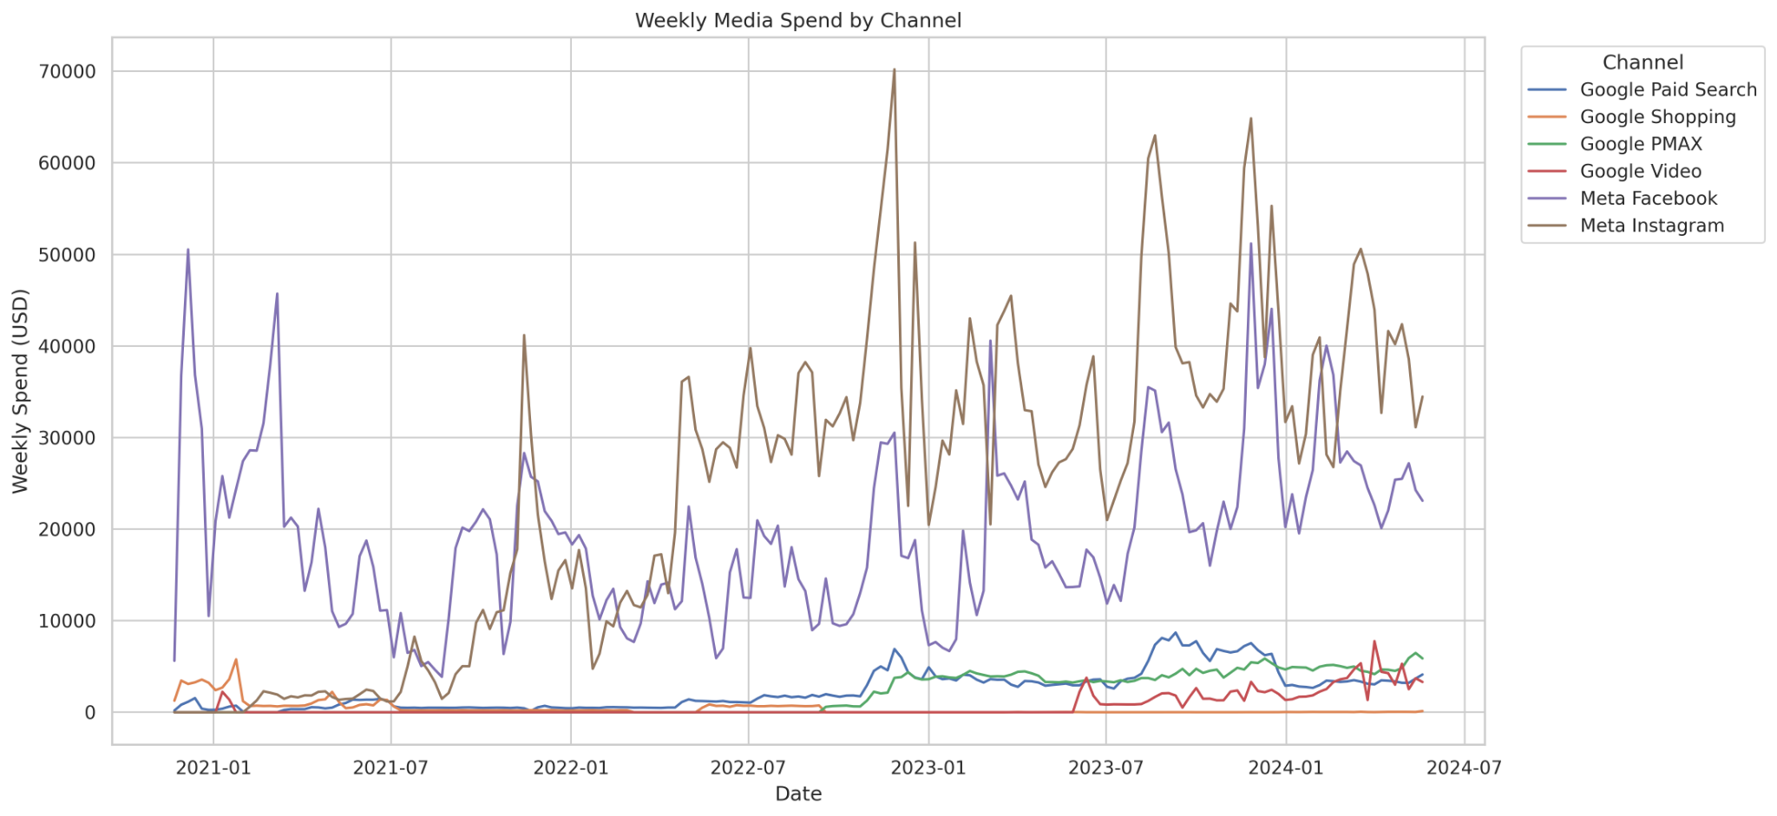
Exploratory analysis
Seasonality and spend concentration are material features of this business.
TASK 1 · 10 POINTS
Spend concentration
Facebook and Instagram absorbed 89% of historical spend.
Seasonality
Sunday was the strongest weekday; November and Black Friday produced the largest spikes.
Outliers
15 purchase outliers were retained because they reflect real promotional demand.
Trend
Purchases and media intensity increased meaningfully through 2023-24.
EDA deliverables: daily demand, spend trends, correlations, seasonality and outlier discussion.
<number>
Notes:
<number>

Slide 6
Data preparation and feature engineering
The final table links purchase demand to paid-media exposure, spend and demand controls.
TASK 2 · 15 POINTS
1
2
3
4
5
Select one complete daily series
Standardize media variables
Create controls
Handle structural missingness
Split and validate
1,276 consecutive days
Spend + impressions for 6 channels
Trend, weekday, yearly harmonics, Black Friday, owned/organic traffic
Zero-fill inactive media days; validate no missing target
80/20 chronological deliverable + balanced Meridian holdout
ALL_PURCHASES
6
16
0
Daily purchases
Impressions + spend
Demand & seasonality
Final modeling data
Target KPI
Paid-media channels
Control variables
Missing values
<number>
Notes:
<number>

Slide 7
Meridian model design and training
The primary model is a Bayesian Marketing Mix Model trained with MCMC posterior sampling.
TASK 3 · 25 POINTS
Bayesian model workflow
Training step
4
`sample_posterior(...)` performed the actual model fitting. Meridian does not use a scikit-learn `.fit()` call.
MCMC chains
Media exposure
6 channels
2 chains per device group
Adstock
Geometric, max lag 8 days
2,000
Posterior samples
Hill saturation
Diminishing returns
500 retained × 4 chains
20%
Controls
16 demand variables
Balanced holdout
8 days
255 observations
Maximum media lag
Posterior outcome
Expected purchases + revenue
Carryover window
Primary output
Contribution, adstock, saturation, ROI and response curves
<number>
Notes:
<number>

Slide 8
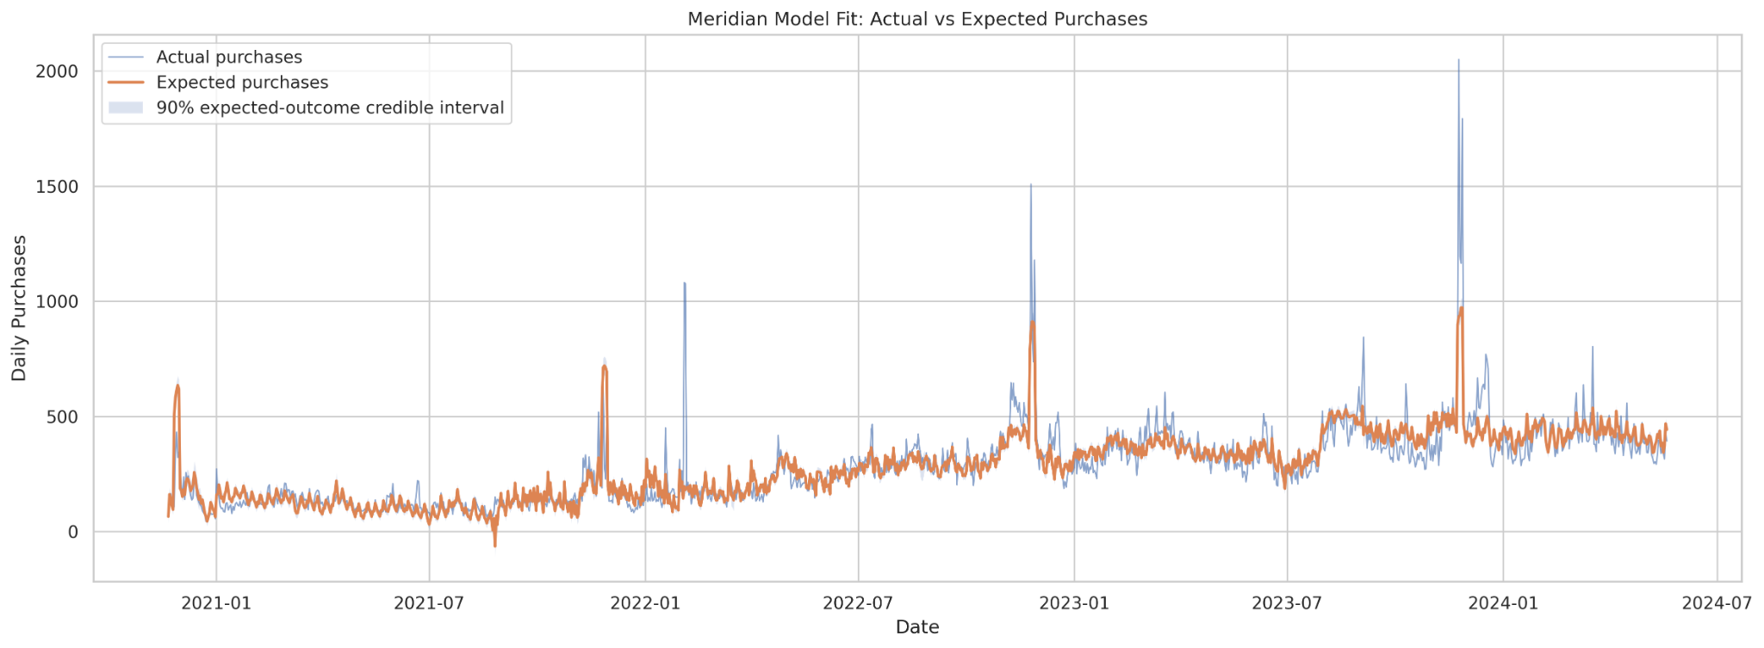
Model quality and holdout performance
The holdout metrics remain close to training results, indicating reasonable generalization.
MODEL VALIDATION
0.746
Training R²
0.710
Holdout R²
81.16
Purchases/day
Holdout RMSE
15.92%
Holdout wMAPE
Interpretation: the small R² gap and slightly lower holdout error suggest limited overfitting. Extreme Black Friday peaks remain difficult to capture fully.
<number>
Notes:
<number>

Slide 9
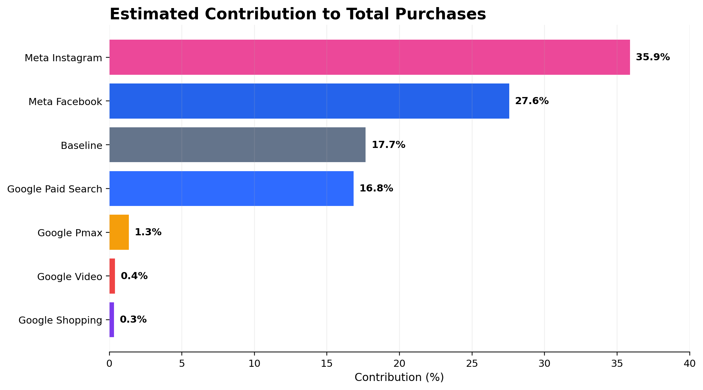
Channel contribution
Meta drives the most volume; Paid Search contributes far more than its budget share.
INCREMENTALITY
35.9%
27.6%
Instagram
Facebook
16.8%
17.7%
Paid Search
Baseline
Core insight
Facebook and Instagram account for 63.5% of modeled purchases, broadly matching their dominant spend. Paid Search contributes 16.8% from only 4.9% of spend, a major efficiency signal.
<number>
Notes:
<number>

Slide 10
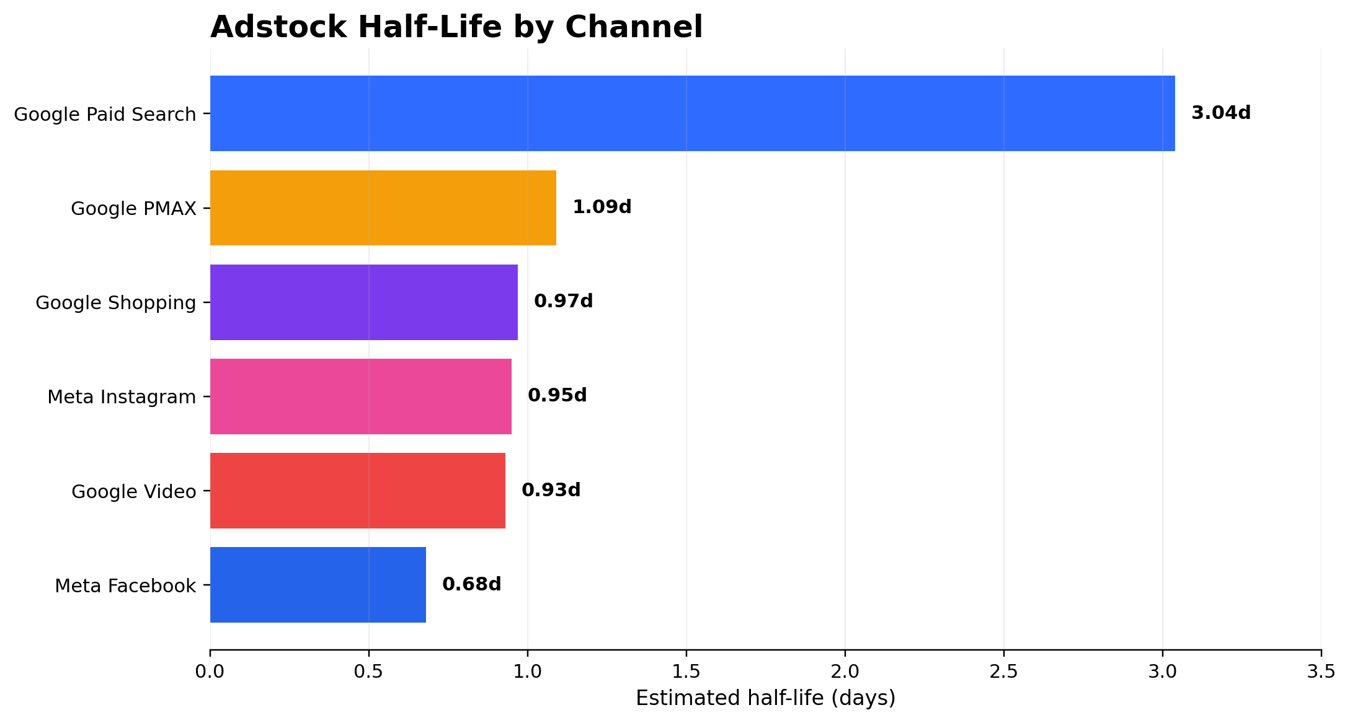
Adstock and lagged media effects
Paid Search has a materially longer carryover window than the other channels.
CARRYOVER
Longest carryover
Google Paid Search half-life: 3.04 days; 35.2% of the initial effect remains after 7 days.
Fastest decay
Meta Facebook half-life: 0.68 days; less than 1% remains after 7 days.
Planning implication
Search can influence purchases over several days. Meta requires more continuous exposure to sustain response.
Exact decay estimates have wide credible intervals for some channels and should be interpreted directionally.
<number>
Notes:
<number>

Slide 11
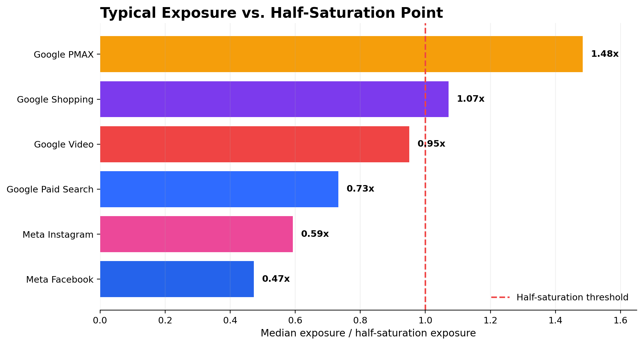
Saturation and diminishing returns
PMAX and Shopping are operating closest to or beyond their half-saturation points.
HILL EFFECTS
1.48×
1.07×
PMAX ratio
Shopping ratio
Most saturated
Above threshold
0.73×
0.47×
Paid Search
Facebook
Still below threshold
Exposure headroom
How to use this result
Saturation alone is not profitability. Final allocation decisions combine Hill headroom with ROI and marginal ROI. This is why Meta can show headroom but Paid Search remains the first scaling priority.
<number>
Notes:
<number>

Slide 12
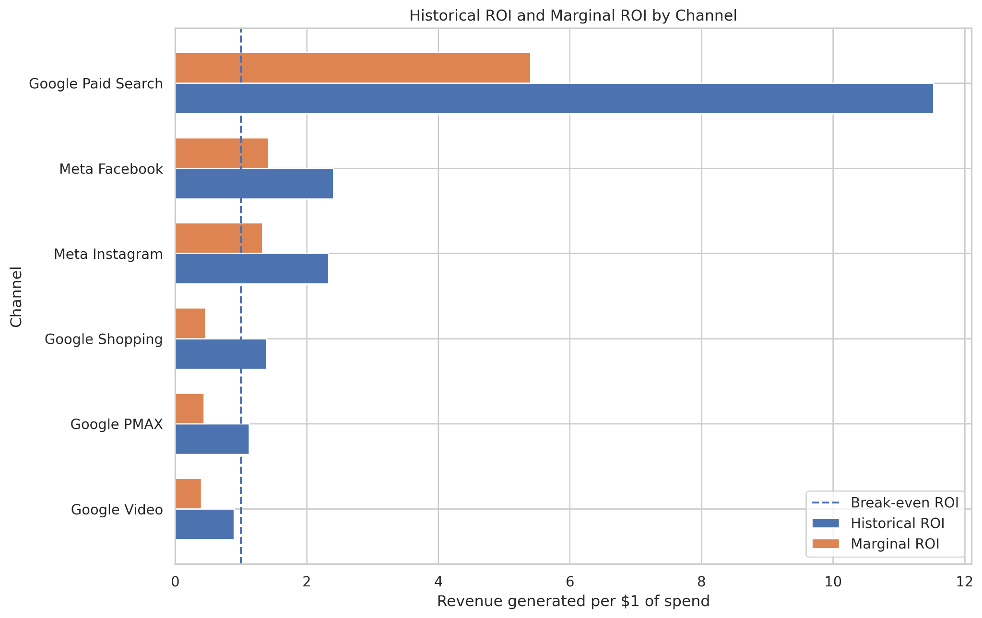
ROI and marginal ROI
Paid Search is the strongest scale opportunity; PMAX, Shopping and Video are weak at the margin.
TASK 4 · 20 POINTS
11.53 / 5.41
Paid Search ROI / mROI
2.40 / 1.42
Facebook ROI / mROI
2.33 / 1.33
Instagram ROI / mROI
Decision rule
mROI > 1 supports incremental investment. Shopping (0.46), PMAX (0.44) and Video (0.40) should be held or reduced.
<number>
Notes:
<number>

Slide 13
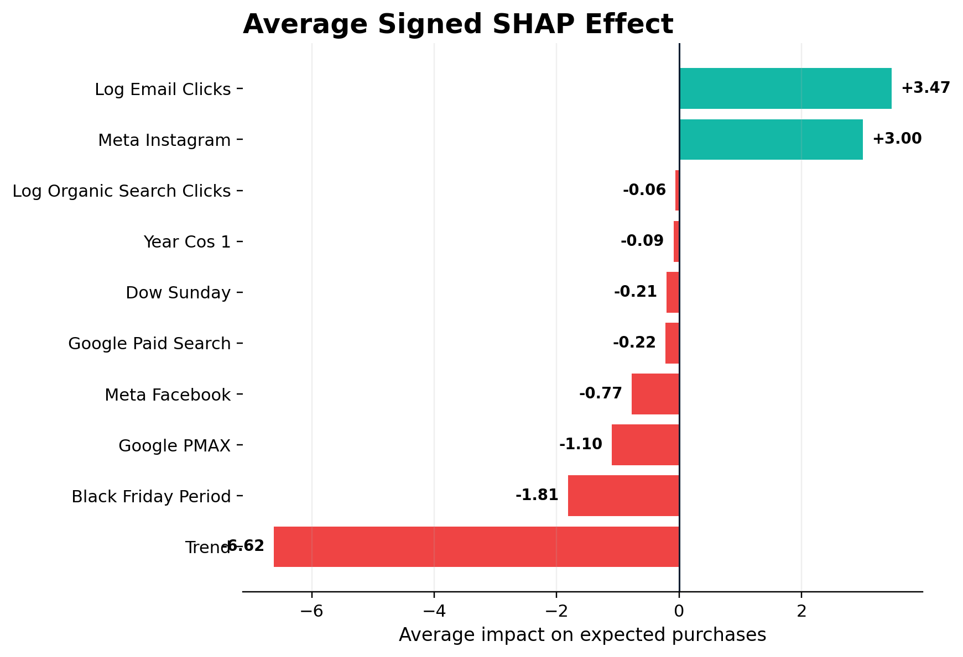
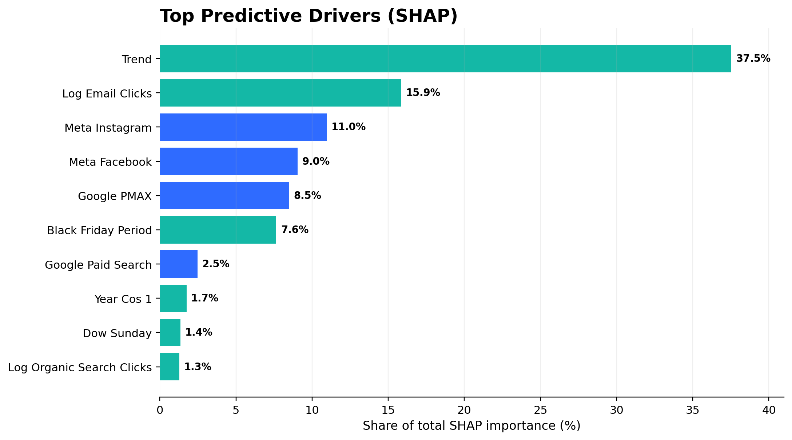
SHAP explainability
A high-fidelity Random Forest surrogate explains Meridian prediction patterns.
TASK 5 · 15 POINTS
0.974
0.988
Interpretation
Important distinction
Holdout
With Meridian
Surrogate R²
Correlation
Trend and email dominate prediction; Meta and PMAX lead paid-media SHAP importance.
SHAP explains prediction patterns. Meridian remains the source for causal contribution, ROI and mROI.
<number>
Notes:
<number>

Slide 14
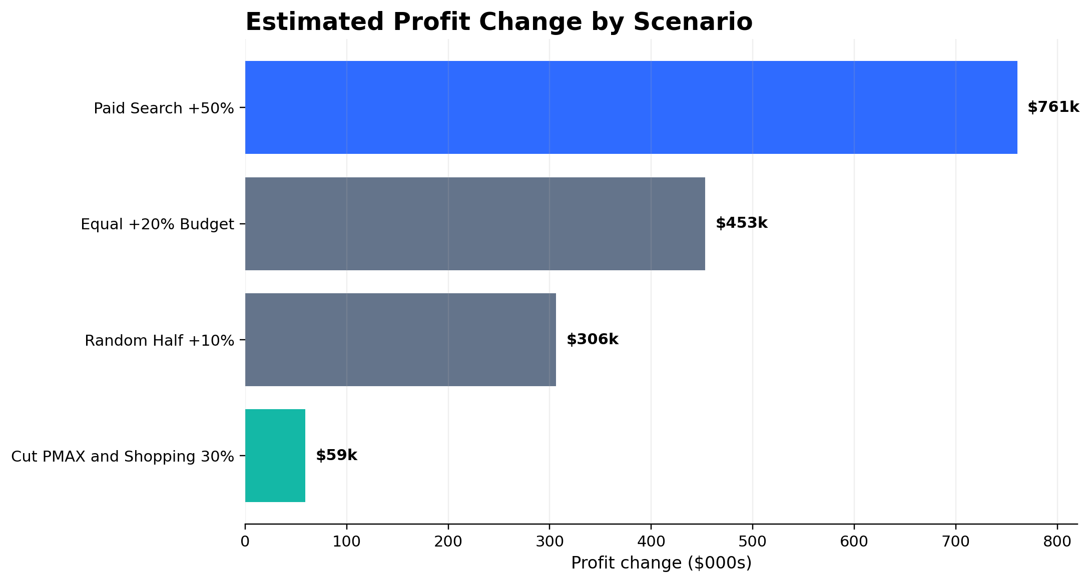
Future marketing investment scenarios
Targeted reallocation outperforms broad-based spending increases.
TASK 6 · 15 POINTS
Scenario comparison
Scenario
Profit change
Extra ROI
Paid Search +50%
+$760.5k
4.46
Equal +20%
+$453.3k
1.25
Random half +10%
+$306.1k
1.60
Cut PMAX + Shopping
+$59.3k
Cost saving
Best result
Paid Search +50% generated $980k revenue and 11.6k purchases from $220k extra spend.
<number>
Notes:
<number>

Slide 15
Recommended next-quarter investment plan
Reallocate toward the channel with the strongest marginal economics.
BUSINESS RECOMMENDATION
SCALE
MAINTAIN / TEST
REDUCE / HOLD
Google Paid Search
Meta Facebook + Instagram
PMAX, Shopping, Video
Increase investment first. Tested +50% scenario produced the strongest profit uplift and an extra-spend ROI of 4.46.
Keep as major volume channels. Scale cautiously because they already represent 89% of spend and mROI is lower than Search.
Trim saturated PMAX and Shopping. Review Video because historical ROI and mROI are below break-even.
Best tested action: Paid Search +50% → +$760.5k estimated profit | +$980.4k revenue | +11,608 purchases
Monitor monthly
<number>
Notes:
<number>

Slide 16
Conclusion, trust and limitations
The business answers are clear, but decisions should still be implemented gradually and measured.
FINAL ANSWERS
Five questions answered
Limitations
1
Highest incremental purchases
Meta Instagram
Results apply to one selected organization and period.
2
Strongest ROI and mROI
Google Paid Search
MMM depends on causal assumptions and available control variables.
Most saturated
Google PMAX
Some channel estimates have wide credible intervals.
3
SHAP explains a surrogate prediction model, not incrementality.
4
Best tested allocation
Paid Search +50%
Scenario results are estimates and should be validated with experiments.
5
Explainability
Strong surrogate fidelity; SHAP is predictive, Meridian is causal
Final recommendation
Scale Paid Search, keep Meta disciplined, and remove low-return spend from saturated channels.
<number>
Notes:
<number>

