Slide 1
The MIPS 32
Our objective is to get an appreciation with:
working with a “typical” computer machine language.
programming in assembly language.
debuging programs at the machine level.
designing machine language “subroutines” and “service routines” that can be used in predominately high level language programs.
We are doing that by investigating and working in a MIPS 32 environment.
It is our objective to develop the capability to feel confident that we can be “comfortable” working in any machine/assembly level environment.
It is not our objective to become competent MISP 32 programmers.

Slide 2
An Aside: Breadboards in the Lab
We have breadboards (one per group) and lockers in the lab for you to keep projects that need to remain set up for a “reasonable” period of time. Breadboards are not to leave the lab.
You must return chips to the proper bins expeditiously so that there are enough chips for all to use. At the end of the quarter all boards must be cleaned up before grades can be issued.
When you want to “keep” a breadboard with chips on it, put the breadboard in a locker and put your names on a “sticky” on the outside of the locker. I prefer you not put a lock on the locker unless you have some of your own equipment/supplies in it. Breadboards without names on the locker may be confiscated.

Slide 3
MIPS (RISC) Design Principles
Simplicity favors regularity
  fixed size instructions – 32-bits
  small number of instruction formats
  opcode always the first 6 bits
Good design demands good compromises
  three instruction formats
Smaller is faster
  limited instruction set
  compromise on number of registers in register file
  limited number of addressing modes
Make the common case fast
  arithmetic operands from the register file (load-store machine)
  allow instructions to contain immediate operands

Slide 4
MIPS Organization
Processor
Memory
Register File
1…1100
src1 addr
5
src1
data
32
src2 addr
32
registers
($zero - $ra)
5
dst addr
read/write
addr
5
src2
data
write data
32
32
2³⁰
words
32
32 bits
branch offset
read data
32
Add
32
PC
32
Add
32
32
4
32
Fetch
PC = PC+4
32
write data
0…1100
32
0…1000
4
5
6
7
0…0100
32
ALU
0
1
2
3
0…0000
Exec
Decode
32
32 bits
word address
(binary)
32
byte address
(big Endian)

Slide 5
MIPS R3000 Instruction Set Architecture (ISA)
Instruction Categories
  Computational
  Load/Store
  Jump and Branch
  Floating Point
    coprocessor
  Memory Management
  Special
Registers
R0 - R31
PC
HI
LO
3 Instruction Formats: all 32 bits wide
OP
rs
rt
rd
sa
funct
R format
OP
rs
rt
immediate
I format
OP
jump target
J format

Slide 6
MIPS Addressing Modes
1. Register addressing
op rs rt rd funct
Register
word operand
2. Base addressing
op rs rt offset
Memory
word or byte operand
base register
3. Immediate addressing
op rs rt operand
4. PC-relative addressing
op rs rt offset
Memory
branch destination instruction
Program Counter (PC)
5. Pseudo-direct addressing
op jump address
Memory
||
jump destination instruction
Program Counter (PC)

Slide 7
MIPS Register Convention
Name | Register Number | Usage | Preserve on call?
$zero | 0 | constant 0 (hardware) | n.a.
$at | 1 | reserved for assembler | n.a.
$v0 - $v1 | 2-3 | returned values | no
$a0 - $a3 | 4-7 | arguments | yes
$t0 - $t7 | 8-15 | temporaries | no
$s0 - $s7 | 16-23 | saved values | yes
$t8 - $t9 | 24-25 | temporaries | no
$gp | 28 | global pointer | yes
$sp | 29 | stack pointer | yes
$fp | 30 | frame pointer | yes
$ra | 31 | return addr (hardware) | yes

Slide 8
Why use Assembly Language Programing ?
When speed is critical. Maybe use Assembly Language for critical components.
To exploit specialized machine capabilities.
When no High Lever Language compiler is available for a machine.
When one wants to debug particularly complex structures.
Why not:
Inherently machine dependent.
Assembly Language programs are much longer.
Assembly Language programs tend to be harder to debug.
Abstraction level is much lower that with a High Level Language.

Slide 9
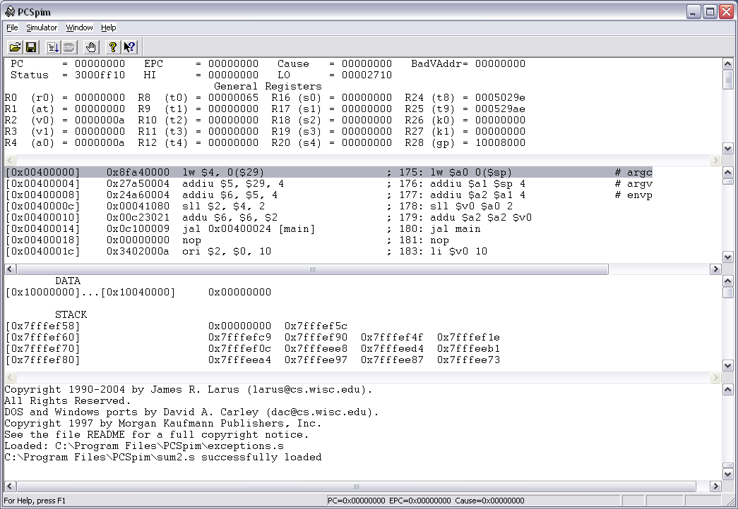
SPIM Simulator (http://pages.cs.wisc.edu/~larus/spim.html)

Slide 10
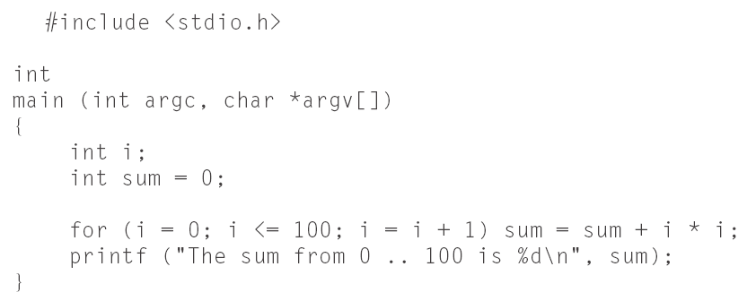
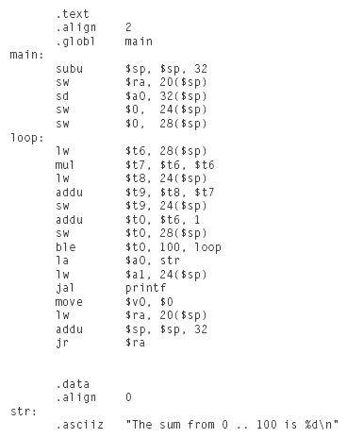
A MIPS Sample Program
C program
MIPS Assy Program
Machine code Memory Dump
Reverse Engineered Code

Slide 11
Homework 2
Analyze MIPS program
Write MIPS program
Use SPIM simulator
Look at MIPS Context Frames

Slide 12
Supporting Procedures
Process:
Place parameters where procedure can access them
Transfer control to the procedure
Acquire storage resources for the procedure
Perform the task
Place result where calling program can access it
Return control to calling program
Support structure:
$a0-$a3 argument passing registers
$v0-$v1 return value registers
$ra return address register

Slide 13
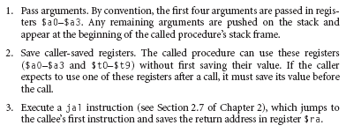
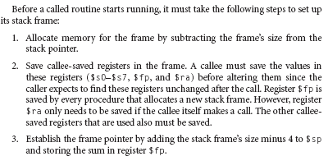
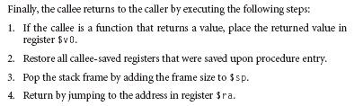
Procedure Call Convention
First the caller must:

Slide 14
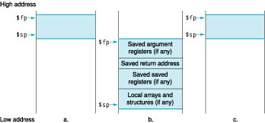
MIPS 32 Context Frames

Slide 15
Calling Procedure: Spilling Registers
What if the callee needs more registers? What if the procedure is recursive?
  uses a stack – a last-in-first-out queue – in memory for passing additional values or saving (recursive) return address(es)
$sp, is used to address the stack (which “grows” from high address to low address)
  add data onto the stack – push
    $sp = $sp – 4 data on stack at new $sp
  remove data from the stack – pop
    data from stack at $sp $sp = $sp + 4
high addr
top of stack
$sp
low addr
Notes:
Note that temporary registers $t0 through $t9 can also be used as by MIPS convention they are not preserved by the callee (kept intact) across subroutine boundaries
However, saved registers $s0 through $s7 must be preserved by the calle - I.e., if the callee uses one, it must first save it and then restore it to its old value before returning control to the caller

Slide 16
MIPS Arithmetic Instructions
MIPS assembly language arithmetic statement
add $t0, $s1, $s2
sub $t0, $s1, $s2
Each arithmetic instruction performs only one operation
Each arithmetic instruction fits in 32 bits and specifies exactly three operands
  destination ← source1 op source2
Those operands are all contained in the datapath’s register file ($t0,$s1,$s2) – indicated by $
Operand order is fixed (destination first)
Notes:
For class handout

Slide 17
MIPS Arithmetic Instructions
MIPS assembly language arithmetic statement
add $t0, $s1, $s2
sub $t0, $s1, $s2
Each arithmetic instruction performs only one operation
Each arithmetic instruction fits in 32 bits and specifies exactly three operands
  destination ← source1 op source2
Each arithmetic instruction performs only one operation
Each arithmetic instruction fits in 32 bits and specifies exactly three operands
  destination ← source1 op source2
Operand order is fixed (destination first)
Those operands are all contained in the datapath’s register file ($t0,$s1,$s2) – indicated by $
Notes:
For lecture

Slide 18
Machine Language - Add Instruction
Instructions, like registers and words of data, are 32 bits long
Arithmetic Instruction Format (R format):
add $t0, $s1, $s2
op rs rt rd shamt funct
op 6-bits opcode that specifies the operation
rs 5-bits register file address of the first source operand
rt 5-bits register file address of the second source operand
rd 5-bits register file address of the result’s destination
shamt 5-bits shift amount (for shift instructions)
funct 6-bits function code augmenting the opcode

Slide 19
MIPS Immediate Instructions
Small constants are used often in typical code
Possible approaches?
  put “typical constants” in memory and load them
  create hard-wired registers (like $zero) for constants like 1
  have special instructions that contain constants !
addi $sp, $sp, 4 #$sp = $sp + 4
slti $t0, $s2, 15 #$t0 = 1 if $s2<15
Machine format (I format):
op rs rt 16 bit immediate
I format
The constant is kept inside the instruction itself!
  Immediate format limits values to the range +2¹⁵–1 to -2¹⁵
Notes:
in gcc 52% of arithmetic operations involve constants – in spice its 69%
have the students answer why not – speed and limited number of registers
much faster than if loaded from memory
addi and slti do sign extend of immediate operand into the leftmost bits of the destination register (ie., copies the leftmost bit of the 16-bit immediate value into the upper 16 bits)
by contrast, ori and andi loads zero’s into the upper 16 bits and so is usually used (instead of the addi) to build 32 bit constants

Slide 20
How About Larger Constants?
We'd also like to be able to load a 32 bit constant into a register, for this we must use two instructions
a new "load upper immediate" instruction
lui $t0, 1010101010101010
Then must get the lower order bits right, use ori $t0, $t0, 1010101010101010
16 0 8 1010101010101010
1010101010101010
0000000000000000
0000000000000000
1010101010101010
1010101010101010 1010101010101010
Notes:
For lecture
sets the upper 16 bits of a constant in a register, allowing the next instruction to specify the lower 16 bits of the constant
note that lui fills the lower 16 bits of the register with zero’s
why can’t addi be used as the second instruction for this 32 bit constant?
also note – the assembler lets me specify constants larger than 16 bits in one instruction and then expands the code into two instructions (lui and ori) automatically

Slide 21
MIPS Memory Access Instructions
MIPS has two basic data transfer instructions for accessing memory
lw $t0, 4($s3) #load word from memory
sw $t0, 8($s3) #store word to memory
The data is loaded into (lw) or stored from (sw) a register in the register file – a 5 bit address
The memory address – a 32 bit address – is formed by adding the contents of the base address register to the offset value
  A 16-bit field meaning access is limited to memory locations within a region of ±2¹³ or 8,192 words (±2¹⁵ or 32,768 bytes) of the address in the base register
  Note that the offset can be positive or negative
Notes:
What is the memory address of the given load and store instructions if $s3 contains the address 24?

Slide 22
Machine Language - Load Instruction
Load/Store Instruction Format (I format):
lw $t0, 24($s2)
op rs rt 16 bit offset
Memory
24₁₀ + $s2 =
0xf f f f f f f f
0x00000018
+ 0x12004094
0x120040ac
0x120040ac
$t0
$s2
0x12004094
0x0000000c
0x00000008
0x00000004
0x00000000
data
word address (hex)
Notes:
destination address no longer in the rd field - now in the rt field
offset limited to 16 bits - so can’t get to every location in memory (with a fixed base address)

Slide 23
Byte Addresses
Since 8-bit bytes are so useful, most architectures address individual bytes in memory
  The memory address of a word must be a multiple of 4 (alignment restriction)
Big Endian: leftmost byte is word address
    IBM 360/370, Motorola 68k, MIPS, Sparc, HP PA
Little Endian: rightmost byte is word address
    Intel 80x86, DEC Vax, DEC Alpha (Windows NT)
little endian byte 0
3 2 1 0
msb
lsb
0 1 2 3
big endian byte 0
Notes:
Talk about the reasons (performance) for the word/byte alignment restriction

Slide 24
Loading and Storing Bytes
MIPS provides special instructions to move bytes
lb $t0, 1($s3) #load byte from memory
sb $t0, 6($s3) #store byte to memory
op rs rt 16 bit offset
What 8 bits get loaded and stored?
  load byte places the byte from memory in the rightmost 8 bits of the destination register
    what happens to the other bits in the register?
  store byte takes the byte from the rightmost 8 bits of a register and writes it to a byte in memory
    what happens to the other bits in the memory word?
Notes:
load byte takes the contents of the byte at the memory address specified, zero-extends it, and loads it into the register
It leaves the other bits in the memory word intact.

Slide 25
MIPS Control Flow Instructions
MIPS conditional branch instructions:
bne $s0, $s1, Lbl #go to Lbl if $s0≠$s1
beq $s0, $s1, Lbl #go to Lbl if $s0=$s1
  Ex: if (i==j) h = i + j;
bne $s0, $s1, Lbl1
add $s3, $s0, $s1
Lbl1: ...
Instruction Format (I format):
op rs rt 16 bit offset
How is the branch destination address specified?

Slide 26
Specifying Branch Destinations
Use a register (like in lw and sw) added to the 16-bit offset
  which register? Instruction Address Register (the PC)
    its use is automatically implied by instruction
    PC gets updated (PC+4) during the fetch cycle so that it holds the address of the next instruction
  limits the branch distance to -2¹⁵ to +2¹⁵-1 instructions from the (instruction after the) branch instruction, but most branches are local anyway
from the low order 16 bits of the branch instruction
16
offset
sign-extend
00
branch dst
address
32
32
Add
PC
32
Add
32
4
32
?
32
32
Notes:
Note that two low order 0’s are concatenated to the 16 bit field giving an eighteen bit address
0111111111111111 00 = 2**15 –1 words (2**17 – 1 bytes)

Slide 27
Other Control Flow Instructions
MIPS also has an unconditional branch instruction or jump instruction:
j label #go to label
Instruction Format (J Format):
op 26-bit address
from the low order 26 bits of the jump instruction
26
00
32
4
PC
32
Notes:
If-then-else code compilation

Slide 28
Branching Far Away
What if the branch destination is further away than can be captured in 16 bits?
The assembler comes to the rescue – it inserts an unconditional jump to the branch target and inverts the condition
beq $s0, $s1, L1
becomes
bne $s0, $s1, L2
j L1
L2:

Slide 29
Instructions for Accessing Procedures
MIPS procedure call instruction:
jal ProcedureAddress #jump and link
Saves PC+4 in register $ra to have a link to the next instruction for the procedure return
Machine format (J format):
Then can do procedure return with a
jr $ra #return
Instruction format (R format):
op 26 bit address
op rs funct
Notes:
jr jumps to the address stored in the register – in this case $ra – which is just what we want.

Slide 30
MIPS ISA – First look
Category | Instr | Op Code | Example | Meaning
Arithmetic (R & I format) | add | 0 and 32 | add $s1, $s2, $s3 | $s1 = $s2 + $s3
 | subtract | 0 and 34 | sub $s1, $s2, $s3 | $s1 = $s2 - $s3
 | add immediate | 8 | addi $s1, $s2, 6 | $s1 = $s2 + 6
 | or immediate | 13 | ori $s1, $s2, 6 | $s1 = $s2 v 6
Data Transfer (I format) | load word | 35 | lw $s1, 24($s2) | $s1 = Memory($s2+24)
 | store word | 43 | sw $s1, 24($s2) | Memory($s2+24) = $s1
 | load byte | 32 | lb $s1, 25($s2) | $s1 = Memory($s2+25)
 | store byte | 40 | sb $s1, 25($s2) | Memory($s2+25) = $s1
 | load upper imm | 15 | lui $s1, 6 | $s1 = 6 * 2¹⁶
Cond. Branch (I & R format) | br on equal | 4 | beq $s1, $s2, L | if ($s1==$s2) go to L
 | br on not equal | 5 | bne $s1, $s2, L | if ($s1 !=$s2) go to L
 | set on less than | 0 and 42 | slt $s1, $s2, $s3 | if ($s2<$s3) $s1=1 else $s1=0
 | set on less than immediate | 10 | slti $s1, $s2, 6 | if ($s2<6) $s1=1 else $s1=0
Uncond. Jump (J & R format) | jump | 2 | j 2500 | go to 10000
 | jump register | 0 and 8 | jr $t1 | go to $t1
 | jump and link | 3 | jal 2500 | go to 10000; $ra=PC+4
Notes:
similarity of the binary representation of related instructions simplifies the hardware design

