Slide 1
INDIA HACKS
DELHI ZONE
TRACK: IOT
THEME: SMART HOME
TEAM: ISHARADZ
MEMBERS: ISHA DUA
RADHIKA DUA

Slide 2
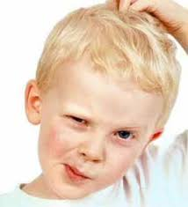
IDEA…...??

Slide 3
IDEA
CameoPlus is a device which can achieve several tasks with the help of softwares installed in our cameras .Few of these tasks are: "For Health Purpose" The software can help to calculate the breathing rate and pulse rate of a person. This device do not need any contact with the person rather it works in such a manner that the person do not gets to know that his/her breathing/pulse rate is being calculated so that the person do not get conscious. The device can be put in a room where a person do the morning exercise or near the mirror where the person is looking while getting ready. This device can help in letting the person know its breathing and pulse rate accurately everyday so that he/she can be aware of any medical problems they may become victim of.

Slide 4
For this device requires a camera and it can be programmed to provide two functionalities namely calculation of breathing rate and pulse rate. The device can be programmed using the computer vision and deep learning technology. For calculation of pulse rate, the camera focuses on forehead and with the change in the colour in the forehead portion( which is the region of interest in this case), we can calculate the pulse rate of a person. For calculation of breathing rate, the camera focuses on the chest portion of the person and then observes the tiny movement in the chest portion( which is the region of interest in this case), we can find the breathing rate of a person.

Slide 5
Part 1: Breathing Rate
The breathing rate of a person can be determined by observing the subtle movement near the chest portion of the body. This minute movement might not be visible with naked eyes but using computer it is possible , that is why computer is nowadays considered as a microscope.

Slide 6
When the breathing rate of the person is calculated using the camera, the video of the person is taken without the person knowing and thus the person does not gets conscious and the accurate breathing rate of the person can be found.

Slide 7
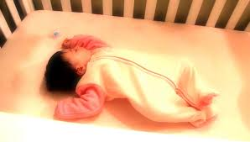
Usecase 1:
A baby is sleeping. The parents cannot look at the baby every minute and even if they look,they cannot be sure always whether baby is breathing or not. This code helps to find the breathing rate of a person using the camera and the parents will always know whether baby is breathing or not. This helps is reducing the death rate of babies.

Slide 8
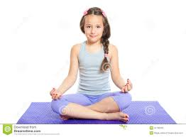
Usecase 2:
The breathing rate of this girl meditating can be found using this code.

Slide 9
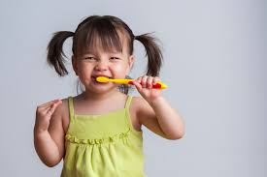
Usecase 3:
The breathing rate of this little girl brushing can be found without her knowing of it and so she will not get conscious and we can determine the breathing rate of the girl accurately.

Slide 10
Part 1: Pulse rate using camera
For calculation of pulse rate, the camera focuses on forehead and with the change in the colour in the forehead portion because of the movement of blood( which is the region of interest in this case), we can calculate the pulse rate of a person.

Slide 11

This seems like magic……….

Slide 12
Thankyou!!!!!!!!!!!!!

