Slide 1
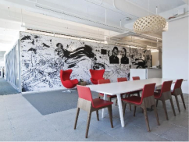


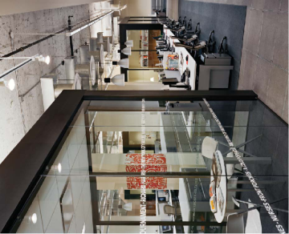


빅데이터를 활용한 스마트데이터
전문가 양성과정
19.06.12
- R 연습문제 5. 한영 워드클라우드 및 그래프 그리기-
오진영

Slide 2
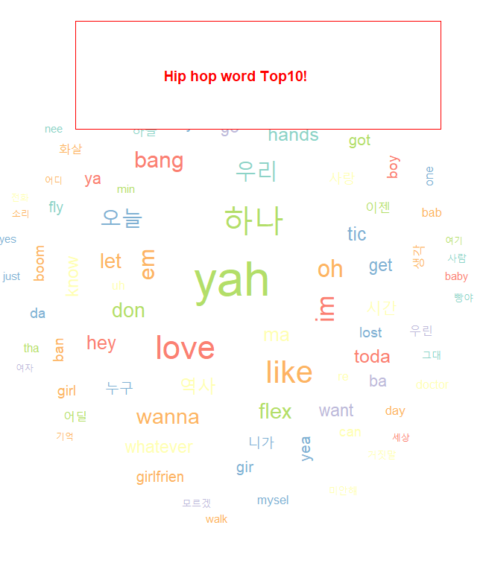
codiing
result
# 한영 워드클라우드
mergeUserDic(data.frame(readLines('hiphop.txt'), "ncn"))
txt <- readLines('hiphop.txt')
hip <- sapply(txt,extractNoun,USE.NAMES = F)
head(unlist(hip),30)
hdata <- unlist(hip)
hip <- str_replace_all(hdata,"[^[:alpha:]]","")
txt1 <- readLines("gsub.txt")
cnt_txt <- length(txt1)
i <- 1
for(i in 1:cnt_txt) {
hip <- gsub((txt1[i]),"",hip)}
corp1<- Corpus(VectorSource(hip))
corp2 <- tm_map(corp1, stripWhitespace)
corp2 <- tm_map(corp2, tolower)
corp2 <- tm_map(corp2, removeNumbers)
corp2 <- tm_map(corp2, removePunctuation)
sword2 <- c(stopwords('en'), 'and','but','not')
corp2 <- tm_map(corp2, removeWords, sword2)
corp3 <- TermDocumentMatrix(corp2,control = list(wordLengths = c(1,Inf)))
corp4 <- as.matrix(corp3)
freq1 <- sort(rowSums(corp4),decreasing = T)
head(freq1,20)
freq2 <- sort(colSums(corp4), decreasing = T) head(freq2,20)
freq1
dim(corp4)
palete <- brewer.pal(7,"Set3")
wordcloud(names(freq1), freq=freq1, scale=c(4,0.5), min.freq = 10, colors=palete, random.order = F,
random.color=T)
legend(0.3,1,'Hip hop!', cex=1,fill=NA,border = NA, bg='white', text.col='red',text.font = 2.2,
box.col = 'red')

Slide 3
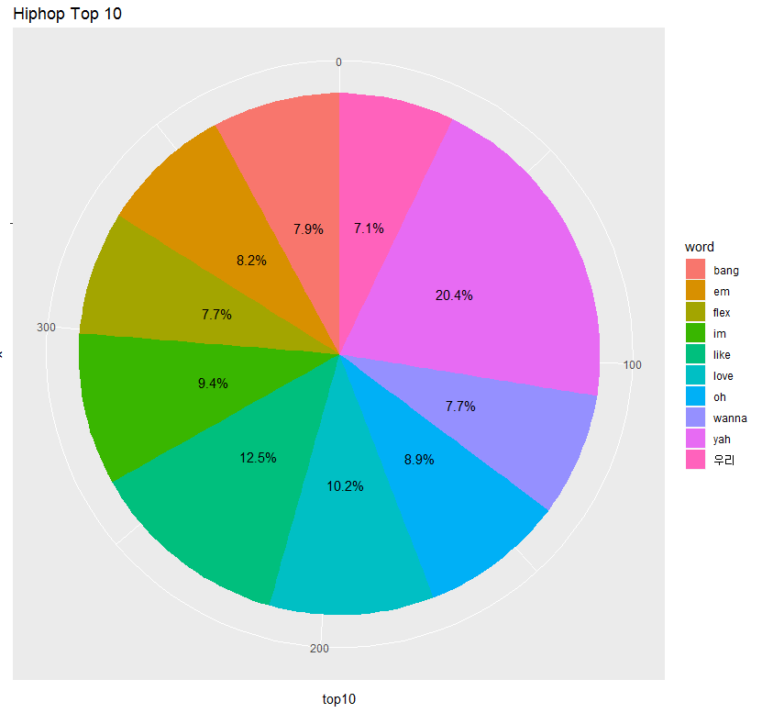
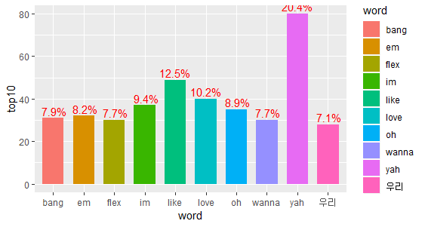
codiing
result
# ggplot pie chart
top10 <-head(sort(freq1, decreasing = T),10) ; top10
top11 <- as.data.frame(top10) ; top11
write(unlist(top10),"hip_top10.txt")
rev <- read.table("hip_top10.txt", header=T)
df_hiphop <- as.data.frame(rev)
df_hiphop
ggplot(df_hiphop, aes(x= '', y = top10, fill = word)) +
geom_bar(width = 1, stat= 'identity') +
coord_polar("y", start = 0)
options(digits = 2)
df_hiphop <- df_hiphop %>%
mutate(pct = top10 / sum(top10) * 100) %>%
mutate(ylabel = paste(sprintf("%4.1f", pct), '%', sep=''))%>%
arrange(desc(word))%>%
mutate(ypos = cumsum(top10) - 0.5 * top10 )
df_hiphop
ggplot(df_hiphop, aes(x= '', y = top10, fill = word)) +
geom_bar(width = 1, stat= 'identity') +
geom_text(aes(y=ypos, label=ylabel),color = 'black') +
coord_polar("y", start = 0) +
ggtitle('Hiphop Top 10')
# ggplot bar chart
ggplot(df_hiphop, aes(x= word, y = top10, fill = word)) +
geom_bar(width = 0.7, stat = 'identity') +
geom_text(aes(label=ylabel),color = 'red',vjust=-0.3)
# ggplot pie
내용을 작성하세요.
세부 설명 내용은 나눔고딕 R, 9pt를 권장합니다.
글자 간격은 좁게 0.3pt를,
줄 간격은 1.5배를 권장합니다.
상황에 따라 조정하실 수 있습니다.
# ggplot bar

Slide 4
감사합니다

