Slide 1

可归约性（ Reducibility ）
本章内容及要求：
Instead of proving directly by the diagonalization method, we reduce the problem of deciding A_{TM} to the problem of deciding a language B => Reduction
Precisely, we show that if we know how to decide B (i.e., B is decidable), so can A_{TM}. In this way, we show that language B is undecidable
Notes:
本章内容与上一章内容衔接，上一节课介绍图灵机语言的可判定性，可判定性可通过对角化方法证明，但是过于繁琐
而可归约性就是将一个问题的判定转化为对另一个问题的判定，也就是归约
准确的说，如果Atm可归约为B，我们知道如何判定B，那Atm也可以判定，所以我们证明B也是不可判定的

Slide 2
Reducibility
归约旨在将一个问题转化为另一个问题，且可以用第二个问题的解来解第一个问题，在日常生活中，虽然不这样称呼，但时常会遇到可归约性问题。
例如，在一个新城市中认路，如果有一张地图，事情就容易了。这样，就将城市认路问题归约为得到地图问题。（ The problem of urban road recognition is reduced to the problem of getting map ）

Slide 3
归约的直观解释 ：调用，
问题 A官 , B兵, 对应C程序(TM)： Prog_官 ( w) ,Prog_兵(w)
如果 官调 兵 如下：
Prog_官(w)
{ ……
….. //简单计算
Prog_兵(w)
…… //简单计算
}
则称官 归约为 兵 ,
主调 被调
如果 B兵 能识别语言 L，则A官 也能
逆否定理 如果A官不能识别L, 则B兵 也不能 ， 我们用这一条
被调用者为核心技术

Slide 4


Problem is reduced to problem
If we can solve problem then
we can solve problem
可归约性总是涉及到两个问题，称之为A和B。如果A可归约到B，就可用B的解来解A。
归约的目的：将一个问题转化为另一个问题；且用第二个问题的解来解第一个问题
Notes:
A难度<=b

Slide 5
Content
Undecidable Problems from Language Theory（语言理论中的不可判定问题）
A Simple Undecidable Problem（一个简单的不可判定问题，Post correspondance problem，波斯特对应问题）
Mapping Reducibility（映射可归约性）
  Computable fimctions（可计算函数）
  Formal definition of mapping reducibility（映射可归约性的形式定义）
Rice’s Theorem（莱斯定理）
Notes:
本节课的内容与书上大致相同，主要为前三个方面，另外补充了ppt内容，以及增加rice定理
其中第二个问题略讲，有兴趣的可以看一下书。。。我们主要讲语言理论中的不可判定性问题以及归约
但是不可判定性现象不仅仅存在于有限自动机，关于串操作的不可判定问题pcp

Slide 6
Undecidable Problems from Language Theory（语言理论中的不可判定问题）
A_{TM}={ <M, w> | M 是一个 TM，且接受 w }
A_{TM} 是不可判定的，即确定一个图灵机是否接受一个给定的输入问题是不可判定的。
下面考虑一个与之相关的问题：HALT_{TM}，即确定一个图灵机对给定输入是否停机（通过接受或拒绝）问题。
若将 A_{TM} 归约到 HALT_{TM}，就可以利用 A_{TM} 的不可判定性证明HALT_{TM}的不可判定性。
HALT_{TM} 的形式化描述
HALT_{TM} = { <M,w> | M是一个TM, 且对输入 w 停机}
Notes:
Atm就是membership问题，A指的是accept，Atm也就是确定一个图灵机是否接受一个给定的输入问题

Slide 7
HALT_{TM} 是不可判定的
定理
6.1
HALT_{TM}是不可判定的。
证明思路：反证法。（将 A_{TM} 归约到 HALT_{TM} ）
假设 TM R 判定 HALT_{TM}，利用 R 可以构造一个判定 A_{TM} 的 TM S。
使用 R，可以检查 M 对 w 是否停机，
如果 M 对 w 不停机，S 就拒绝，因为 <M,w > 不在 A_{TM} 中。
如果 M 对 w 确实停机，S 就模拟它，而不会有死循环的危险。
这样，如果 TM R 存在，就能判定 A_{TM}。

Slide 8
Undecidable Problems from Language Theory
定理
6.1
HALT_{TM}是不可判定的。
假设 TM R 判定 HALT_{TM}，由之可以构造 TM S 来判定A_{TM}，其构造如下：
S=“ 在输入 <M, w >上，此处<M, w >是 TM M 和串 w 的编码：
  1) 在输入 <M, w >上运行 TM R。
  2) 如果 R 拒绝，则拒绝。
  3) 如果 R 接受，则在 w 上模拟 M，直到它停机。
  4) 如果 M 已经接受，则接受；如果 M 已经拒绝，则拒绝。”
显然，如果 R 判定 HALT_{TM}，则 S 判定 A_{TM}。
因为 A_{TM} 是不可判定的，故 HALT_{TM} 也必定是不可判定的。

Slide 9
Content
Undecidable Problems from Language Theory（语言理论中的不可判定问题）
A Simple Undecidable Problem（一个简单的不可判定问题，Post correspondance problem，波斯特对应问题）
Mapping Reducibility（映射可归约性）
  Computable fimctions（可计算函数）
  Formal definition of mapping reducibility（映射可归约性的形式定义）
Rice’s Theorem（莱斯定理）
Notes:
本节课的内容与书上大致相同，主要为前三个方面，另外补充了ppt内容，以及增加rice定理
其中第二个问题略讲，有兴趣的可以看一下书。。。我们主要讲语言理论中的不可判定性问题以及归约
但是不可判定性现象不仅仅存在于有限自动机，关于串操作的不可判定问题pcp

Slide 10
Post correspondance problem，波斯特对应问题
Contents :
Introduction
What Is PCP ?
Instances Of PCP ?
Introduction Of Modified PCP (MPCP)
Why MPCP?
Reducing MPCP to PCP !
PCP Is Undecidable !!
  Statements
  Proof
Conclusion
References
http://citeseerx.ist.psu.edu/viewdoc/download?doi=10.1.1.721.2199&rep=rep1&type=pdf

Slide 11
Content
Undecidable Problems from Language Theory（语言理论中的不可判定问题）
A Simple Undecidable Problem（一个简单的不可判定问题，Post correspondance problem，波斯特对应问题）
Mapping Reducibility（映射可归约性）
  Computable fimctions（可计算函数）
  Formal definition of mapping reducibility（映射可归约性的形式定义）
Rice’s Theorem（莱斯定理）
Notes:
接下来我们跳过博斯特对应问题，讲映射可归约性

Slide 12
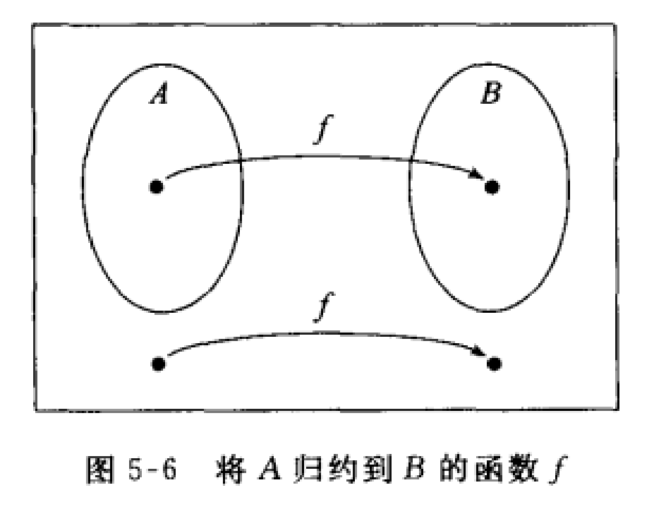
映射可归约性（Mapping Reducibility）
将一个问题归约为另一个问题的概念可以用多种方式来形式定义，选择使用哪种方式要根据具体应用情况。我们的选择是一种简单方式的可归约性，叫做映射可归约性。
粗略地说，“用映射可归约性将问题 A 归约为问题 B ” 是指，存在一个可计算函数，它将问题 A 的实例转换成问题 B 的实例。如果有了这样一个转换函数，就能用B的解决方案来解 。原因是，A 的任何一个实例可以这样来解：首先用这个归约将A转换为 B 的一个实例，然后应用 B 的解决方案。

Slide 13



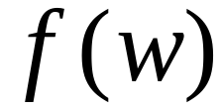
Computable fimctions（可计算函数）
Computable function :
There is a deterministic Turing machine
which for any string computes
函数 f : Σ*→ Σ* 是一个可计算函数，如果有某个图灵机 M，使得在每个输入w上停机，且此时只有 f (w)出现在带上。
定义
6.12
例6.13 整数上所有通常的算术运算都是可计算函数。
例如，可以制造一个机器，它以 <m, n> 为输入且返回 m 与n 的和 m+n。

Slide 14
Formal definition of mapping reducibility（映射可归约性的形式定义）
语言 A 是映射可归约到语言 B 的，如果存在可计算函数 f : Σ*→Σ* 使得对每个 w，
Language A is reduced to language B
There is a computable function f (reduction) such that: w∈A ⇔ f (w) ∈B
记作A≤_{m}B。称函数 f 为 A 到 B 的归约。
定义
6.15
定义
5.6
A
f
B
f
Notes:
形式化定义

Slide 15


Theorem:
If: a: Language is reduced to
b: Language is decidable
Then: is decidable
Proof:
Basic idea:
Build the decider for
using the decider for
Notes:
下面将给出两个定理，并用映射可归约性进行证明
第一个定理是：
第二个定理是他的逆否定理
使用B的判定器构建A的判定器

Slide 16
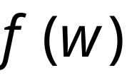

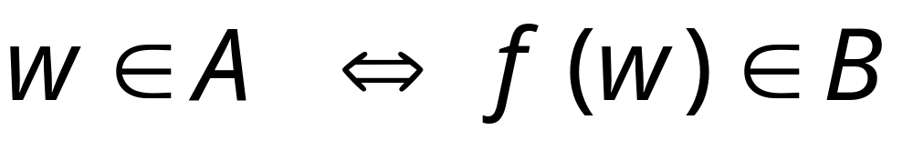
Decider for
Reduction
Input
string
YES
accept
YES
accept
compute
Decider
for
(halt)
(halt)
NO
reject
NO
reject
(halt)
(halt)
END OF PROOF
Notes:
构建B的判定器，f是从A到B的归约，对于B输入为f，B可判定，所以输出为接受或拒绝
显然，如果w属于A，fw属于B，因为f是从A到b的归约，所以，只要w属于A，则M接受fw，所以A可判定

Slide 17
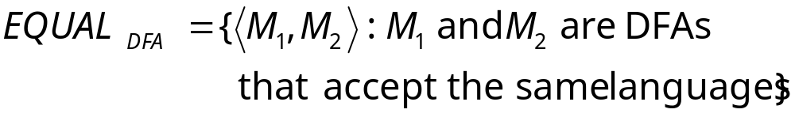
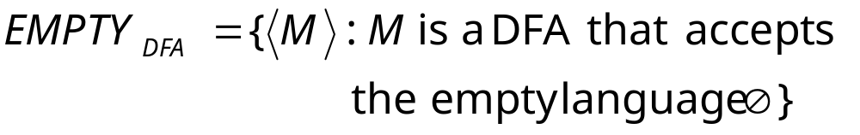
Example:
is reduced to:
Notes:
Deterministic Finite Automaton,即确定有穷自动机
Equal问题可归约到empty问题

Slide 18
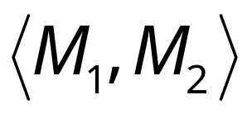
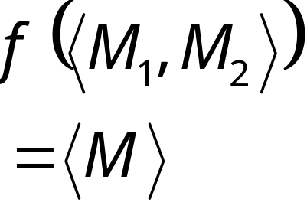

We only need to construct:
Turing Machine
for reduction
DFA

Slide 19

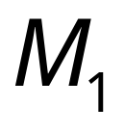

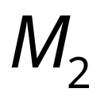
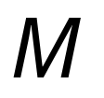
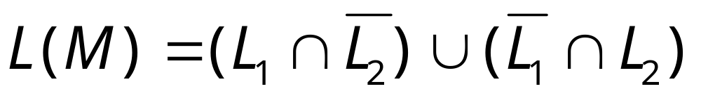
Let be the language of DFA
Let be the language of DFA
Turing Machine
for reduction
DFA
construct DFA
by combining and so that:

Slide 20
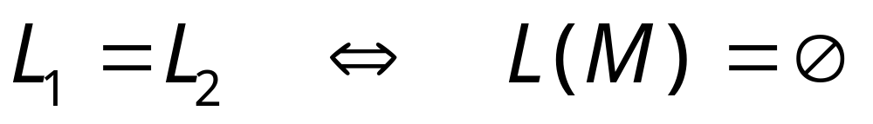

Slide 21
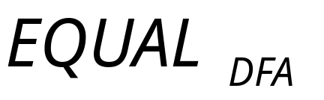
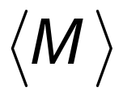
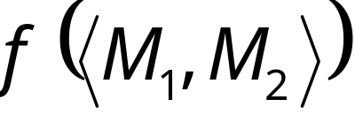
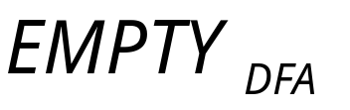
Decider for
Input
string
Reduction
YES
compute
YES
Decider
NO
NO

Slide 22
Theorem (version 1):
If: a: Language is reduced to
b: Language is undecidable
Then: is undecidable
(this is the negation of the previous theorem)
Proof:
Suppose is decidable
Using the decider for
build the decider for
Contradiction!

Slide 23

If is decidable then we can build:
Decider for
Reduction
Input
string
YES
accept
YES
accept
compute
Decider
for
(halt)
(halt)
NO
reject
NO
reject
(halt)
(halt)
CONTRADICTION!
END OF PROOF

Slide 24
Problem is reduced to problem
If is decidable then is decidable
If is undecidable then is undecidable
Notes:
逆否命题

Slide 25


Observation:
In order to prove
that some language is undecidable
we only need to reduce a
known undecidable language
to
Notes:
为了证明B是不可判定的，我们只需归约一个已知的不可判定的A到B即可

Slide 26
Reducibility Examples
(undecidable language)
Notes:
下面讲两个可归约性例子
一个是状态进入问题，一个是空白纸袋问题
不可判定语言

Slide 27
Example:
the halting problem
is reduced to
the state-entry problem
Notes:
停机问题-》状态进入问题

Slide 28



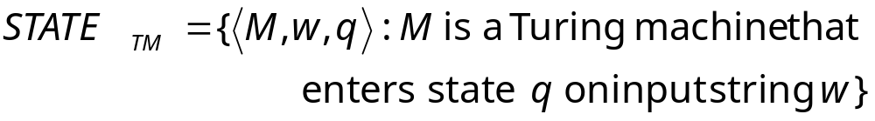
State-entry problem
Input:
Turing Machine
State
String
Question:
Does
enter state
while processing input string ?
Corresponding language:

Slide 29
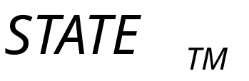
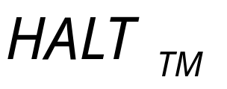
Theorem:
is undecidable
(state-entry problem is unsolvable)
Proof:
Reduce
(halting problem)
to
(state-entry problem)

Slide 30





We want to reduce the halting problem to
the state-entry problem:
Halting problem decider
halts on
enters
YES
YES
State-entry
problem
decider
NO
NO
dosenotenters
doesnothalts on

Slide 31
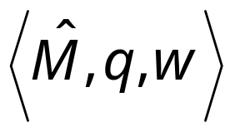
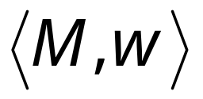
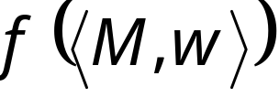
Halting Problem Decider
Decider for
state-entry problem
decider
Reduction
YES
Compute
Decider
YES
NO
NO
Given the reduction,
if is decidable,
then is decidable
A contradiction!
since
is undecidable
Notes:
We need to convert one problem instance
to the other problem instance

Slide 32
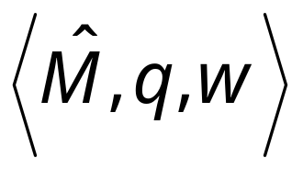

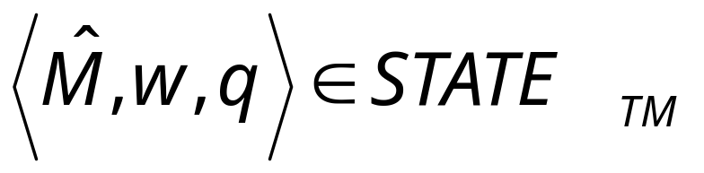
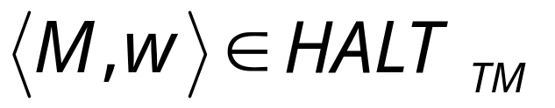
We only need to build the reduction:
Reduction
Compute
So that:

Slide 33
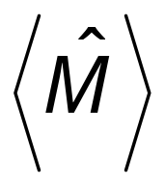

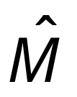

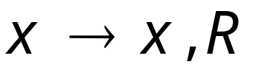

Construct from :
special
halt state
halting
states
A transition for every unused
tape symbol of
Notes:
Qi是对于任何一个未使用磁带符号x的转换
Q也属于特殊的停机状态，包含以上几种情况

Slide 34


special
halt state
halting
states
halts
halts on state
Notes:
所以M停机也就是M’在状态q停机

Slide 35
Therefore:
halts on input
halts on state on input
Equivalently:
END OF PROOF

Slide 36
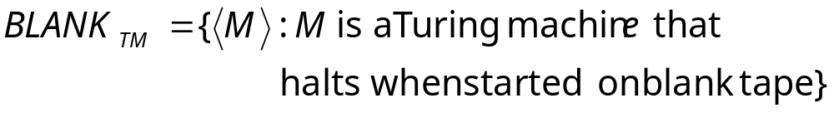
Blank-tape halting problem
Input:
Turing Machine
Question:
Does
halt when started with
a blank tape?
Corresponding language:

Slide 37
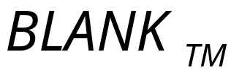
Theorem:
is undecidable
(blank-tape halting problem is unsolvable)
Proof:
Reduce
(halting problem)
to
(blank-tape problem)

Slide 38
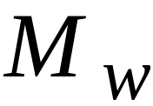
We want to reduce the halting problem to
the blank-tape halting problem:
Halting problem decider
halts on
halts on
blank tape
YES
Blank-tape
halting problem
decider
YES
NO
NO
doesn’t halts
onblank tape
doesnothalts on
Notes:
我们想要归约停机问题到空白磁带问题
首先构造空白磁带问题的判定器，当输入为Mw时，如果在空白磁带停机，则停机，如果不停机则不停机

Slide 39

Halting Problem Decider
Decider for
blank-tape problem
decider
Reduction
YES
Compute
Decider
YES
NO
NO
Given the reduction,
If is decidable,
then is decidable
A contradiction!
since
is undecidable
Notes:
然后构造归约，如果空白磁带问题是可判定的那么停机问题就是可判定的，最后构造矛盾，因为停机问题是不可判定的

Slide 40
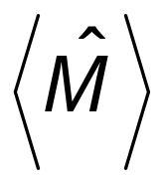
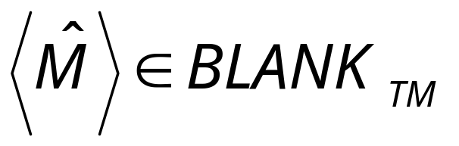
We only need to build the reduction:
Reduction
Compute
So that:
Notes:
接下来我们需要构造映射归约可计算函数

Slide 41




Construct from :
no
Tape is blank?
yes
Run
Write on tape
with input
If halts then halt
Notes:
从<M,w>构造M-

Slide 42
no
Tape is blank?
yes
Run
Write on tape
with input
halts on input
halts when started on blank tape

Slide 43
halts on input
halts when started on blank tape
Equivalently:
END OF PROOF

Slide 44
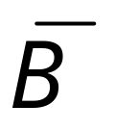
Theorem (version 2):
If: a: Language is reduced to
b: Language is undecidable
Then: is undecidable
Proof:
Suppose is decidable
Then is decidable
Using the decider for
build the decider for
Contradiction!

Slide 45


Suppose is decidable
reject
Decider
for
(halt)
accept
(halt)

Slide 46

Suppose is decidable
Then is decidable
(we have proven this in previous class)
Decider for
NO
reject
YES
accept
Decider
for
(halt)
(halt)
YES
NO
accept
reject
(halt)
(halt)

Slide 47

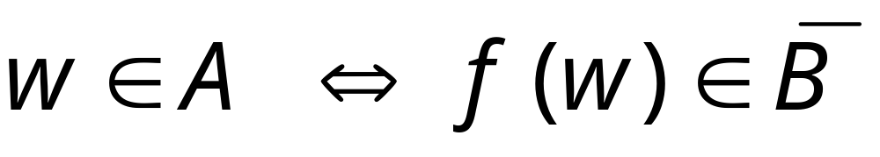
If is decidable then we can build:
Decider for
Reduction
Input
string
YES
accept
YES
accept
compute
Decider
for
(halt)
(halt)
NO
reject
NO
reject
(halt)
(halt)
CONTRADICTION!

Slide 48
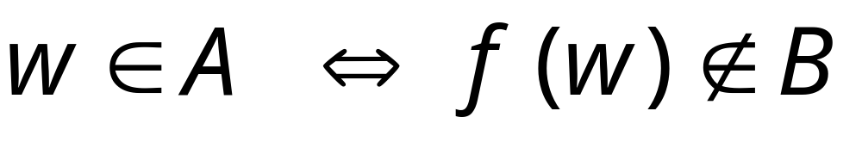
Alternatively:
Decider for
Reduction
Input
string
NO
reject
YES
accept
compute
Decider
for
(halt)
(halt)
YES
NO
accept
reject
(halt)
(halt)
CONTRADICTION!
END OF PROOF
Notes:
或者

Slide 49
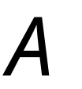

Observation:
In order to prove
that some language is undecidable
we only need to reduce some
known undecidable language
to
or to
(theorem version 1)
(theorem version 2)

Slide 50
Content
Undecidable Problems from Language Theory（语言理论中的不可判定问题）
A Simple Undecidable Problem（一个简单的不可判定问题，Post correspondance problem，波斯特对应问题）
Mapping Reducibility（映射可归约性）
  Computable fimctions（可计算函数）
  Formal definition of mapping reducibility（映射可归约性的形式定义）
Rice’s Theorem（莱斯定理）

Slide 51
Rice’s Theorem (Definition)
Rice theorem states that any non-trivial semantic property of a language which is recognized by a Turing machine is undecidable. A property, P, is the language of all Turing machines that satisfy that property.
Formal Definition
If P is a non-trivial property, and the language holding the property, L_{p} , is recognized by Turing machine M, then L_{p} = {<M> | L(M) ∈ P} is undecidable.
Notes:
赖斯定理指出，由图灵机识别的语言的任何非平凡的语义特性都是不可判定的。属性P是满足该属性的所有图灵机的语言。
正式定义
如果P是非平凡的属性，并且拥有该属性的语言L _{p}被图灵机M识别，则L _{p} = {<M> | L（M）∈P}是不确定的。

Slide 52

RICE’s Theorem
Undecidable problems:
is empty?
is regular?
has size 2?
This can be generalized to all non-trivial
properties of Turing-acceptable languages

Slide 53



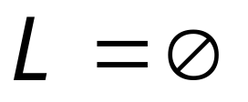
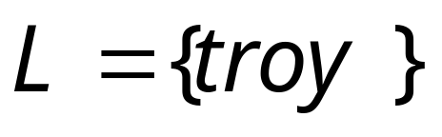
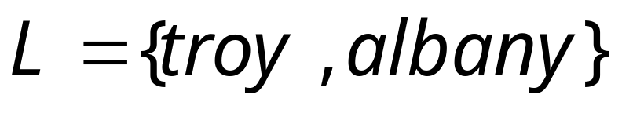
Non-trivial property:
A property possessed by some
Turing-acceptable languages
but not all
Example:
: is empty?
YES
NO
NO
Notes:
非平凡属性

Slide 54

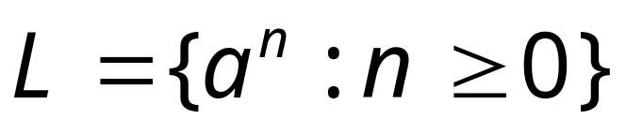
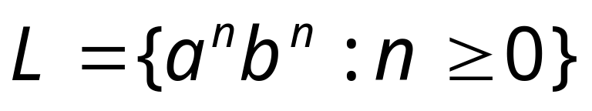

More examples of non-trivial properties:
: is regular?
YES
YES
NO
: has size 2?
NO
NO
YES

Slide 55
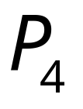

Trivial property:
A property possessed by ALL
Turing-acceptable languages
Examples:
: has size at least 0?
True for all languages
: is accepted by some
Turing machine?
True for all
Turing-acceptable languages
Notes:
平凡属性

Slide 56
Rice’s Theorem (Description and Properties)
Property of languages, P, is simply a set of languages. If any language belongs to P (L ∈ P), it is said that L satisfies the property P.
A property is called to be trivial if either it is not satisfied by any recursively enumerable languages, or if it is satisfied by all recursively enumerable languages.
A non-trivial property is satisfied by some recursively enumerable languages and are not satisfied by others. Formally speaking, in a non-trivial property, where L ∈ P, both the following properties hold:
  Property 1 − There exists Turing Machines, M1 and M2 that recognize the same language, i.e. either ( <M1>, <M2> ∈ L ) or ( <M1>,<M2> ∉ L )
  Property 2 − There exists Turing Machines M1 and M2, where M1 recognizes the language while M2 does not, i.e. <M1> ∈ L and <M2> ∉ L

Slide 57
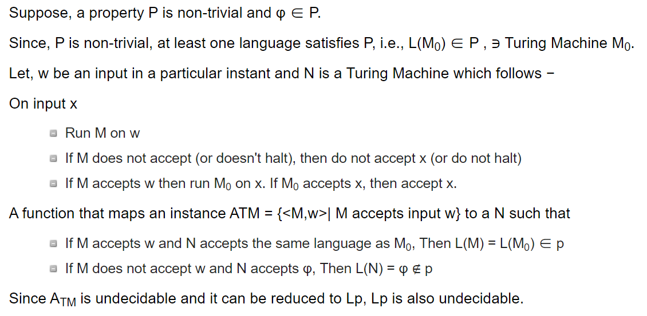
Rice’s Theorem (Proof)
Notes:
确定某一

Slide 58
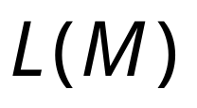
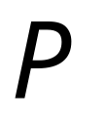
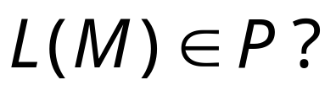
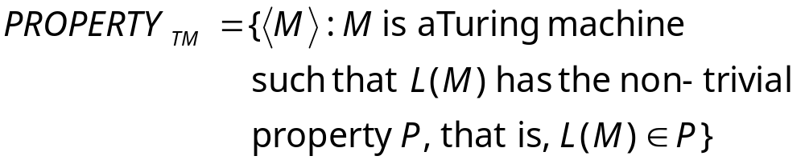
Non-trivial property problem
Input:
Turing Machine
Question:
Does have the non-trivial
property ?
Corresponding language:

Slide 59
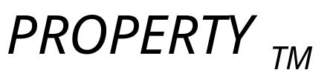


Rice’s Theorem:
is undecidable
(the non-trivial property problem is unsolvable)
Proof:
Reduce
(membership problem)
to
or

Slide 60



We examine two cases:
Case 1:
Examples:
: is empty?
: is regular?
Case 2:
Example:
: has size 2?

Slide 61



Case 1:
Since is non-trivial, there is
a Turing-acceptable language
such that:
Let be the Turing machine that
accepts

Slide 62
Reduce
(membership problem)
to

Slide 63
membership problem decider
Decider for
Non-trivial property
problem decider
Reduction
YES
Compute
Decider
YES
NO
NO
Given the reduction,
if is decidable,
then is decidable
A contradiction!
since
is undecidable

Slide 64


We only need to build the reduction:
Reduction
Compute
So that:

Slide 65





Construct from :
Tape of
input string
skip input
string
write
on tape
run
on input
If
yes
accepts ?
then accept

Slide 66
For this phase we can run machine
that accepts , with input string
skip input
string
write
on tape
run
on input
If
yes
accepts ?
then accept

Slide 67




accepts
does not
accept
skip input
string
write
on tape
run
on input
If
yes
accepts ?
then accept

Slide 68

Therefore:
accepts
Equivalently:

Slide 69


Case 2:
Since is non-trivial, there is
a Turing-acceptable language
such that:
Let be the Turing machine that
accepts

Slide 70
Reduce
(membership problem)
to

Slide 71
membership problem decider
Decider for
Non-trivial property
problem decider
Reduction
YES
Compute
Decider
YES
NO
NO
Given the reduction,
if is decidable,
then is decidable
A contradiction!
since
is undecidable

Slide 72

We only need to build the reduction:
Reduction
Compute
So that:

Slide 73
Construct from :
Tape of
input string
skip input
string
write
on tape
run
on input
If
yes
accepts ?
then accept

Slide 74
accepts
does not
accept
skip input
string
write
on tape
run
on input
If
yes
accepts ?
then accept

Slide 75

Therefore:
accepts
Equivalently:
END OF PROOF

Slide 76
Summary of Undecidable Problems
Halting Problem:
Does machine halt on input ?
Membership problem:
Does machine accept string ?

Slide 77
Blank-tape halting problem:
Does machine halt when starting
on blank tape?
State-entry Problem:
Does machine enter state
on input ?

