Slide 1
CFG检查代码字符串是否符合文法
与
下推自动机的基本组成
王晟典 S20190701

Slide 2
Parsing
Using theory of CFG

Slide 3
Program File
Machine Code
v = 5;
if (v>5)
x = 12 + v;
while (x !=3) {
x = x - 3;
v = 10;
}
......
Add v,v,5
cmp v,5
jmplt ELSE
THEN:
add x, 12,v
ELSE:
WHILE:
cmp x,3
...
Compiler

Slide 4
Compiler
Lexical
analyzer
parser
Input String
Output
Program
file
machine
code

Slide 5
Lexical analyzer:
Recognizes the lexemes of the
input program file:
Keywords (if, then, else, while,…),
Integers,
Identifiers (variables), etc
It is built with DFAs (based on the
theory of regular languages)

Slide 6
Parser:
Knows the grammar of the
programming language to be compiled
Constructs derivation (and derivation tree)
for input program file (input string)
Converts derivation to machine code

Slide 7

Example Parser
PROGRAM STMT_LIST
STMT_LIST STMT; STMT_LIST | STMT;
STMT EXPR | IF_STMT | WHILE_STMT
| { STMT_LIST }
EXPR EXPR + EXPR | EXPR - EXPR | ID
IF_STMT if (EXPR) then STMT
| if (EXPR) then STMT else STMT
WHILE_STMT while (EXPR) do STMT

Slide 8
The parser finds the derivation
of a particular input file
Example
Parser
derivation
E => E + E
=> E + E * E
=> 10 + E*E
=> 10 + 2 * E
=> 10 + 2 * 5
Input string
E -> E + E
| E * E
| INT
10 + 2 * 5

Slide 9
derivation
derivation tree
b
E
E => E + E
=> E + E * E
=> 10 + E*E
=> 10 + 2 * E
=> 10 + 2 * 5
a
E
+
E
10
E
*
E
2
5
machine code
Derivation trees
are used to build
Machine code
mult a, 2, 5
add b, 10, a

Slide 10
A simple (exhaustive) parser

Slide 11
We will build an exhaustive search parser
that examines all possible derivations
Exhaustive Parser
input
string
grammar
derivation

Slide 12

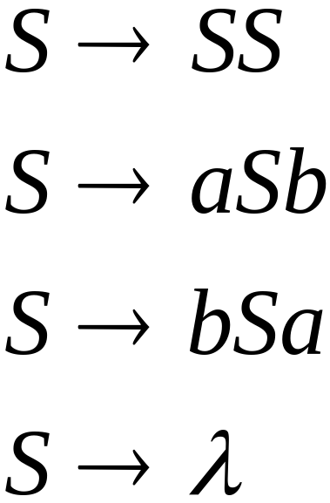
Example:
Find derivation of string
Exhaustive Parser
derivation
Input string
?

Slide 13
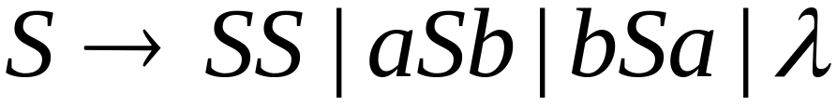
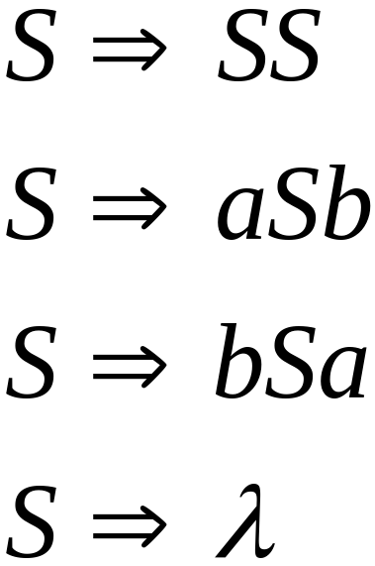
Exhaustive Search
Phase 1:
Find derivation
of
All possible derivations of length 1

Slide 14
Phase 1:
Find derivation
of
Cannot possibly produce

Slide 15
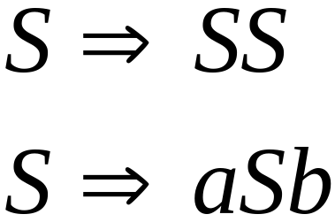
In Phase 2,
explore the next step
of each derivation
from Phase 1
Phase 1

Slide 16
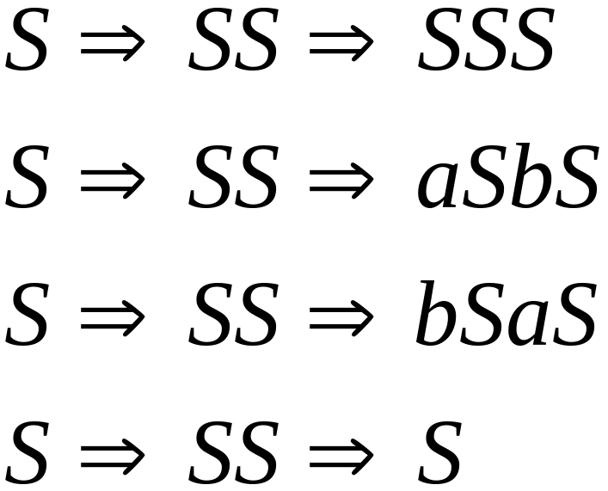
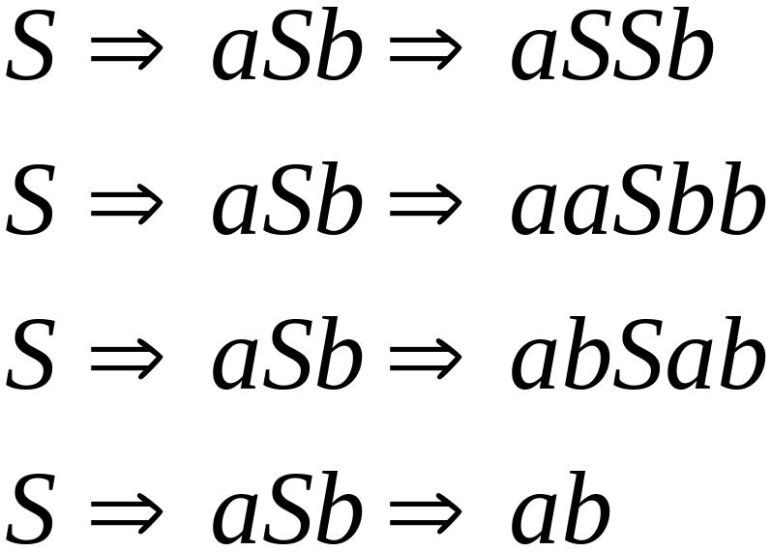
Phase 2
Phase 1
Find derivation
of

Slide 17
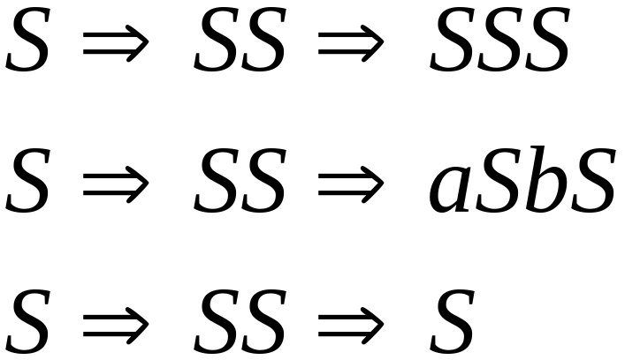
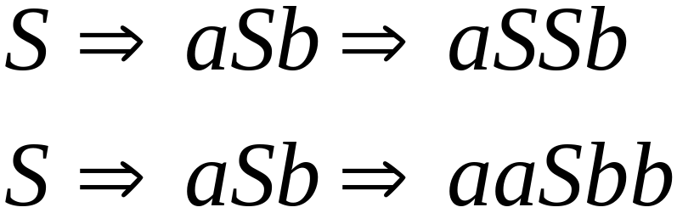
Phase 2
Find derivation
of
In Phase 3 explore
all possible derivations

Slide 18
Phase 2
Find derivation
of
A possible derivation
of Phase 3

Slide 19
Final result of exhaustive search
Exhaustive Parser
Input
string
derivation

Slide 20



Time Complexity
Suppose that the grammar does not have
productions of the form
( -productions)
(unit productions)

Slide 21
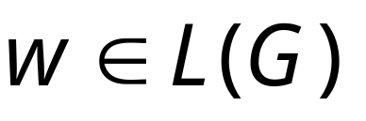
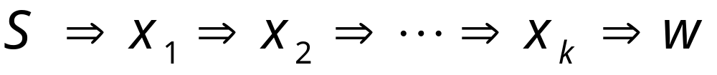
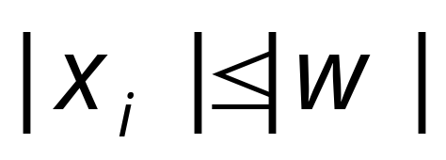

Since there are no -productions
For any derivation of a
string of terminals
it holds that
for all

Slide 22
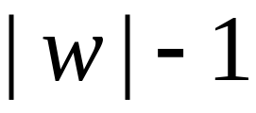
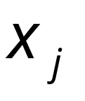
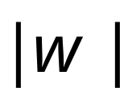
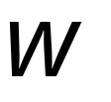
Since there are no unit productions
1. At most derivation steps are needed
to produce a string with at most
variables
2. At most derivation steps are needed
to convert the variables of to the
string of terminals

Slide 23
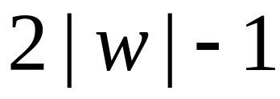
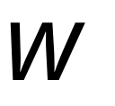

Therefore, at most derivation
steps are required to produce
The exhaustive search requires at most
phases

Slide 24


Suppose the grammar has productions
Possible derivation choices
to be examined in phase 1:
at most

Slide 25
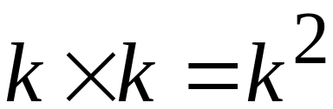
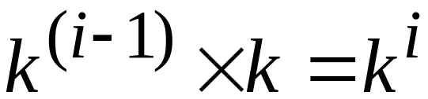
Choices for phase 2: at most
Choices of
phase 1
Number of
Productions
In General
Choices for phase i: at most
Choices of
phase i-1
Number of
Productions

Slide 26

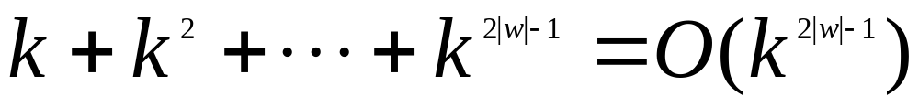
Total exploration choices for string :
phase 1
phase 2
phase 2|w|-1
Exponential to the string length
Extremely bad!!!

Slide 27
Faster Parsers

Slide 28



There exist faster parsing algorithms
for specialized grammars
S-grammar:
terminal
String of variables
Each pair of variable, terminal
appears once in a production
(a restricted version of Greinbach Normal form)

Slide 29
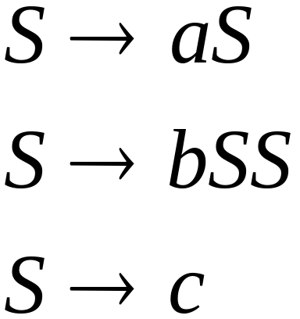
S-grammar example:
Each string has a unique derivation

Slide 30

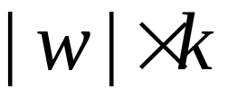
For S-grammars:
In the exhaustive search parsing
there is only one choice in each phase
Steps for a phase:
Total steps for parsing string :

Slide 31
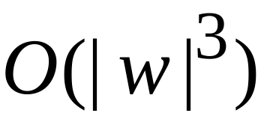

For general context-free grammars:
Next, we give a parsing algorithm
that parses a string in time
(this time is very close to the worst case
optimal since parsing can be used to solve
the matrix multiplication problem)

Slide 32


The CYK Parsing Algorithm
Input:
Arbitrary Grammar
in Chomsky Normal Form
String
Output:
Determine if
Number of Steps:
Can be easily converted to a Parser

Slide 33

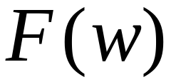
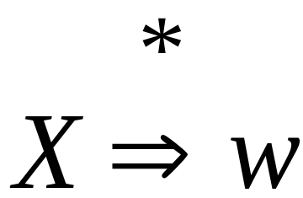
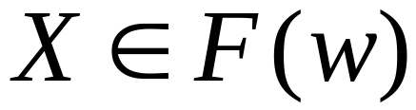
Basic Idea
Consider a grammar
In Chomsky Normal Form
Denote by the set of variables
that generate a string
if

Slide 34
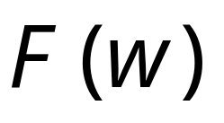
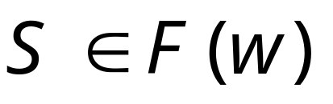
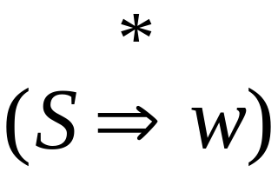
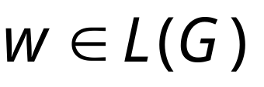
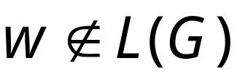
Suppose that we have computed
Check if :
YES
NO

Slide 35

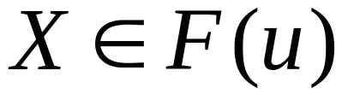
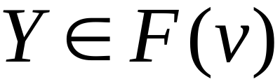
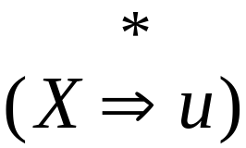
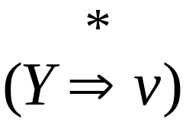
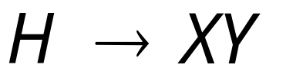
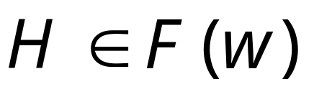
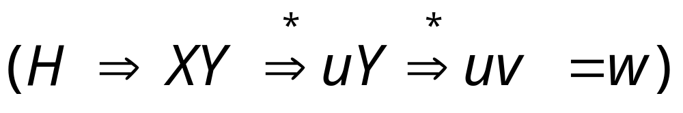
can be computed recursively:
prefix
suffix
Write
If
and
and there is production
Then

Slide 36
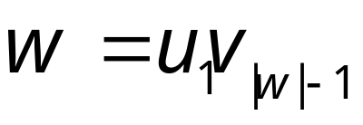

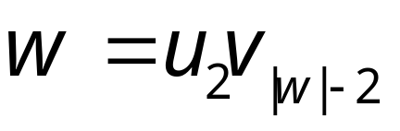

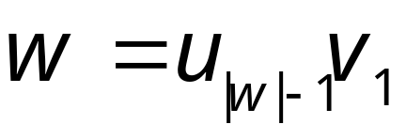
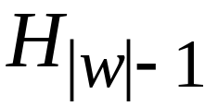
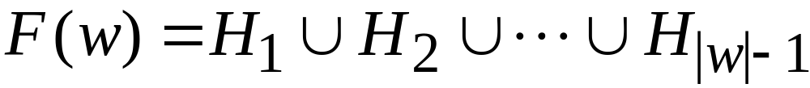
Examine all prefix-suffix
decompositions of
Length
Set of Variables
that generate
1
2
|w|-1
Result:

Slide 37
拆分字符串
Find derivation aabb
aabb= a abb
aabb= aa bb
aabb=aaa b
H->H(a)H(abb)
H->H(aa)H(bb)
H->H(aaa)H(b)
H(a)=Ф H(b)= Ф
H(aa)= Ф H(ab)={S} H(bb)= Ф
H(aab)=H(a) H(ab) U H(aa)H(b) = Ф
H(abb)=H(a)H(bb) U H(ab)H(b)={S}
H(aabb)={S}

Slide 38

At the basis of the recursion
we have strings of length 1
terminal
Very easy to find

Slide 39
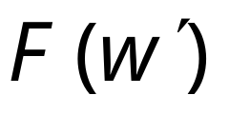
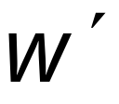
Remark:
The whole algorithm can be implemented
with dynamic programming:
First compute for smaller
substrings and then use this
to compute the result for larger
substrings of

Slide 40
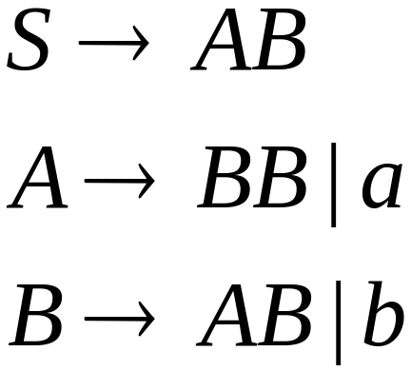
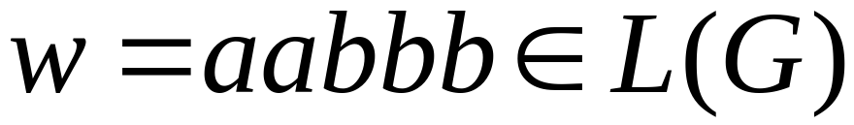
Example:
Grammar :
Determine if

Slide 41

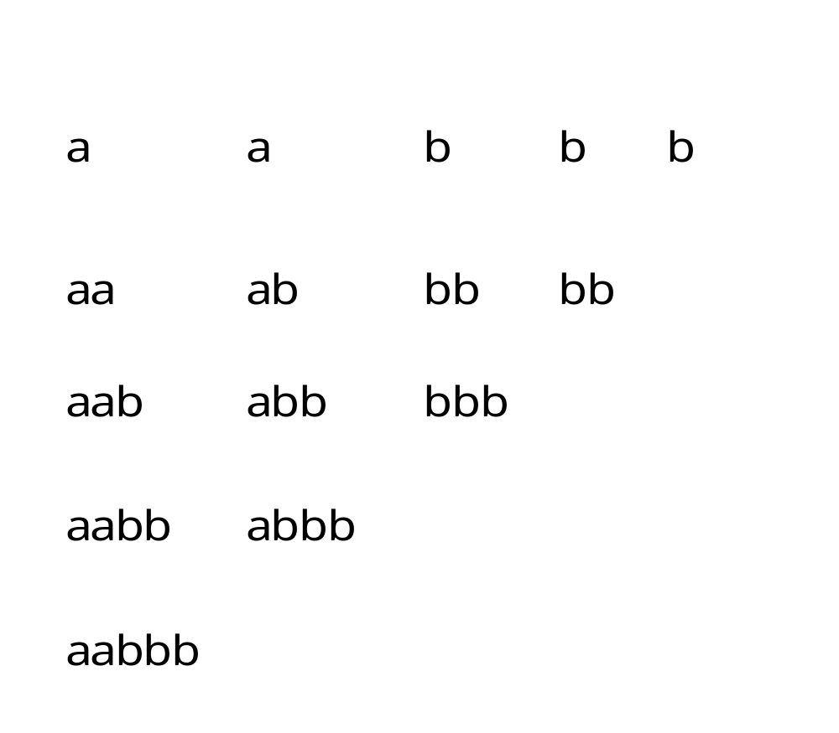
Decompose the string
to all possible substrings
Length
1
2
3
4
5

Slide 42
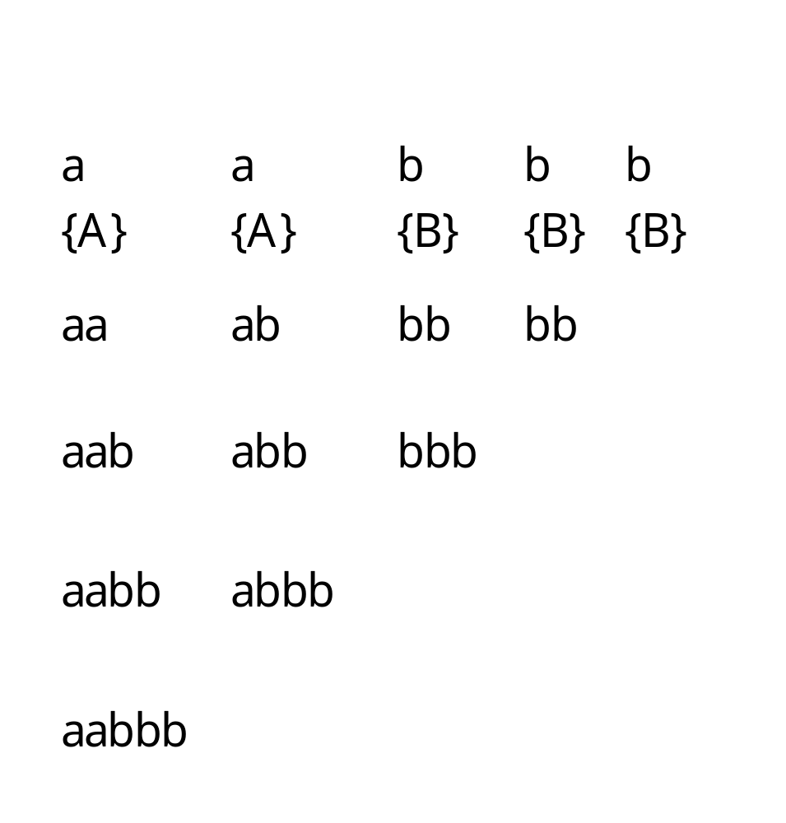
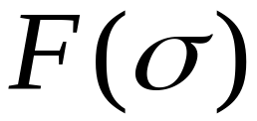

Slide 43




Slide 44











prefix
suffix
There is no production of form
Thus,
prefix
suffix
There are two productions of form
Thus,

Slide 45


Slide 46







Decomposition 1
prefix
suffix
There is no production of form
There are 2 productions of form

Slide 47




Decomposition 2
prefix
suffix
There is no production of form

Slide 48




Since

Slide 49

Approximate time complexity:
Number of
Substrings
|w|+(|w|-1)+(|w|-2)+…+1
= |w|*(|w|+1)/2
Number of
Prefix-suffix
decompositions
for a string |w|-1

Slide 50
下推自动机
(PushDown Automata)

Slide 51

2. 2 下推自动机
Objectives
Introduce Pushdown Automaton (PDA)
Show that PDA = CFG
  In terms of descriptive power

Slide 52

Stack is powerful

Slide 53
Pushdown Automaton -- PDA
Input String
Stack
States

Slide 54


Initial Stack Symbol
Stack
Stack
stack
head
top
bottom
special symbol
Appears at time 0

Slide 55



The States
Input
symbol
Pop
symbol
Push
symbol

Slide 56






input
stack
top
Replace

Slide 57

input
stack
top
Push

Slide 58

input
stack
top
Pop

Slide 59


input
stack
top
No Change

Slide 60

Pop from Empty Stack
input
Pop
Automaton halts!
stack
$
top
If the automaton attempts to pop from
empty stack then it halts and rejects input

Slide 61



PDAs are non-deterministic
Allowed non-deterministic transitions

Slide 62
下推自动机(PDA) －小结
Pushdown automata are for context-free
languages , finite automata are for regular
languages. PDA :描述CFL的设备
Difference: CFL are inherently nondeterministic.
So we just discuss nondeterministic PDA(They are not practical machines.) 天生不确定

Slide 63







Example PDA
PDA :

Slide 64

Basic Idea:
Push the a’s
on the stack
2. Match the b’s on input
with a’s on stack
3. Match
found

Slide 65


Execution Example:
Time 0
Input
Stack
current
state

Slide 66
Time 1
Input
Stack

Slide 67
Time 2
Input
Stack

Slide 68
Time 3
Input
Stack

Slide 69
Time 4
Input
Stack

Slide 70
Time 5
Input
Stack

Slide 71
Time 6
Input
Stack

Slide 72
Time 7
Input
Stack

Slide 73
Time 8
Input
Stack
accept

Slide 74
A string is accepted if there is
a computation such that:
All the input is consumed
AND
The last state is an accepting state
we do not care about the stack contents
at the end of the accepting computation

Slide 75
A string is rejected if there is no
computation to accept it
case of rejection:
All the input is consumed but
The last state is not an accepting state
OR
There no path to go but
The input is not all consumed

Slide 76
Rejection Example
Time 0
Input
Stack
current
state

Slide 77
Time 1
Input
Stack
current
state

Slide 78
Time 2
Input
Stack
current
state

Slide 79
Time 3
Input
Stack
current
state

Slide 80
Time 4
Input
Stack
current
state

Slide 81
Time 5
Input
Stack
reject
current
state

Slide 82

There is no accepting computation for
The string is rejected by the PDA

Slide 83

Formal Definition
δ: Q × Σ_{ε} × Γ_{ε} → P (Q × Γ_{ε})
Pushdown Automaton (PDA)
Accept
states
States
Input
alphabet
Stack
start
symbol
Transition
function
Initial
state
字母表
Stack
alphabet
可压栈字符表

Slide 84
Formal Description PDA
A Pushdown Automata M is defined by a
6-tuple (Q,Σ,Γ,δ,q₀,F), with
Q finite set of states 有限个状态（寄存器）
Σ finite input alphabet 字母表
Γ finite stack alphabet 可压栈字符表
q₀ start state ∈ Q
F set of accepting states ⊆Q 接受态
δ transition function
状态转移函数 ~ 相当于3种语句goto, push ,pop
δ: Q × Σ_{ε} × Γ_{ε} → P (Q × Γ_{ε})

Slide 85
Formalities for PDAs

Slide 86


Reads a, pop w1, push w2
Transition function:

Slide 87



状态转移函数 ~ 相当于3种语句goto, push ,pop
Transition function:

Slide 88
PDA Summary 1
Some points to notice:
–The formal definition of PDA does not allow us to
test if the stack is empty
–The previous PDA tries to get the same effect by first placing $ to the stack, so that if it ever sees $ again, it knows the stack is empty
–Similarly, PDA cannot test if the input has all
been processed
–The previous PDA can have the same effect because it can stay at the accept states only at the end of the input

Slide 89

Instantaneous Description
Current
state
Current
stack
contents
Remaining
input

Slide 90


Example:
Time 4:
Input
Stack

Slide 91

Example:
Instantaneous Description
Time 5:
Input
Stack

Slide 92
We write:
Time 4
Time 5

Slide 93

A computation:

Slide 94

For convenience we write:

Slide 95
Acceptance by PDA
A PDA M = (Q, Σ, Γ, δ, q0, $,F) accepts the input string w if
  w can be written as w₁ w₂…wm where w_{i} in Σε
  there exist states r0, r1, …, rm in Q, and
  there exist strings s0, s1, …, sm in Γ* satisfying the following three conditions:
(see next slide)
Intuitively,
ri denotes the sequence of states visited by the PDA;
si denotes the corresponding contents in the stack (reading from top to bottom)

Slide 96

Acceptance by PDA

Slide 97
Acceptance by PDA

Slide 98
下推自动机(Push-Down Automata ) －小结
下推自动机﹙PDA﹚是自动机理论中定义的一种抽象的计算模型。下推自动机比有限状态自动机复杂：
除了有限状态组成部分外，还包括一个长度不受限制的栈；
下推自动机的状态迁移不但要参考有限状态部分，也要参照栈当前的状态；状态迁移不但包括有限状态的变迁，还包括一个栈的出栈或入栈过程。
下推自动机可以形象的理解为，把有限状态自动机扩展使之可以存取一个栈。
PDAs are recognizing automata that have a single stack (= memory)
=> “硬件” 增加了栈
Last-In First-Out pushing and popping
对应于 可用 if ，goto, 读，和栈操作 的C程序

Slide 99

PDA (example 1)
First, for each ‘a’ read, we should push it onto the stack (for later matching)
Then, we guess whether ‘a’ should be matched with ‘b’ or matched with ‘c’
We can guess because of the non-deterministic
nature of PDA

Slide 100

PDA (example 1)

Slide 101



PDA (example 2)
PDA :

Slide 102

Basic Idea:
Push v
on stack
3. Match on input
with v on stack
2. Guess
middle
of input
4. Match
found

Slide 103
Execution Example:
Time 0
Input
Stack

Slide 104
Time 1
Input
Stack

Slide 105
Time 2
Input
Stack

Slide 106
Time 3
Input
Guess the middle
of string
Stack

Slide 107
Time 4
Input
Stack

Slide 108

Time 5
Input
Stack

Slide 109
Time 6
Input
Stack
accept

Slide 110
Rejection Example:
Time 0
Input
Stack

Slide 111
Time 1
Input
Stack

Slide 112
Time 2
Input
Stack

Slide 113
Time 3
Input
Guess the middle
of string
Stack

Slide 114
Time 4
Input
Stack

Slide 115
Time 5
Input
There is no possible transition.
Input is not consumed
Stack

Slide 116
Another computation on same string:
Input
Time 0
Stack

Slide 117
Time 1
Input
Stack

Slide 118
Time 2
Input
Stack

Slide 119
Time 3
Input
Stack

Slide 120
Time 4
Input
Stack

Slide 121
Time 5
Input
No accept state
is reached
Stack

Slide 122


There is no computation
that accepts string

Slide 123










PDA (example 3)
PDA :

Slide 124

Pushing & Popping Strings
Pop
string
Input
symbol
Push
string

Slide 125




Example:
input
stack
top
push
string
top
pop
string
Replace

Slide 126






Equivalent
transitions
pop
push

Slide 127



Language of PDA
Language accepted by PDA :
Initial state
Accept state

Slide 128


Example:
PDA :

Slide 129


PDA :

Slide 130

Any Questions?

