Slide 1

语 言
本章内容及要求：
字母、字符串与语言
相关运算

Slide 2
Preliminaries of automata theory
How do we ask the question
First, we need a way of describing the problems that we are interested in solving
Can machine A solve problem B?

Slide 3
Problems
Examples of problems we will consider
  Given a word s, does it contain “to” as a subword?
  Given a number n, is it divisible by 7?
  Given two words s and t, are they the same?
All of these have “yes/no” answers.
There are other types of problems, like “Find this” or “How many of that” but we wont look at them.

Slide 4
Alphabets and strings
A common way to talk about words, numbers, pairs of words, etc. is by representing them as strings
To define strings, we start with an alphabet
Examples
An alphabet is a finite set of symbols.
Σ₁ = {a, b, c, d, …, z}: the set of letters in English
Σ₂ = {0, 1, …, 9}: the set of (base 10) digits
Σ₃ = {a, b, …, z, #}: the set of letters plus the
special symbol #

Slide 5
Strings
A string over alphabet Σ is a finite sequence
of symbols in Σ.
abfbz is a string over Σ₁ = {a, b, c, d, …, z}
9021 is a string over Σ₂ = {0, 1, …, 9}
ab#bc is a string over Σ₃ = {a, b, …, z, #}
The empty string will be denoted by ε
We write Σ* for the set of all strings over Σ

Slide 6
Languages
A language is a set of strings
(over the same alphabet).
Languages describe problems with “yes/no” answers:
L₁ = All strings that contain the substring “to”
Σ₁ = {a, b, …, z}
stop, to, toe are in L₁
ε, oyster are not in L₁
L₁ = {x ∈ Σ₁*: x contains the substring “to”}

Slide 7
Examples of languages
L₂ = {x ∈ Σ₂*: x is divisible by 7}
Σ₂ = {0, 1, …, 9}
= {7, 14, 21, …}
L₃ = {s#s: s ∈ {a, b, …, z}*}
Σ₃ = {a, b, …, z, #}
ab#ab
in L₃
ab#ba
not in L₃
a##a#
not in L₃

Slide 8
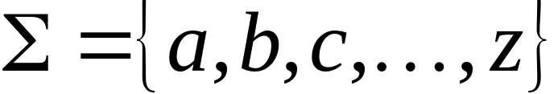
Language: a set of strings
String: a sequence of symbols
from some alphabet
Example:
Strings: cat, dog, house
Language: {cat, dog, house}
Alphabet:

Slide 9
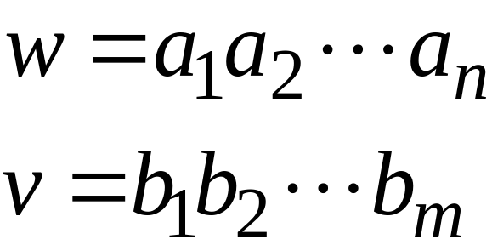
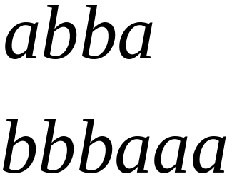
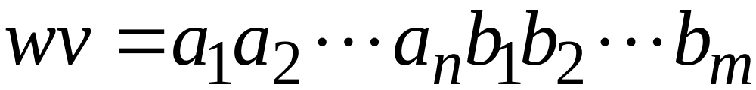

String Operations
Concatenation

Slide 10




Reverse

Slide 11


String Length
Length:
Examples:

Slide 12
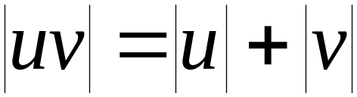

Length of Concatenation
Example:

Slide 13
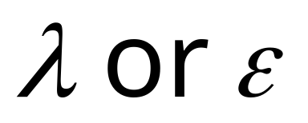
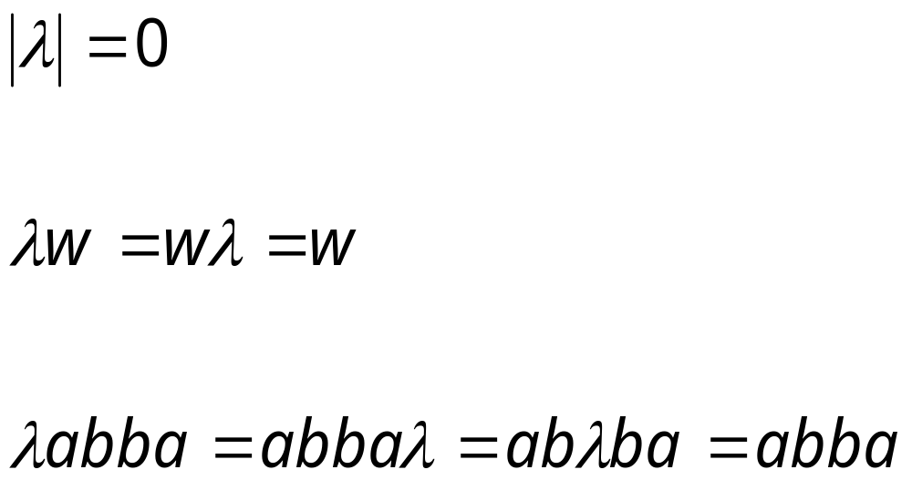
Empty String
A string with no letters is denoted:
Acts as a neutral element
Observations:

Slide 14


Substring
Substring of string:
  a subsequence of consecutive characters
String Substring

Slide 15




Prefix and Suffix
Prefixes Suffixes
prefix
suffix

Slide 16
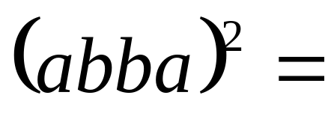
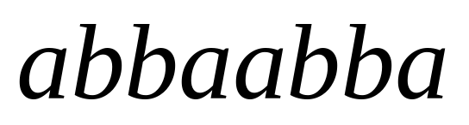


Exponent Operation
Example:
Definition:

Slide 17



The * Operation
: the set of all possible strings from
alphabet

Slide 18


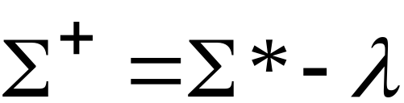
The + Operation
: the set of all possible strings from
alphabet except

Slide 19


Languages
A language over alphabet
is any subset of
Examples:
Language:
Language:
Language:

Slide 20
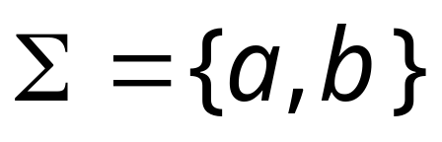




More Language Examples
Alphabet
An infinite language

Slide 21
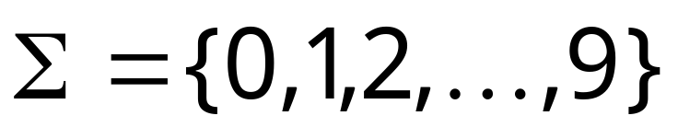
Prime numbers
Alphabet
Language:

Slide 22
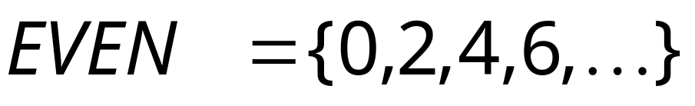
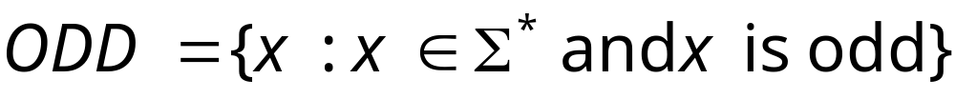
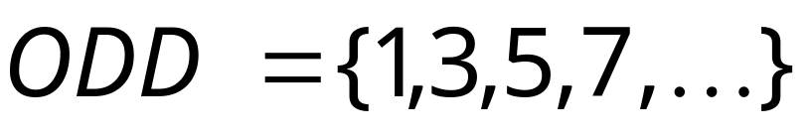
Even and odd numbers
Alphabet

Slide 23
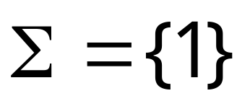

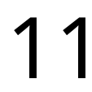
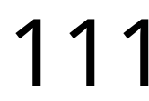
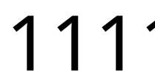
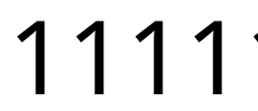




Unary numbers alphabet
Unary number:
Decimal number:
Notes:
Unary: 一元的

Slide 24
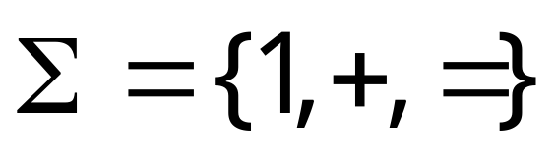
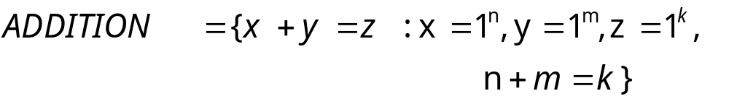
Unary Addition
Alphabet:
Language:

Slide 25
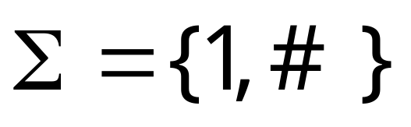
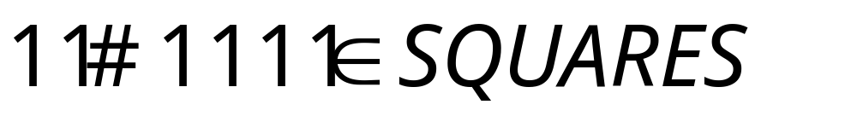
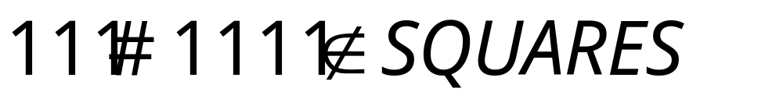
Squares (of unary numbers)
Alphabet:
Language:

Slide 26

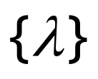
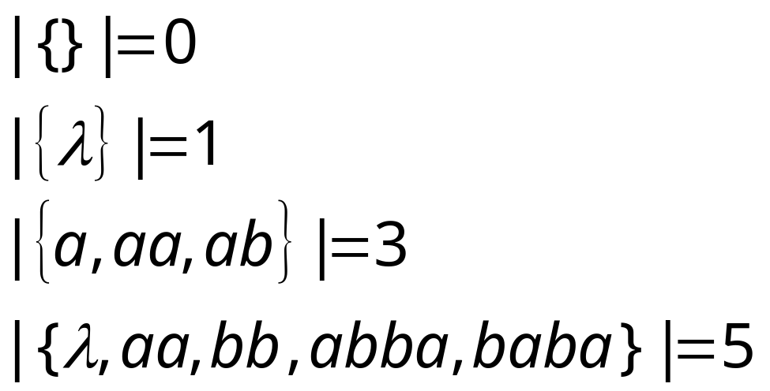
Two special languages
Language with
empty string
Empty language
Size of a language (number of elements):

Slide 27
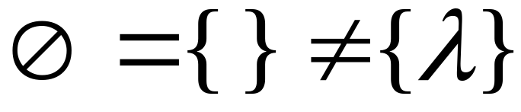



Note that:
Sets
Set size
Set size
String length

Slide 28


Operations on Languages
The usual set operations
Complement:

Slide 29

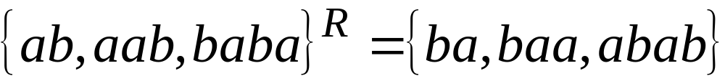
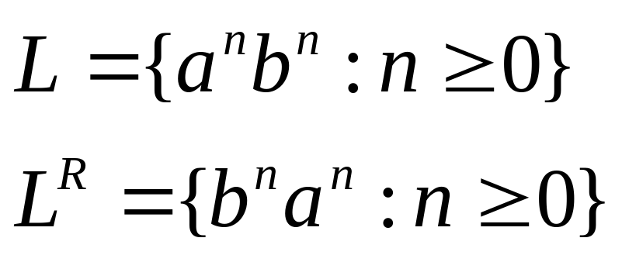
Reverse
Definition:
Examples:

Slide 30


Concatenation
Definition:
Example:

Slide 31


Another Operation
Definition:
Special case:

Slide 32




Slide 33



Star-Closure (Kleene *)
All strings that can be constructed from
Definition:
Example:

Slide 34
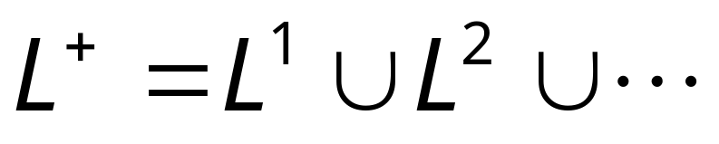
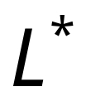


Positive Closure
Definition:
Same with but without the

Slide 35
语言是字符串的集合，因此，传统的集合运算（如并、交、差、补、笛卡尔积）对语言都适用。除此之外，语言还有一种重要的专门的运算，即闭包运算。
语言、文法以及自动机有着密切的关系。语言由文法产生。短语结构语言、上下文有关语言、上下文无关语言和正规语言分别由0型文法、1型文法、2型文法和3型文法产生。自动机是识别语言的数学模型，各类文法所对应的自动机分别是图灵机、线性有界自动机、下推自动机和有限状态自动机。
需要指出的是，语言与数学模型不是一一对应的关系，一种语言可以由不同的文法产生，也可以由不同的自动机识别。
返 回

Slide 36
概念：语言与自动机
绿星表示此页有补充内容
可计算理论把 程序或算法 作不同级别的简化和抽象，抓出其特征，根据忽略和抽象的等级依次得到：
抽象模型 | 变种 | 对应语言 | 相当于程序或算法 | 备注
自动机 | 不确定 NFA | 正则语言 3型 | If ,case ,goto, 无变量（内存）无数组
下推机 | 不确定下推机 | 前后文无关语言， 2型 | 增加： 堆栈。仍无变量（内存）无数组
 | 不确定线性界限下推机 | 前后文有关语言1型 语言
一定停机的图灵机 | XXX的图灵机 多带,随机，有界 | 递归语言族 | 增加数组，变量，内存 保证了不会死循环
图灵机 |  | 0型，递归可枚举 | 输入在语言外时，可能死循环，
数学模型，简洁，易分析 |  |  | 不要程序细节，易于分析本质

