Slide 1

Pharmacy Management Database System
Faculty: Computing and Information Sciences (CIS)
Department: Information Systems Management (ISM)
Course: Database Programming
Technology Used: Oracle Database, PL/SQL, Power
Prepared by: Shedrick Duanah

Slide 2

INTRODUCTION
A pharmacy requires an efficient system to manage medicines, suppliers, patients, prescriptions, sales, and inventory records.
The Pharmacy Management Database System was developed to improve data management, reduce manual errors, and support better decision-making through database technologies.
The system provides:
Medicine and stock management
Supplier management
Patient records management
Prescription tracking
Audit and user activity monitoring
Business intelligence reporting using Power BI

Slide 3

Problem Statement – Problem Definition
Definition
Many pharmacies still face challenges in managing medicine information, inventory, suppliers, and patient records using manual or inefficient methods.
Common problems include:
Difficulty tracking available medicines and stock levels
Lack of proper monitoring of medicine expiry dates
Errors caused by manual record keeping
Difficulty generating accurate reports
Poor management of supplier and patient information
Proposed Solution
A Pharmacy Management Database System was developed to provide a centralized and reliable database solution for managing pharmacy operations.

Slide 4

Problem Statement – Context of Use
Users Context
The system is designed for pharmacy environments where large amounts of healthcare information must be stored, updated, and retrieved efficiently.
The system supports daily pharmacy activities such as adding and managing medicines, monitoring stock availability, recording prescriptions and sales, tracking suppliers and patients, and generating reports for management decisions.
Target Users
The main users of the system include:
Pharmacists – Manage medicines and dispensing activities. Pharmacy Managers – Monitor inventory and generate reports
Employees – Record daily transactions
Administrators – Manage database security and user activities

Slide 5

Problem Statement – Objectives & Expected Benefits
Projective Objective
Design and implement a pharmacy database system using Oracle Database
Improve medicine and inventory management
Ensure data accuracy through database constraints
Automate operations using SQL and PL/SQL programming
Provide analytical reports using Power BI
Implement security and audit mechanisms
Expected Benefits
The system provides:
Faster access to pharmacy information
Better stock monitoring and expiry control
Reduced data errors
Improved decision-making through reports
Secure tracking of user activities
Efficient pharmacy operations

Slide 6

Methodology
Development Methodology
The project followed a structured database development approach:
Requirement Analysis
Identified pharmacy business needs
Defined system users and processes
Database Design
Created ER Diagram
Defined entities, attributes, and relationships
Applied normalization up to 3NF
Implementation
Created Oracle database
Developed tables, constraints, and sample data
Testing and Reporting
Tested SQL and PL/SQL programs
Created Power BI dashboard for analysis

Slide 7
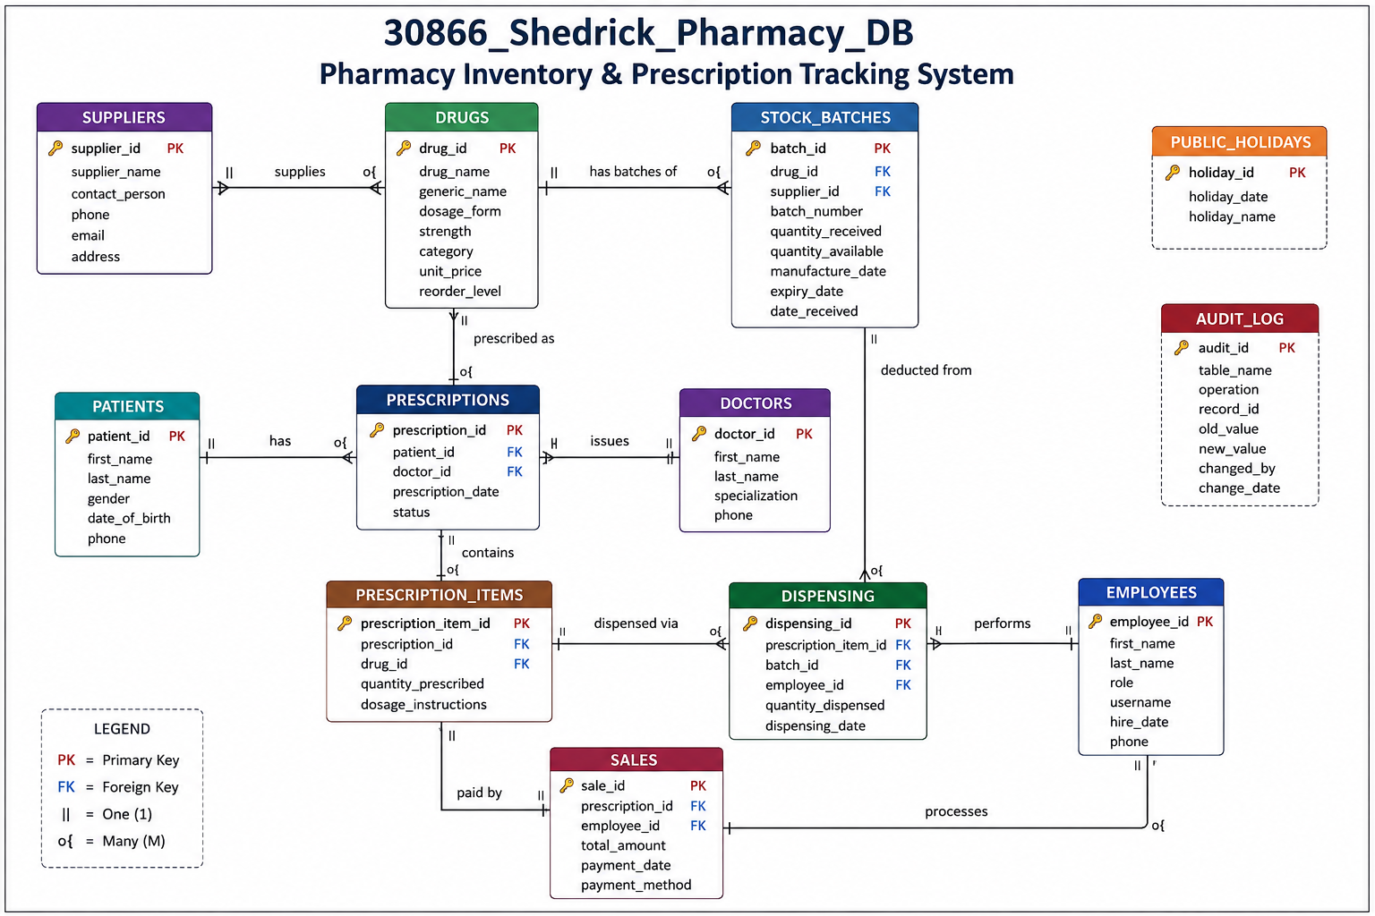
Database Design
Database Structure
Entity Relationship Diagram (ERD)
The database was designed using a relational model.
Main Entities:
Drugs Stock Batches
Suppliers Patients
Doctors Prescriptions
Sales Employees
Audit Log
Database Design Features:
Primary keys
Foreign keys
NOT NULL constraints
UNIQUE constraints
CHECK constraints
Normalization up to 3NF

Slide 8
Implementation
Database Implementation
Advanced Database Features
The system was implemented using Oracle Database.
Implemented Components:
SQL Implementation
Created tables, inserted sample data, and Applied integrity constraints
PL/SQL Implementation
Procedures, Functions, Packages, Cursors, Exception handling, and Transaction control (COMMIT/ROLLBACK)
Advanced Features
Triggers, Audit system, and User activity tracking
Security and Automation
The system includes:
Trigger Implementation
Simple triggers
Compound triggers
Audit System
Tracks User activities
Database changes
Operations performed
Security Restrictions
Business rule implementation:
Blocks INSERT, UPDATE, DELETE operations during weekdays,
Blocks operations during public holidays, stored in reference tables

Slide 9
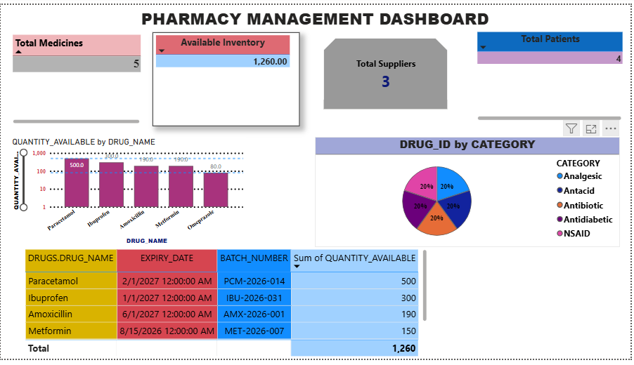
Results
Live Power BI Dashboard — Pharmacy Management System
Tracks 5 medicines across 1,260 units of available inventory
Monitors 3 registered suppliers and 4 patients
Visualizes stock distribution by drug (Paracetamol, Ibuprofen, Amoxicillin, Metformin, Omeprazole)
Breaks down inventory by drug category — Analgesic, Antacid, Antibiotic, Antidiabetic, NSAID
Displays batch-level expiry tracking (drug, expiry date, batch number, quantity available) to support proactive restocking
Dashboard connects live to the Oracle database — refreshes to reflect real-time stock changes, demonstrated by updating stock in Oracle and showing the change reflected instantly

Slide 10

CONCLUSION
Project achievements
Delivered a fully functional pharmacy database system covering the complete workflow, from prescription to dispensing to payment
Implemented batch-level stock traceability, role-based security, automated auditing, and a live Power BI dashboard
Skills gained
Applied database design principles (ERD, normalization, constraints) to a real-world business problem
Built and debugged PL/SQL procedures, functions, packages, and triggers, including compound triggers and exception handling
Gained hands-on experience with Oracle database administration, security roles, and connecting external BI tools to a live database
Benefits of the system
Reduces manual errors in prescription dispensing through automated stock validation
Improves accountability with full audit trails of every stock and dispensing change
Gives pharmacy staff real-time visibility into low stock and near-expiry drugs, supporting better restocking decisions

