Slide 1
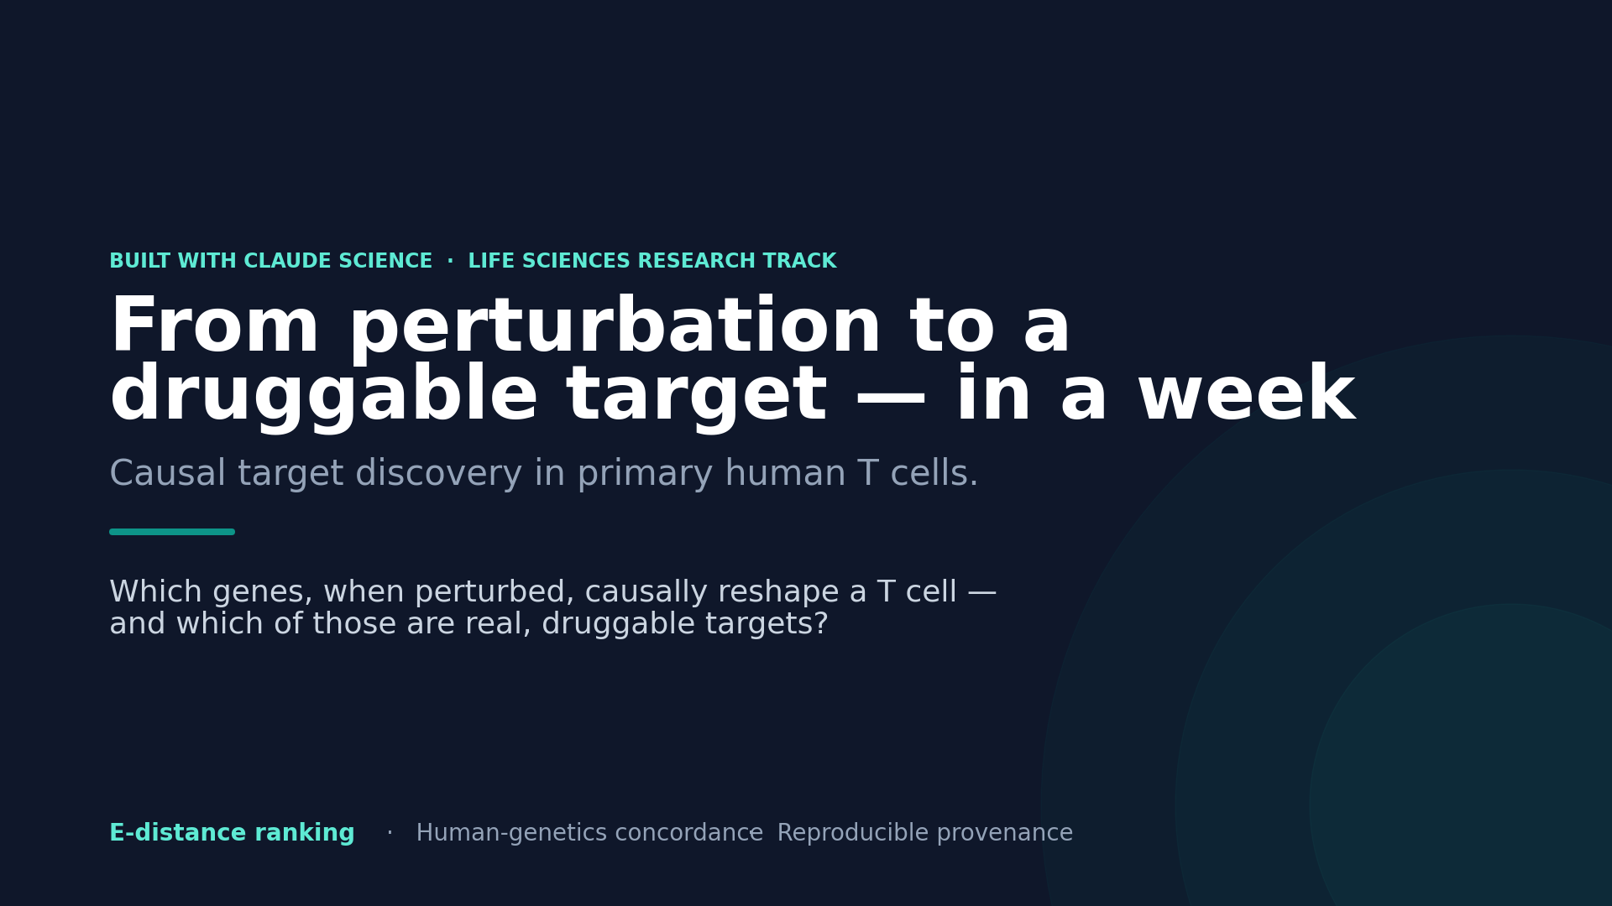
Notes:
BEAT 1 (0:00-0:25). Which genes, when you perturb them, causally reshape a T cell — and which of those are real, druggable targets? That's the question behind every T-cell therapy. We answered it end to end, on real primary human T-cell CRISPR data, using Claude Science.

Slide 2
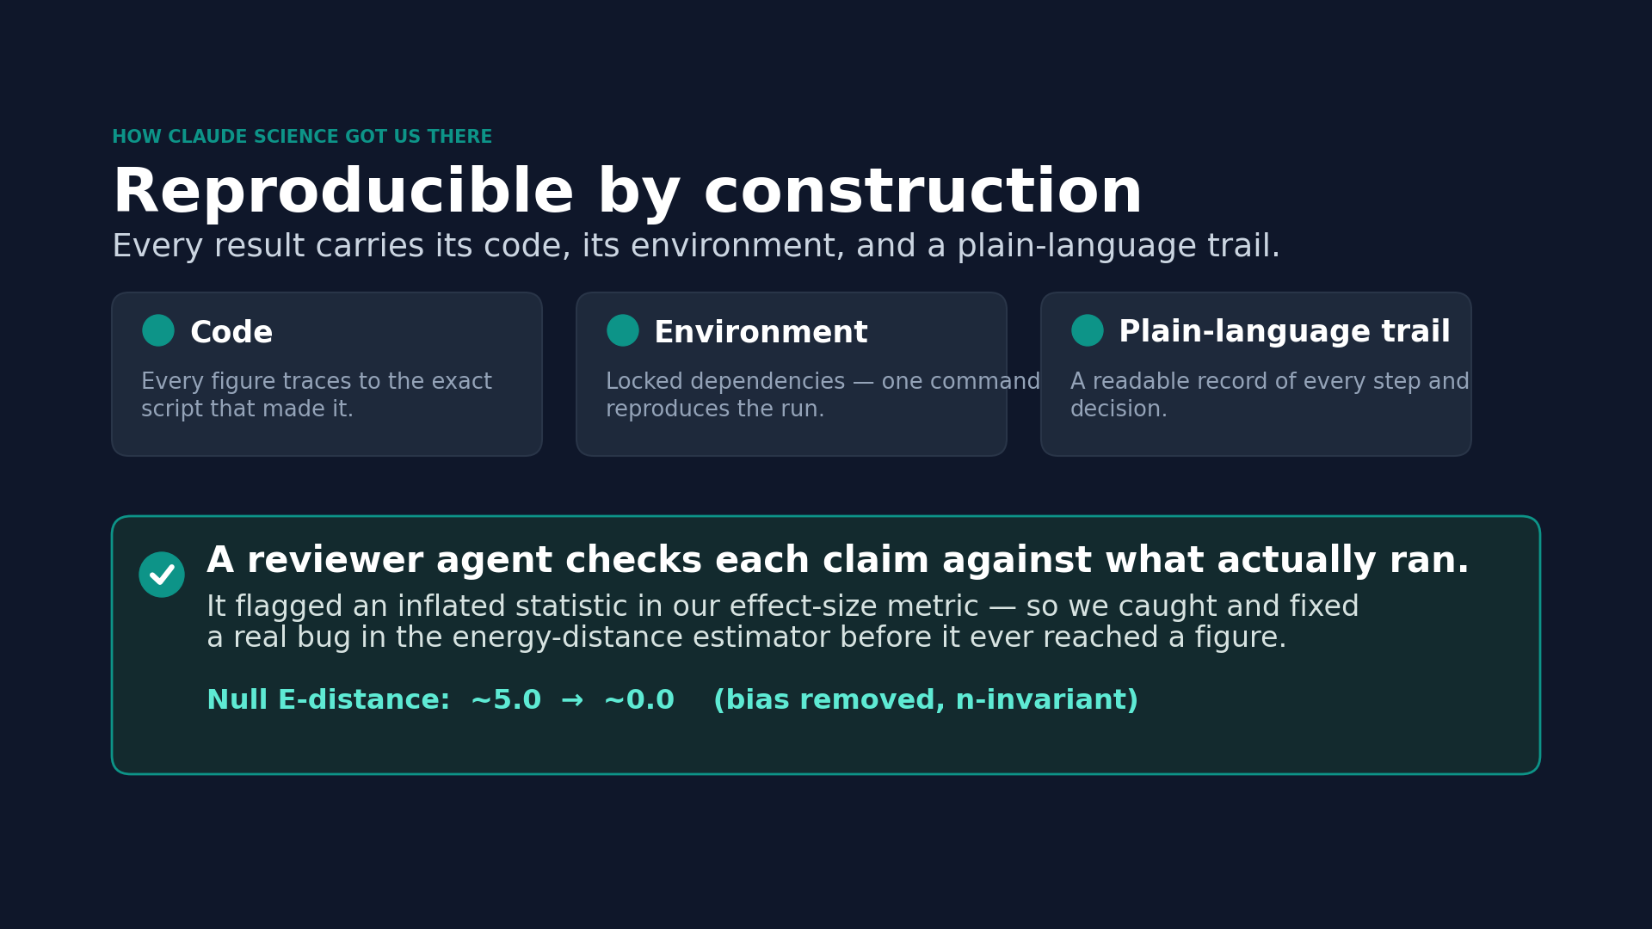
Notes:
BEAT 2 (0:25-1:05). Everything you'll see is reproducible. In Claude Science, every result carries its code, its environment, and a plain-language trail — and a reviewer agent checks each claim against what actually ran. When it flagged an inflated statistic in our effect-size metric, we caught and fixed a real bug before it ever reached a figure. [Screen-capture the CS Provenance panel + reviewer here.]

Slide 3
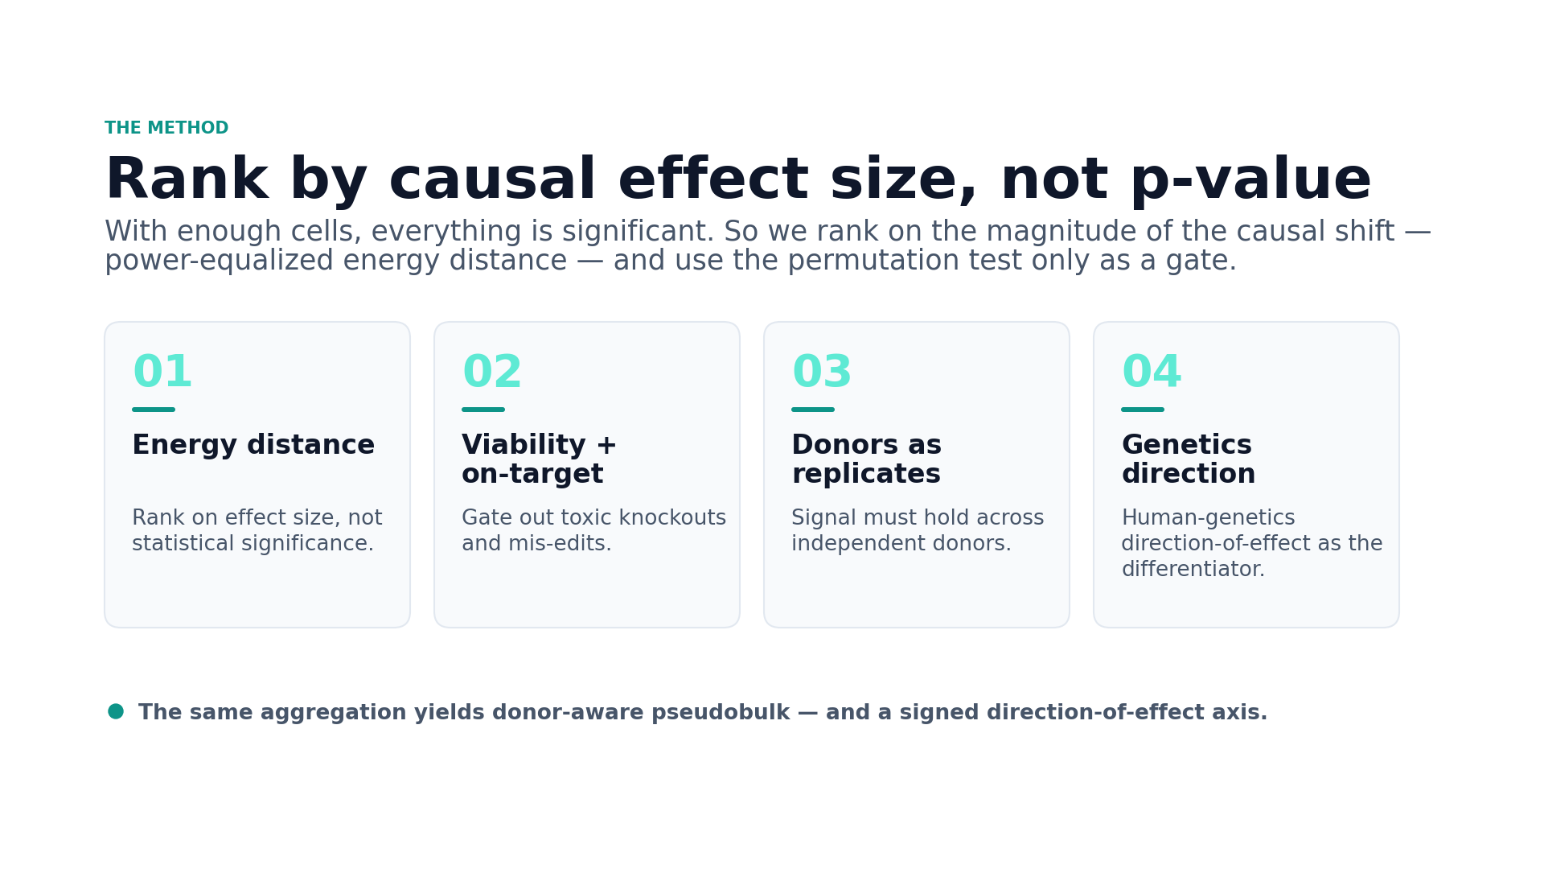
Notes:
BEAT 3 (1:05-1:35). Our method ranks perturbations by causal effect size — energy distance — not by p-value, because with enough cells everything looks significant. We gate on viability and on-target effect, treat donors as replicates, then layer human-genetics direction-of-effect as the differentiator.

Slide 4
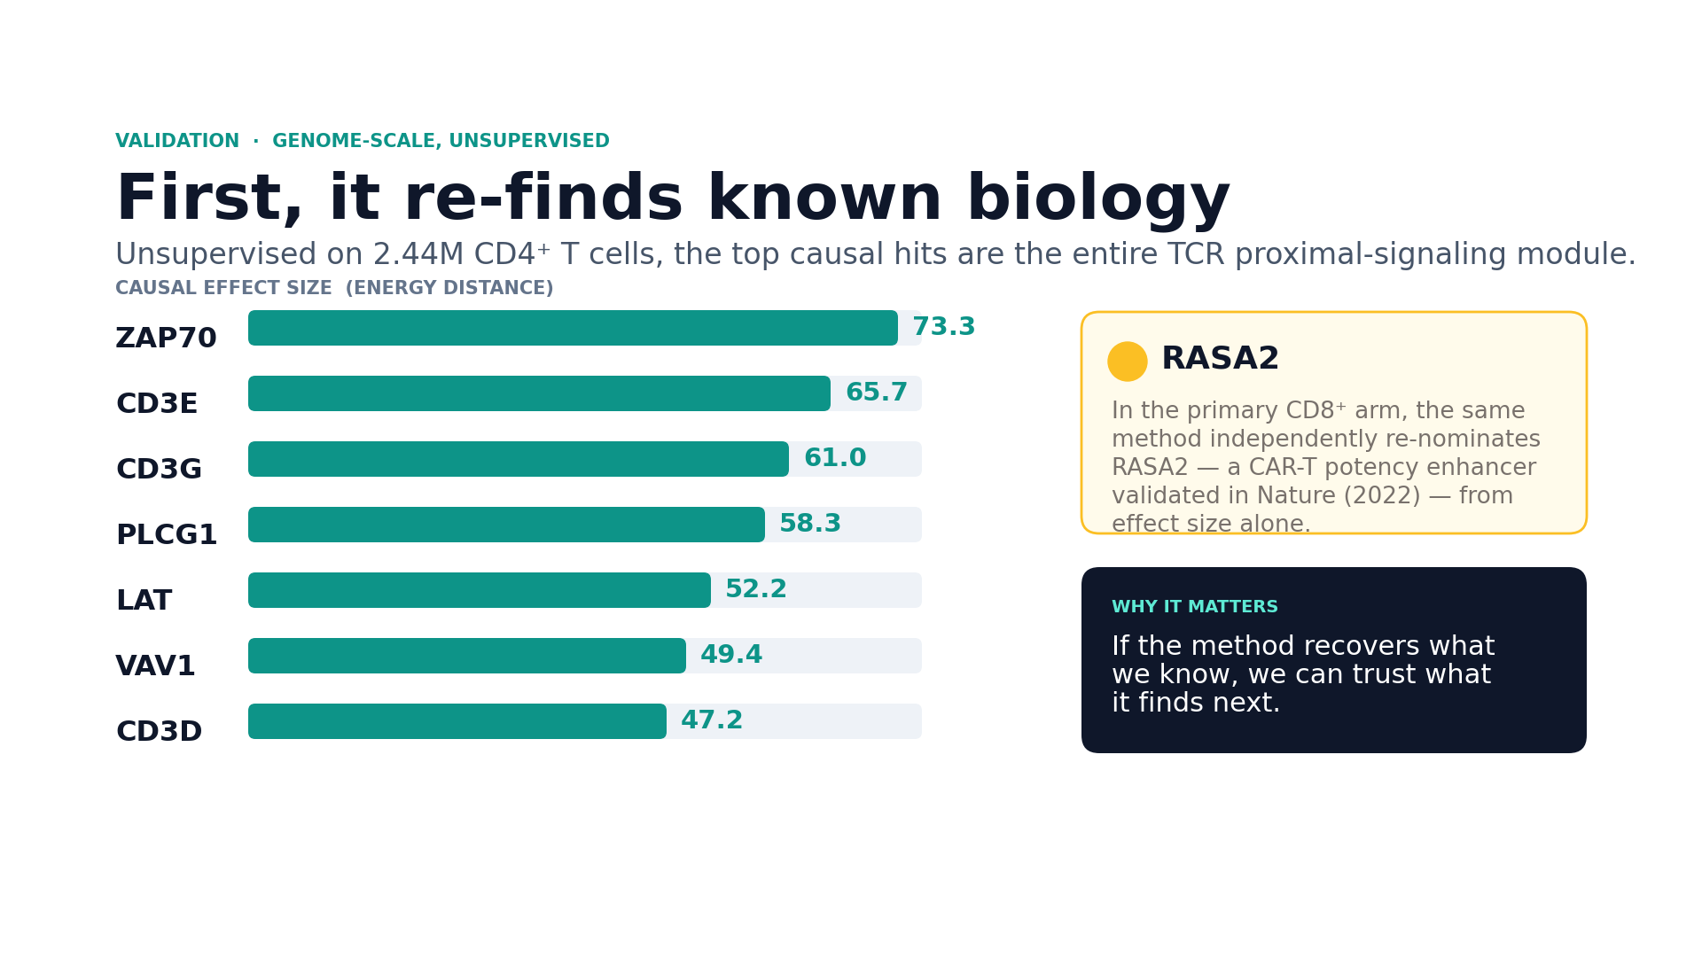
Notes:
BEAT 4 (1:35-2:10). First, does it find known biology? Unsupervised, the ranking re-discovers the core TCR machinery — ZAP70, CD3D/E/G, LAT, PLCG1. And in the primary CD8 arm it independently re-nominates RASA2, a CAR-T potency enhancer validated in Nature — from effect size alone. If the method recovers what we know, we can trust what it finds next.

Slide 5
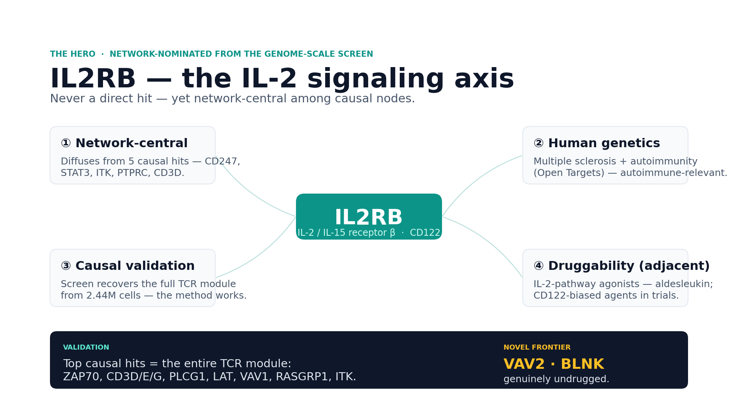
Notes:
BEAT 5 (2:10-2:45). From the genome-scale Gladstone screen — 2.44 million CD4 T cells — we diffused the causal signal over the protein-interaction network. It re-discovered IL2RB, the IL-2 receptor beta: never a direct hit, yet network-central among causal nodes, carrying multiple-sclerosis and autoimmune genetics, and drug-adjacent through IL-2-pathway agonists. The pipeline surfaced a real, actionable immune node from raw data — with VAV2 and BLNK as the genuinely undrugged frontier. [Screen-capture the CS hero/convergence view here.]

Slide 6
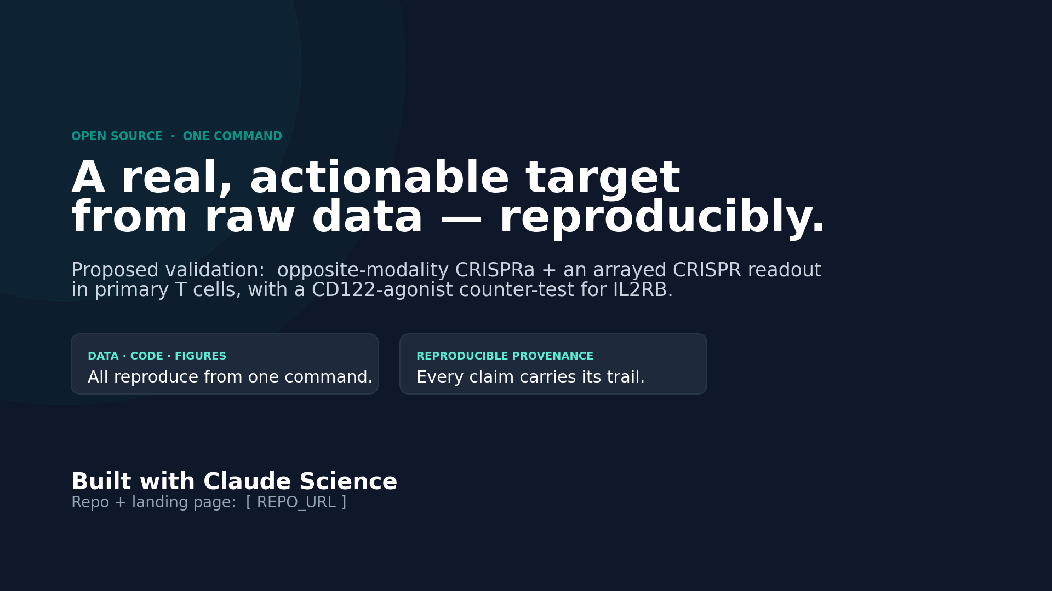
Notes:
BEAT 6 (2:45-3:00). We propose validating IL2RB by opposite-modality replication and an arrayed CRISPR readout in primary T cells. Everything — data, code, figures — reproduces from one command. Built with Claude Science.

