Slide 1

FEWSim—
WEAP and LEAP Time Step Control Capability Study
Adil Mounir
Presentation to: CEE 543
March 20, 2018
Adil Mounir
Presentation to: CEE 543
March 20, 2018

Slide 2
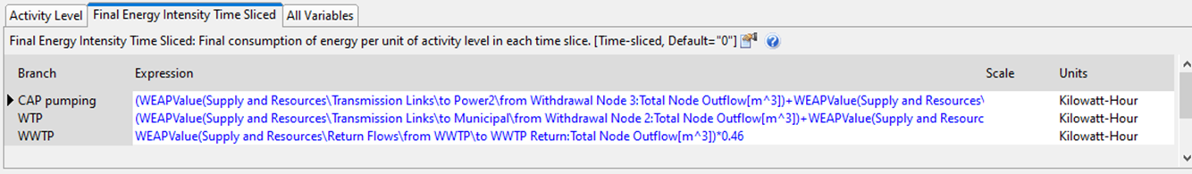
Motivation
We are curious about the flexibility of time step control in WEAP and LEAP
The flexibility will facilitate the integration of statistical economy models in FEWSim system.
There may be other situations where we need enough flexibility when running WEAP and LEAP, such as when we need to update the WEAP-LEAP coupled parameters’ formula or inject a new scenario policy in the middle of the simulation.
WEAP-LEAP coupled
Parameters:
Policy #1
Policy #2
Policy #3
Policy Injection:
Start Year
End Year

Slide 3
Methods for Time Control in WEAP and LEAP
The following table gives a summary of methods that are available for WEAP and LEAP simulation time step control.
 | Yearly Time Step Path | Method | Test Status | Conclusion | Note
#1 | Controlling through WEAP and LEAP software time step setting panel | WEAP and LEAP General Setting menu | Completed | This method only allows WEAP and LEAP to run over the full time span. | There is no software built-in function to run WEAP and LEAP by yearly steps.
#2 | Controlling through 'Calculate' API | API: WEAP.Calculate(LastYear, LastTimestep) LEAP.Calculate(LastYear, LastTimestep) | Completed | This method only controls the last time step. | This method only allows WEAP and LEAP to run from beginning year to a specified year and does NOT give enough flexibility to let WEAP and LEAP to run on yearly basis.
#3 | Controlling through 'Time Step' API | API: WEAP.BaseYear WEAP.EndYear LEAP.BaseYear LEAP.FirstScenarioYear LEAP.EndYear | Completed | This is a valid way to control WEAP and LEAP to run by yearly time step at high cost of time and labor for the development. | The condition LEAP.BaseYear<LEAP.FirstScenarioYear<=LEAP.EndYear need to be satisfied. Or LEAP software will crash when accessing through API.
 | Non-Yearly Time Step Path (Alternative)
#1-N | Running WEAP and LEAP with time series from statistical model outputs | Time Series Format (string): Step( 2001, value1, 2002, value2, 2003 value3 ) | Completed | This method is conditionally valid. | This method requires the assumption that WEAP and LEAP outputs have minimum or NO influence (feed back) to statistical model.

Slide 4
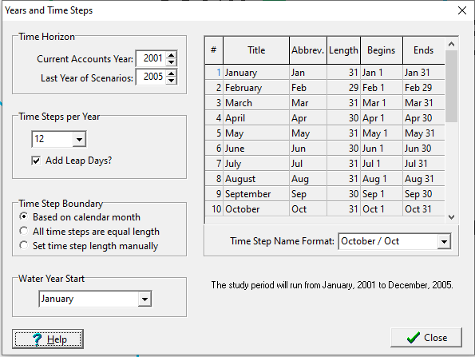
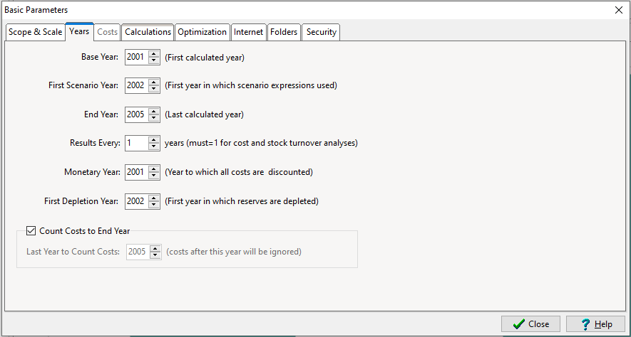
Methods for Time Control in WEAP and LEAP
1. Controlling through WEAP and LEAP software time step setting panel
WEAP and LEAP only allows simulation running over the full time span from start year to end year without the step control function in the software setting panel.
WEAP
LEAP

Slide 5
Methods for Time Control in WEAP and LEAP
2. Controlling through 'Calculate' API
There is WEAP and LEAP API which allows us to manipulate the time step but it only allows controlling the end time step. By this method, WEAP and LEAP only allow simulation running from the start year to a specified end year. This is NOT an ideal method to run WEAP and LEAP by yearly step.
API:
WEAP.Calculate(LastYear, LastTimestep)
LEAP.Calculate(LastYear, LastTimestep)
Example:
(LastYear, LastTimestep)
Start Year = 1985
Start Year = 1985

Slide 6
Methods for Time Control in WEAP and LEAP
3. Controlling through 'Time Step' API
By this method, it is POSSIBLE to run WEAP and LEAP by yearly steps. The following discussion will cover the test of this method in details including:
Time Step Control
WEAP and LEAP Model Used in the Test
What to be Tested
Test Results
Conclusion
Discussion
Step Run: This method is referring running WEAP and LEAP by yearly steps.
Bulk Run: is referring the regular WEAP and LEAP run over the full time span

Slide 7
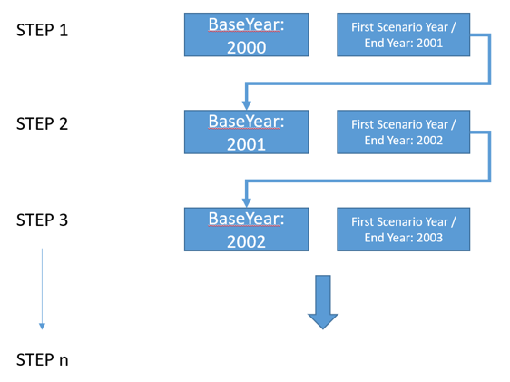
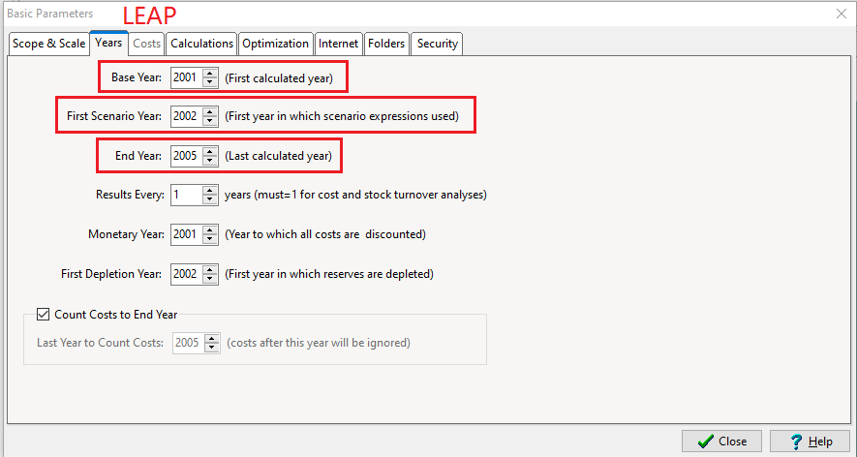
1) Time Step Control
Why use the span of two(2) years as cycle period?
Because LEAP has three parameters for time step control and they also have to be in a particular order:
Base Year < First Scenario Year <End Year
IF this rule is violated, LEAP software will crash when the setting year API is called through script (Python).

Slide 8
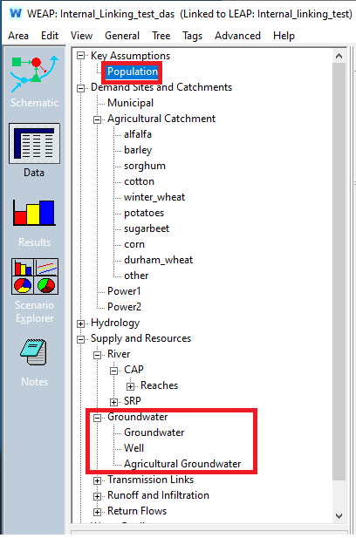
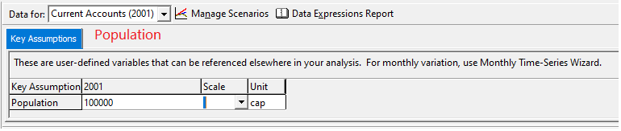
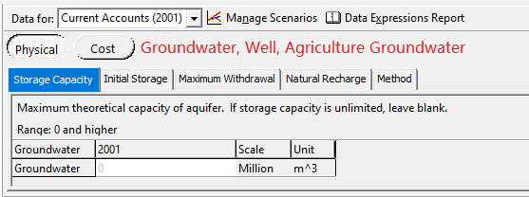
1) Time Step Control
WEAP Parameters to be updated: Population, Goundwater(Groundwater, Well, Agriculture Groundwater)

Slide 9
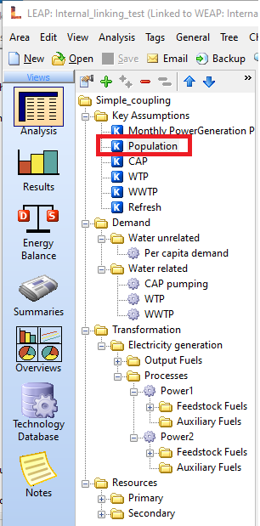
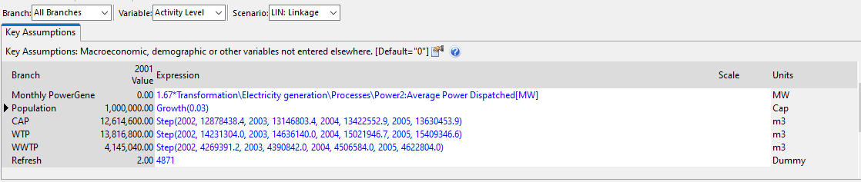
1) Time Step Control
LEAP Parameters to be updated: Population

Slide 10
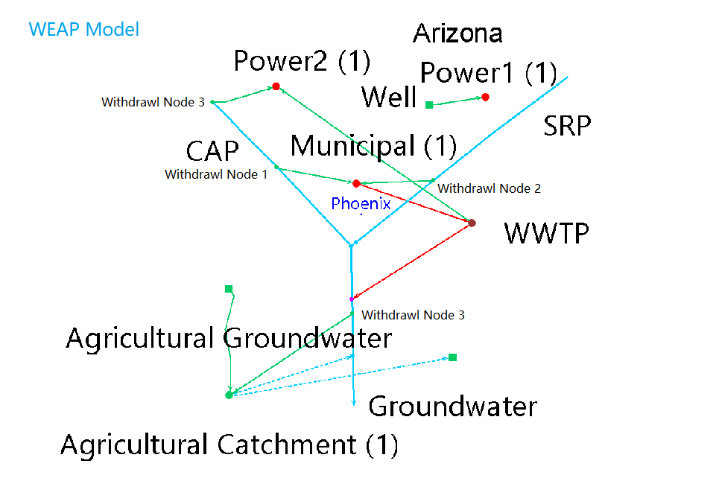
2) WEAP and LEAP Model Used in the Test
Coupled Parameters:
Power1 = 2.1 * LEAPValue(Transformation\Electricity generation\Processes\Power1:Average Power Dispatched[MW])* 24 * Days
Power2 = 2.1 * LEAPValue(Transformation\Electricity generation\Processes\Power2:Average Power Dispatched[MW])* 24 * Days

Slide 11
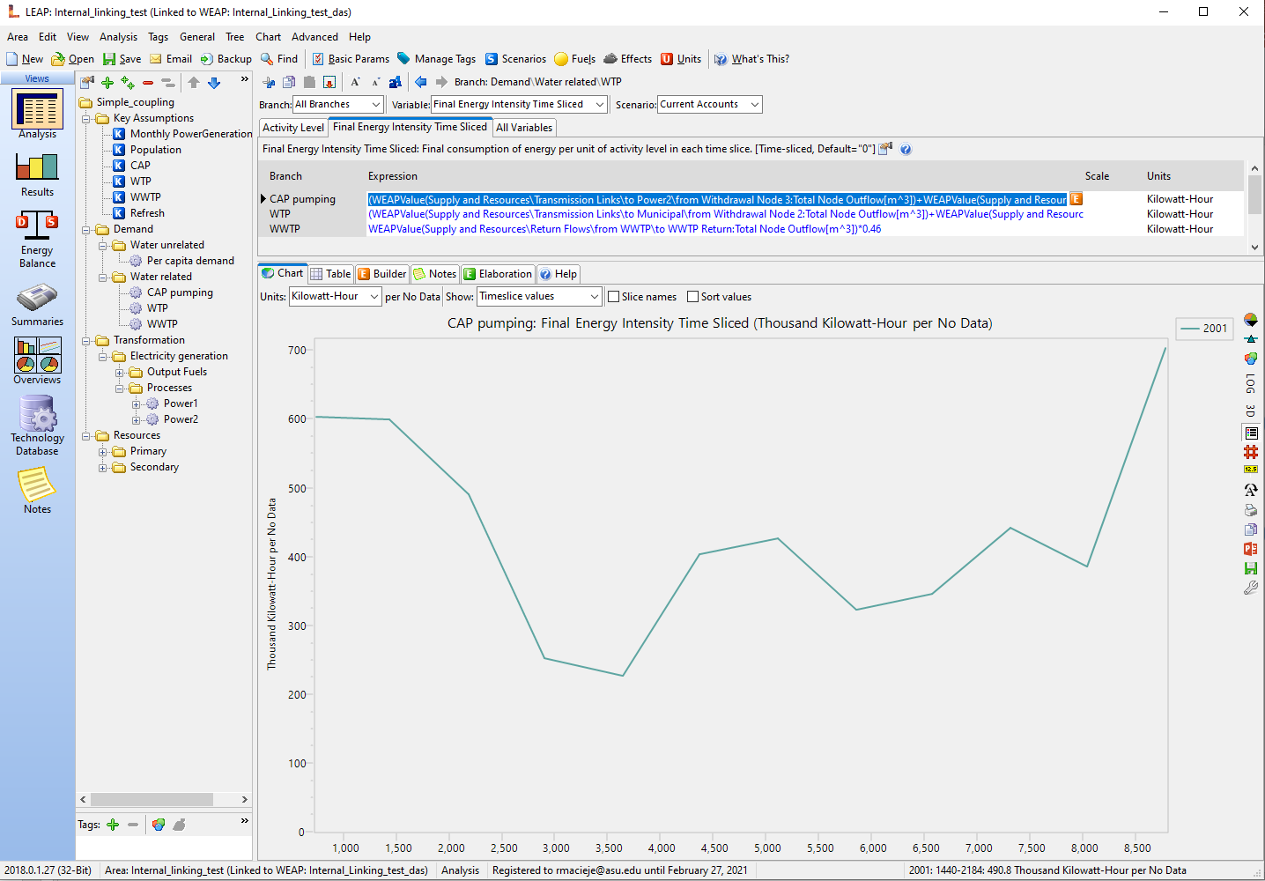
2) WEAP and LEAP Model Used in the Test
Coupled Parameters:
CAP pumping = (WEAPValue(Supply and Resources\Transmission Links\to Power2\from Withdrawal Node 3:Total Node Outflow[m^3])+WEAPValue(Supply and Resources\Transmission Links\to Municipal\from Withdrawal Node 1:Total Node Outflow[m^3]))*1.5
WTP = (WEAPValue(Supply and Resources\Transmission Links\to Municipal\from Withdrawal Node 2:Total Node Outflow[m^3])+WEAPValue(Supply and Resources\Transmission Links\to Municipal\from Withdrawal Node 1:Total Node Outflow[m^3]))*0.45
WTP = WEAPValue(Supply and Resources\Return Flows\from WWTP\to WWTP Return:Total Node Outflow[m^3])*0.46

Slide 12
3) What to be Tested?
The WEAP and LEAP simulation is a process solving an optimization problem with/without constraints (limited resource)
for the purpose of allocating resource (water, electricity), through constrained/unconstrained links, to every demand sites.
In order to validate the step run, we will compare the results of step run with bulk run under following conditions.
Unconstrained source and Unconstrained link Test
Unconstrained source and Constrained link Test
Constrained source and Unconstrained link Test
There may be more complicated combinations of test conditions, such as partially constrained
source or partially constrained links. However it takes more time to build the test condition and
test them. So lets check those three test results first.

Slide 13
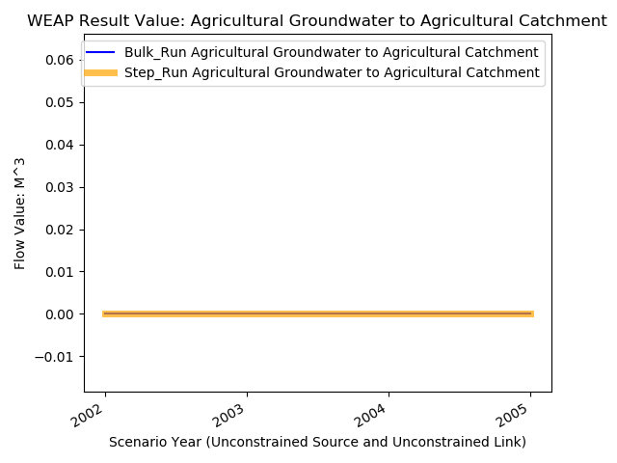
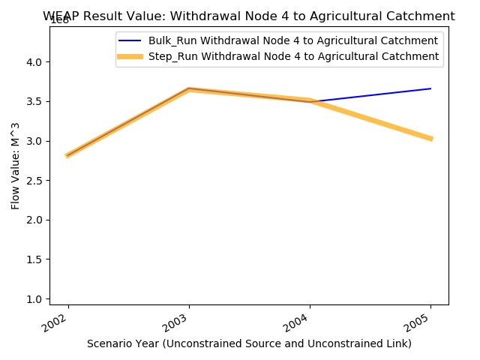
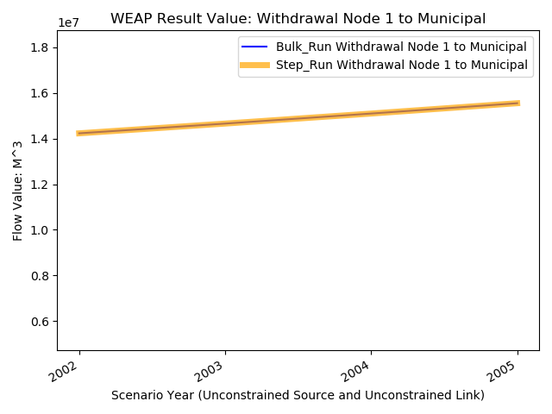
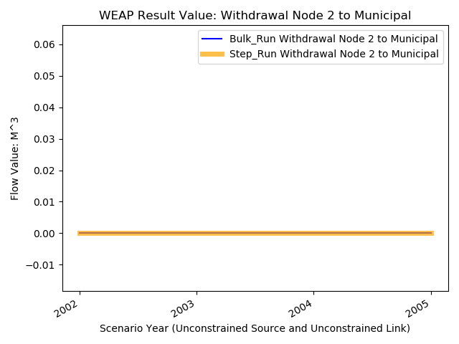
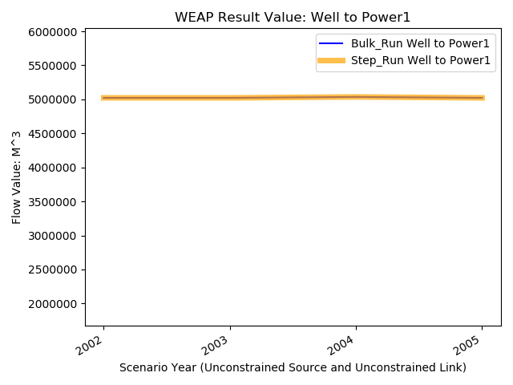
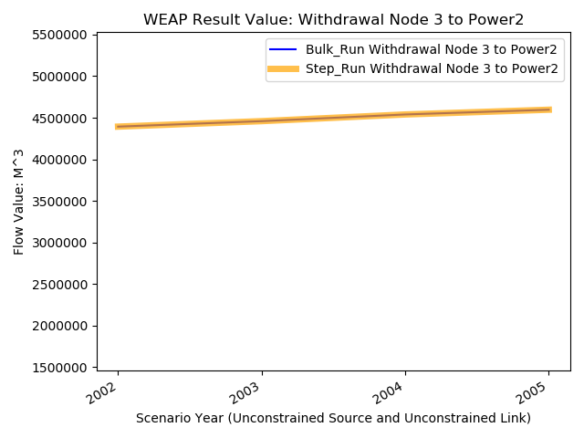
4) Test Result: Unconstrained Source and Unconstrained Link Test
WEAP

Slide 14
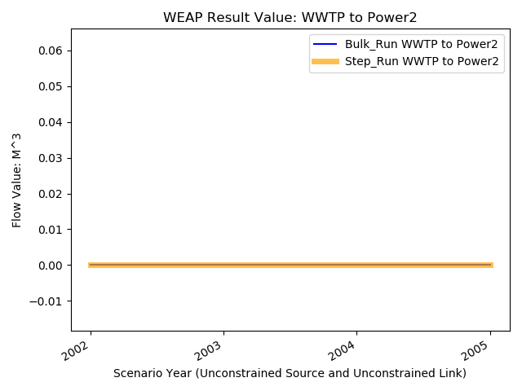
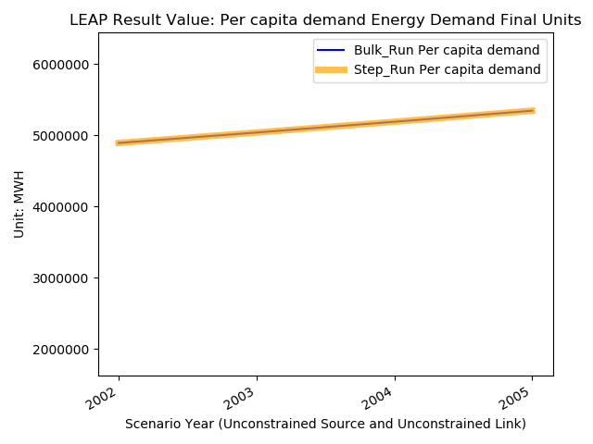
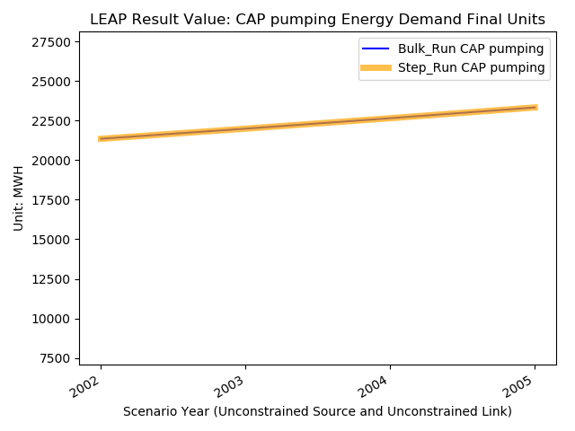
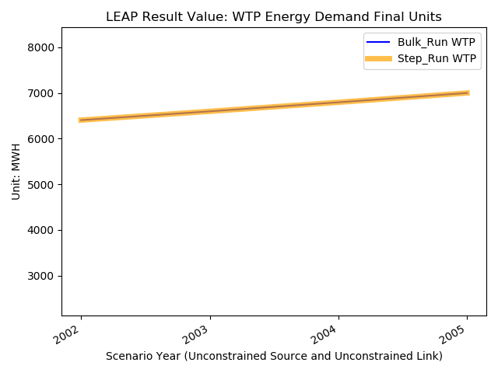
4) Test Result: Unconstrained Source and Unconstrained Link Test
2. LEAP:

Slide 15
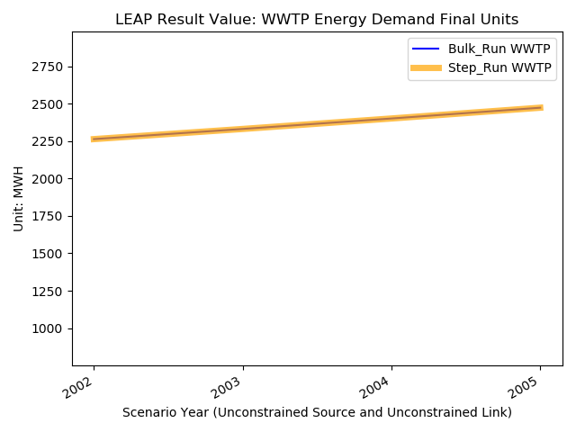
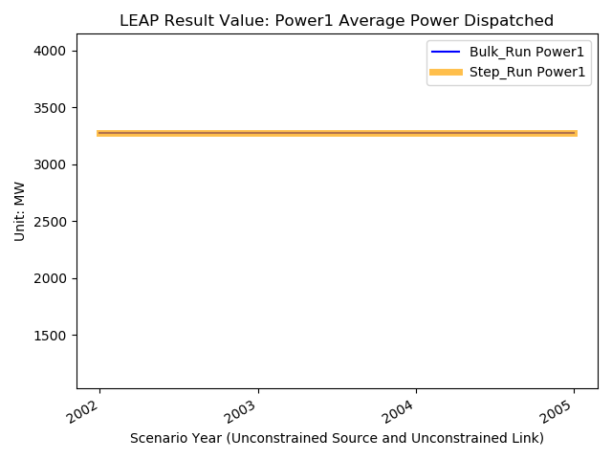
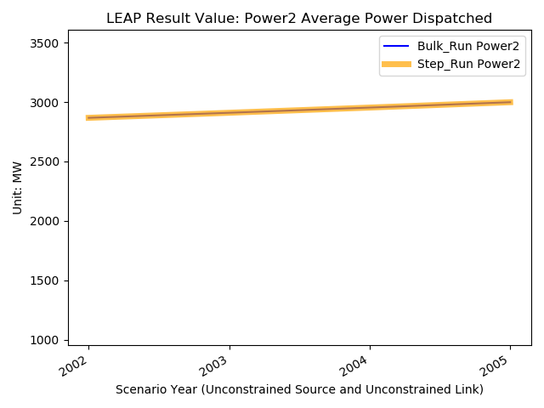
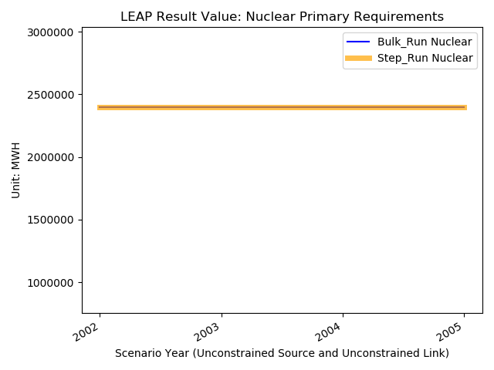
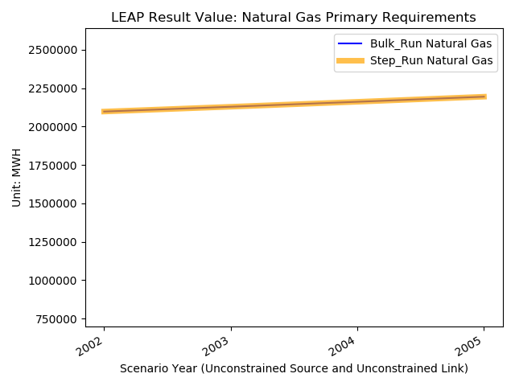
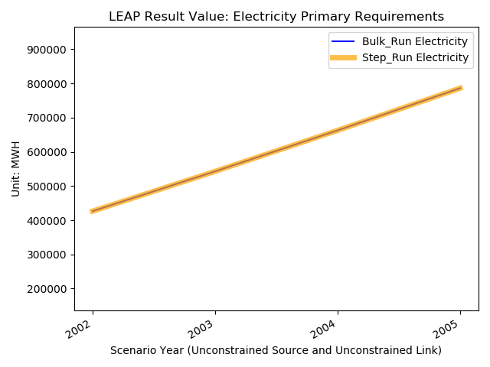
4) Test Result: Unconstrained Source and Unconstrained Link Test

Slide 16
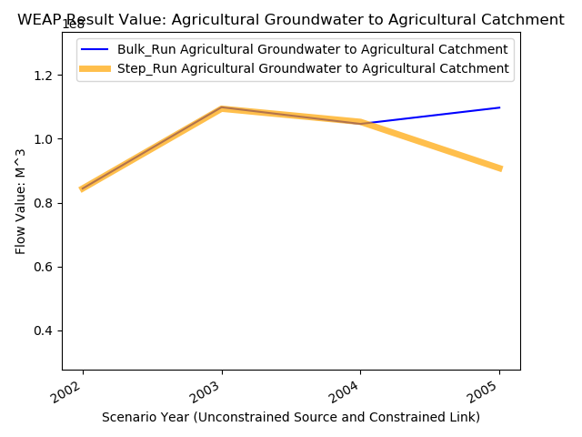
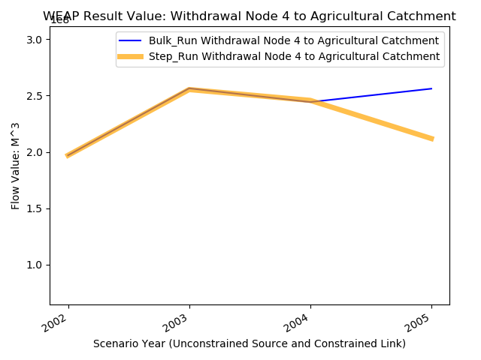
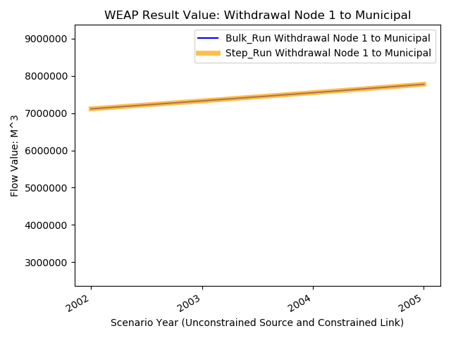
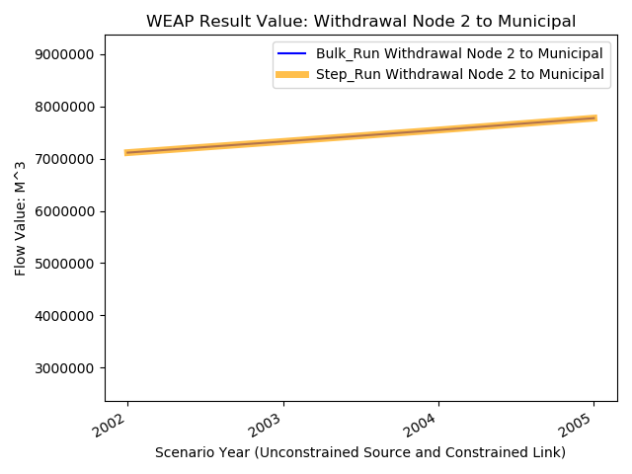

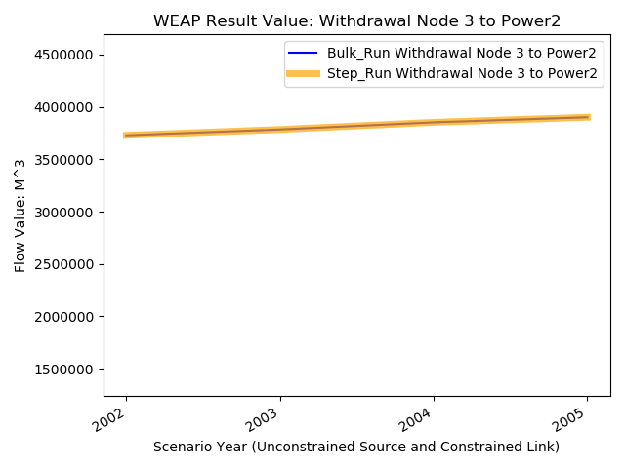
4) Test Result: Unconstrained Source and Constrained Link Test
1. WEAP:

Slide 17
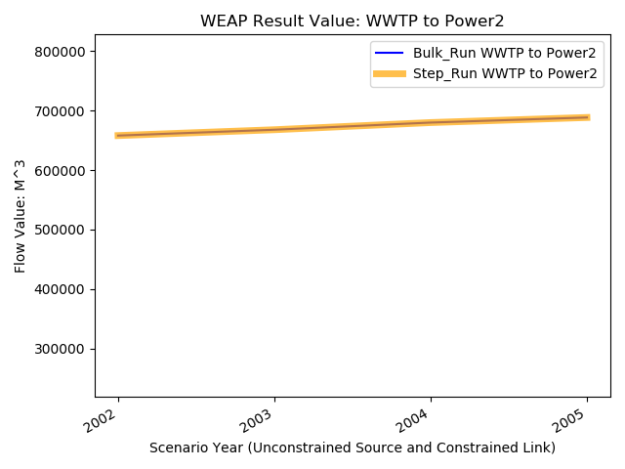

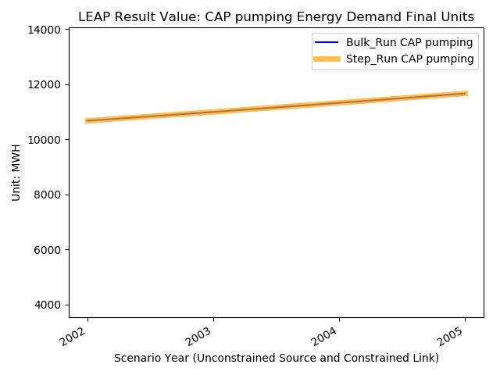

4) Test Result: Unconstrained Source and Constrained Link Test
2. LEAP:

Slide 18


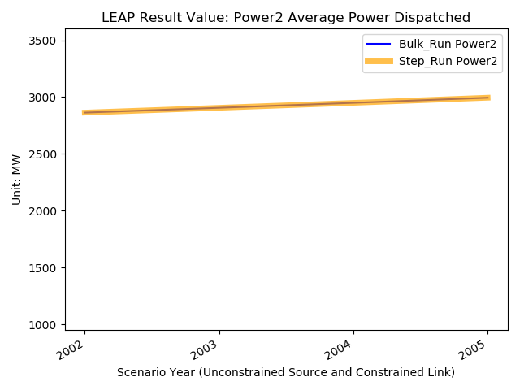

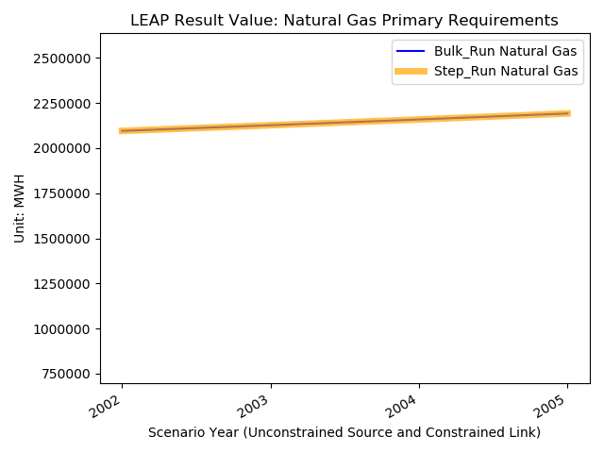
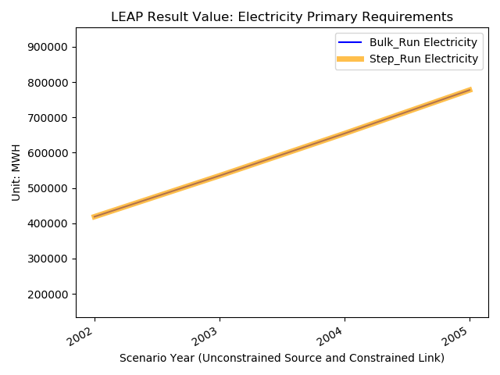
4) Test Result: Unconstrained Source and Constrained Link Test

Slide 19
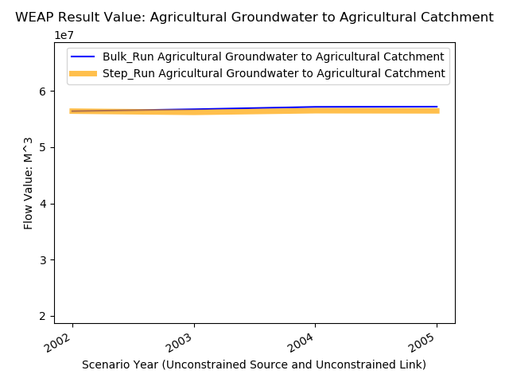
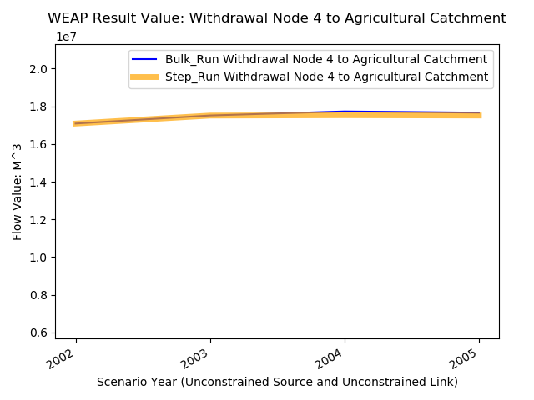
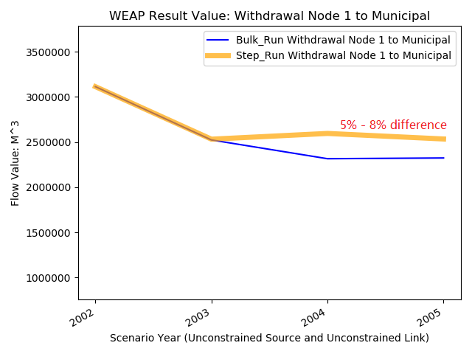
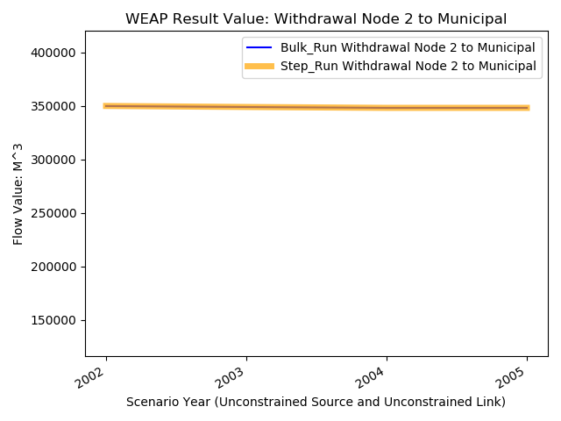
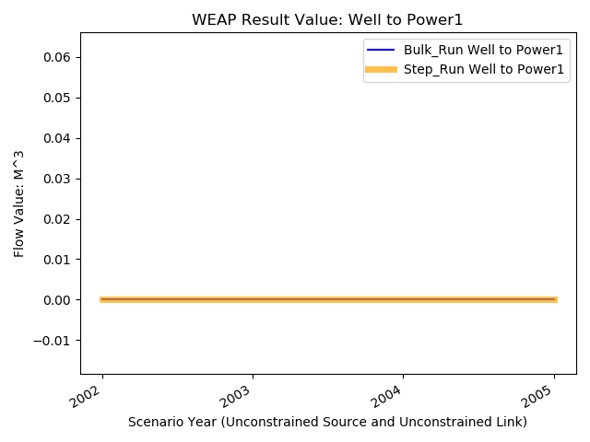
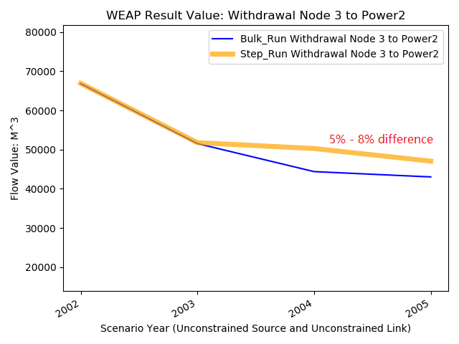
4) Test Result: Constrained Source and Unconstrained Link Test
1. WEAP:

Slide 20
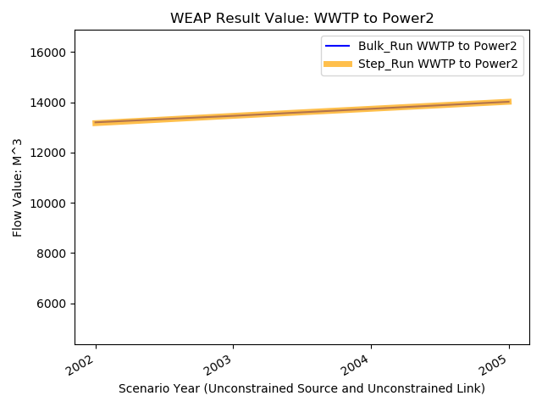
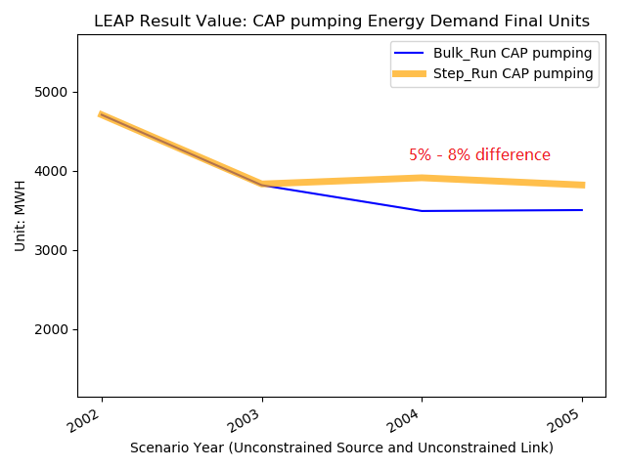
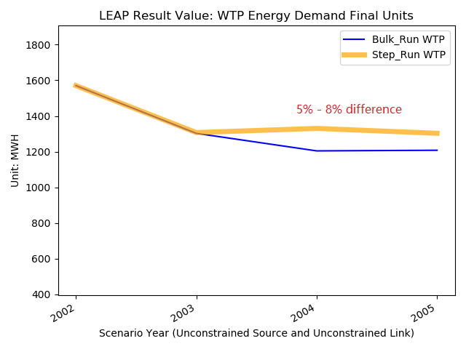
4) Test Result: Constrained Source and Unconstrained Link Test
2. LEAP:

Slide 21
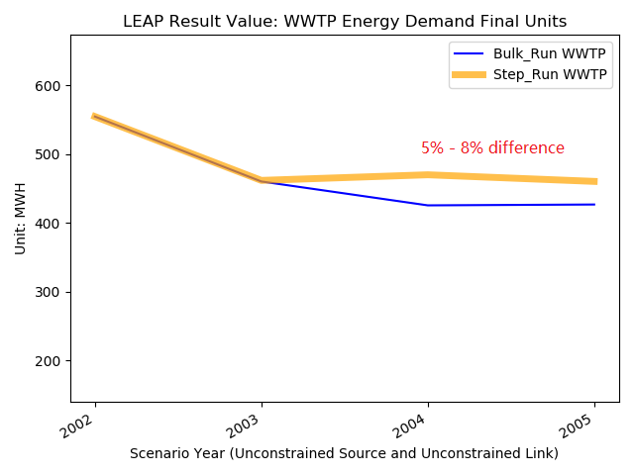
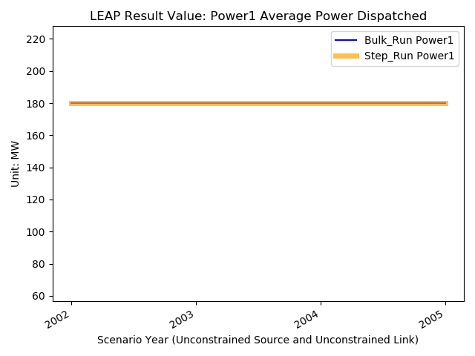

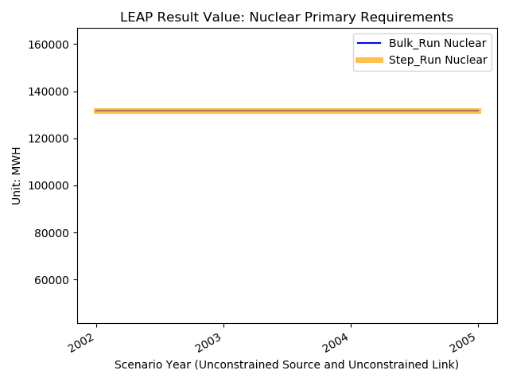


4) Test Result: Constrained Source and Unconstrained Link Test

Slide 22
5) Conclusion
For all three test conditions, the majority of the results of step run match the bulk run perfectly.
There may be two reasons that a few results are not matched:
The roundup error when WEAP and LEAP process data
Incorrectly updating the input parameter at each time step
Controlling WEAP and LEAP to run by yearly steps is possible!

Slide 23
6) Discussion
Pros:
Running by yearly steps gives a lot of flexibility to control over WEAP and LEAP simulation.
The parameters could be updated at each time step. Even the coupled WEAP-LEAP parameter
could also be manipulated. The flexibility enables building more complex models.
Cons:
1. It takes more time to run the simulation since at each step parameters are updated and WEAP
and LEAP has to re-initialize to run the model.
2. It takes a lot more effort to build the script to automate the parameters update process.
3. It is at higher risk that an error may occur in the script when updating the parameters, such as
miss-matched time step, making the simulation less reliable, while the bulk run is more stable
since all the processes are packaged in WEAP and LEAP software.

Slide 24

WEAP MABIA Input Time Series Format
The WEAP MABIA takes either a single number or time series step of the following format as input: format: 'Step( 2001,3.38, 2002,3.38, 2003,3.38, 2004, 3.38, 2005,3.38 ) ‘
The Script syntax to set the WEAP MABIA input is as the following.
WEAP.BranchVariable("\Demand Sites and Catchments\Agricultural Catchment\\durham_wheat: Area").Expression = 'Step( 2001,3.38, 2002,3.38, 2003,3.38, 2004, 3.38, 2005,3.38 )‘

Slide 25
Prerequisite to Use Time Series for WEAP MABIA
The statistical economy model doesn’t take feedback from WEAP and LEAP at each time step. Thus we preprocess the economy model over the full time span and use the input as yearly time series to WEAP MABIA.
The output from economy model should be of yearly time steps since WEAP MABIA takes the yearly time series as mentioned in previous slide.

